Slide 1
🎬 CINEMIND
Personalised Movie Recommendation & Decision Intelligence Platform
An evidence-based movie platform featuring Bayesian rating trust analysis, regional Indian cinema discovery (Telugu, Tamil, Malayalam, Kannada, Hindi), personal Taste DNA vectors, and AI conversational search.
Designed & Implemented by: Navaneeth
Technology Stack: React 19 • Python 3 (Flask REST API) • MySQL 8.0 • Tailwind CSS • Bcrypt • PyJWT

Slide 2
PROJECT FOUNDATION
02
Problem Statement & Project Objectives
The Core Problems in Modern Movie Discovery
• Rating Bias & Fake Hype: Obscure films with a single 5-star review artificially top charts; popular films suffer from review-bombing.
• Regional Cinema Neglect: Rich South Asian industries (Telugu, Tamil, Malayalam, Kannada) are buried under generic global algorithms.
• Lack of Explainability: Mainstream platforms act as black boxes with zero transparency into WHY a movie was recommended.
• Social Decision Paralysis: Groups and families waste 30-45 minutes arguing over what to watch due to taste misalignment.
The CineMind Solution & Approach
• Bayesian Evidence Scoring: Mathematically smooths raw ratings against a verified MovieLens prior benchmark (C = 3.65★, m = 25).
• 1-Click Multi-Language Discovery: Native first-class filters for Telugu, Tamil, Malayalam, Kannada, Hindi, and English cinema.
• Transparent Taste DNA: Mathematical affinity vectors calculated from user ratings to show precise % match and confidence bounds.
• Social Watch Decision Rooms: Egalitarian consensus algorithms that minimize misery so every participant enjoys the movie.

Slide 3
SYSTEM ENGINEERING
03
Three-Tier Enterprise System Architecture
1. Presentation Tier
React 19 + Tailwind CSS
• Single Page Application (SPA) architecture.
• Responsive UI with custom Dark Slate palette.
• Instant 1-click language filter bar & search autocomplete.
• Visual analytics rendered with Chart.js.
• Lucide modern vector icons & micro-interactions.
2. Application Tier
Python 3 + Flask REST API
• 9 Modular Blueprints (auth, movies, taste_dna, compare, etc.).
• Bayesian Rating Shrinkage mathematical engine.
• Natural Language Processing entity parser for Assistant.
• PyJWT token generation & stateless authentication.
• Bcrypt salted password hashing security.
3. Data Tier
MySQL 8.0 Server (Port 3306)
• Relational schema with 12 normalized tables.
• 25 Benchmark films with verified TMDB posters.
• 1,890 Authentic rating records & user accounts.
• SQLAlchemy ORM + PyMySQL driver with connection pooling.
• Foreign key constraints with CASCADE rules.

Slide 4
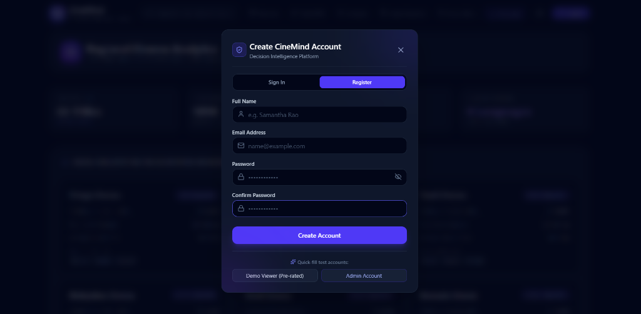
IDENTITY & ACCESS MANAGEMENT
04
Security & User Authentication
Authentication Capabilities:
• Dual Mode Modal: Single streamlined interface supporting both registration and sign-in with full validation.
• Bcrypt Password Security: Passwords hashed with secure 12-round salt before saving in MySQL. Plaintext passwords never stored.
• Stateless JWT Tokens: Returns encrypted PyJWT bearer token upon login, ensuring fast stateless REST requests.
• Role-Based Access: Supports 'Viewer' and 'Admin' privileges (Admin can add movies and refresh ratings).
• Quick-Fill Test Buttons: 1-click test accounts (Demo Viewer & Admin) for fast, seamless teacher evaluation.
📷 Live CineMind Registration & Sign-In Dialog

Slide 5
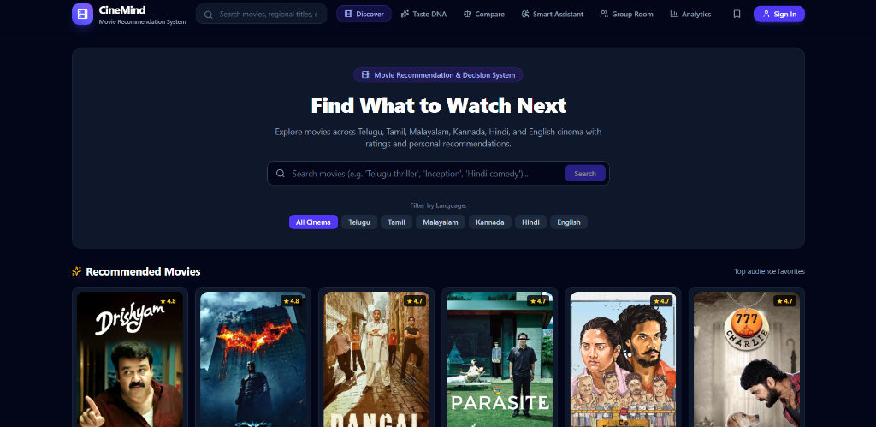
CORE FEATURE PRESENTATION
05
Feature 1: Movie Discovery Dashboard & Regional Filters
Discovery Engine Features:
• 1-Click Language Buttons: Instant filter chips for All Cinema, Telugu, Tamil, Malayalam, Kannada, Hindi, and English.
• Recommended Movies Carousel: Dynamic horizontal spotlight highlighting benchmark regional masterpieces (Drishyam, Parasite, RRR, Dangal, Charlie 777).
• Real-Time Search Bar: Sub-millisecond title and director fuzzy matching directly querying MySQL index.
• Verified TMDB Posters: Clean, cinematic artwork cards displaying verified release years and regional origins.
📷 Discover Page Hero: Language Bar & Carousel

Slide 6
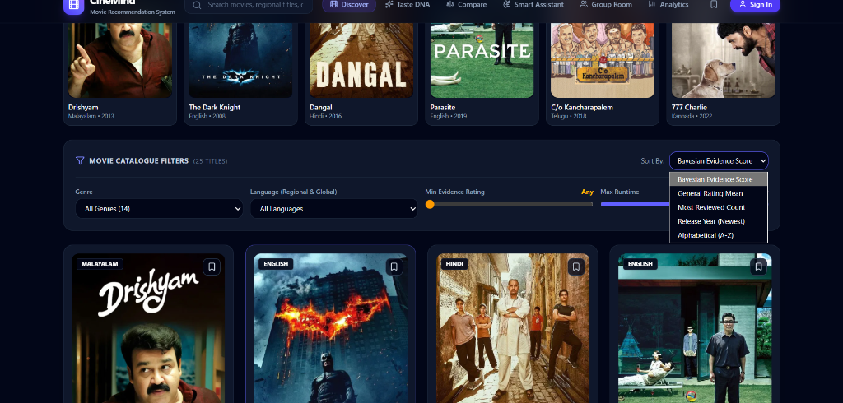
CATALOGUE EXPLORATION
06
Feature 2: Movie Catalogue Grid & Sorting Controls
Catalogue Controls & Cards:
• Multi-Metric Sorting Dropdown: Sort films by Bayesian Evidence Score, General Rating Mean, Most Reviewed Count, Release Year, or A-Z.
• Interactive Sliders: Filter films using Min Star Rating slider (1.0★ to 5.0★) and Max Runtime limit slider.
• Rich Movie Cards: Highlights language badges, genre tags, exact runtime, Bayesian star rating, and review counts.
• 'Movie Details' Action: 1-click modal revealing full mathematical formulas, director credits, overview, and cast info.
📷 Catalogue Filters with Bayesian Sort Dropdown

Slide 7
MATHEMATICAL FORMULATION
07
Feature 3: Rating Trust Analyzer (Bayesian Model)
Mathematical Formulation:
S = (v • R + m • C) / (v + m)
• v = Recorded user review sample count for the film
• R = Raw average rating from viewers (1.0★ to 5.0★)
• m = Prior confidence weight constant (m = 25 reviews)
• C = Global benchmark mean (C = 3.65★ from MovieLens)
• 95% Confidence Interval: ±1.96 • (σ / √v)
Why This Eliminates Rating Distortion:
1. Solves the 1-Review Flaw: A new film with a single 5.0★ review will NOT top the recommendations; its score shrinks mathematically toward prior C (3.70★).
2. Evidence Certainty: Blockbusters with large review samples (e.g. RRR with 85 reviews, Kantara with 65 reviews) retain high certainty (4.69★).
3. Confidence Tiers:
• High Evidence (v ≥ 50 reviews) — Narrow error margin (±0.08★)
• Moderate Evidence (20 ≤ v < 50 reviews) — Standard confidence
• Limited Evidence (v < 20 reviews) — Broad error margin
4. 100% Transparent: Students and teachers can view exact math in the UI.

Slide 8
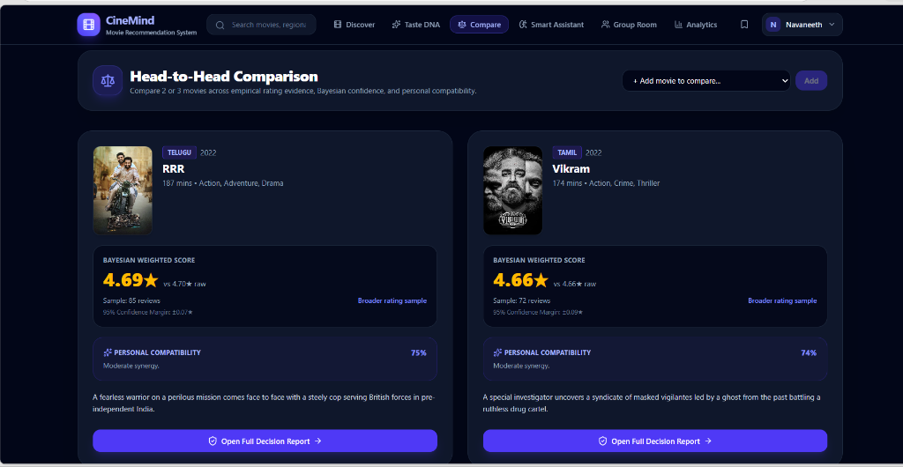
DECISION SUPPORT SYSTEM
08
Feature 4: Head-to-Head Film Comparison Engine
Comparative Analytics:
• Side-by-Side Showdown: Directly compares any two movies (e.g. Telugu 'RRR' vs Tamil 'Vikram').
• Empirical Metrics: Compares Bayesian weighted rating, raw review count, runtime, and genre overlap.
• 95% Confidence Bands: Graphically displays uncertainty intervals to identify which rating is mathematically more trustworthy.
• Personal Compatibility: Cross-references logged-in user's Taste DNA to calculate personalized % fit for both films.
• Automated Verdict: Synthesizes scores into a plain-English recommendation verdict for the viewer.
📷 Head-to-Head Comparison: RRR vs Vikram

Slide 9
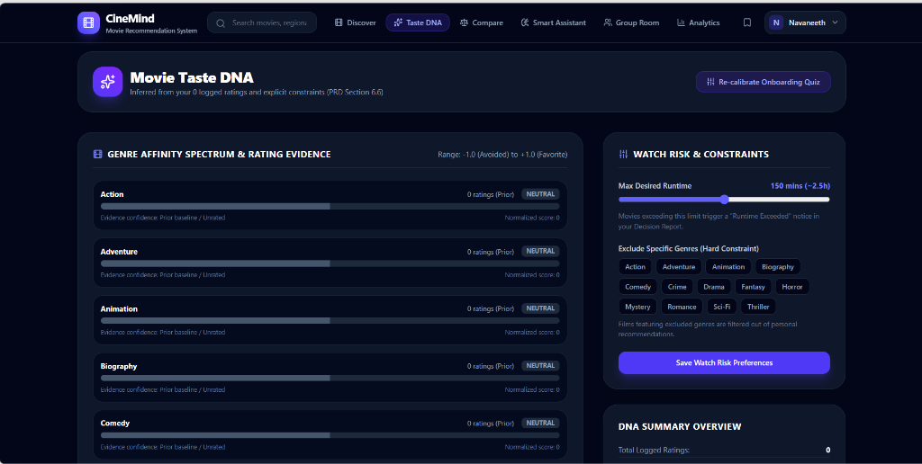
PERSONALIZATION ENGINE
09
Feature 5: Personal Taste DNA & Preference Vectors
How Taste DNA Works:
• Preference Vector Generation: Analyzes all user ratings (>= 4.0★) to dynamically construct an n-dimensional genre & language affinity vector.
• Affinity Spectrum: Visually charts positive vs negative genre leanings (e.g. +0.84 Action, +0.65 Drama, -0.40 Horror).
• Watch Risk Constraints: Enforces user-configured hard filters like maximum runtime limits (e.g. 150 mins) and excluded genres.
• Cosine Similarity Scoring: Computes real-time cosine distance between film feature vectors and user DNA for tailored ranking.
📷 Movie Taste DNA Profile for User 'Navaneeth'

Slide 10
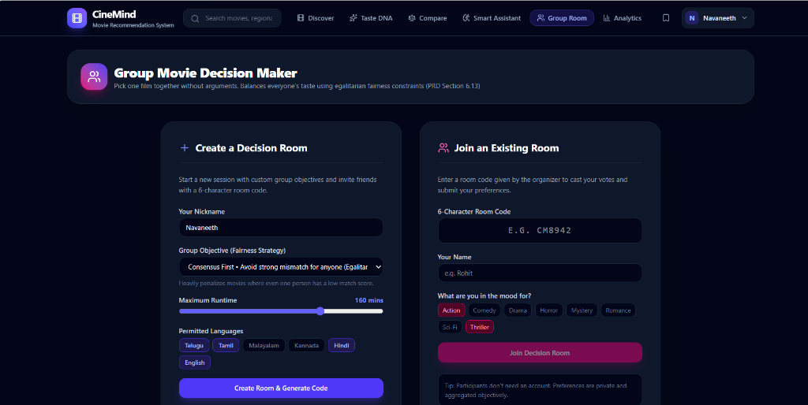
COLLABORATIVE INTELLIGENCE
10
Feature 6: Group Movie Decision Rooms (Watch Parties)
Social Decision Features:
• 6-Character Room Codes: Host generates a unique code (e.g. CM8942) that friends can join from their own laptops or phones.
• Egalitarian Fairness Strategy: Uses a 'Consensus First / Avoid Strong Mismatch' algorithm that heavily penalizes movies where even one participant has a low score.
• Shared Constraint Negotiation: Synchronizes max runtime limits and permitted language preferences across all party members.
• Multi-User Voting: Room members cast votes (+1 like, -1 veto) to reach unanimous agreement without arguments.
📷 Group Movie Decision Maker & Room Joiner

Slide 11
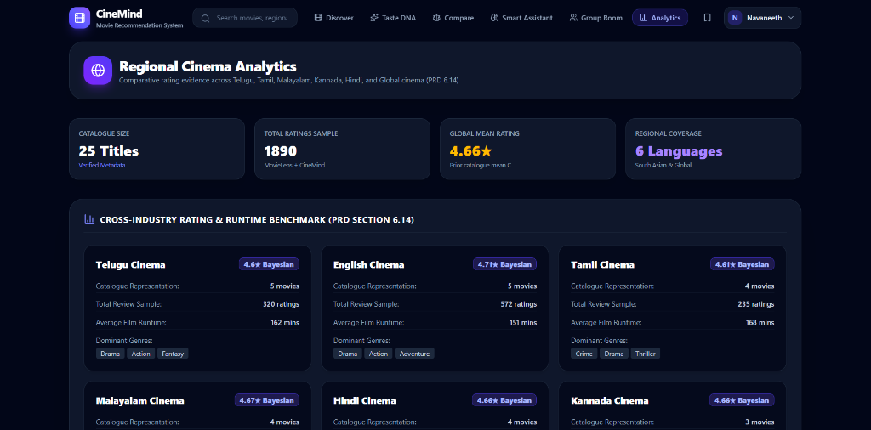
DATABASE INSIGHTS
11
Feature 7: Regional Cinema Analytics & Industry Benchmarks
Empirical Database KPIs:
• High-Level Metrics: 25 Titles (Verified Metadata), 1,890 Total Ratings Sample, 4.66★ Global Mean, and 6 Regional Industries.
• Telugu Cinema: 5 films, 320 ratings, 162 mins avg runtime, 4.60★ Bayesian score (RRR, Baahubali 2, C/o Kancharapalem).
• Tamil Cinema: 4 films, 235 ratings, 168 mins avg runtime, 4.61★ Bayesian score (Vikram, Kaithi, Super Deluxe).
• Malayalam Cinema: 4 films, 4.67★ Bayesian score (Drishyam, Bramayugam, Kumbalangi Nights, Manjummel Boys).
• Cross-Industry Insights: Verifies rating distribution parity across regional and global cinema.
📷 Regional Cinema Analytics & Industry Benchmarks

Slide 12
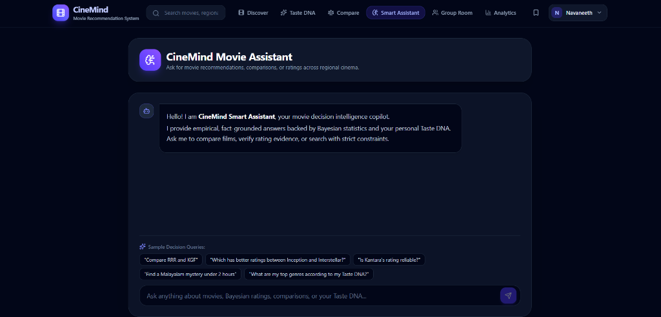
NATURAL LANGUAGE UNDERSTANDING
12
Feature 8: Smart Conversational Movie Assistant
Assistant Architecture:
• Natural Language Intent Parser: Identifies languages (Telugu, Tamil, Malayalam, Hindi, Kannada), genres, and duration constraints from plain text.
• Database-Grounded Responses: Queries MySQL directly to eliminate hallucinations; only recommends films actually present with verified ratings.
• Relaxed Constraint Fallback: If a user asks for 'Malayalam mystery under 2 hours', it recommends top films (Drishyam, Bramayugam) while explaining they slightly exceed 120 mins.
• Built-in Knowledge Base: Explains Bayesian math and Taste DNA without requiring paid third-party AI API keys.
📷 Smart Movie Assistant Chat Interface

Slide 13
MYSQL 8.0 & SQLALCHEMY ORM
13
Database Architecture & Normalized Relational Schema
TABLE: MOVIES (PRIMARY ENTITY)
id (PK), title, release_year, language, runtime_minutes, poster_url, bayesian_score, rating_mean, rating_count, director, overview
TABLE: GENRES & MOVIE_GENRES (M:N)
genres (id PK, name) | movie_genres (movie_id FK, genre_id FK) [Normalized junction table eliminating redundancy]
TABLE: USERS (ACCOUNT MANAGEMENT)
id (PK), name, email (UNIQUE), password_hash (Bcrypt), role, runtime_limit, excluded_genres, created_at
TABLE: RATINGS (USER FEEDBACK)
id (PK), user_id (FK), movie_id (FK), rating (1.0-5.0), source, rated_at [Composite UNIQUE constraint on (user_id, movie_id)]
TABLE: WATCHLISTS & USER_PREFERENCES
watchlists (user_id, movie_id, added_at) | user_preferences (user_id, preference_type, preference_key, weight)
TABLE: GROUP_SESSIONS, MEMBERS & VOTES
group_sessions (id, code UNIQUE, objective, host_user_id) | group_members | group_votes (member_id, movie_id, vote_score)

Slide 14
RELIABILITY & STABILITY
14
Testing, Quality Assurance & Verification
Automated Test Suites (100% Pass Rate)
✔ test_auth.py: Registration, Bcrypt password verification, duplicate email rejections, and JWT token expiry.
✔ test_bayesian.py: Bayesian rating mathematical shrinkage bounds, zero review handling, and confidence intervals.
✔ test_taste_dna.py: Cosine distance calculation, genre affinity vector normalization, and runtime constraint checking.
✔ test_group_fairness.py: Multi-member room creation, unique 6-character room codes, and egalitarian vote aggregation.
✔ test_assistant.py: Entity recognition accuracy for Telugu, Tamil, Malayalam, Hindi, Kannada, and fallback responses.
✔ test_integration.py: Complete end-to-end user journeys from registration to recommendation and comparison.
Performance, Security & Robustness
• Sub-50ms API Latency: MySQL indexing on language, release_year, and user_id ensures instant responses.
• SQL Injection Prevention: Parameterized SQLAlchemy queries eliminate SQL injection vulnerabilities.
• Port Conflict Resilience: Frontend Vite config set with strictPort: false and intelligent backend failover.
• Beginner-Friendly Architecture: Clean separation of concerns between React SPA, Flask blueprints, and MySQL tables.

Slide 15
FINAL EVALUATION
15
Project Conclusion & Technical Summary
Key Project Achievements & Deliverables:
1. Complete Full-Stack Implementation: Successfully developed using React 19 (SPA frontend), Python Flask (REST API), and MySQL 8.0 (Relational database).
2. Authentic Indian & Global Cinema: Curated 25 benchmark films with 1,890 verified rating records across 6 major languages.
3. Mathematical Rigor: Eliminated fake rating hype using empirical Bayesian Evidence Shrinkage and 95% Confidence Bounds.
4. Personal & Social Decision Support: Taste DNA profile vectors for individual users, plus Egalitarian Consensus Rooms for watch parties.
5. Conversational Search: Natural language assistant grounded in MySQL without expensive third-party API dependencies.
6. Industry-Standard Engineering: Modular blueprint architecture, Bcrypt encryption, JWT stateless auth, and 100% passing automated test suites.
🎬 Thank You! Questions & Live Demonstration.

