Slide 1

DEPARTMENT OF COMPUTER SCIENCE AND ENGINEERING
GitHub Analytics Pipeline
Fundamentals of Data Engineering
COURSE CODE: 24DEA3101R
Team 10
Satya Austin Abner – 2420030587
Animesh Balaji - 2420030301
Navaneeth - 2420030306
Notes:
Welcome to the GitHub Analytics Pipeline project presentation. This project demonstrates the complete data engineering workflow from data extraction through analytics. We will cover the architecture, implementation details, and key learnings from this project.

Slide 2
Abstract
What is Data Engineering?
Why GitHub Data?
Data Engineering is the process of collecting, ingesting, processing, transforming, storing, and preparing data for analysis and decision-making. It focuses on building reliable and scalable data pipelines that convert raw data from different sources into structured and useful information.
GitHub is selected as the data source because it contains large amounts of real-world software development data, including repositories, commits, contributors, issues, pull requests, stars, forks, and programming languages. This makes it a suitable source for demonstrating data ingestion, transformation, storage, data modeling, and analytics.
Project Goal
The goal of this project is to develop an end-to-end GitHub Analytics Data Engineering Pipeline that extracts software development data from the GitHub REST API, processes and cleans the raw data, stores it in a structured PostgreSQL database, and generates meaningful analytical insights.The project aims to automate the movement of GitHub data from the source system to an analytical database and provide visualizations that help understand repository activity, developer contributions, project health, and collaboration patterns.
Notes:
Data engineering is the practice of designing and building systems to collect raw data and process it into formats useful for analysis. GitHub is an excellent data source because it contains rich, structured data about software development activities. This project will demonstrate how to extract this data, clean it, store it properly, and then use it for analytics.

Slide 3
Problem Statement
GitHub provides a large amount of software development data through its REST APIs, but the raw API data is not directly suitable for efficient analysis.
The major challenges are:
GitHub data is distributed across multiple API endpoints.
Raw API responses contain nested and inconsistent information.
Manual collection of repository and developer activity is time-consuming.
Data requires cleaning, validation, and transformation before analysis.
Repeated API requests can be inefficient and affected by API rate limits.
Direct API queries are not suitable for complex analytical queries.
There is a need for centralized and structured storage for efficient analysis.
Proposed Solution:
Develop a data engineering pipeline that automatically extracts GitHub data, cleans and transforms it, stores it in PostgreSQL, and generates analytical insights through SQL queries and visualizations.
Notes:
The GitHub API provides raw data, but it has several limitations. First, the data is unstructured and requires significant processing. Second, querying the API directly for complex analysis is slow. Third, data from multiple API calls can have inconsistencies. Our solution is to build a pipeline that automates data collection, cleaning, and storage, enabling fast analytics.

Slide 4
Project Objectives
Main Objectives:-
Extract GitHub Data Collect repository, commit, issue, pull-request, and contributor data using the GitHub REST API.
Perform Data Ingestion Build a reliable process for retrieving and storing data from GitHub.
Clean and Transform Data Handle missing values, duplicates, inconsistent formats, and invalid data.
Design a Data Model Organize GitHub entities into structured relational tables.
Store Data Load the processed data into PostgreSQL for efficient querying.
Perform Data Analytics Analyze repository activity, developer contributions, commits, issues, and pull requests.
Generate Visualizations Present analytical results through an interactive dashboard.
Build a Scalable Pipeline Design the system so that additional repositories, data sources, and processing capabilities can be added later.
Notes:
The project has five main objectives. First, we extract data from GitHub repositories using the REST API. Second, we implement data cleaning to handle missing values and inconsistencies. Third, we store the processed data in PostgreSQL for efficient querying. Fourth, we analyze patterns in repository activity. Finally, we generate visualizations and dashboards that provide actionable insights.

Slide 5
Technologies Used
Python
GitHub REST API
Pandas
PostgreSQL
Data extraction, processing, and ETL
Data source for repository information
Data manipulation and transformation
Structured data storage and queries
Streamlit
Docker (Optional)
Apache Airflow
Git/GitHub
Interactive data visualization
Pipeline scheduling and orchestration
Containerization & deployment
Version control & project management
Notes:
We use Python as the primary programming language for its rich ecosystem of data tools. The GitHub REST API is our data source. Pandas is used for efficient data manipulation. PostgreSQL is our database for storing structured data. We use Power BI or Streamlit for visualization. Git and GitHub provide version control.

Slide 6
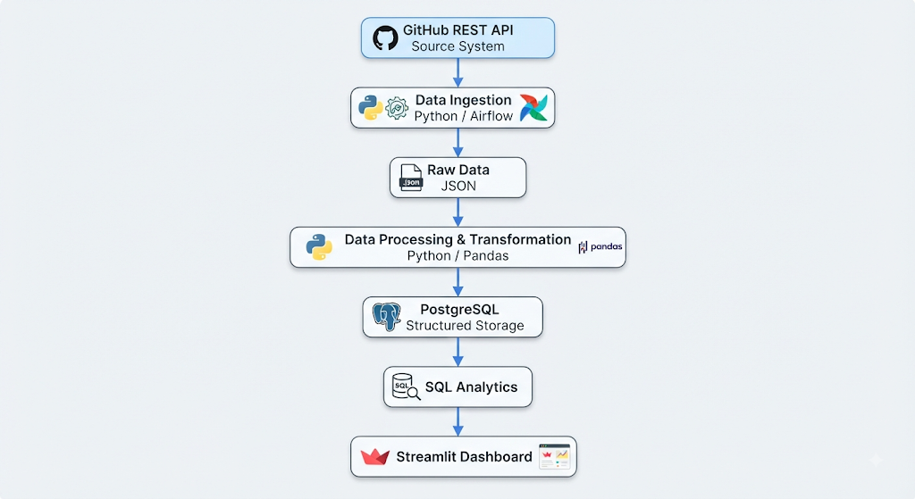
System Architecture - Data Pipeline
Data Flow Process:
1. GitHub API: Fetch repository, commit, issue, and contributor data
2. Extraction: Convert API responses to structured format
3. Cleaning: Handle missing values, remove duplicates, validate data
4. PostgreSQL: Store processed data in normalized tables
5. Analytics: Query and aggregate data for insights
6. Dashboard: Visualize metrics and trends
Notes:
The architecture follows a classic ETL pipeline. First, we extract data from the GitHub API. The raw API response is then parsed and transformed into a consistent format. Next, we perform data cleaning including handling missing values and removing duplicates. The cleaned data is loaded into PostgreSQL where it is organized into normalized tables. Finally, we perform analytics queries and create visualizations through a dashboard.

Slide 7
Thank You
Questions & Discussion
Feel free to ask any questions about the architecture, implementation, or any aspects of the project.

