Slide 1
PART 1
Acoustic Simulation
& Baseline FxLMS
Active Noise Cancellation • Dataset Generation • Baseline Evaluation
Class presentation

Slide 2
1. Objective and ANC concept
What Part 1 builds and measures
Goal
Primary source
Error mic
Build a simulated acoustic environment, validate FxLMS, and establish a baseline for faster adaptation methods.
Unwanted noise
Measures residual
Secondary speaker
Produces anti-noise
Residual error: e(n) = d(n) + yₛ(n)
Objective: minimize mean-square error E[e²(n)]
02

Slide 3
2. Acoustic room setup
Simulation parameters based on the stated configuration
Room
Sampling rate
6 × 6.2 × 3 m
16 kHz
62.5 μs per sample
RT60
Impulse response
0.15 s
Short reverberation
512 taps = 32 ms
Room reflections are modelled using the Image-Source Method (ISM).
03

Slide 4
3. Sources and acoustic paths
Only the primary source moves; speaker and microphone stay fixed
Primary source
Secondary speaker
Error microphone
[1.5, 1, 1] → [3, 2, 2] m
2,048 positions
[3, 2.5, 1.5] m
Fixed
[4.5, 3, 1.5] m
Fixed
Primary path P
Secondary path G
Model assumption: Ĝ = G
Noise source → microphone
Speaker → microphone
Perfect secondary-path estimate in this experiment.
P: primary acoustic path G: physical secondary path Ĝ: estimated secondary path
04

Slide 5
4. How FxLMS cancels noise
The algorithm accounts for the secondary speaker-to-microphone path
Reference noise
Adaptive filter
Microphone error
x(n): white Gaussian noise
y(n) = wᵀ(n)x(n)
e(n) = d(n) + G*y(n)
Primary signal: d(n) = P * x(n)
Simplified update:
w(n+1) = w(n) + μ e(n) x_f(n)
Filtered reference: x_f(n) = Ĝ * x(n)
Your implementation uses a normalized, block-averaged update (Eq. 4).
μ controls adaptation speed and stability.
05

Slide 6
5. Pipeline and dataset generation
From acoustic paths to experiments
1
ism.py
2
build_paths.py
3
tests.py
4
sweep_mu.py
Room simulation
P, G, Ĝ, positions, Wiener filters
Validate fast FxLMS
Find stable step sizes
5
make_dataset.py
6
run_part1.py
7
make_figures.py
Generate converged filters
50-trial experiments
Plots and PCA
Shipped outputs allow Part 2 and Part 3 to start without rerunning the full pipeline.
06

Slide 7
6. What the filter dataset tells us
W.npy stores the converged filter for each source position
Dataset shape
Global PCA
Local PCA
2,048 × 512
float32 ≈ 4 MiB
81 components → 99%
32 components → 61%
3 components → 99%
64 neighbouring positions
Interpretation
• The main arrival tap shifts by about 82 samples along the path.
• Neighbouring filters are about 20× closer than random pairs.
• Filters are locally low-dimensional, but the full path forms a curved global manifold.
• This structure may help a future method adapt faster by exploiting nearby filters.
07

Slide 8
7. Validation results
Two checks build confidence in the baseline
Implementation check
Wiener benchmark
Vectorized block FxLMS matches a sample-wise reference to 2 × 10⁻¹⁶.
This is near double-precision numerical error.
FxLMS attenuation: 15.7 dB
Wiener optimum: 15.8 dB
Median relative filter distance: 3.2%
Conclusion
The implementation reproduces the reference algorithm and converges close to the best linear solution under the stated model.
08

Slide 9
8. Baseline experiment design
Measure initial learning and recovery after the source moves
Trials
Duration
Source jump
50 independent trials
400 blocks × 100 samples
6.25 ms per block
At block 100
Block 0
Block 100
Block 400
Start
Source jumps
End
Convergence threshold: ρ = 0.4 • Steady-state error: last 40 blocks
09

Slide 10
9. Step-size sweep: results
Mean convergence time ± standard deviation; attenuation in dB
μ | Initial convergence | After jump | Attenuation
8 | 279 ± 31 blocks | 182 ± 17 blocks | 13.6 ± 0.6 dB
16 | 195 ± 69 blocks | 136 ± 15 blocks | 15.5 ± 0.8 dB
24 | 115 ± 62 blocks | 100 ± 13 blocks | 15.5 ± 0.8 dB
32 | 70 ± 37 blocks | 73 ± 16 blocks | 14.7 ± 2.0 dB
48 | Diverges | Diverges | Unstable
Fastest stable tested setting
Best attenuation among stable rows
μ = 32
μ = 16 or 24 (15.5 dB)
10

Slide 11
10. Important limitation: attenuation ceiling
Why the result differs from the paper's reported ≈37 dB
Reported paper result
Our Wiener optimum
Difference
≈37 dB
≈15.8 dB median
≈21.2 dB
• 512-tap responses are truncated; the secondary path includes a 74-sample delay.
• Some residual energy cannot be cancelled by the specified finite filter configuration.
• Bandlimiting noise and tapering responses did not remove the discrepancy.
• The exact cause is unresolved; the paper's full setup may differ in an unreported detail.
Keep comparisons fair: use the same acoustic model and evaluation method across algorithms.
11

Slide 12
Key takeaways
01
Simulate
Model the room and both acoustic paths.
02
Validate
Check the fast implementation and Wiener benchmark.
03
Measure
Compare speed, stability, and attenuation across μ.
04
Exploit structure
Nearby positions produce similar filters.
05
Set the baseline
μ = 32 is fastest among the tested stable settings.
Part 1 creates the validated reference system for evaluating improvements in Part 3.

Slide 13
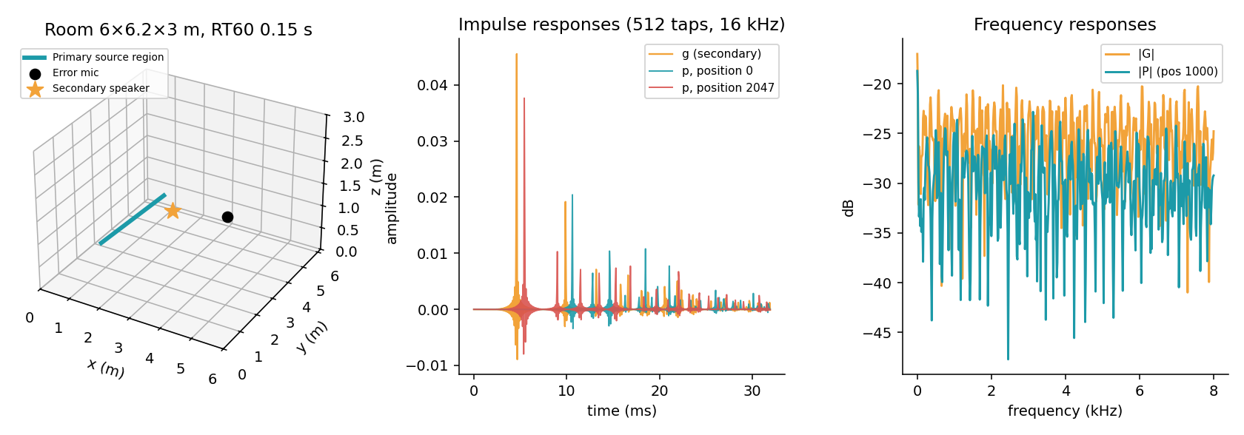
Appendix A — Room, impulse responses & frequency response
Simulation geometry and acoustic paths at 16 kHz
Use this figure to explain the room geometry, the 512-tap responses, and how the paths differ by frequency.
13

Slide 14
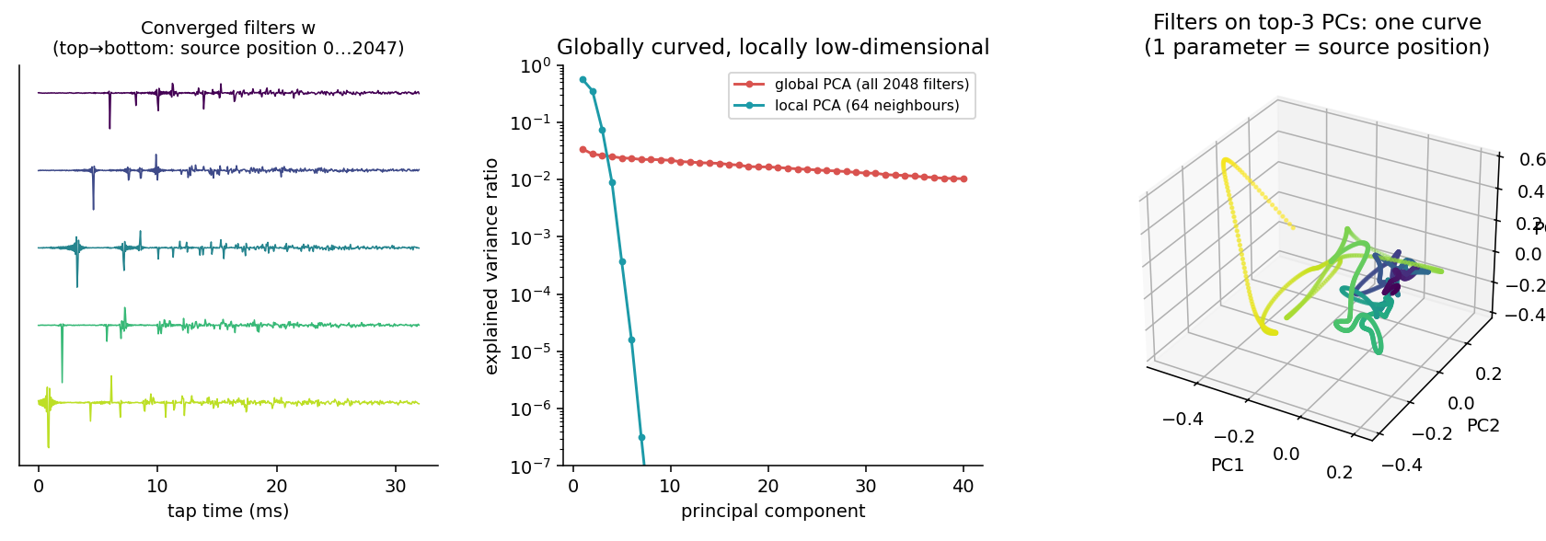
Appendix B — Filter dataset & PCA structure
2,048 converged filters; global versus local dimensionality
Global PCA needs 81 components for 99% variance; locally, 3 components explain 99% across 64 neighbours.
14

Slide 15
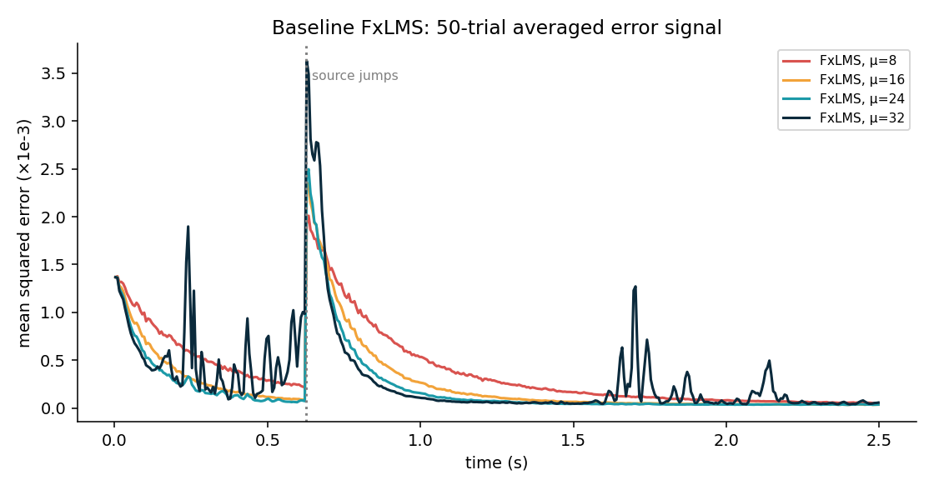
Appendix C — Baseline FxLMS error curves
Mean squared error over 50 trials; source jumps at approximately 0.625 s
Faster step sizes generally settle sooner, while the source jump causes a temporary rise in residual error.
15

Slide 16
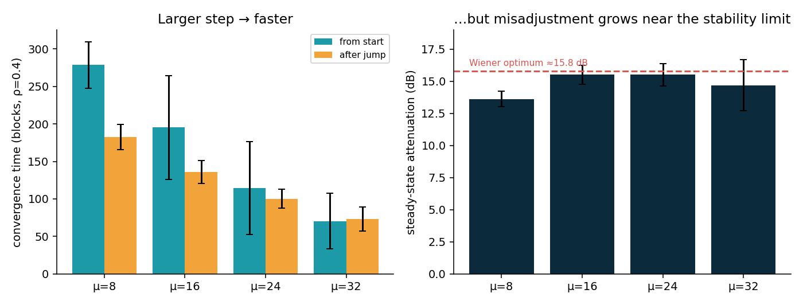
Appendix D — Step-size trade-off
Convergence speed versus steady-state attenuation
μ = 32 is fastest among tested stable settings; μ = 16 and 24 achieve the highest reported attenuation.
16

