Slide 1
Part 2 — Latent FxLMS
Autoencoders
Compressing 512-tap adaptive filters into 32-dimensional latent codes
Project evaluation • Group of three
Important: figures supplied here are labelled synthetic smoke-test outputs, not Part 1 measurements.

Slide 2
1. The problem we are solving
• Part 1 produces W: 2,048 filters, each with 512 real-valued taps.
• Storing and working with every tap is high-dimensional.
• Goal: learn a compact 32-value latent code for each filter.
• A decoder maps the 32 values back to a 512-tap filter.
• Part 2 is a representation-learning stage; Part 3 uses the decoder and its derivatives.
Input: W.npy • Expected shape: (2048, 512)
Output: trained checkpoints + latent codes + evaluation metrics
One filter = 512 numbers → 32 latent numbers
Compression in dimension: 16×
02

Slide 3
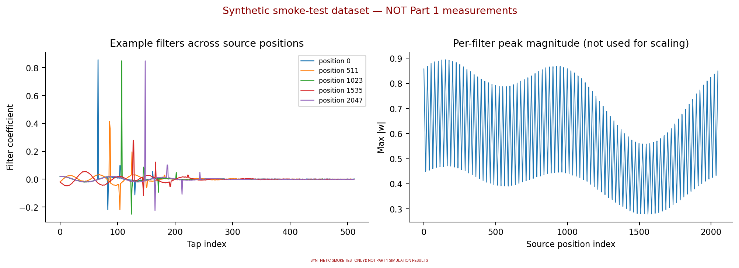
2. Dataset and source positions
• Rows correspond to source-position samples.
• Each row contains a 512-tap filter.
• A position-aware holdout tests generalization to unseen positions.
• Synthetic demo plots are for software smoke-testing only.
Real evaluation must use the actual Part 1 W.npy.
03

Slide 4
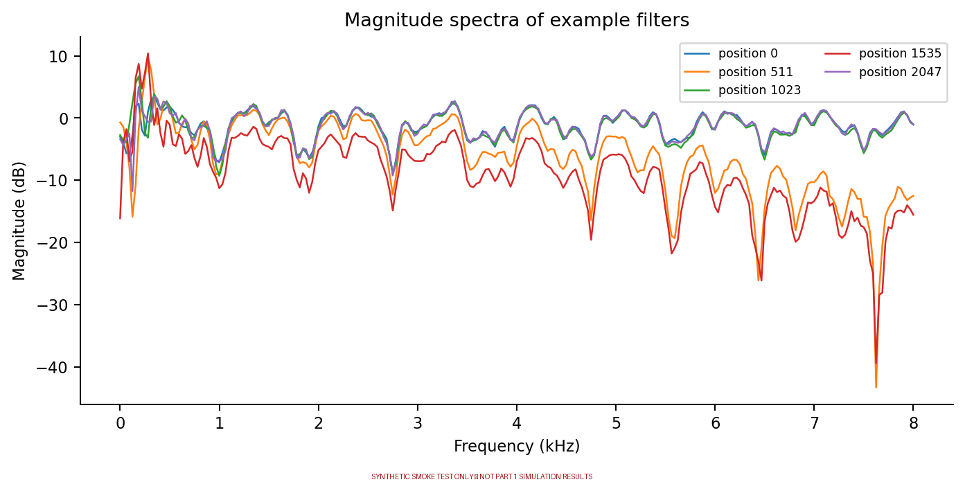
3. Preprocessing: preserve the filter scale
• Load W.npy strictly and check its shape.
• Apply one global max-absolute scale.
• Split by source position: every eighth sample is held out.
• Use the saved scale to return decoded filters to original units.
Why not per-filter scaling? It can hide meaningful differences in filter magnitude.
04

Slide 5
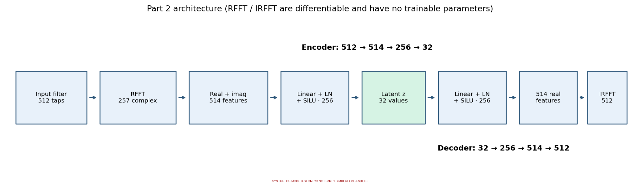
4. Model architecture: 512 → 32 → 512
Encoder: 512 taps → RFFT (257 complex) → 514 real features → 256 → 32
Decoder: 32 → 256 → 514 → IRFFT → 512 taps
05

Slide 6
5. Six variants: what changes between them?
AE
VAE
InfoVAE
Reconstruction MSE
Reconstruction + Gaussian KL
Reconstruction + MMD
Each also has a +mixup version: AE+mixup, VAE+mixup, InfoVAE+mixup.
• Mixup adds mixed-filter reconstruction consistency (L_C).
• Mixup also encourages latent linearity (L_z).
• InfoVAE default MMD kernel variance = 0.01; monitor whether it saturates.
06

Slide 7
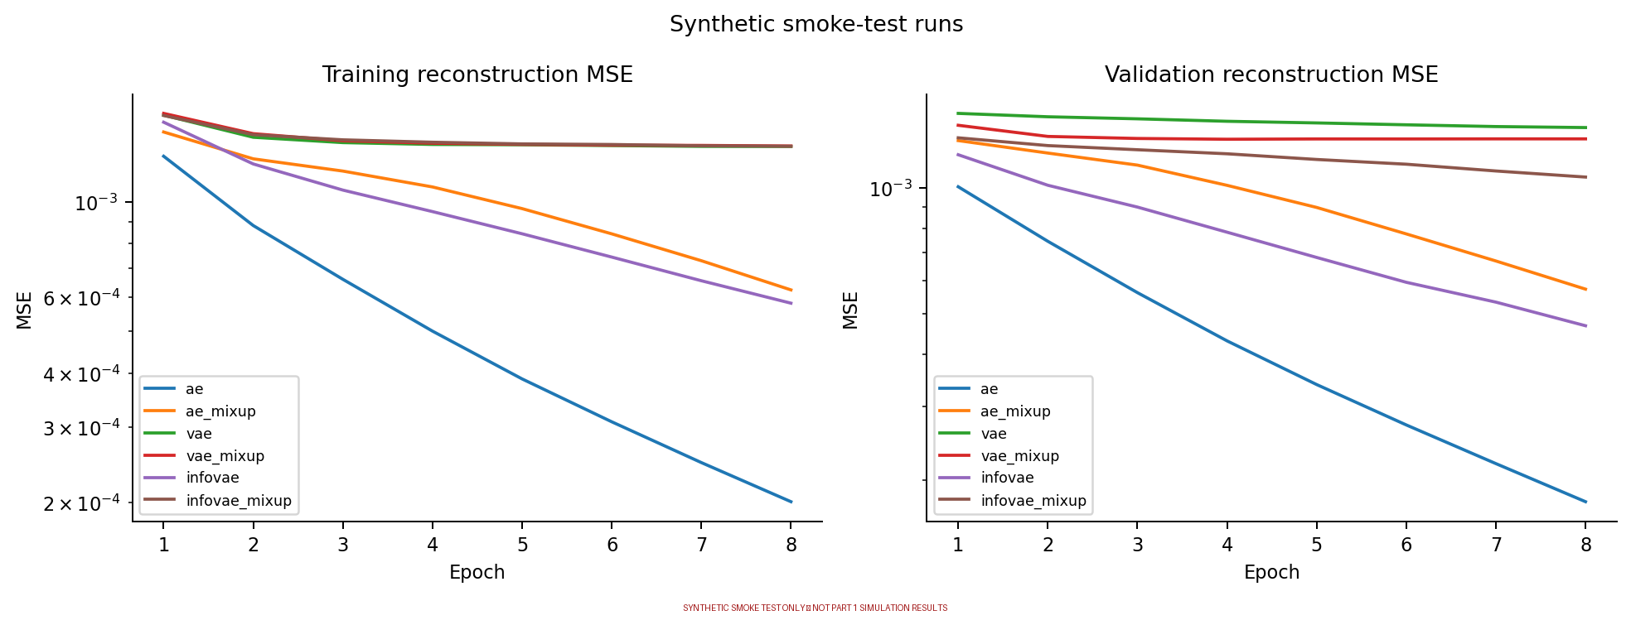
6. Training behaviour and loss
• Optimizer: Adam, learning rate 0.001.
• Default research run: up to 120 epochs with early stopping.
• VAE beta = 1; mixup weights = 1.
• Demo: only 8 epochs to smoke-test the pipeline.
A lower training loss alone does not prove better filters.
07

Slide 8
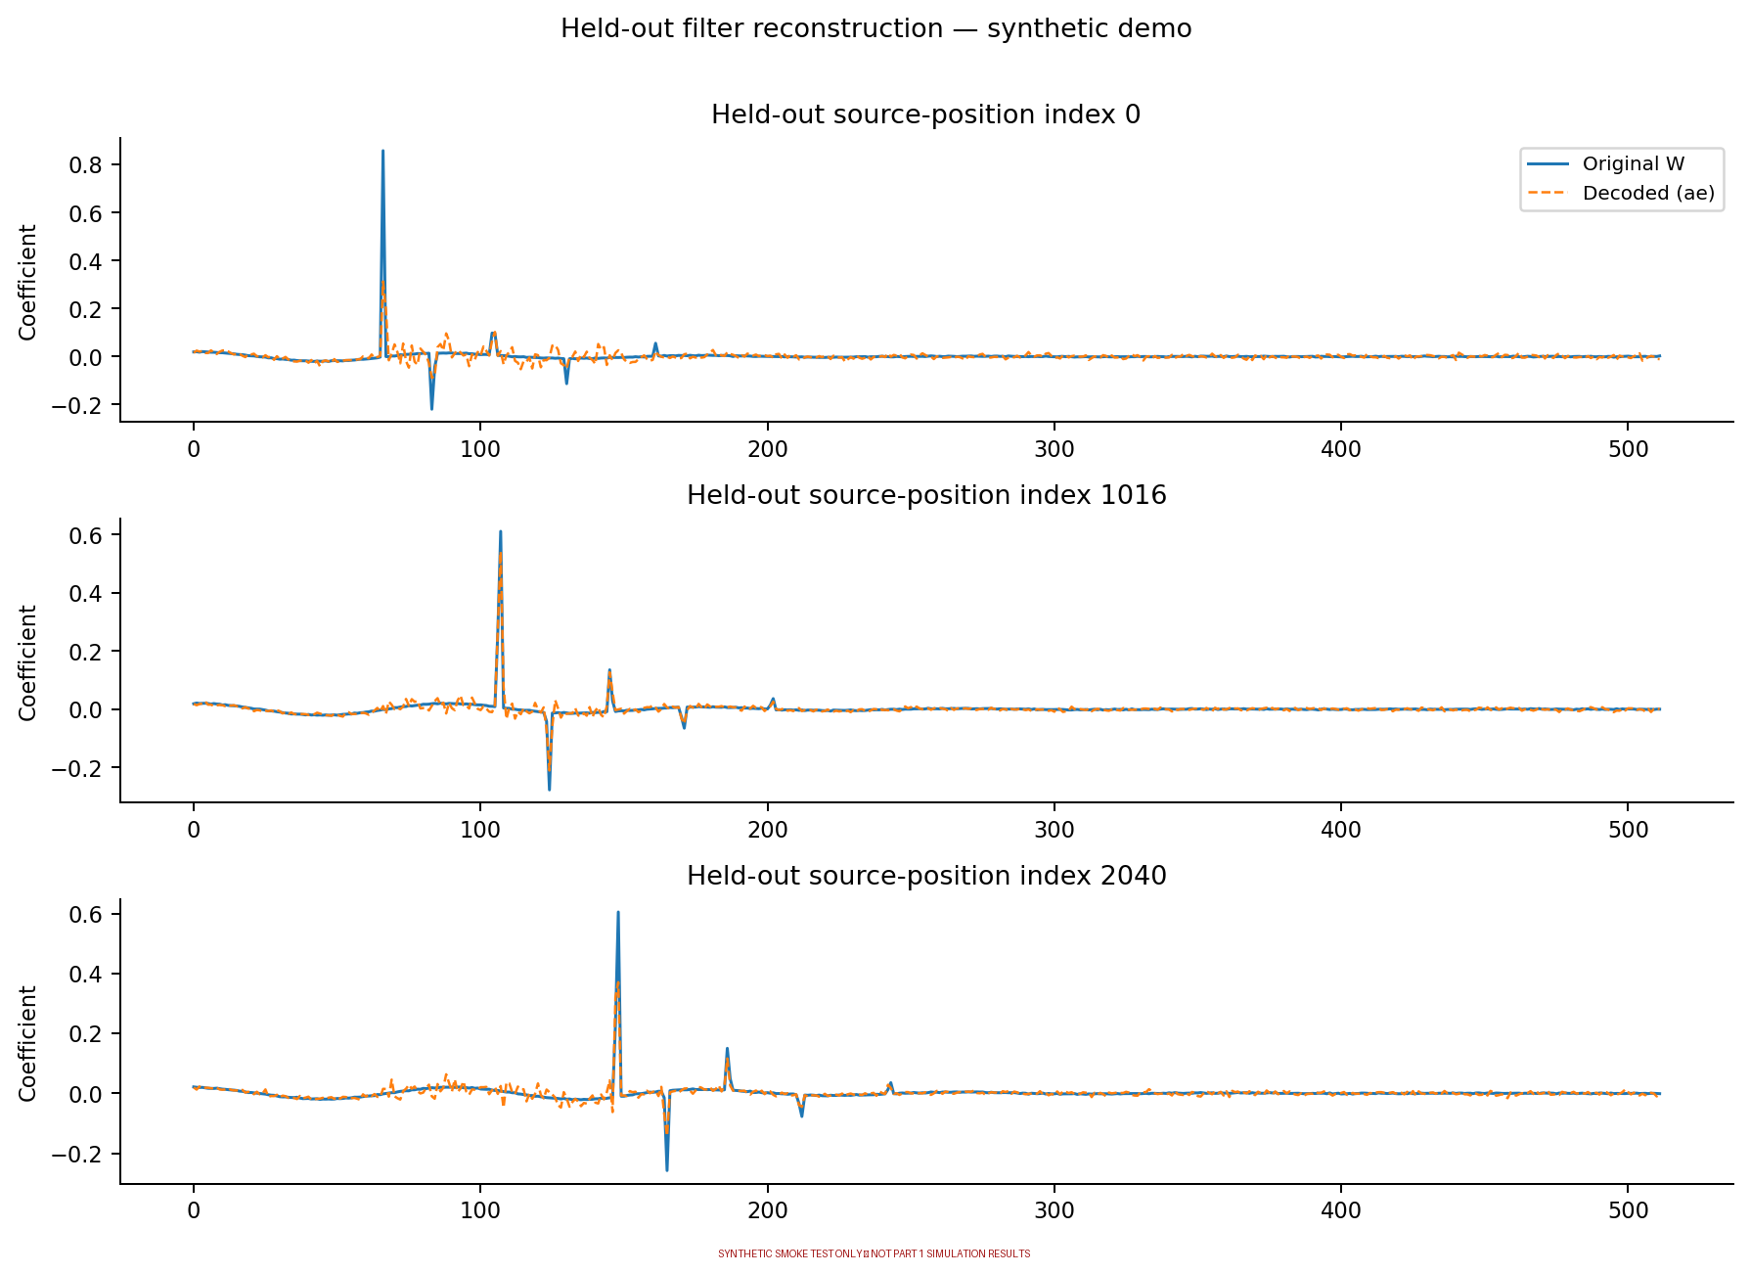
7. Does the decoder reconstruct unseen filters?
• Held-out positions are not used for training.
• Compare the original and decoded tap sequences.
• Use relative reconstruction error as one metric.
• Check attenuation too—not only visual similarity.
The supplied figure is a synthetic demo, not a real-data result.
08

Slide 9
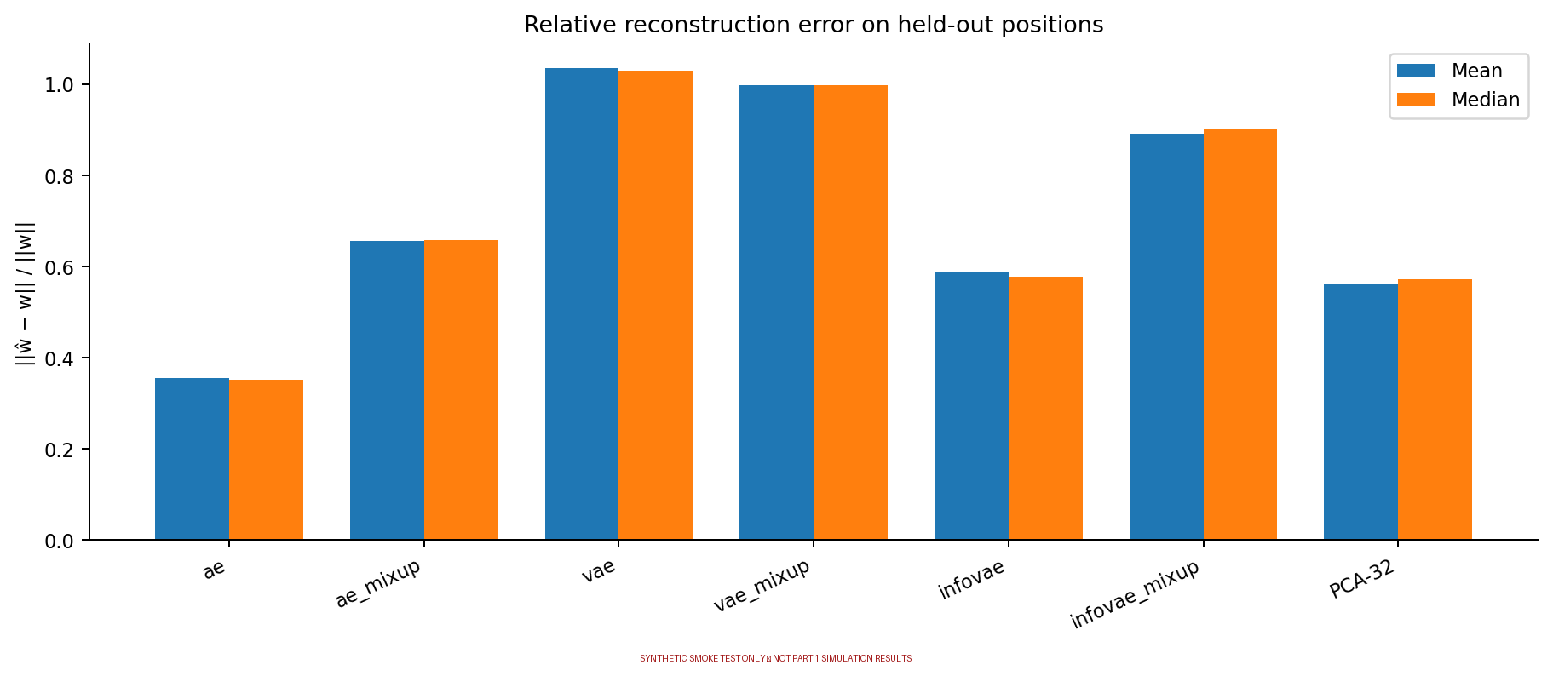
8. Comparing models fairly
• Compare mean and median held-out relative error.
• PCA-32 is a simple dimensionality-reduction baseline.
• Choose using held-out reconstruction AND attenuation.
• Do not present synthetic numbers as Part 1 simulation results.
09

Slide 10
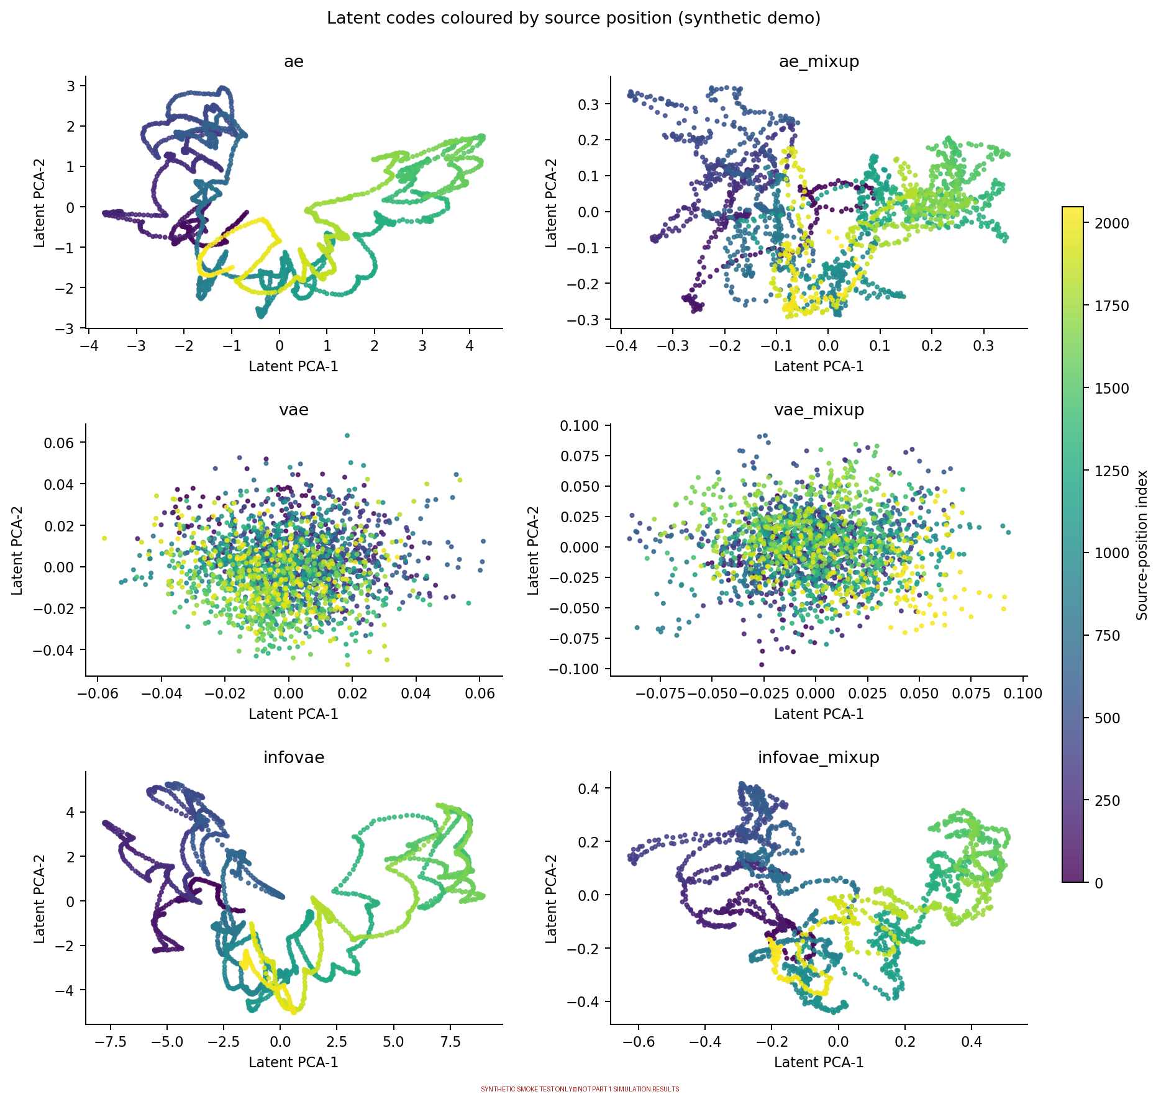
9. What do the 32-dimensional latent codes show?
• Each dot represents one filter's latent code.
• Colour indicates source-position index.
• PCA shows only a 2D view of a 32D code.
• Patterns are exploratory, not proof of performance.
10

Slide 11
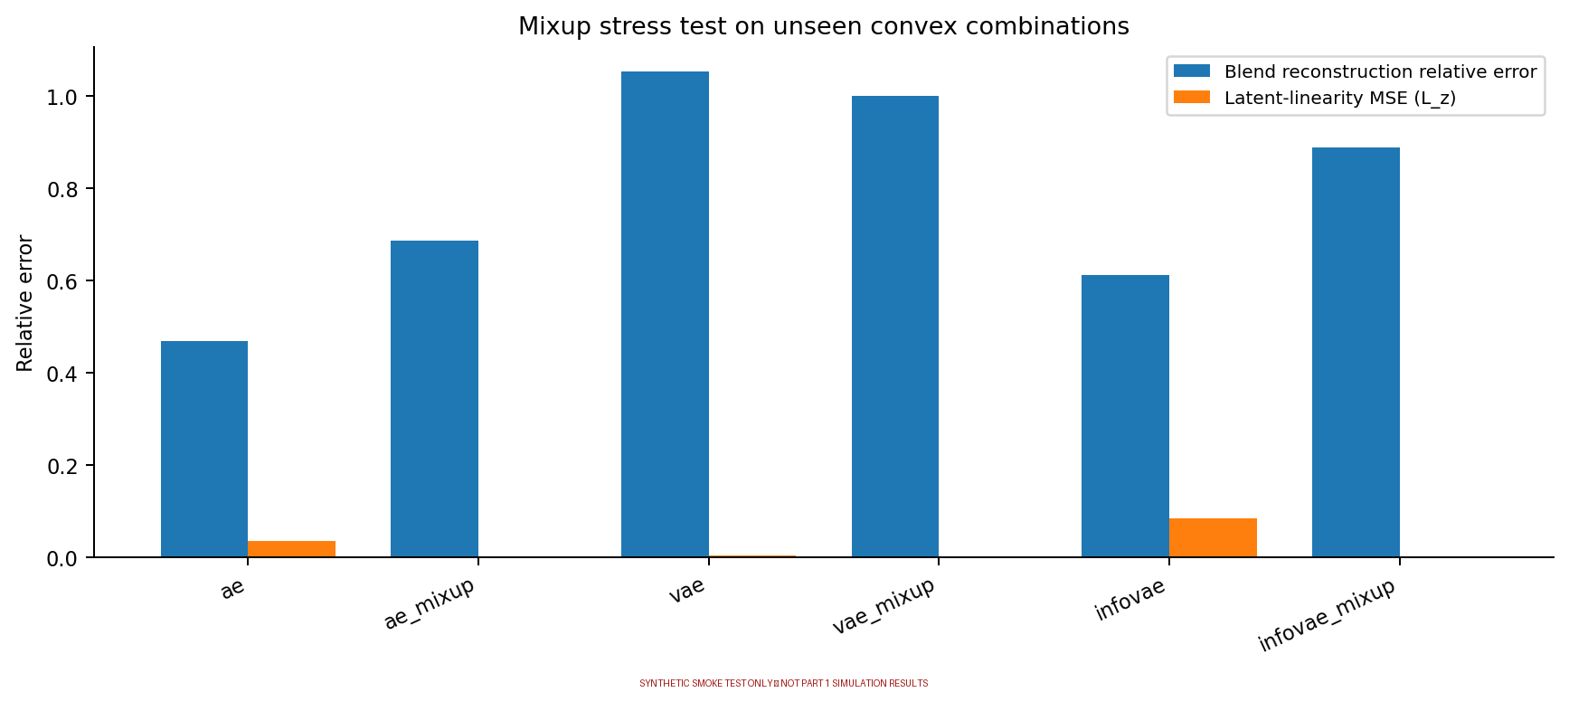
10. Why use mixup?
• Blend two filters using a mixing weight.
• L_C: reconstruct the mixed filter consistently.
• L_z: encourage linearity in latent space.
• Stress-test unseen convex combinations.
Mixup helps test interpolation behaviour; it does not guarantee low reconstruction error.
11

Slide 12
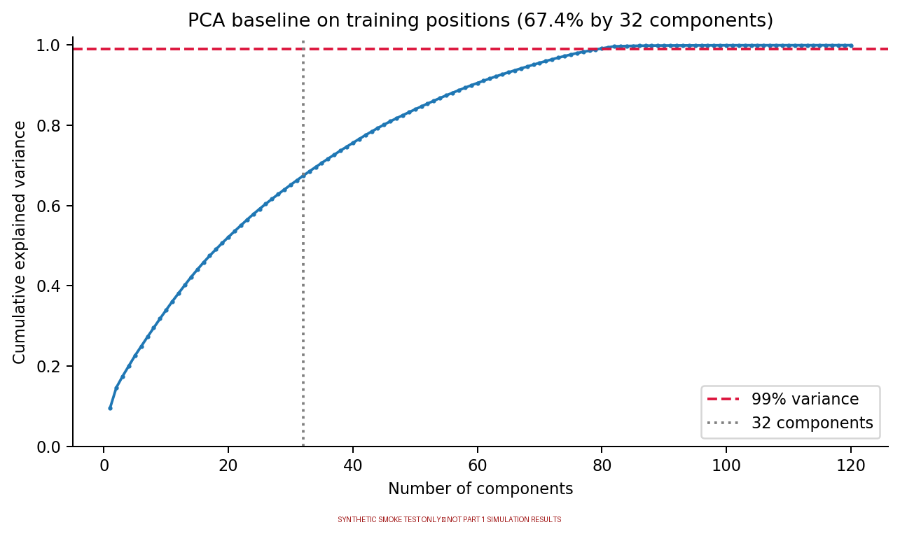
11. Baseline: PCA with 32 components
• PCA is linear; an autoencoder can learn nonlinear mappings.
• Compare reconstruction error using the same test split.
• Use identical input scaling for a fair comparison.
12

Slide 13
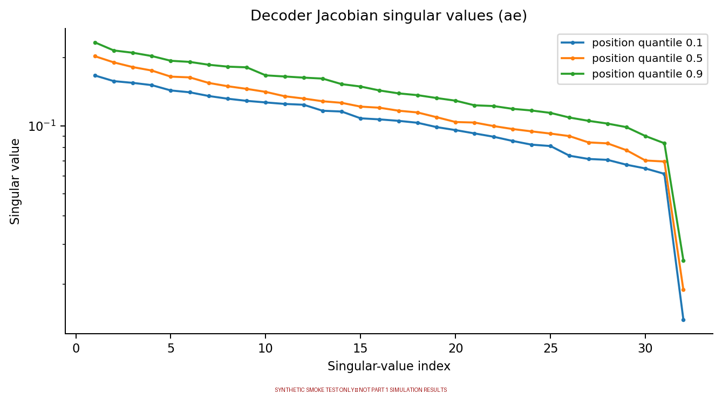
12. Decoder Jacobian: bridge to Part 3
• Jacobian shape: 512 × 32.
• It is computed by automatic differentiation.
• FFT and inverse FFT are differentiable and have no learned parameters.
• Smooth SiLU activations support derivative-based analysis.
13

Slide 14
13. Outputs, limitations, and final takeaway
• Outputs: model checkpoints, Z_<model>.npy, z0_<model>.npy, metrics, and plots.
• If P.npy and g.npy are available, evaluate attenuation of decoded filters.
• The attenuation formula follows Part 1: 10 log10(sum(p²) / sum(r²)).
• Paper/project notes report a setup discrepancy: about 15.8 dB median Wiener-optimum in Part 1 versus about 37 dB in the paper.
• Final model selection must use real-data held-out error AND attenuation.
Takeaway: learn a compact 32D representation, validate on unseen positions, and pass a differentiable decoder to Part 3.
14

