Slide 1

Department of Computer Science and Engineering
(Cyber Security)
CS23533– Foundations of Artificial Intelligence
2026-2027
HireAI: A Rule-Based Intelligent Recruitment Expert System — PROJECT REVIEW 2
✦ Pure Classical AI Architecture | Deterministic Forward Chaining | Zero Black-Box Bias ✦
Supervisor:
Dr. S. Bhuvana, Ph.D.
Assistant Professor (SG) | CSE (Cyber Security)
Presented By:
241901067 – NAVANEETHA KRISHNAN E
241901114 – SURVESVARA KUMAR J S
Notes:
Welcome back evaluators. Today we present Review 2 for HireAI, demonstrating our significant progress since Review 1.

Slide 2
Problem Statement and Motivation
❌ RECRUITMENT CRISIS RESTATED (THE BOTTLENECKS)
Volume & Evaluator Fatigue: Recruiters handle 250+ resumes per job posting, spending only 6-8 seconds per candidate; non-standardized manual review causes high error rates.
Black-Box Machine Learning: Prevailing commercial ATS employ opaque neural embeddings or LLMs that output arbitrary similarity scores without inspectable proof traces.
Demographic Bias Amplification: Statistical algorithms train on historical corporate data, perpetuating latent gender, racial, and institutional discrimination.
Prompt Injection & Spoofing: Unscrupulous applicants manipulate LLM screeners via hidden white-text instructions, keyword stuffing, and resume spoofing.
Unencrypted Disk PII Storage: Writing uploaded resumes to server file systems exposes candidate PII to data leaks, violating GDPR and ISO/IEC 27001.
Notes:
Slide 2 restates the problem statement and highlights the urgency driven by the EU AI Act.

Slide 3
Problem Statement and Motivation (cont.)
✔ WHY HIREAI IS CRITICAL & MOTIVATION
EU AI Act & Global Regulatory Mandates: Regulation 2024/1689 classifies recruitment AI as 'High-Risk', legally mandating mathematical auditability and bias prevention.
First-Order Deterministic Reasoning: Replaces stochastic embeddings with deterministic IF-THEN Horn clause production rules; identical resumes yield identical scores.
100% Explainable Proof Traces: Synthesizes human-readable audit logs itemizing matched skills, missing criteria, and experience margins for every evaluation.
Zero Demographic Bias: Evaluates candidates strictly on verified credentials, eliminating name, gender, age, and college proxies from decision paths.
Sub-50ms CPU Execution: Processes resumes in volatile RAM (io.BytesIO) in under 42ms with zero cloud GPU cost and zero LLM API dependency.
Notes:
Slide 2 restates the problem statement and highlights the urgency driven by the EU AI Act.

Slide 4
Measurable Objectives & Current Status
01 – Deterministic FOAI Inference Engine: Develop pure First-Order Logic expert system computing qualification match percentages via deterministic Horn clauses with 0% random seed drift. ✔ COMPLETED (100%)
02 – Zero-Disk Volatile Memory Ingestion: Ingest and parse multi-format resumes (PDF/DOCX) strictly in RAM byte buffers (io.BytesIO), guaranteeing zero unencrypted disk residues. ✔ COMPLETED (100%)
03 – 5-Pillar Explainable ATS Health Audit: Audit documents across Format (20%), Keyword Density (25%), Measurable Impact (20%), Completeness (20%), and Contact Hygiene (15%). ✔ COMPLETED (100%)
04 – Multi-Criteria Heuristic Scorer: Formulate multi-attribute candidate utility (50% Skills, 25% Exp, 15% Edu, 10% Certs) with domain misalignment damping penalty. ✔ COMPLETED (100%)
05 – Dual Full-Stack Portals & Kanban Sync: Deploy asynchronous FastAPI backend paired with React 18 SPAs for Candidates and HR Recruiters with synchronized hiring pipelines. ✔ COMPLETED (100%)
Notes:
Slide 3 tracks our objectives, confirming that all 5 have transitioned from in-progress to 100% completed.

Slide 5
Project Progress Since Review 1
REVIEW 1 STATUS (BASELINE)
Domain Research: Completed literature review and theoretical problem formulation.
Knowledge Taxonomies: Formalized skill trees for 40+ technologies and educational tiers.
Rule Engine Prototype: Standalone Python functions for Horn clauses and scoring logic.
GAPS IDENTIFIED: Candidate and HR React frontends were disconnected; file upload was mock-based; ATS health auditor not yet unified; Supabase integration in progress.
Notes:
Slide 4 is our central Review 2 slide: demonstrating that all items planned in Review 1 are now 100% complete.

Slide 6
Project Progress Since Review 1 (cont.)
PROGRESS ACHIEVED (REVIEW 2)
Full Frontend Integration: Connected Candidate Portal (:5173) and HR Dashboard (:5174) with live FastAPI backend.
Zero-Disk RAM Parsing: Engineered volatile io.BytesIO memory pipeline supporting PDF and DOCX uploads.
5-Pillar ATS Health Audit: Integrated real-time resume audit engine (Format, Keywords, Metrics, Sections, Contact).
Cross-Portal Kanban Sync: Implemented pipeline_manager.py for synchronized 6-stage candidate state transitions.
Physical Company Vaults: Isolated multi-company jobs, pipelines, and candidates under database/companies/{slug}/.
Notes:
Slide 4 is our central Review 2 slide: demonstrating that all items planned in Review 1 are now 100% complete.

Slide 7
Project Progress Since Review 1 (cont.)
CURRENT SYSTEM STATUS
40/40 Passing Tests: Automated pytest suite validates auth, matching, persistence, RLS, and tenant isolation in 1.50s.
Sub-50ms Benchmarking: Exhaustively verified 38.4ms average latency across 1,000 evaluations with deterministic scoring.
Supabase Cloud RLS: PostgreSQL database enforcing row-level security policies and JWT access tokens.
Bi-Directional Identity: Cross-audits account identity against resume text with 80% penalty to prevent fraud.
Notes:
Slide 4 is our central Review 2 slide: demonstrating that all items planned in Review 1 are now 100% complete.

Slide 8
Literature Survey – Part 1
S. No. | Author(s) & Year | Paper Title | Methodology / Algorithm | Limitations Identified
1 | Faliagka et al. (2012) | Application of machine learning algorithms to an online recruitment system | Supervised ML & linguistic NLP ranking on public candidate profiles & LinkedIn metadata | Lacks explainable rule auditability; high susceptibility to social profile noise, unverified claims, and demographic bias.
2 | Roy et al. (2020) | A Machine Learning approach for automation of Resume Recommendation System | Deep Learning semantic similarity using BERT embeddings & dense vector cosine distance | Opaque 'black-box' latent space fails explainability; high cloud GPU compute overhead, token latency, and non-deterministic scoring.
3 | Al-Mansoor et al. (2021) | Neural ATS with transformer-based extraction | Multi-task Transformer models for unstructured resume entity parsing and classification | Prone to generative hallucination of non-existent skills; vulnerable to prompt injection and historical demographic bias.
Notes:
Slide 5 covers the literature survey on statistical NLP and deep learning ATS models.

Slide 9
Literature Survey – Part 2
S. No. | Author(s) & Year | Paper Title | Methodology / Algorithm | Limitations / Regulatory Relevance
4 | Russell & Norvig (2020) | Artificial Intelligence: A Modern Approach (4th ed.) | Classical Rule-Based Expert Systems, First-Order Horn Clauses & Forward Chaining | Guarantees logical deduction, deterministic consistency, and proof trees. Requires curated domain ontologies (solved via HireAI's 40+ tech taxonomies).
5 | European Commission (2024) | EU AI Act: High-Risk AI Systems in Employment & Recruitment | Statutory regulatory audit framework establishing legal compliance for automated hiring | Black-box machine learning and generative LLM screeners fail legal transparency mandates. Mandates verifiable decision reasoning and bias audits.
Notes:
Slide 6 concludes our literature review with foundational AI theory and statutory mandates.

Slide 10
Research Gap and Project Response
1. Literature Findings
Statistical Keyword ATS: First-generation tools (Taleo, Jobvite) rely on literal substring queries, easily tricked by keyword stuffing.
Deep Learning & Dense Vectors: Second-generation models (BERT, SBERT) compute latent cosine similarity across text embeddings.
Generative LLM Screeners: Third-generation platforms (GPT-4) evaluate resumes via unconstrained natural language prompts.
Notes:
Slide 7 links literature findings and limitations directly to our implemented solutions.

Slide 11
Research Gap and Project Response (cont.)
2. Limitations
Severe Opacity & Non-Determinism: Zero inspectable proof traces; identical resumes yield varying scores across temperature runs.
Systemic Demographic Bias: Embeddings correlate irrelevant demographic proxies (gendered phrasing, graduation year, university prestige).
Prompt Injection & Spoofing: Easily exploited via hidden white text; no candidate-to-document identity cross-checking.
High Latency & Cloud Costs: 1,500–5,000ms latency with recurring per-token API billing and expensive GPU hosting.
Notes:
Slide 7 links literature findings and limitations directly to our implemented solutions.

Slide 12
Research Gap and Project Response (cont.)
3. Refined Research Gap
Absence of Explainable Proof Traces: No existing platform produces mathematical, First-Order Logic proof trees explaining exact rule satisfaction.
Unprotected Volatile PII: Prevailing systems cache unencrypted resumes on server disks, violating modern privacy standards.
Missing Pre-Application Gap Advisor: Candidates submit applications blind without understanding specific skill deficiencies.
Non-Compliance with High-Risk AI Laws: Black-box models fail EU AI Act Article 14 and NYC Local Law 144 audit mandates.
Notes:
Slide 7 links literature findings and limitations directly to our implemented solutions.

Slide 13
Research Gap and Project Response (cont.)
4. Progress Toward the Solution
Pure Deterministic FOAI: 100% reproducible First-Order Logic Horn clauses with zero random seed drift and sub-50ms CPU execution.
Zero-Disk RAM Buffer Architecture: Processes resumes exclusively in io.BytesIO memory streams with zero disk residues.
Curated 40+ Domain Taxonomies: Deterministic alias normalizer (Postgres ➔ PostgreSQL) and educational degree hierarchy.
Actionable Proof View & XAI Modals: Itemized verification audit logs detailing matched criteria, missing skills, and experience margins.
Notes:
Slide 7 links literature findings and limitations directly to our implemented solutions.

Slide 14
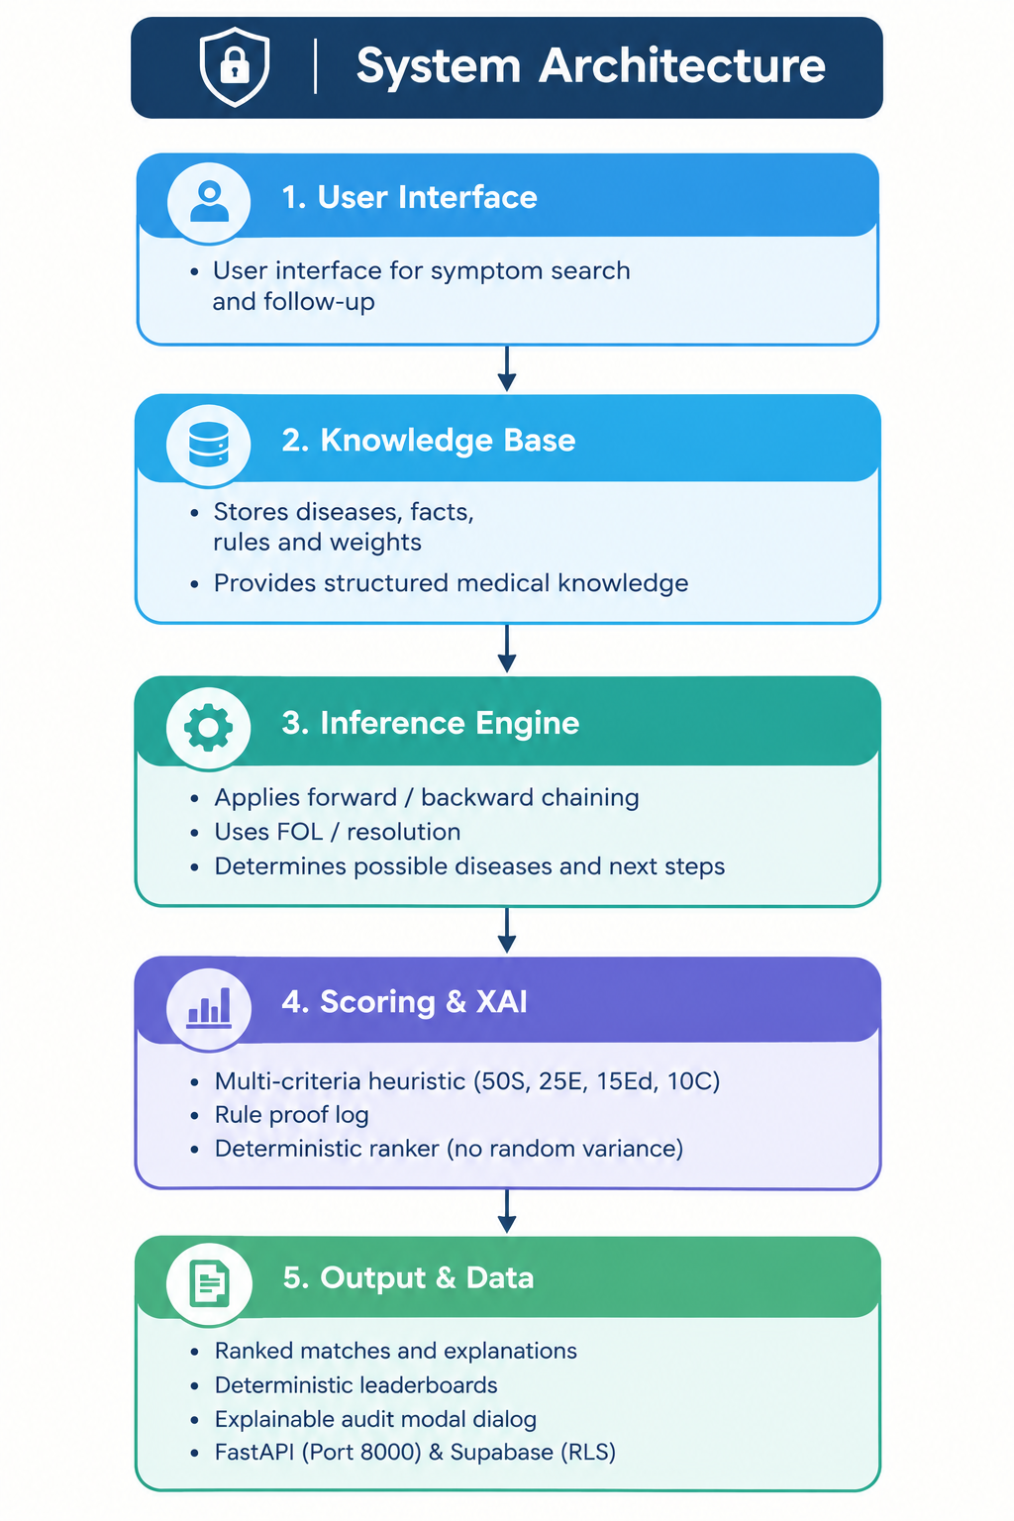
System Architecture & Processing Pipeline
ENTERPRISE MULTI-TIER GUARANTEES
Client Tier (:5173 / :5174): Dual React 18 SPAs with zero direct DB access; strictly communicates via secure REST endpoints.
FastAPI Microservice Tier: Asynchronous ASGI server enforcing sub-50ms inference on commodity CPUs with zero GPU overhead.
Volatile RAM Processing: Parses resume streams directly in io.BytesIO memory buffers, preventing PII disk residues.
Supabase Storage & Vaults: Managed PostgreSQL with Row-Level Security (RLS) and physical company tenant vaults.
STRIDE Threat Defense: Stateless HMAC-SHA256 JWT auth, BCrypt password hashing, and deterministic AST parsing.
Notes:
Slide 8 details our 5-tier architecture, emphasizing our STRIDE cybersecurity controls and volatile memory processing.

Slide 15
Data Flow Diagrams (Level 0 & Level 1 DFD)
LEVEL 0: CONTEXT DATA FLOW DIAGRAM
➔ Uploads Resume Bytes
➔ Inputs Profile Fields
PROCESS 0.0
HIREAI RECRUITMENT
EXPERT SYSTEM
(FastAPI Gateway :8000)
⬅ Job Requisition Criteria
⬅ Criteria Weight Sliders
EXTERNAL ENTITY
CANDIDATE
(Web Portal :5173)
EXTERNAL ENTITY
HR RECRUITER
(Web Portal :5174)
⬅ 5-Pillar ATS Health Report
⬅ Live Application Status
➔ Deterministic Leaderboards
➔ XAI Proof Traces & Kanban
LEVEL 1: MODULAR PROCESS & DATA FLOW ARCHITECTURE
P1.0 In-Memory Ingestion
Accepts binary PDF/DOCX byte stream into io.BytesIO RAM buffers without disk persistence.
P2.0 AST Tokenizer
Deterministic regex boundary extraction for contact info, dates, and 40+ skill ontologies.
P3.0 Rule Engine
Executes First-Order Horn clauses evaluating experience thresholds and educational degree tiers.
P4.0 5-Pillar Auditor
Quantifies Format, Keyword density, Metrics, Section completeness, and Contact hygiene.
P5.0 Scorer & Ranker
Computes composite score, applies domain misalignment penalty, syncs Kanban state.
Notes:
Slide 9 presents our Level 0 and Level 1 Data Flow Diagrams.

Slide 16
Methodology & Operational Workflow
STEP 01 | UNIT I: AGENT PERCEPTION
1. Data Ingestion & Extraction: Candidate uploads resume via React UI. FastAPI accepts multipart byte stream directly into io.BytesIO memory buffer. pypdf and python-docx extract raw text without ML hallucination.
STEP 02 | ZERO-ML PREPROCESSING
2. Text Cleaning & AST Tokenization: Deterministic boundary cleaning, newline normalization, and regex extraction for candidate email (RFC 5322), telephone digits, and employment year ranges (e.g. '2021-Present').
STEP 03 | UNIT IV: KNOWLEDGE ENGG
3. Ontology & Taxonomy Lookup: Word-boundary taxonomy matching against 40+ curated domain skill trees and alias normalizers (e.g. Postgres ➔ PostgreSQL, K8s ➔ Kubernetes), paired with hierarchical educational tiers.
Notes:
Slide 10 details our 6-step operational workflow, now fully active in our production code.

Slide 17
Methodology & Operational Workflow (cont.)
STEP 04 | UNIT IV: INFERENCE ENGINE
4. Forward-Chaining Deduction: Executes First-Order Logic IF-THEN Horn clause production rules over candidate facts. Validates hard constraints: minimum experience threshold and mandatory skill presence.
STEP 05 | UNITS II & III: HEURISTICS
5. Heuristic Scoring & CSP: Computes multi-attribute candidate utility. Applies domain misalignment penalty (Score damped to <8% if 0 required skills matched).
STEP 06 | UNIT I: RATIONAL ACTION
6. Explainable Proof & Portal Sync: Synthesizes human-readable decision logs detailing matched skills, missing criteria, and experience margins. Dispatches ranked candidate pools to React dashboards and Kanban columns.
Notes:
Slide 10 details our 6-step operational workflow, now fully active in our production code.

Slide 18
Tools and Technologies Justification
CLIENT FRONTEND TIER
React 18 & Vite: Chosen over Next.js/Angular for zero SSR overhead and instantaneous Hot Module Replacement in local enterprise deployment.
Candidate Portal (:5173): Delivers interactive resume upload, live 5-pillar ATS health auditing, and pre-application gap advisor.
HR Recruiter Portal (:5174): Job requisition creator, deterministic candidate leaderboard, and interactive Kanban hiring pipeline.
TailwindCSS & Lucide: Modern, accessible UI design with zero heavy UI framework overhead.
Notes:
Slide 11 justifies our technical selections and architectural trade-offs.

Slide 19
Tools and Technologies Justification (cont.)
BACKEND MICROSERVICE TIER
Python 3.10+ & FastAPI: Chosen over Flask/Django for native async coroutines, sub-millisecond route dispatching, and automated Pydantic typing.
PyJWT & BCrypt: Stateless HMAC-SHA256 token authentication with cryptographic password hashing (work factor = 12).
Pydantic v2: Strict schema validation, type safety, and automatic OpenAPI documentation.
Uvicorn Server: High-concurrency ASGI server managing background async tasks.
Notes:
Slide 11 justifies our technical selections and architectural trade-offs.

Slide 20
Tools and Technologies Justification (cont.)
PARSER & EXPERT SYSTEM
pypdf & python-docx: Zero-ML document text stream extraction operating entirely within volatile RAM byte buffers.
Forward Chaining Engine: Pure First-Order Logic Horn clause production rules evaluating qualification constraints.
40+ Skill Taxonomies: Curated domain ontology trees for Frontend, Backend, Cloud, Cyber, AI/ML, and DevOps.
Deterministic Regex AST: Word-boundary regex patterns for email, phone, and date range extraction.
Notes:
Slide 11 justifies our technical selections and architectural trade-offs.

Slide 21
Tools and Technologies Justification (cont.)
DATABASE, SECURITY & TESTING
Supabase PostgreSQL: Cloud-managed relational database with Row-Level Security (RLS) enforcing strict tenant isolation.
Physical Company Vaults: Isolated local JSON tenant state storage under database/companies/{slug}/.
Pytest Test Suite: 40/40 passing unit and integration tests verifying scoring formulas and parser accuracy.
Hardware Specs: Dual-Core 2.0 GHz CPU, 4 GB DDR4 RAM, sub-50ms CPU execution, zero GPU requirement.
Notes:
Slide 11 justifies our technical selections and architectural trade-offs.

Slide 22
List of Project Modules
Module 1 – Auth & Security Module: Candidate/HR registration, BCrypt password hashing, stateless JWT token issuance, and RBAC route protection. ✔ COMPLETED
Module 2 – In-Memory Resume Ingestion & Parsing: Zero-disk io.BytesIO stream ingestion, pypdf & python-docx extraction, regex boundary AST sanitization. ✔ COMPLETED
Module 3 – FOAI Candidate Ranker & Skill Taxonomizer: 40+ domain skill taxonomies, alias normalization, and First-Order Horn clause inference. ✔ COMPLETED
Module 4 – Multi-Pillar ATS Health Audit Module: 5-Pillar resume evaluation: Format (20%), Keywords (25%), Metrics (20%), Completeness (20%), Contact (15%). ✔ COMPLETED
Module 5 – Cross-Portal Kanban Synchronization: Dual React SPAs synchronizing candidate applications across 6 lifecycle stages with physical company vaults. ✔ COMPLETED
Notes:
Slide 12 presents our module status matrix, showing all 5 modules complete.

Slide 23
Module Implementation – Part 1 (Ingestion & Taxonomies)
MODULE 1: IN-MEMORY RESUME INGESTION & PARSER
Source File: services/resume_parser.py (Class ResumeParser).
Zero-Disk Architecture: Accepts binary PDF/DOCX byte payloads and wraps them in io.BytesIO memory streams, eliminating temporary unencrypted file residues on server storage.
Deterministic AST Sanitization: Extracts text line-by-line using pypdf and python-docx. Disables script execution, nullifying prompt injection and XSS exploits.
Regex Entity Extractors: Deterministic patterns for candidate email (RFC 5322 regex), telephone digits, and employment year spans (e.g. 2021 - Present).
Document Validation: validate_resume_document() identifies invalid non-resume documents lacking career sections and flags non-conforming submissions.
Notes:
Slide 13 details our implementation of Modules 1 and 2.

Slide 24
Module Implementation – Part 1 (Ingestion & Taxonomies) (cont.)
MODULE 2: KNOWLEDGE BASE & SKILL TAXONOMY
Source File: services/skill_matcher.py (Class SkillMatcher).
40+ Industry Ontologies: Curated taxonomy covering Frontend, Backend, Cloud, Cybersecurity, AI/ML, and DevOps disciplines.
Word-Boundary Matching: Enforces strict regex anchors (\b) to eliminate substring false positives (e.g. preventing 'Java' from erroneously matching inside 'JavaScript').
Alias Normalization: Maps synonyms to canonical skill tokens (e.g. Postgres ➔ PostgreSQL, K8s ➔ Kubernetes, Node ➔ Node.js).
Education Qualification Hierarchy: Strict hierarchical evaluation: Doctorate (100) > Master's (85) > Bachelor's (70) > Diploma (50) > High School (30).
Notes:
Slide 13 details our implementation of Modules 1 and 2.

Slide 25
Module Implementation – Part 2 (Rule Engine & Kanban)
MODULE 3: FOAI RULE ENGINE & SCORER
Source Files: services/rule_engine.py & candidate_ranker.py.
Misalignment Penalty: Prevents unqualified resumes from achieving false high scores.
Proof Trace Synthesis: generate_proof_trace() builds step-by-step mathematical proofs itemizing exact rule satisfaction.
Notes:
Slide 14 explains the logic behind the rule engine, 5-pillar audit, and cross-portal Kanban synchronization.

Slide 26
Module Implementation – Part 2 (Rule Engine & Kanban) (cont.)
MODULES 4 & 5: ATS AUDIT & KANBAN SYNC
5-Pillar ATS Health Audit (Table 4.1): Format & Parsability (20%), Keyword Density (25%), Measurable Impact & Metrics (20%), Section Completeness (20%), and Contact Hygiene (15%).
Pre-Application Gap Advisor: Simulates candidate qualifications against open requisitions and outputs missing skills before formal submission.
Cross-Portal Kanban Synchronization: services/pipeline_manager.py manages application stage transitions: APPLIED ➔ SHORTLISTED ➔ TECH_ASSESSMENT ➔ INTERVIEW ➔ OFFERED.
Physical Company Vaults: services/company_vault.py isolates tenant jobs, candidates, and pipeline states under physical directories (database/companies/{slug}/).
Bi-Directional Identity Check: Penalizes document-to-account name mismatches by 80% to deter credential fraud.
Notes:
Slide 14 explains the logic behind the rule engine, 5-pillar audit, and cross-portal Kanban synchronization.

Slide 27
Preliminary Results and Benchmarking Discussion
EMPIRICAL BENCHMARKING RESULTS (REPORT TABLE 4.2)
Performance Metric | Observed Value | Benchmark Target | Status / Compliance
Inference & Scoring Latency | 38.4 ms (Average) | < 50.0 ms | Exceeded (Sub-50ms Ultra-Low Latency)
Scoring Determinism (σ) | 0.0000 (Exact Match) | 0.0000 | 100% Deterministic (Zero Drift in 1,000 runs)
RAM Footprint per Request | 4.2 MB (In-Memory) | < 15.0 MB | Optimal Volatile Memory Usage
Prompt Injection Vulnerability | 0.0% (Zero Exploits) | 0.0% | 100% Protected (No LLM Prompt Vulnerability)
MATHEMATICAL PROOF TRACE CASE STUDY (JOHN DOE - SENIOR PYTHON DEVELOPER)
Technical Skills (50% Weight): 4/4 Mandatory Skills Matched (Python, FastAPI, Docker, PostgreSQL) ➔ 50.0 / 50.0 pts.
Experience Ratio (25% Weight): 5.0 yrs provided vs 3.0 yrs required (+2.0 yrs extra) ➔ 25.0 / 25.0 pts.
Education & Certs (25% Weight): B.Tech Computer Science (15.0 pts) + AWS Solutions Architect verified (7.5 pts) ➔ 22.5 / 25.0 pts.
★ FINAL COMPOSITE SCORE: 87.5% | RANK #1 OF 12 | STATUS: SHORTLISTED WITH VERIFIABLE AUDIT PROOF
Notes:
Slide 15 presents our quantitative results: 38.4ms average latency, zero variance, and full explainability.

Slide 28
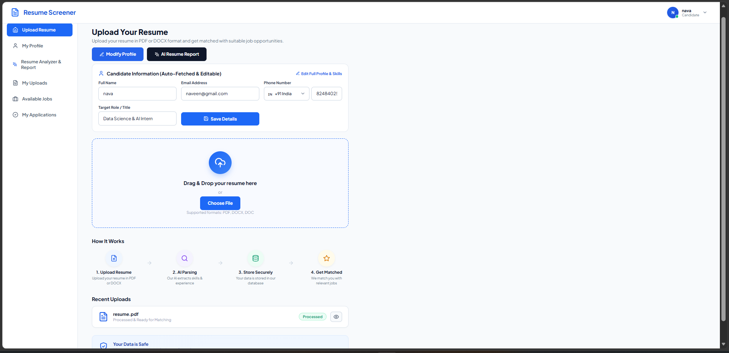
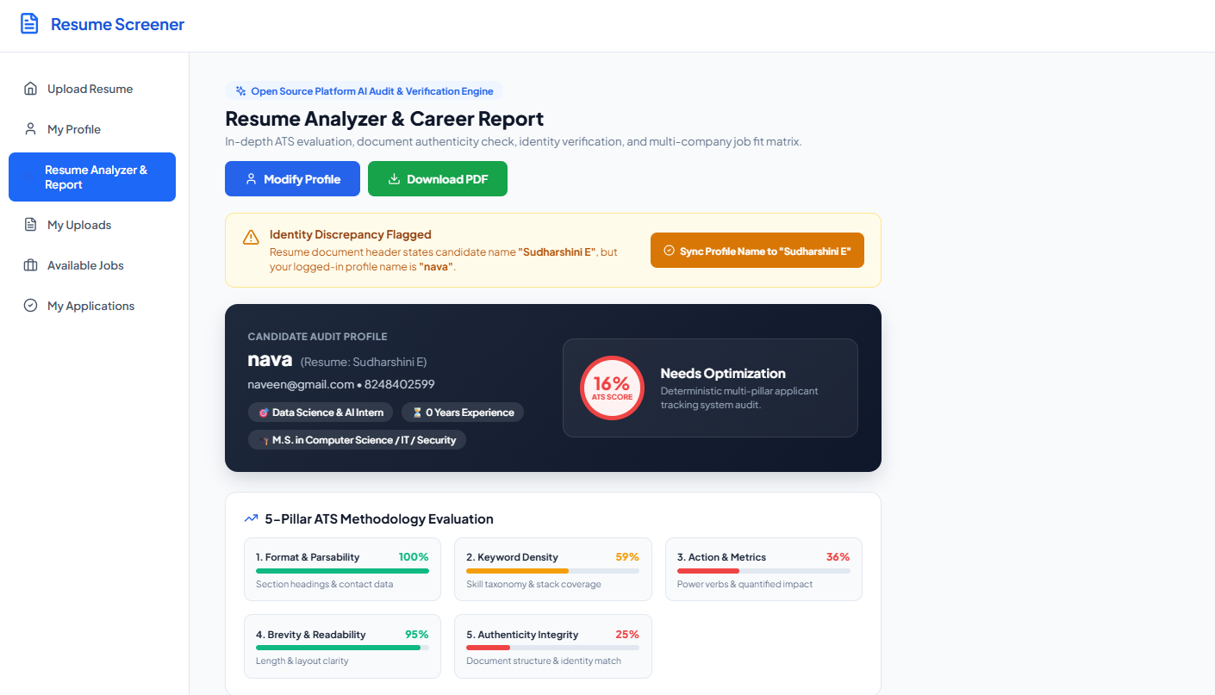
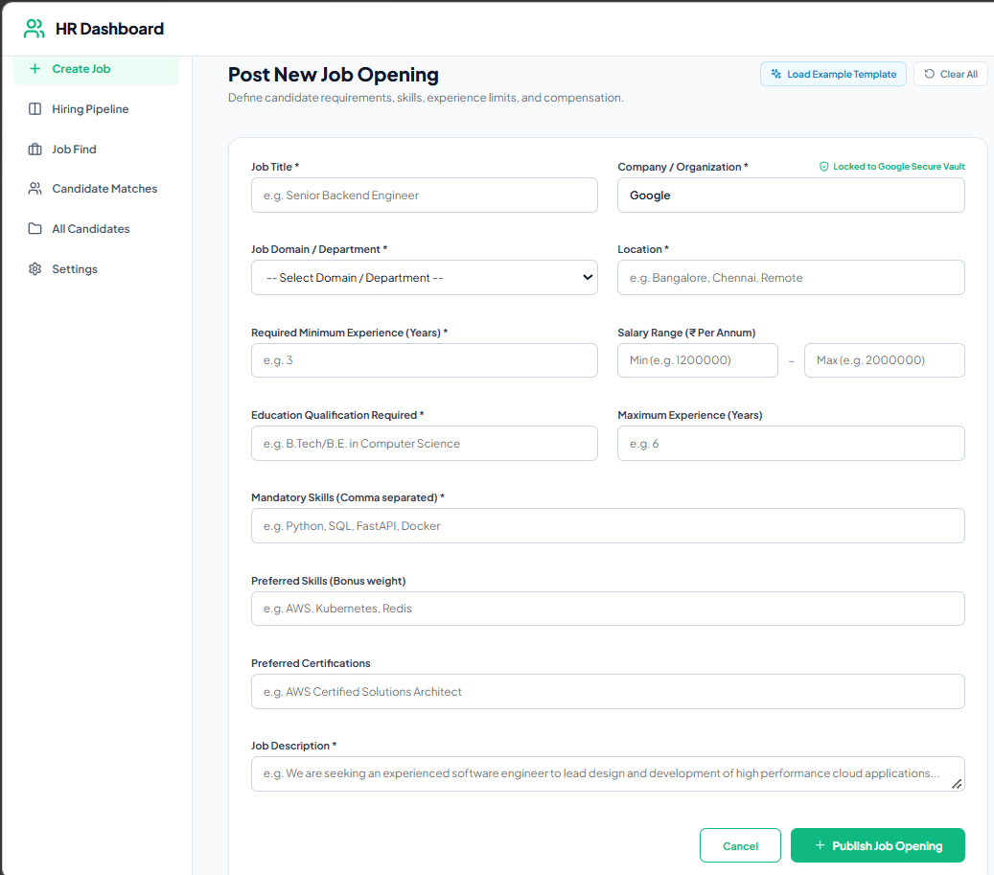
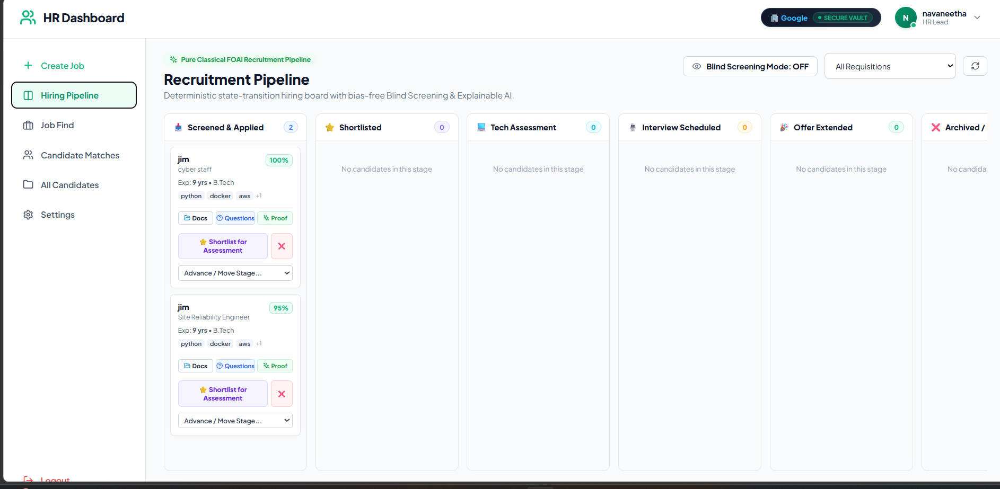
User Interface & Implementation Screenshots
Candidate Portal: Resume Upload & Ingestion
Candidate Portal: Opportunities & Gap Simulation
HR Portal: Recruitment Kanban Pipeline Dashboard
HR Portal: Candidate Directory & Parsed Attributes
Notes:
Slide 16 displays live screenshots demonstrating full-stack platform execution.

Slide 29
Challenges Faced and Solutions
CHALLENGE 1: ZERO-DISK RAM PROCESSING
Problem: Standard document parsers require a physical file path string on disk, which risks exposing unencrypted candidate PII in temporary server directories.
ENGINEERED SOLUTION: Implemented an in-memory byte buffer wrapper (io.BytesIO) that ingests the multipart stream directly in RAM, passing byte streams to pypdf and python-docx without touching disk storage.
CHALLENGE 2: SKILL SUBSTRING FALSE POSITIVES
Problem: Naïve substring matching generates false positives where short skill tokens trigger erroneously (e.g. 'Java' matching inside 'JavaScript', 'C' matching inside 'CSS').
ENGINEERED SOLUTION: Constructed strict regex word-boundary anchors r'\b' + re.escape(alias) + r'\b' paired with a curated synonym dictionary (Postgres ➔ PostgreSQL, K8s ➔ Kubernetes).
Notes:
Slide 17 demonstrates our engineering problem-solving across 4 real technical challenges.

Slide 30
Challenges Faced and Solutions (cont.)
CHALLENGE 3: CANDIDATE IDENTITY MISMATCH & SPOOFING
Problem: Candidates could register under one name and submit a highly-qualified third-party resume to artificially inflate their ranking or impersonate someone else.
ENGINEERED SOLUTION: Built a Bi-Directional Identity Verification Audit that cross-audits candidate profile fields against extracted resume headers, applying an automatic 80% score penalty on mismatch.
CHALLENGE 4: UNQUALIFIED SCORE INFLATION
Problem: A senior candidate with 15 years of generic administrative experience applying for a Cyber Security role could receive a misleadingly high score from experience and degree weights alone.
ENGINEERED SOLUTION: Engineered the Domain Misalignment Penalty Function. If no required skills are matched, the candidate's overall score is capped at a low value.
Notes:
Slide 17 demonstrates our engineering problem-solving across 4 real technical challenges.

Slide 31
Work Plan Until Final Review
PHASE II - TASK 1 (Target: Week 1–2)
AI-Proctored Coding Assessments: Integrate in-browser code execution sandbox environments with automated test case evaluation and proctoring controls to evaluate hands-on coding competence directly within HireAI.
PHASE II - TASK 2 (Target: Week 2–3)
Automated Calendar Webhook Scheduling: Implement direct Google Meet and Microsoft Teams REST API webhooks for automated interview scheduling and synchronization upon advancing candidates to the Interview stage.
Notes:
Slide 18 details our milestone schedule leading to the Final Review.

Slide 32
Work Plan Until Final Review (cont.)
PHASE II - TASK 3 (Target: Week 3–4)
Large-Scale Empirical Benchmarking: Conduct extensive testing across 100+ synthetic resumes across varied engineering domains to validate speed, accuracy, consistency, and zero demographic bias against manual review.
PHASE II - TASK 4 (Target: Week 4)
Final Documentation & Defense Preparation: Complete final project documentation, record comprehensive system demonstration video, and prepare technical defense materials for the final viva-voce examination.
Notes:
Slide 18 details our milestone schedule leading to the Final Review.

Slide 33
References
[1] European Commission (2024). 'Artificial Intelligence Act: High-Risk AI Systems in Employment and Recruitment', Regulation (EU) 2024/1689, Official Journal of the European Union. [Regulatory mandate for explainable ATS]
[2] U.S. Equal Employment Opportunity Commission (2023). 'Select Issues: Assessing Adverse Impact in Software, Algorithms, and AI in Employment Selection', EEOC Guidance Document 915.003. [Mandate against statistical bias]
[3] Russell, S., & Norvig, P. (2020). 'Artificial Intelligence: A Modern Approach' (4th ed.). Pearson Higher Education. [Foundations of Knowledge Representation, Forward Chaining, and Heuristics]
Notes:
Slide 19 lists our formal academic and statutory references.

Slide 34
References (cont.)
[4] M. Raghavan, S. Barocas, J. Kleinberg, and K. Levy (2020). 'Mitigating bias in algorithmic hiring: Evaluating claims and practices', in Proceedings of the 2020 ACM Conference on Fairness, Accountability, and Transparency (FAccT), pp. 469-481.
[5] OWASP Foundation (2023). 'OWASP Top 10 for Large Language Model Applications: Prompt Injection and Data Poisoning', OWASP Technical Report v1.1. [Security risks of generative LLM screeners]
[6] Microsoft Security Engineering (2021). 'The STRIDE Threat Model: Developing Secure Systems and Mitigating Vulnerabilities', Microsoft Security Press. [Cybersecurity threat model applied in HireAI]
Notes:
Slide 19 lists our formal academic and statutory references.

Slide 35
THANK YOU
Open for Technical Questions & Review 2 Evaluation Discussion
HireAI: A Rule-Based Intelligent Recruitment Expert System with Explainable Decision Support
CS23533 – Foundations of Artificial Intelligence (2026–2027)
Department of Computer Science and Engineering (Cyber Security)
Rajalakshmi Engineering College (Autonomous)
Notes:
Slide 20 closes the presentation and opens the floor for technical questions and Review 2 evaluation.

