Slide 1
Introduction to Machine Learning
Lecture 1 — what learning from data means
• Machine learning: algorithms that improve with experience
• Task T, experience E, performance measure P
• Three paradigms: supervised, unsupervised, reinforcement
Notes:
Explain: Machine learning: algorithms that improve with experience / Task T, experience E, performance measure P / Three paradigms: supervised, unsupervised, reinforcement

Slide 2
Supervised vs Unsupervised
The two workhorses
• Supervised: labelled (x, y) pairs — classification & regression
• Unsupervised: unlabelled data — clustering, dimensionality reduction
• Reinforcement: agent, environment, reward signal
Notes:
Explain: Supervised: labelled (x, y) pairs — classification & regression / Unsupervised: unlabelled data — clustering, dimensionality reduction / Reinforcement: agent, environment, reward signal

Slide 3
Linear Regression
Fitting a line to data
• Prediction: y_hat = w·x + b
• Loss: mean squared error (MSE)
• Closed form: normal equations w = (X^T X)^{-1} X^T y
• O(d^3) inversion — gradient descent often preferred
Notes:
Explain: Prediction: y_hat = w·x + b / Loss: mean squared error (MSE) / Closed form: normal equations w = (X^T X)^{-1} X^T y / O(d^3) inversion — gradient descent often preferred

Slide 4
Gradient Descent
The optimization engine
• theta := theta - alpha * grad L(theta)
• Learning rate alpha: too small = slow, too large = diverge
• SGD uses mini-batches for cheaper steps
Notes:
Explain: theta := theta - alpha * grad L(theta) / Learning rate alpha: too small = slow, too large = diverge / SGD uses mini-batches for cheaper steps

Slide 5
Overfitting & Regularization
When memorizing beats learning
• Overfitting: great on train, poor on new data
• L2 (ridge): lambda * ||w||^2 — smooth shrinkage
• L1 (lasso): lambda * ||w||_1 — sparse, feature selection
• Tune lambda on validation, report on test
Notes:
Explain: Overfitting: great on train, poor on new data / L2 (ridge): lambda * ||w||^2 — smooth shrinkage / L1 (lasso): lambda * ||w||_1 — sparse, feature selection / Tune lambda on validation, report on test

Slide 6
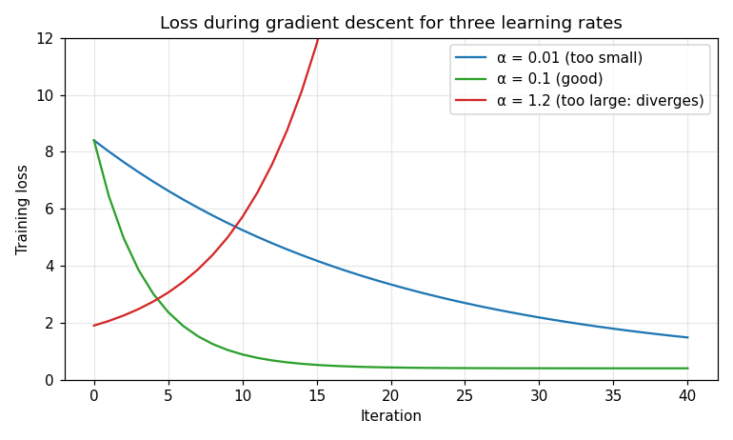
Choosing the Learning Rate
Reading the loss curve
• Plot the training loss every iteration
• Compare three step sizes side by side
Notes:
Walk through the figure with the class.

