Slide 1
PROJECT
SALES PERFORMANCE
ANALYSIS
An end-to-end data analytics project using Python, Power BI, Git and GitHub
Submitted by NAVANEETH P
B.Tech Computer Science and Engineering
College of Engineering Trikaripur
2026

Slide 2
Project at a Glance
Turning sales records into useful business insights
TOTAL SALES
DISTINCT ORDERS
TOP CATEGORY
TOP REGION
₹308,750
39
Electronics
South
Sales in the dataset
Unique order IDs
₹233,500
₹131,900
• Prepared and analyzed sales records containing order, customer, product, quantity, price, and region fields.
• Used Python for data preparation, exploratory analysis, and six visualizations.
• Built an interactive Power BI dashboard with KPIs, charts, and slicers.
• Summarized findings and recommendations for sales and inventory decisions.
WEEK 6 CAPSTONE • SALES DATA ANALYTICS
02

Slide 3
Problem Statement & Objectives
The business questions guiding the project
PROBLEM
OBJECTIVES
Raw sales records are difficult to interpret directly. Analysis is needed to identify leading products, category performance, regional differences, and sales trends.
• Inspect and prepare the dataset.
• Handle missing or duplicate records where appropriate.
• Explore descriptive statistics, patterns, correlations, and potential outliers.
• Create charts and an interactive dashboard.
• Translate results into practical recommendations.
WEEK 6 CAPSTONE • SALES DATA ANALYTICS
03

Slide 4
Dataset & Technology Stack
Fields used and tools applied
DATASET FIELDS
TOOLS
• Order ID — unique order identifier
• Order Date — order date
• Customer Name — customer field
• Product and Category — item details
• Quantity and Unit Price — volume and price
• Region — sales geography
• Sales Amount — Quantity × Unit Price
• Python and Pandas — inspection, cleaning, calculations
• Matplotlib and Seaborn — visualizations
• Power BI and DAX — dashboard and KPI measures
• Git and GitHub — version control and project sharing
• CSV, PBIX, and PPTX — data and deliverables
WEEK 6 CAPSTONE • SALES DATA ANALYTICS
04

Slide 5
End-to-End Project Workflow
Eight stages in the capstone assignment
01
02
03
04
Git & GitHub
Git workflow
Data preparation
EDA
Repository setup
Clone, add, commit, push, pull
Inspect and clean data
Statistics and patterns
05
06
07
08
Visualization
Power BI
Business insights
Documentation
Six Python charts
Dashboard and DAX
Findings and actions
README and presentation
WEEK 6 CAPSTONE • SALES DATA ANALYTICS
05

Slide 6
Data Preparation & Quality Checks
Making the dataset suitable for analysis
• Inspected sample records, row and column counts, and data types.
• Checked missing values and duplicate records.
• Handled missing or incorrect values where appropriate.
• Reviewed date and numeric fields for analysis.
• Calculated Sales Amount = Quantity × Unit Price.
• Used the prepared dataset for EDA, visualizations, and Power BI.
Data quality note: investigate records labelled “Unknown” and correct them only when reliable source information is available.
WEEK 6 CAPSTONE • SALES DATA ANALYTICS
06

Slide 7
Exploratory Data Analysis — Six Charts
Each chart addresses a different sales question
01
Sales by Category
02
Sales by Region
Which categories contribute most revenue?
Where are sales strongest or weakest?
03
Monthly Sales Trend
04
Top 10 Products
How do sales change over time?
Which products generate the most sales?
05
Quantity vs. Unit Price
06
Sales Amount Distribution
How do quantity and price relate?
How widely do sales values vary?
WEEK 6 CAPSTONE • SALES DATA ANALYTICS
07

Slide 8
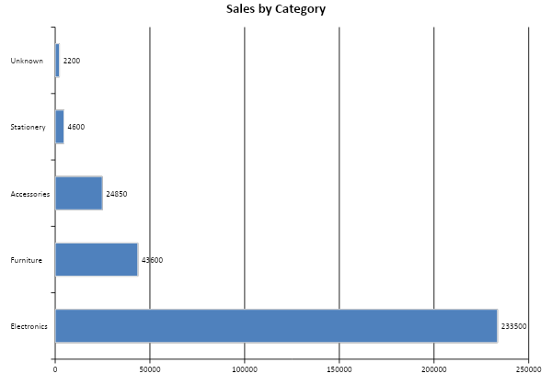
Finding 1 — Electronics Leads Category Sales
Category totals in the selected dataset
₹233,500
Electronics sales
• Electronics is the largest category by sales.
• Laptops, monitors, and printers are major contributors.
• Use demand patterns to support stock and supplier planning.
WEEK 6 CAPSTONE • SALES DATA ANALYTICS
08

Slide 9
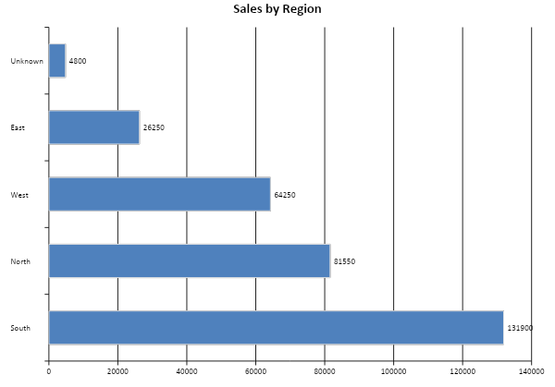
Finding 2 — South Region Has Highest Sales
Regional totals show differences in performance
₹131,900
South region sales
• South recorded the highest sales.
• North and West were the next strongest regions.
• Investigate lower East sales before deciding on targeted actions.
WEEK 6 CAPSTONE • SALES DATA ANALYTICS
09

Slide 10
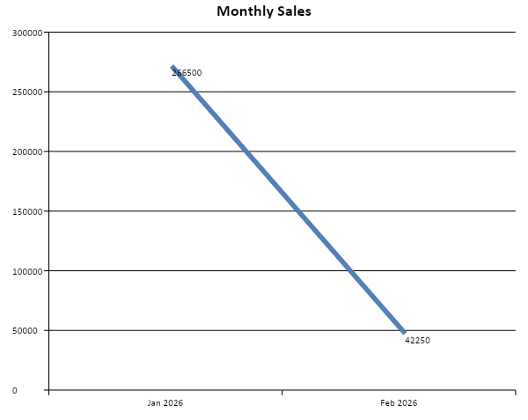
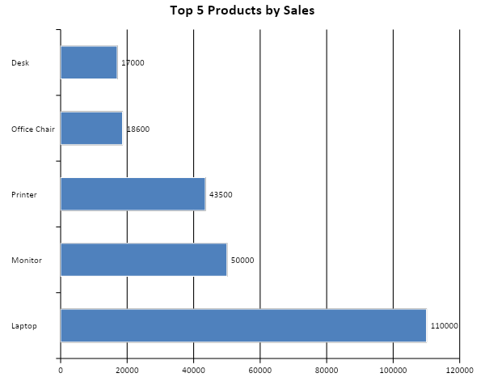
Finding 3 — Monthly Sales & Leading Products
Sales totals for the available records
Caution: February includes fewer recorded days, so this is not a full-month comparison.
WEEK 6 CAPSTONE • SALES DATA ANALYTICS
10

Slide 11
Power BI Dashboard
Interactive reporting for sales performance
TOTAL SALES
TOTAL ORDERS
QUANTITY SOLD
DASHBOARD FEATURES
₹308.75K
39
Sum of qty
• KPI cards for key performance indicators.
• Charts for category, region, monthly trend, and top products.
• Slicers for Region, Category, and Order Date.
• DAX measures for reusable summary calculations.
DAX MEASURES
Total Sales = SUM('cleaned_sales_dataset'[Sales Amount])
Total Orders = DISTINCTCOUNT('cleaned_sales_dataset'[Order ID])
Total Quantity Sold = SUM('cleaned_sales_dataset'[Quantity])
Dashboard preview is schematic; open the actual .pbix file to view the interactive report.
WEEK 6 CAPSTONE • SALES DATA ANALYTICS
11

Slide 12
Key Findings
The strongest signals in the sales dataset
TOTAL SALES
DISTINCT ORDERS
TOP PRODUCT
₹308,750
39
Laptop
All selected records
Unique order IDs
₹110,000 in sales
TOP CATEGORY
TOP REGION
RECORDED PERIOD
Electronics
South
Jan–Feb 2026
₹233,500
₹131,900
Partial February
WEEK 6 CAPSTONE • SALES DATA ANALYTICS
12

Slide 13
Business Recommendations
Actions suggested by the analysis
• Prioritize inventory planning for leading products such as laptops, monitors, and printers.
• Use Electronics category performance to inform planning while monitoring other categories.
• Investigate regional differences, especially lower sales in the East region.
• Review records labelled Unknown and correct them only when source data supports it.
• Refresh the Power BI dashboard regularly and compare equivalent periods.
• Validate these patterns with more data before major pricing, inventory, or expansion decisions.
WEEK 6 CAPSTONE • SALES DATA ANALYTICS
13

Slide 14
CONCLUSION
From raw data to
business insight
PROJECT DELIVERABLES
• Original and cleaned datasets
• Python analysis scripts
• Six data visualizations
• Power BI dashboard (.pbix)
• README documentation
• Project presentation
This project demonstrates an end-to-end workflow combining data preparation, exploratory analysis, Python visualization, Power BI reporting, version control, and documentation.
Thank you
NAVANEETH P • College of Engineering Trikaripur
14

