Slide 1
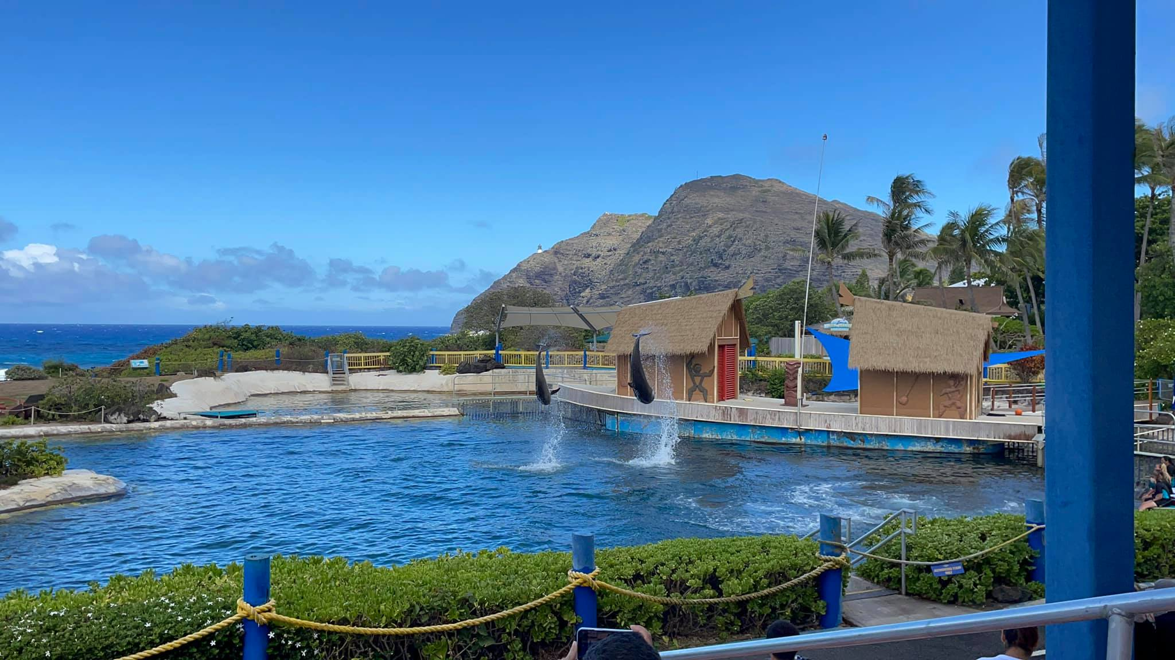
Hawaii Dream Vacation

