Slide 1















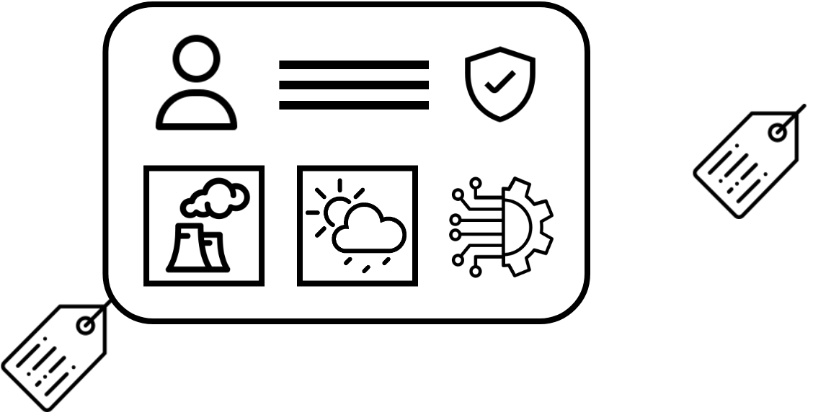
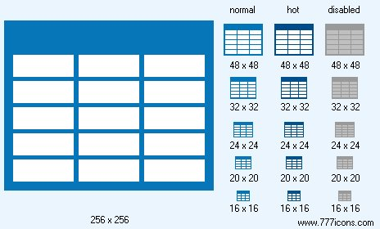

Rare diseases: making environmental health studies’ data as open as possible
Albert Navarro-Gallinad, Maria Christofidou, Solange Gonzalez Chiappe, Fabrizio Orlandi, Nathan Lea, Dipak Kalra and Declan O’Sullivan
20th International Vasculitis and ANCA Workshop 2022
Key message
Data protection problem!
We have shown how rare disease research data can be made Findable, Accessible, Interoperable and Reusable (FAIR) whilst ensuring good data protection practices through semi-automated support for researchers.
Location and time from environmental data
Context from a person’s rare disease
Data protection risk without effective anonymization
Our solution: an approach that yields data that can be published as open as possible!
</>
Region-season alike example data as a data table and a graph
Transparent metadata record as a graph
This research was conducted with the financial support of HELICAL as part of the European Union’s Horizon 2020 research and innovation programme under the Marie Sklodowska-Curie Grant Agreement No. 813545 and No. 713567 at the ADAPT Centre for Digital Content Technology (grant number 13/RC/2106 P2) at Trinity College Dublin, collaborating with the European Institute for Innovation through Health Data (i~HD).

