Slide 1
Emissivity Measurements
Board 2

Slide 2
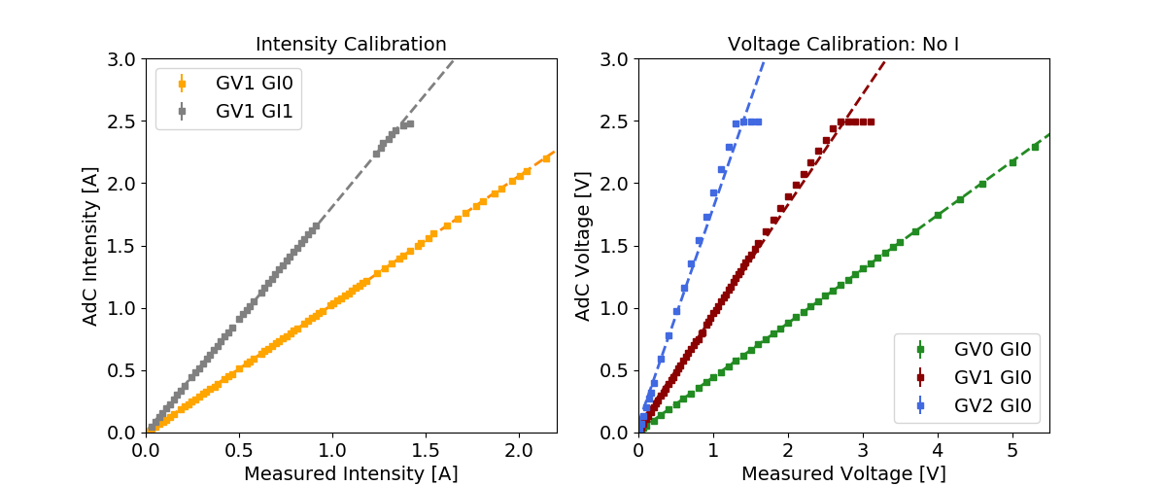
The measuring circuits have been calibrated for the range of intensities and voltages of interest. Calibration performed with two external mustimeters for direct Intensity and Voltage measurements on wire.
All the following measurements have been corrected to account for nonlinearities in the measuring system.
GV1GI0: Iadc = -0,00465 + 1,03126 * Imeas
GV1GI1: Iadc = 0,00279826 + 1,80851 * Imeas
GV0GI1: Vadc = 0,012721 + 0,43219 * Vmeas
GV1GI1: Vadc = 0,05580 + 0,885568 * Vmeas
GV2GI1: Vadc = 0,07591 + 1,7285 * Vmeas

Slide 3
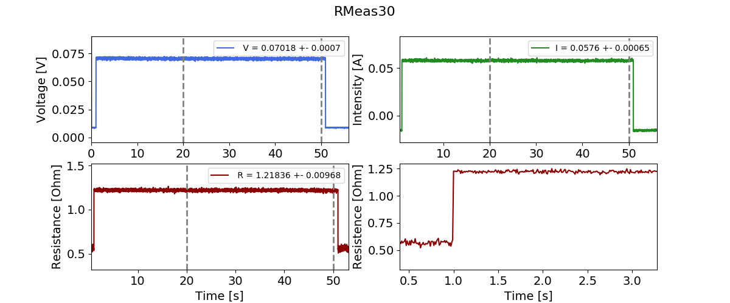
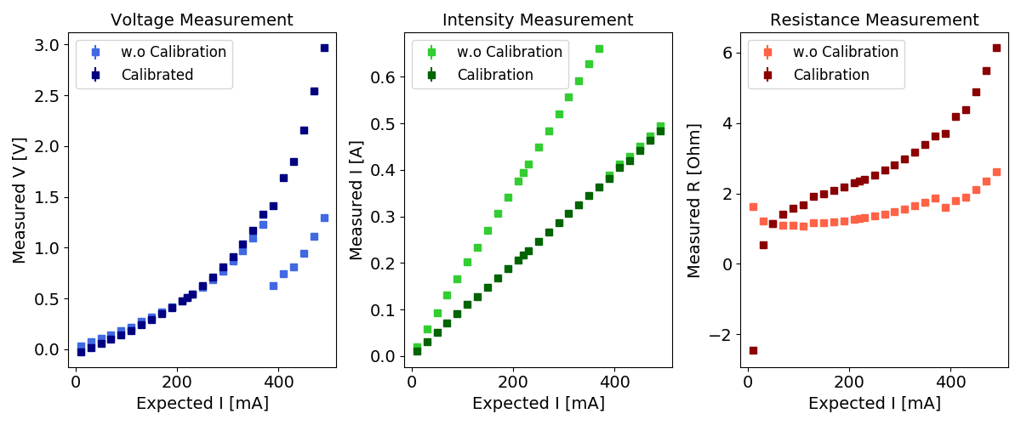
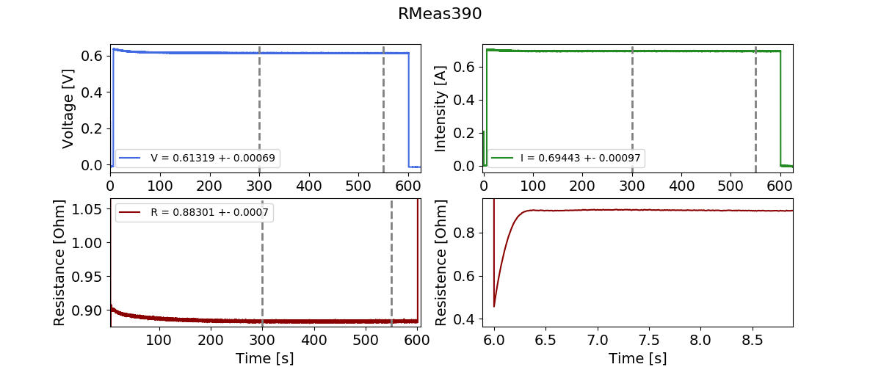
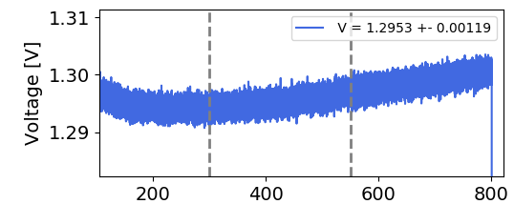
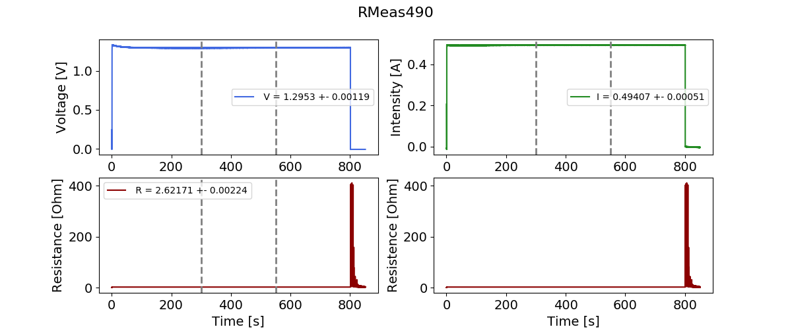
From 10 mA to 390 mA: GV1GI1
From 390 mA onwards: GV0GI0
Measurement1: WAu 40um Not vacuum
Even if intensity is correctly given, results in voltage start to fluctuate, other elements in the circuit are getting very hot….

Slide 4
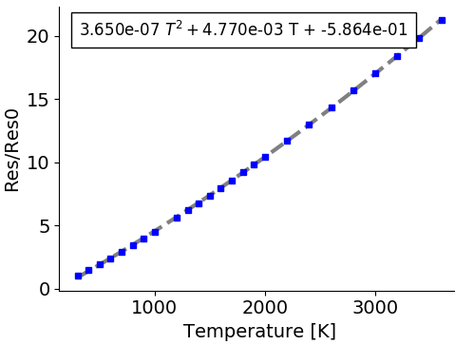
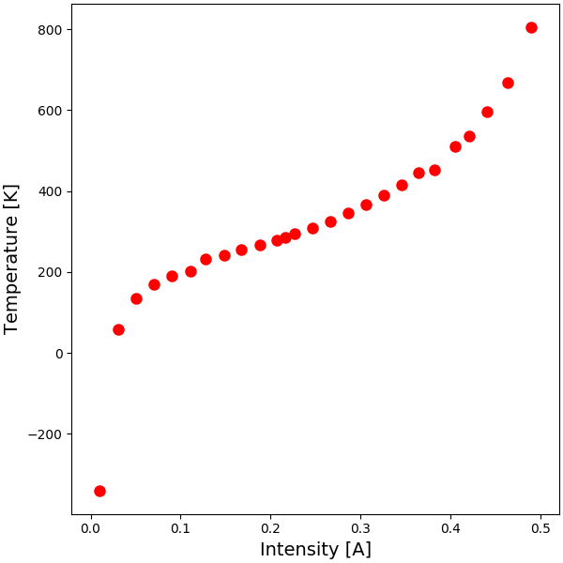
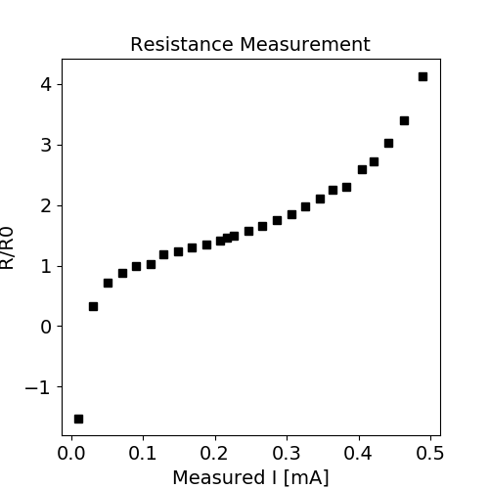
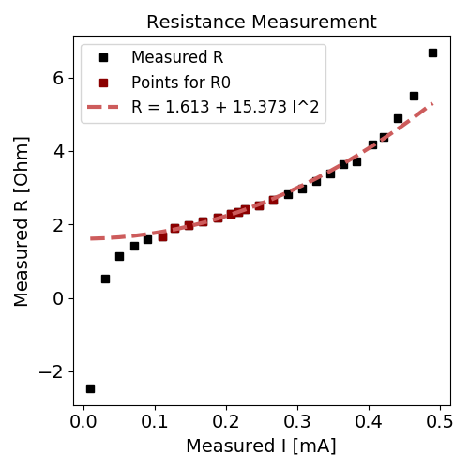
Measurement1: WAu 40um Not vacuum
Plot of Literature R/R0 vs T
Try to redo small intensity measurements….

Slide 5
Measurement3: WAu 100um No vacuum

Slide 6
To do the same with the rest of the Materials.
Carbon (Try)
Tungsten (No gold)
And the different radiuses if possible.

Slide 7
Effects of vacuum in measurements: Convection and Oxidation

Slide 8
Study of tao, how long it takes for intensity to stabilize as function of temperature.

