Slide 1
Emissivity Measurements
Board 2

Slide 2
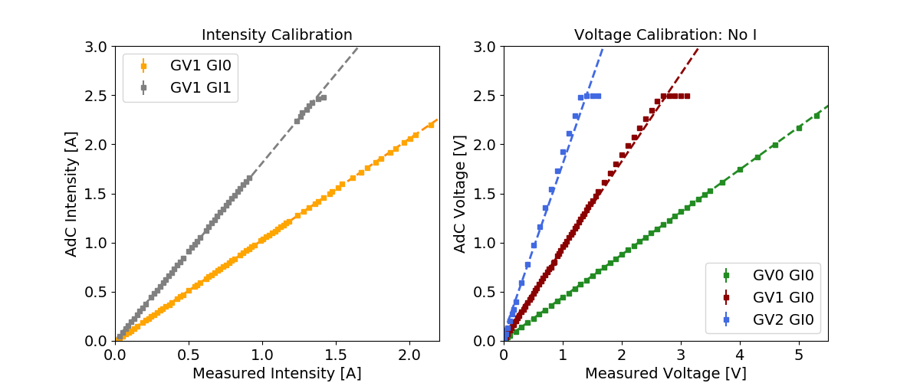
The measuring circuits have been calibrated for the range of intensities and voltages of interest. Calibration performed with two external mustimeters for direct Intensity and Voltage measurements on wire.
All the following measurements have been corrected to account for nonlinearities in the measuring system.
GV1GI0: Iadc = -0,00465 + 1,03126 * Imeas
GV1GI1: Iadc = 0,00279826 + 1,80851 * Imeas
GV0GI1: Vadc = 0,012721 + 0,43219 * Vmeas
GV1GI1: Vadc = 0,05580 + 0,885568 * Vmeas
GV2GI2: Vadc = 0,07591 + 1,7285 * Vmeas

