Slide 1
Hand Gesture Recognition Team name: NAND
Team Members
Navateja Cherukuri
Durga Vara Prasad Reddy Maryada
Navya Lakshmi Kusam
Sai Venkata Anudeep Sanchula

Slide 2
Objective
The main objective of this project is to recognize the hand gestures.
The image is captured from the camera and the hand gesture captured in the image is predicted.
In this project we are going to train the data using deep learning modules

Slide 3
Dataset
Source : Kaggle
Datasets
Hand Gesture Classification
Sign Language for Numbers
Sign Language Gesture Images Dataset

Slide 4

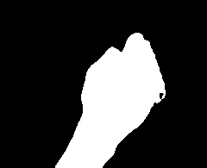

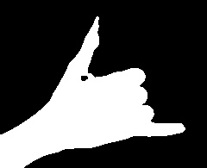


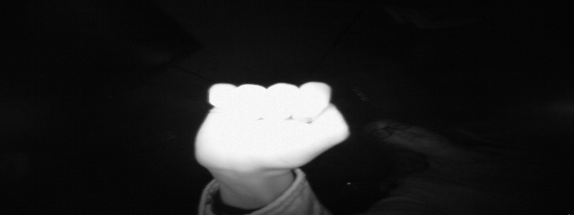

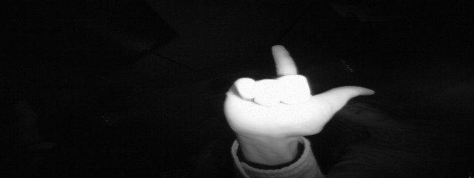







Hand Gestures

Slide 5
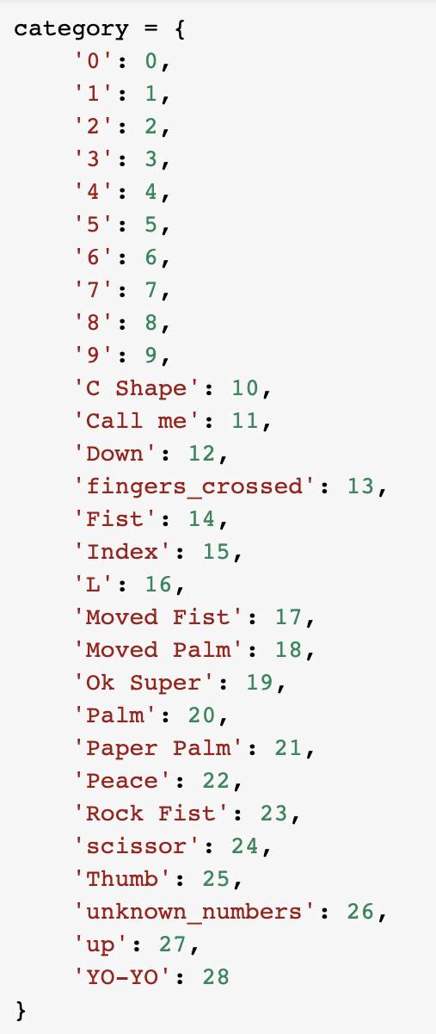
Hand Gesture Categories

Slide 6
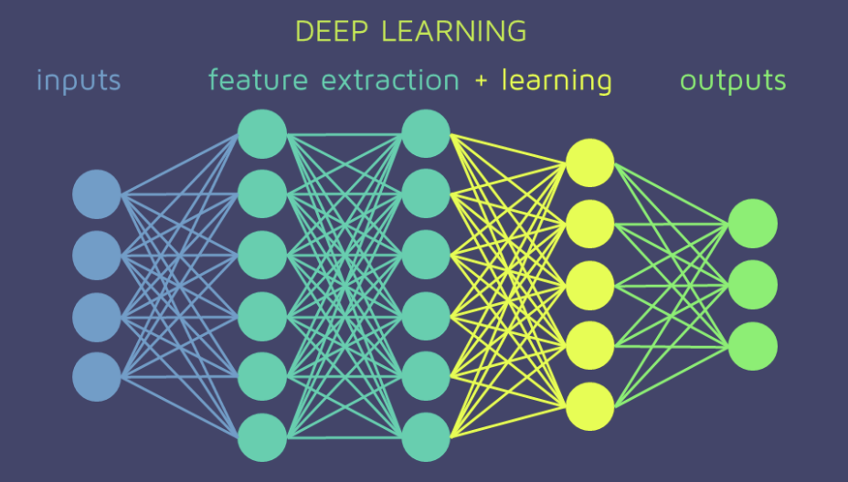
Technology and Libraries
Technology
Deep Learning
Libraries
NumPy and Pandas for preprocessing the data
Open-CV to read the image
Keras for training the data and visualizing the model

Slide 7

Importing The data
There are total 28 categories.
150 Images are loaded from each category for training the data.
50 images are loaded from each category for testing the data.

Slide 8
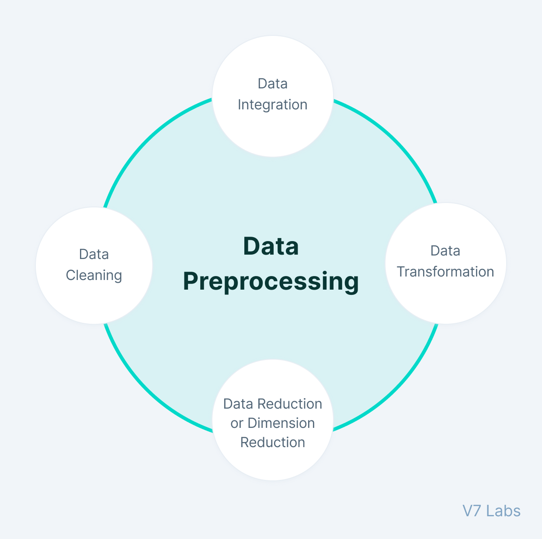
Data pre-processing
Converting data types
Reshaping
Scaling the values between 0 and 1
Transforming target data to binary class matrix

Slide 9
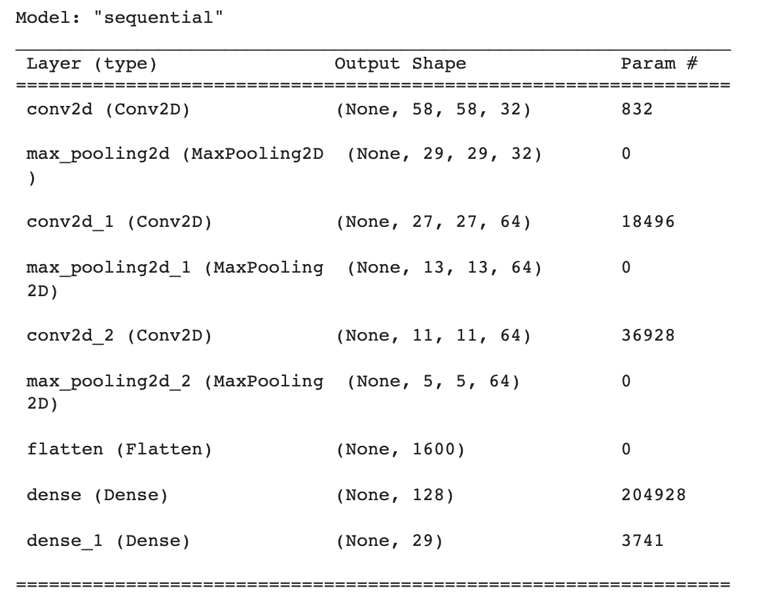
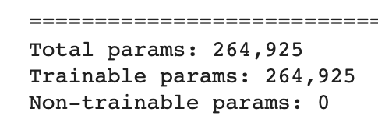
Model Summary

Slide 10
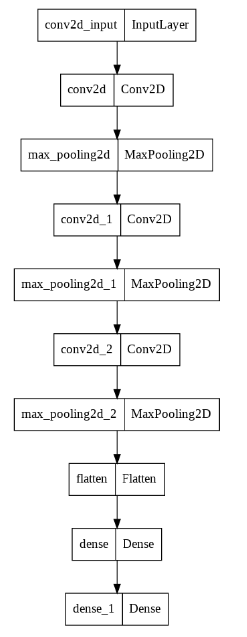
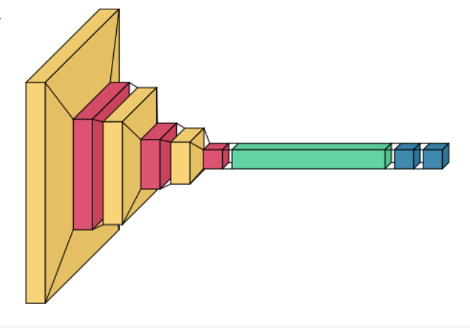
Model Flow Diagram and Layered View

Slide 11
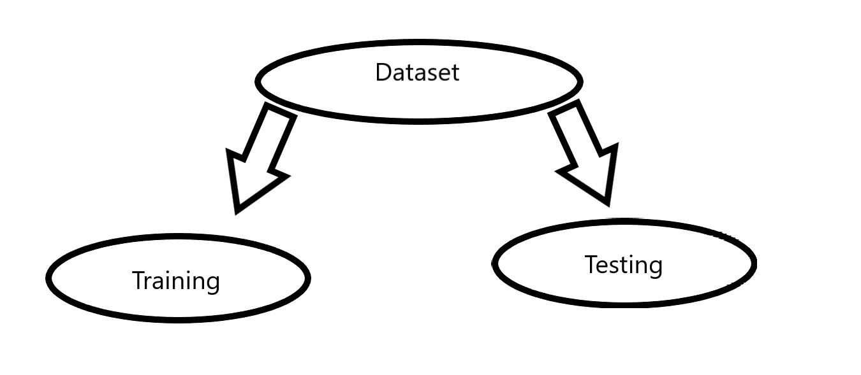
Training the Data
4650 samples for train data
1550 samples for test data
Number of epochs is 10

Slide 12
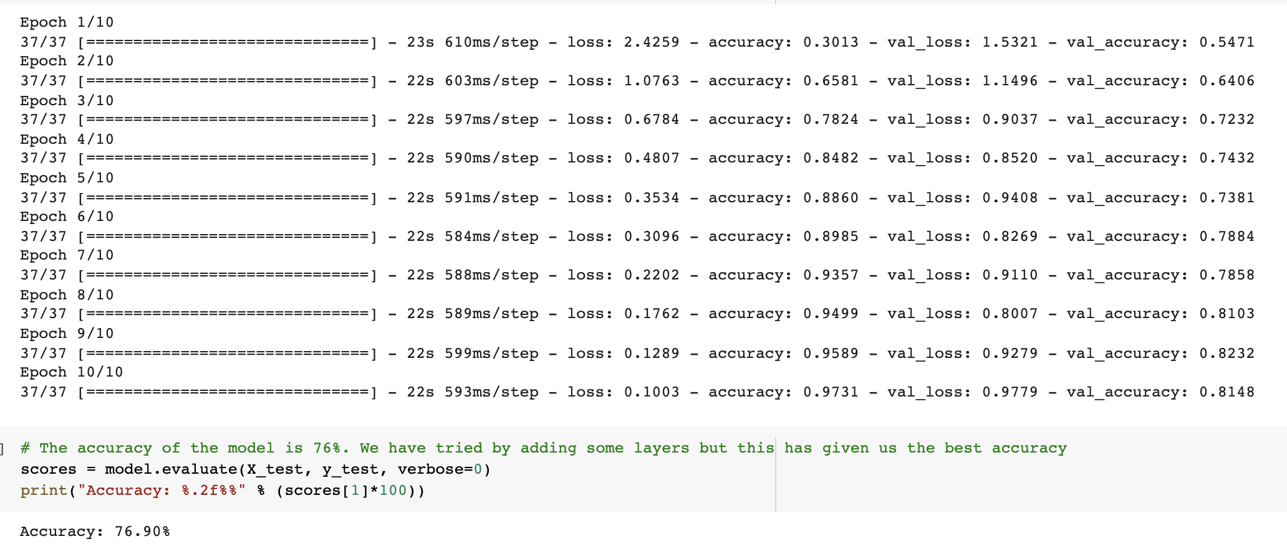
Model Performance

Slide 13
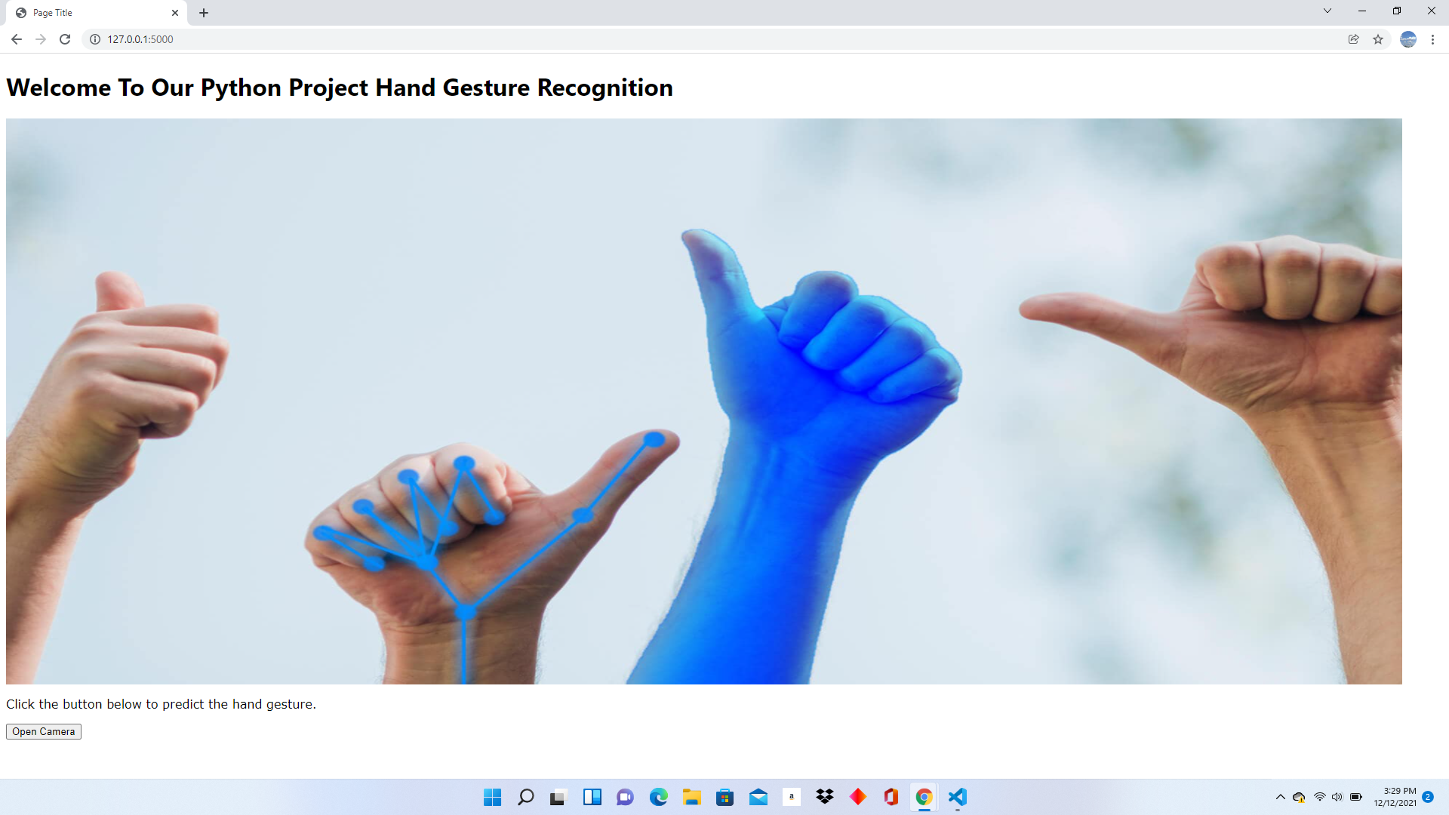
User Interface

Slide 14
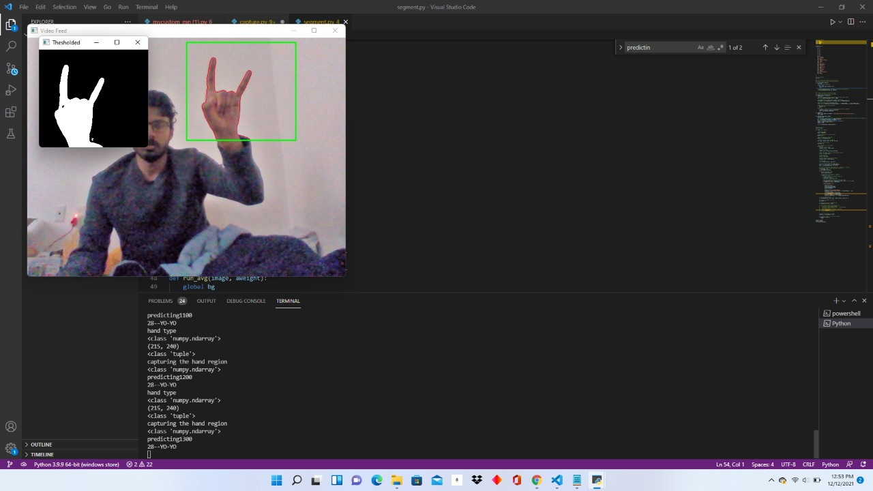
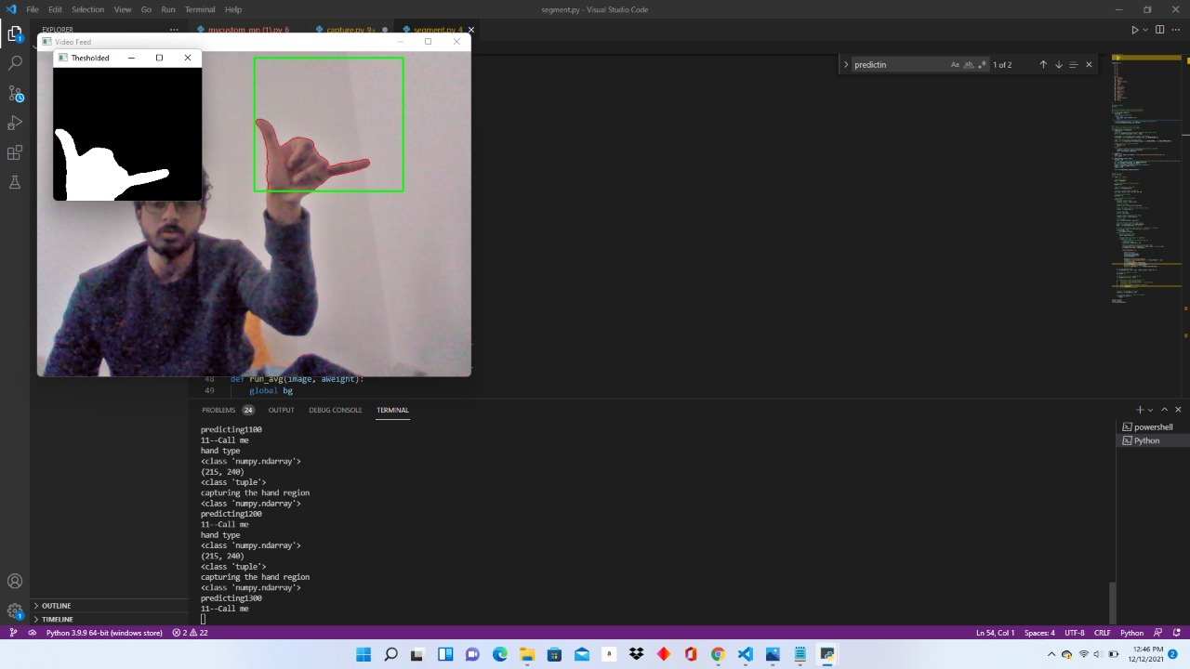
Predictions from the Model

Slide 15
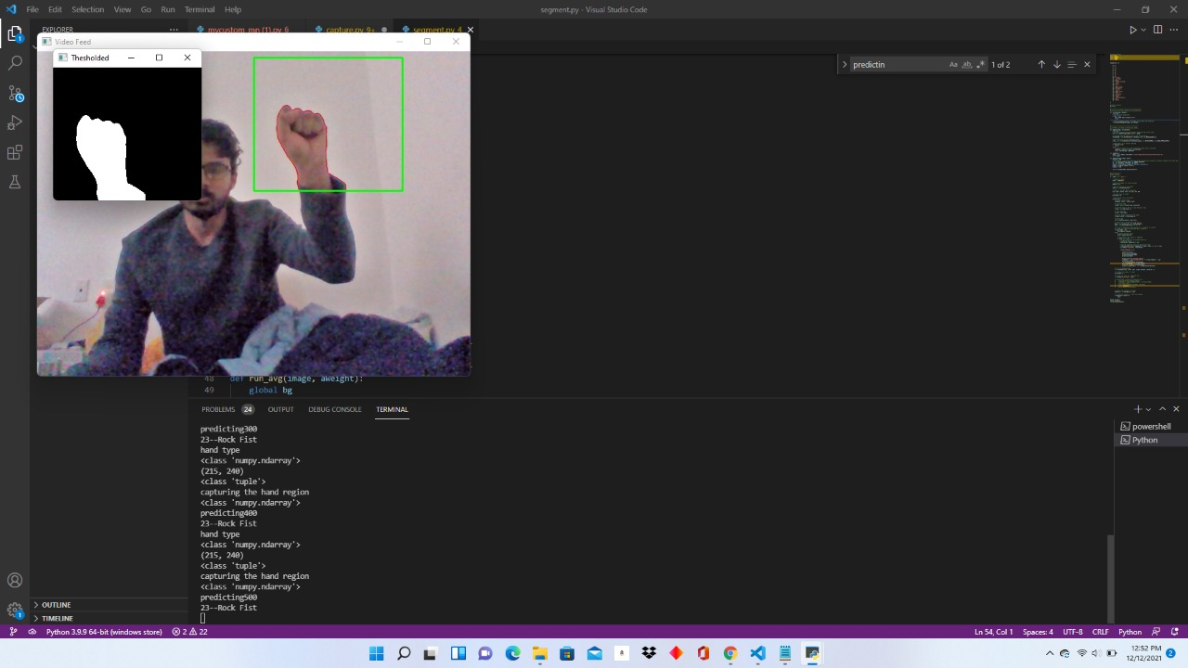
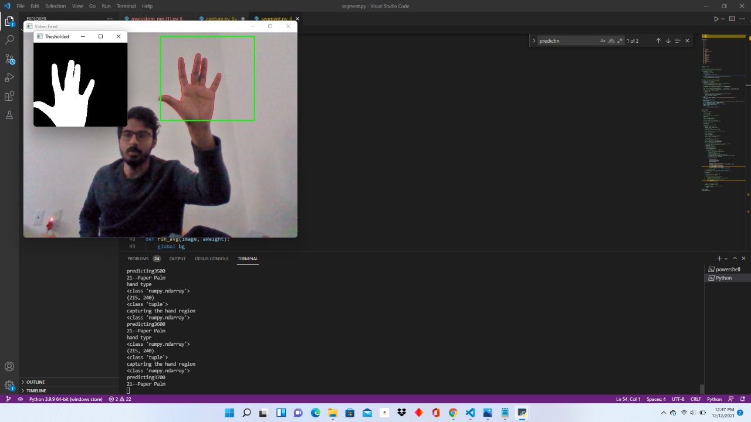
Predictions from the Model

Slide 16
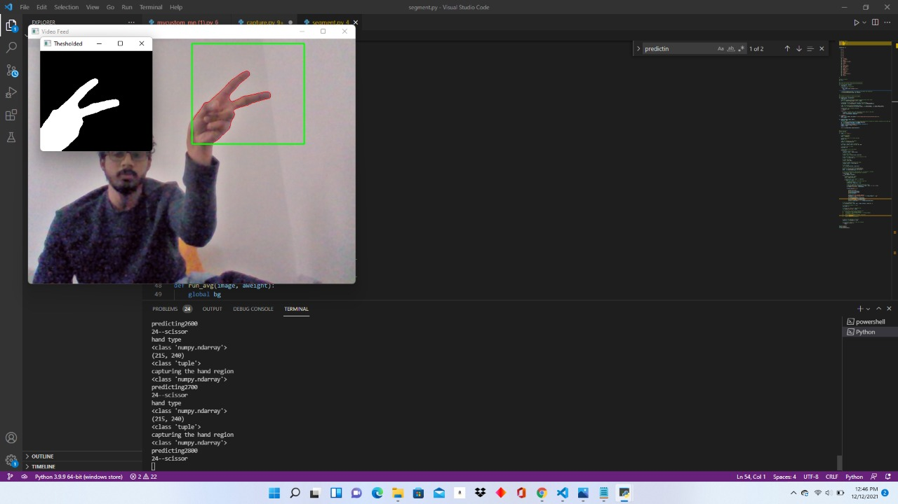
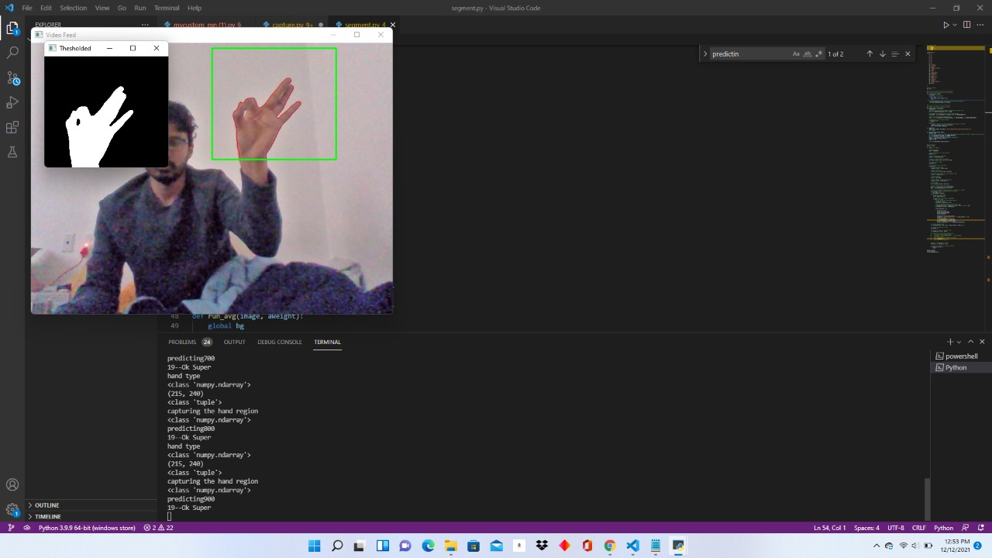
Predictions from the Model

Slide 17
Future Scope
This project can be further developed to aid handicapped people for day-to-day activities from their self defined gesture configurations.

Slide 18
Any Questions?

Slide 19
Thank You

