Slide 1
Session-2: Concept of Static vs Non Static Dr. Naveen Kumar Associate Professor AIIT Amity University Patna

Slide 2
Session Outcomes
Students will be able to understand
The use of static block, variables and methods and accessing them.

Slide 3
Java Class
Everything in Java is associated with classes and objects, along with its attributes and methods.
It is a logical entity that does not occupy any space/memory.
Memory is allocated when we create the objects of a class type.
To create a class, use the keyword class

Slide 4
Java Class
Syntax :
<access-modifier> class <ClassName>
{
//Class body containing variables and methods
}
Example:
class Student{
int id;
String name;
String branch;
int section;
}

Slide 5
Class Diagram
A Class is a blueprint that is used to create Object. The Class defines what object can do.
UML CLASS DIAGRAM gives an overview of a software system by displaying classes, attributes, operations, and their relationships.
This Diagram includes the class name, attributes, and operation in separate designated compartments.

Slide 6
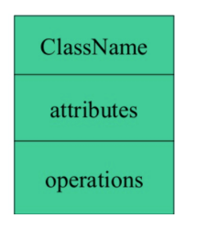
Essential elements of UML class diagram are:
1.Class Name
2.Attributes
3.Operations

Slide 7
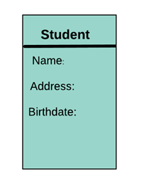
Attributes
An attribute is named property of a class which describes the object being modelled.

Slide 8
Attributes Characteristics
The attributes are generally written along with the visibility factor.
public, private, protected and default are the four visibilities which are denoted by +, -, #, or ~ signs respectively.
Visibility describes the accessibility of an attribute of a class.
Attributes must have a meaningful name that describes the use of it in a class.

Slide 9
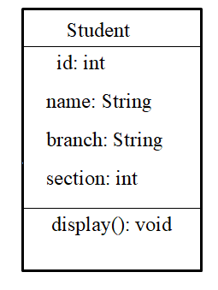
Class Diagram
Class name
Attributes
Operations

Slide 10
Java Naming Conventions
Java uses Camel Case as a practice for writing names of methods, variables, classes, packages and constants.
Make the code more readable.
Looks good and more efficient

Slide 11
Class naming convention
Class names generally should be nouns, in title-case with the first letter of each separate word capitalized.
Example:
class Car{ }
class Employee{ }
class Record { }

Slide 12
Variable naming convention
Variables : Variable names should be short yet meaningful. Variables can also start with either underscore(‘_’) or dollar sign ‘$’ characters.
One-character variable names should be avoided except for temporary variables.
Example:
int speed = 0;
int gear = 1;

Slide 13
Method naming convention
Methods : Methods should be verbs, in mixed case with the first letter lowercase and with the first letter of each internal word capitalised.
Examples:
void changeGear();
void speedUp();
void applyBrakes();

Slide 14
Example
class Car{
int speed = 0;
int gear = 1;
void changeGear()
{
…….
}
void speedUp()
{
……….
}
}

Slide 15
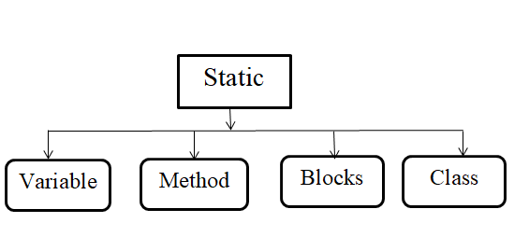
Static keyword

Slide 16
Static variable declaration
Syntax:
static data_type variable_name;
Example:
static int count=5;
Static keyword
Data type
Variable name

Slide 17
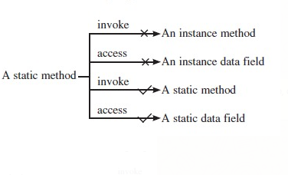
Static method
syntax:
static void walk()
{
……….
statements;
}

Slide 18
Example
class JavaExample
{ static int age;
static String name;
static void disp(){
System.out.println("Age is: "+age);
System.out.println("Name is: "+name); }
public static void main(String args[]) // This is also a static method
{ age = 30;
name = "Steve";
disp(); }
}
Static variables
Static method
Output:
Age is: 30 Name is: Steve

Slide 19
Static Block
static block
static {
……..
statements
………
}
Static Block

Slide 20
Predict the output
class JavaExample{
static int num;
static String mystr;
static{
num = 97;
mystr = "Static keyword in Java";
}
public static void main(String args[])
{ System.out.println("Value of num: "+num); System.out.println("Value of mystr: "+mystr); } }

Slide 21
Predict the output
class JavaExample2{
static int num;
static String mystr;
static{ //First Static block
System.out.println("Static Block 1");
num = 68;
mystr = "Block1"; }
static{ //Second static block
System.out.println("Static Block 2");
num = 98;
mystr = "Block2"; }
public static void main(String args[]) {
System.out.println("Value of num: "+num);
System.out.println("Value of mystr: "+mystr); } }

Slide 22
THANK YOU

