Slide 1
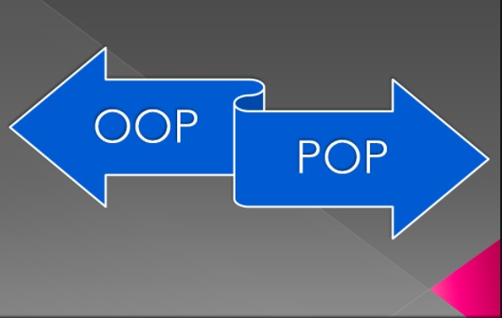
Object Oriented Paradigm vs. Procedural Paradigm

Slide 2
Objectives
How Paradigm shifted from Procedural Oriented Programming towards Object Oriented Programming.
Object Oriented Principles

Slide 3
Agenda
What is POP?
What is OOP?
Languages for POP and OOP
POP vs. OOP

Slide 4
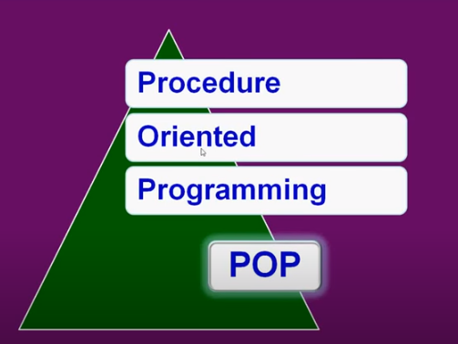
What is POP?
Procedure Oriented Programming is based on the concept of breaking a problem into modules and combining all those modules as a single unit.

Slide 5
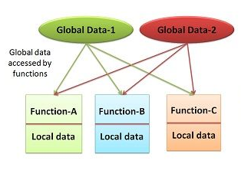
Structure of Procedure Oriented Programming
Features
Top-down programming
Modularity
Pre-defined Functions
Scope of variables (Local/Global)
Data moves freely from one function to another
General –Purpose Programming

Slide 6
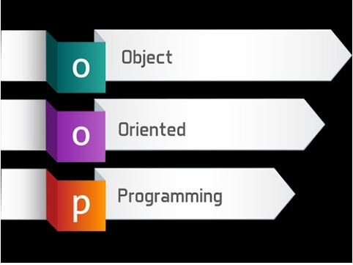
What is OOP?
OOP is based on the idea of “objects” to represent data and methods.
This approach is used to create a reusable code instead of redundancy

Slide 7
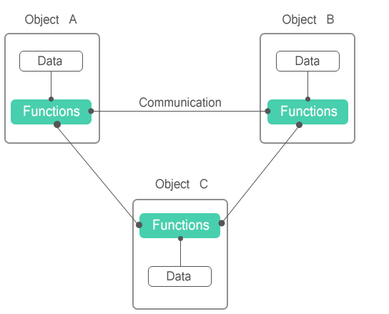
Structure of Object Oriented Paradigm

Slide 8

Example for OOP vs. POP
Let us consider a car with different characteristics like company name, model name, fuel type, mileage and price.
Company name ----Maruti
Model name ----- Swift
Fuel type ------ Diesel
Mileage ---- 20km/ liter
Price ---- 20 lakhs

Slide 9
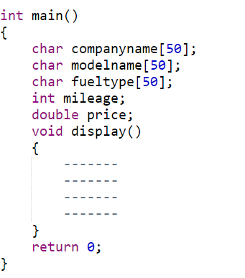

POP
What happens if we want to display for 100 variety of models ?
Need to create 500 different variables which makes our code tedious.

Slide 10

To overcome that we can implement using structures concept ?????
But, No Data Security available

Slide 11
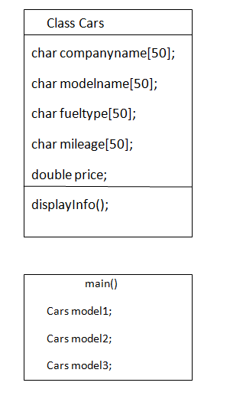



OOP
model1
model2
model3

Slide 12
POP
OOP
This paradigm is based on the concept of procedures or functions
POP follows Top-Down approach
Overloading is not possible
POP needs less memory
This doesn't have any access specifiers.
No data Security
Ex: C,FORTRAN,PASCAL
This paradigm is based on the concept of classes/objects
OOP follows Bottom-Up approach
Overloading is possible
OOP needs more memory
OOP have access specifiers.
private
public
protected
OOP provide data hiding so it provides more security.
Ex: C++,JAVA,PYTHON

Slide 13
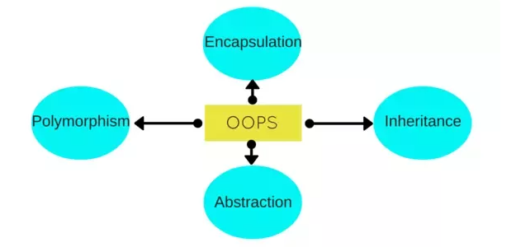
OOPS CONCEPTS
Inheritance
Polymorphism
Abstraction
Encapsulation

Slide 14


Inheritance
Inheritance is a mechanism of extracting the properties and methods of one class to another class.
for example let us consider a problem to implement program for two watches one is normal watch and the another is digital watch.
displayDate()
displayTime()
displayDay()
displayDate()
displayTime()
diaplayDay()
setAlarm()
setTimer()
Instead of writing the 3 methods again in DigitalWatch class we can inherit them from NormalWatch class

Slide 15
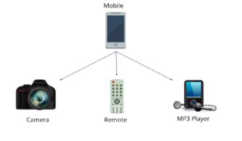
Polymorphism
Polymorphism means “many forms". It refers to differentiate between entities with the same name efficiently.

Slide 16
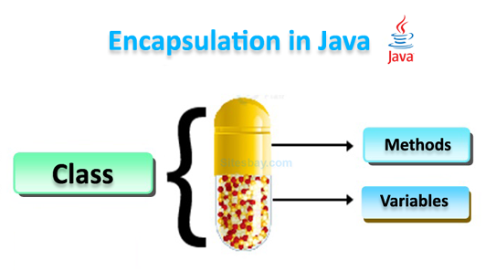
Encapsulation
Encapsulation is a process of wrapping of data and methods in a single unit is called encapsulation.

Slide 17

Abstraction
Abstraction is a process of hiding the implementation details and showing only functionality to the user.

Slide 18
Java Byte code
Java Bytecode: The Compiler class supports the creation of Java environments in which Java bytecode is compiled into executable code rather than interpreted.
Bytecode is a highly optimized set of instructions designed to be executed by the Java run-time system, which is called the Java Virtual Machine (JVM). In essence, the original JVM was designed as an interpreter for bytecode

Slide 19
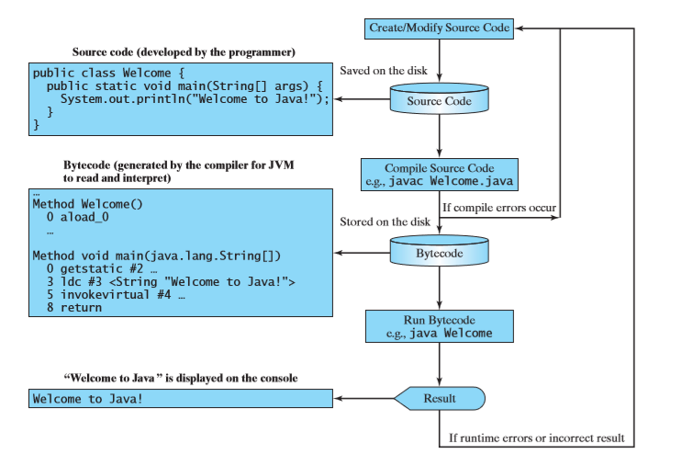
Notes:
The Java language is a high-level language, but Java bytecode is a low-level language. The bytecode is similar to machine instructions but is architecture neutral and can run on any platform that has a Java Virtual Machine (JVM), the virtual machine is a program that interprets Java bytecode.JVM is an interpreter, It translates the individual instructions in the bytecode into the target machine language code one at a time rather than the whole program as a single unit

Slide 20
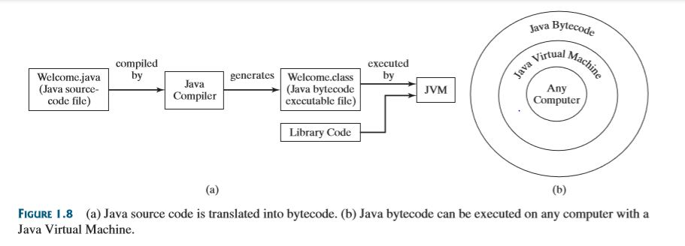

Slide 21
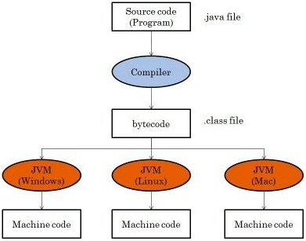

Slide 22
Architectural neutrality and JVM
Unlike many other programming languages including C and C++, when Java is compiled, it is not compiled into platform specific machine, rather into platform-independent byte code.
This byte code is distributed over the web and interpreted by the Virtual Machine (JVM) on whichever platform it is being run on.
In short, Java compiler generates an architecture-neutral object file format, which makes the compiled code executable on many processors, with the presence of Java runtime system

Slide 23
Q & A

