Slide 1
SESSION – 3 & 4

Slide 2
Objectives
Students will be able to
Apply modularization – Method and class level Modularization
Understand the usage of Access Specifiers – public, private and default
Apply modularization – Class and package level

Slide 3
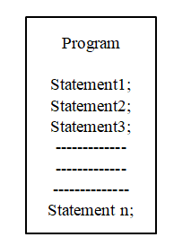
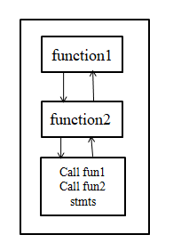
Modularity
Modularity principle suggests dividing a complex system into smaller pieces, called Modules.
Without Modularization
With Modularization

Slide 4
Advantages of Modularity Approach
Ease to use
Reusability
Ease of Maintenance

Slide 5
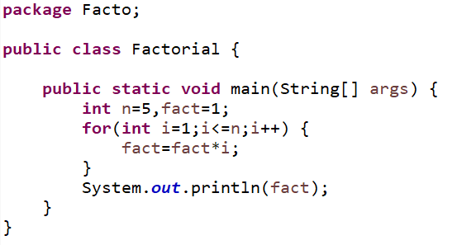
Example : Without Modularization
Finding the factorial of a number

Slide 6
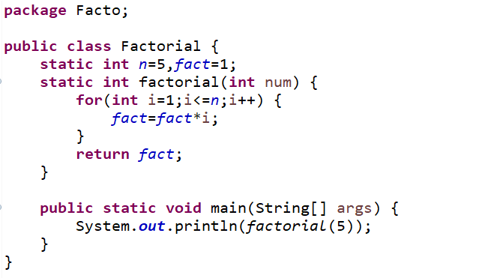
Example : Modularization
Finding the factorial of a number

Slide 7
Class Level Modularization
Class level modularization makes use of modules of one class from another class and vice versa.
class1
class2
function1
function1
function2
function2
function3
function3

Slide 8
Practice Problem:1 Without Modularization
Write a Cuboid class with 3 static variables length, breadth and height of type double, and a static method volume (), access them using main () method within the same class.
Class Diagram:
Cuboid
length : double breadth : double height : double
volume(l : double, b : double, h : double) : void +main(args[] : String) : void

Slide 9
Practice Problem:1-With Modularization
Write a Cuboid class with 3 static variables length, breadth and height of type double, and a static method volume (), access them using main () method within another class Demo.
package1
Cuboid
length : double breadth : double height : double
volume(l : double, b : double, h : double) : void
Demo
+main(args[] : String) : void

Slide 10
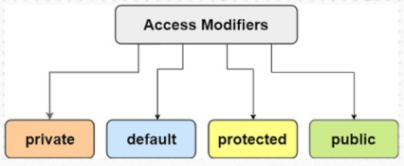
Access Modifiers
The access modifiers specifies the accessibility or scope of a field, method, constructor, or class. We can change the access level of fields, constructors, methods, and class by applying the access modifier on it.
T
here are four types of access modifiers:

Slide 11
Access Modifiers
private: The access level of a private modifier is only within the class. It cannot be accessed from outside the class.
default: The access level of a default modifier is only within the package. It cannot be accessed from outside the package. If you do not specify any access level, it will be the default.
public: The access level of a public modifier is everywhere. It can be accessed from within the class, outside the class, within the package and outside the package.
We’ll see more about protected in coming sessions

Slide 12
Understanding Access Modifiers
Access Modifier | Symbol used in class diagram | Within class | Within package | Outside package by subclass only | Outside package
private | - | Y | N | N | N
default | ~ | Y | Y | N | N
protected | # | Y | Y | Y | N
public | + | Y | Y | Y | Y

Slide 13
Example :3 Class Level Modularization
Rewrite the Cuboid class with appropriate Access Specifiers
package1
Cuboid
- length : double - breadth : double - height : double
~volume(l : double, b : double, h : double) : void
Demo
+main(args[] : String) : void

Slide 14
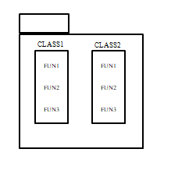
Package level Modularization
Package is a collection of classes. Package level modularization makes use of functions of one package to another package. Accessing permission mainly depends on access modifiers.
package1
package2

Slide 15
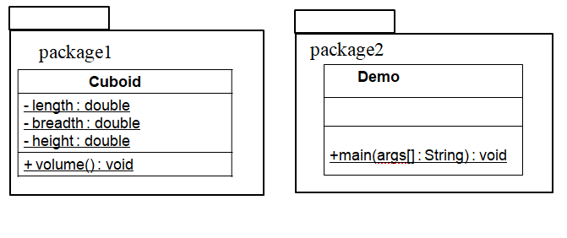
Example :4 Package Level Modularization
Rewrite the Cuboid class with appropriate Access Specifiers to calculate the volume of a Cuboid.

Slide 16
Example :5 Package Level Modularization
To the above modularized code, add a method isCube() that returns true if all dimensions are same, else returns false..
package1
package2
Cuboid
+ length : double + breadth : double + height : double
+ volume() : void
Demo
+ isCube() : boolean +main(args[] : String) : void

Slide 17
Predict the Output
class Access{
public static int x;
private static int y;
public static void cal(int a , int b) {
x = a + 1;
y = b;
}
}
public class Access_Specifier {
public static void main(String args[]) {
Access.cal(2, 3);
System.out.println(Access.x + " " + Access.y);
}
}

Slide 18
Practice Problem
Create a class Student with id, marks for 3 subjects, total as static variables, static method to compute the total, main method to print the Student information. Modularize the code to class and package levels.

Slide 19
Q & A

