Slide 1
Creating objects and accessing members through object SESSION 5

Slide 2
Session Outcomes
Students will be able to:
Understand the reference variables, creation of objects using new keyword.
Access the instance variable using objects.

Slide 3
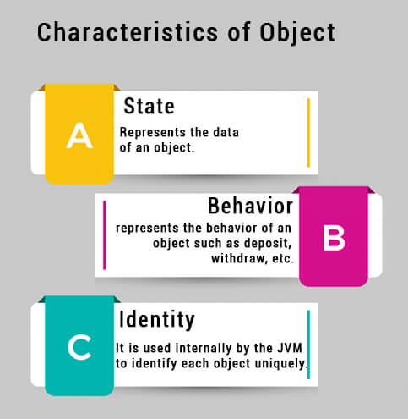
Object in OOP
Object is a basic building block of an OOP language.
We can create an object by creating an instance of a class or instantiating a class.

Slide 4
‘new’ keyword
Used to create an object or instance of the class
It allocates memory (heap) for the newly created object and also returns the reference of that object to that memory.

Slide 5
Heap memory
Java objects reside in an area called the heap.
The heap is created when the JVM starts up and may increase or decrease in size while the application runs.

Slide 6
Syntax for creating an object:
ClassName objectName = new ClassName();

Slide 7
Creating an object using ‘new’ : It can be done in two ways
Declaration and instantiation in single line
MyClass a= new MyClass();
Note: Only declarations doesn’t create objects.
b) Declaration of object , then instantiation in next line.
MyClass a;
a=new MyClass();

Slide 8
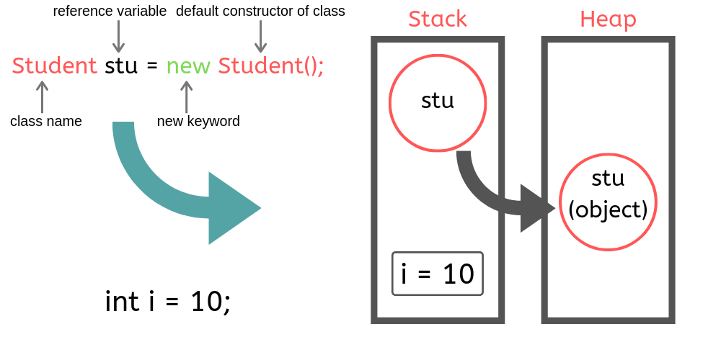
Using new Keyword
Example:
public class Student
{
int i = 10;
public static void main(String[] args)
{
Student stu = new Student();
}
}
KLEF OOPS BES-1

Slide 9
Creating an object using ‘new’
iii) Initialising object
MyClass a= new MyClass();
Performs three actions:
i. declaration,
ii. instantiation, and
iii. initialization.
ii) ‘new’ operator instantiates the MyClass class (thereby creating a new MyClass object)
i) ‘a’ is an object created of type MyClass

Slide 10
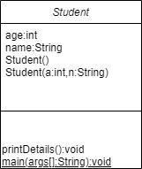
Class Diagram
Class name
Instance variables/attributes
Instance methods

Slide 11
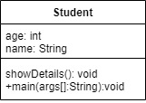
Problem Statement 1: Create a class Student with two instance variables and one instance method, create object in main method to print details of student
Sample Output:
Student Details are:
Name: Teja
Age: 18

Slide 12
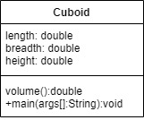
Problem Statement 2: Create a Cuboid class with 3 instance variables length, breadth and height of type double, and a method volume (). Create 2 objects with different values and print the volume.
Sample output:
Volume of cuboid is : 120.00
(when user inputs length=4,breadth=5,height=6)
Volume of cuboid is: 36
(when user inputs length=2,breadth=3,height=6)

Slide 13

Predict the output of the following code snippet
Code snippet 1:
class BoxDemo2 {
public static void main(String args[]) {
Box mybox1 = new Box();
Box mybox2 = mybox1;
mybox1.width=10;
System.out.println(mybox2.width);
}
}
Assume following class:
mybox1 is an object
mybox1
mybox2
Notes:
Assume class Box { double width; double height; double depth; } for prog2-NullPointerException as mybox2 is made null

Slide 14
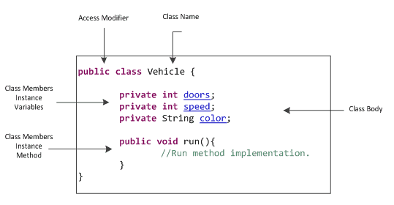
Instance members in java

Slide 15
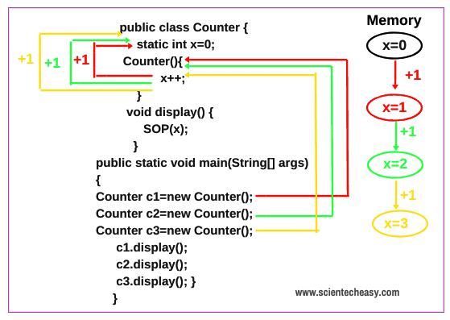
Static members in java

Slide 16
Instance members and static members and rules of accessing
Instance members/methods
Static members/methods
They can be called after creating the Object of the class.
Every individual Object created from the class has its own copy of the instance method(s) of that class
Stored in a single memory location
can be overridden since they are resolved using dynamic binding at run time
Static method(s) are associated to the class in which they reside.
can not be overridden. But can be overloaded since they are resolved using static binding by compiler at compile time
Notes:
Recall types of variables: local-inside method,instance-inside class,outside method,class-inside class but with word static

Slide 17
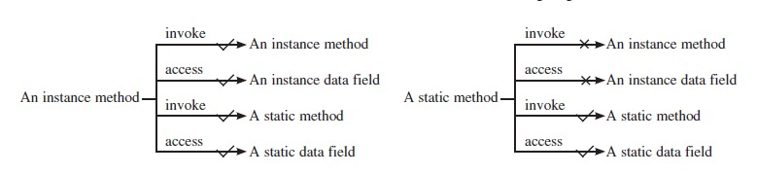
Instance members and static members and rules of accessing

Slide 18
Q & A

