Slide 1
Session-6

Slide 2
Session Outcome
Session Outcomes:
Students will be able to:
Understand the usage of Accessor and mutator methods
Students will understand the toString() method

Slide 3
Need of Accessors and Mutators:
Accessors are used to get the value of a private field and Mutators are used to set the value of a private field.
Accessors are also known as ‘getters’ and mutators are also known as ‘setters’.
If we have declared the members as private then they would not be accessible outside the class so we need to use getter and setter methods.

Slide 4
Example
Class Demo{
private int age;
private String name;
public void display(){
-----------
-----------
-----------
}
}
It is not possible to access the private members i.e., age and name from another class as they are declared as private
But , by using setters and getters it is possible to access(set/get) the private members of another class

Slide 5
Syntax:
Accessors:
public int getAge()
{
return number;
}
public String getName()
{
return name;
}
Mutators:
public void setName(String name)
{
this.name=name;
}
public void setAge(int age)
{
this.age = age;
}

Slide 6
toString () method:
The toString() method returns the string representation of the object.
If you print any object, java compiler internally invokes the toString() method on the object.
So overriding the toString() method, returns the desired output, it can be the state of an object etc. depends on your implementation.
Eg:
public String toString()
{
return name + " " + age + " " + college + " " + course;
}

Slide 7
Create a Cuboid class with 3 private instance variables length, breadth and height of type double, and a public method volume of return type double(). Add 3 setter methods with return type boolean (the instance variable is set when the argument is +ve) for each of the 3 instance members Also add 3 getter methods of return type, which return the value appended with m (meters). Use toString() method to print the details of Cuboid
Problem :

Slide 8
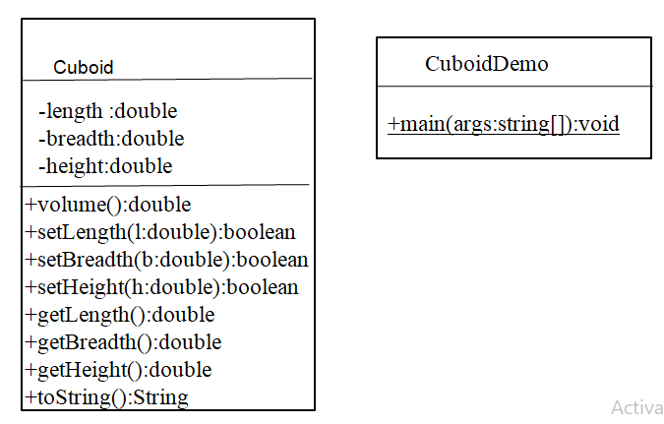
Class Diagram

Slide 9
package p1;
class Cuboid{ private double l,b,h; public boolean setLength(double l) {
---------------
----------------
}
public boolean setBreadth(double b) { ---------------
-----------------
}
public boolean setHeight(double h) { ---------------
-----------------
}
public double getLength()
{
return l;
}
public double getBreadth()
{
return b;
}
public double getHeight()
{
return h;
}

Slide 10
This is the another way of writing setter by passing all arguments at a time
public boolean setDimensions(double l, double b, double h) { if(l<0 || b <0 || h < 0) return false; this.l=l; this.b=b; this.h=h; return true; }

Slide 11
public String toString()
{
String output=String.format("Length =%.1f Breadth= %.1f Height = %.1f volume= %.1f",l,b,h,volume() );
return output;
}
public double volume()
{
-------------;
}

Slide 12
Access each of these methods through an object of Cuboid from the main() method of Demo class. Set the instance variables by obtaining input from console.

Slide 13
Practice problem-1
Write a Java Program to create Student class with ID, name, gender and branch. Use getter and setters. The ID must be 9-digit number, name must not have special characters and digits, gender must be either M/F and branch must be either ECE/CSE/ME/ECSE/CE/BT/EEE. Use toString() to format the details of Student.

Slide 14
Class Diagram
Student
studentDemo
-id:long
-name:String
-gender:String
-branch:String
+main(args:String[]):void)
+setName(name:String):boolean
+setId(id:long): boolean
+setGender(gender:String): boolean
+setBranch(branch:String): boolean
+getName():String
+getId():long
+getgender():String
+getBranch():String
+toString():String

Slide 15
Practice Problem-2
Read data from console and create 2 student objects and print the data of each student

Slide 16
Class Diagram
Student
StudentDemo
-name:String
-age:int
-address:String
-branch:String
+main(args:String[]):void)
+setName(name:String)
+setAge(id:int)
+setAdress(gender:String)
+setBranch(branch:String)
+getName():String
+getAge():int
+getAdress():String
+getBranch():String
+toString():String
+Student(name:String,age:int,address:String,branch:String)
+toString():String

Slide 17
Thank you

