Slide 1
Session-7&8

Slide 2
Session Outcomes
Student will understand
How to obtain input through command line arguments and Scanner class.
How to use Wrapper classes and methods in them.

Slide 3
Command Line Arguments
Inputs that are passed at the time of running can be called as Command Line Arguments.
The arguments that are passed from the console can be received and used as input in the java program.

Slide 4
Command Line Arguments
public class Demo {
public static void main(String[] args)
{
System.out.println("Command-Line arguments");
for(String str: args)
{
System.out.println(str);
}
}
}

Slide 5
The main() method includes an array of strings named args as its parameter.
The String array stores all the arguments passed through the command line.
Arguments are stored as strings
Separated by white-space.

Slide 6
How to handle Numeric data
The main() method accepts arguments as strings.
It is not possible to pass numeric arguments through the command line.
we can later convert string arguments into numeric values.

Slide 7
Wrapper Class
Most of the objects collection store objects and not primitive data type.
Primitive data types can be used as objects when required.
Wrapper classes allow primitive type to be accessed as objects.

Slide 8

Wrapper Class…Contd
It acts as a wrapper and wraps the primitive data type into an object of that class.

Slide 9
Difference between Primitive data type and object of a wrapper class
int x=25;
x
25
Declares an integer variable x and initializes it with value 25

Slide 10
Object of a wrapper class
Integer y = new Integer(33);
33
y
Instantiates an integer object
The object is initialized with the value 33
Reference to the object is assigned to the object variable y

Slide 11
Wrapper Class Example : Sum of two numbers
public class sum
{
public static void main(String ar[])
{
int x,y,s;
x=Integer.parseInt(ar[0]);
y=Integer.parseInt(ar[1]);
s=x+y;
System.out.println("sum of " + x + " and " + y +" is " +s);
}
}
Wrapper class

Slide 12
Practice Problem-1
Create a Cuboid class with 3 public instance variables length, breadth and height of type double, and a method volume ().
Create object with values obtained by command line arguments and print the volume.

Slide 13
Class Diagram
Cuboid
+length : double +breadth : double +height : double
+setDimensions(l : double, b : double, h : double) : void +volume() : double
ClassDemo
+main(args[]:String):void

Slide 14
Demo class with main method
public class ClassDemo {
public static void main(String[] args)
{
Cuboid Z1=new Cuboid(); Z1.setDimensions(Double.parseDouble(args[0]), Double.parseDouble(args[1]), Double.parseDouble(args[2])); System.out.println(Z1.volume());
} }
Complete the Cuboid class with instance members, setter and volume method

Slide 15
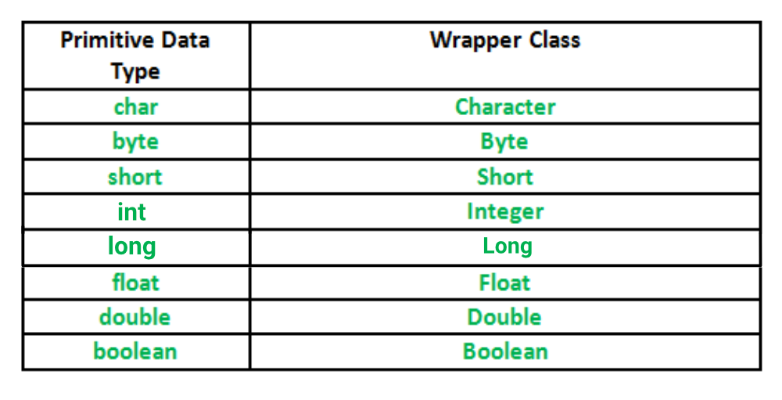
Primitive Data types and their Corresponding Wrapper class

Slide 16
Scanner Class
It is one of the ways to read input from the keyboard.
The simplest way to get input in Java.
It is found in the java.util package.
It extends Object class and implements Iterator and Closeable interfaces.

Slide 17
To create object for scanner class
Constructing a Scanner object
Scanner name = new Scanner(System.in);
Example:
Scanner console = new Scanner(System.in);

Slide 18
A few Scanner Class Methods
Sl.No | Method | Description
1 | nextInt() | reads a token of user input as an int
2 | nextDouble() | reads a token of user input as a double
3 | next() | reads a token of user input as a String
4 | nextLine() | reads a line of user input as a String

Slide 19
Practice Problem-1
Write a Java Program to read Student ID, name, marks of 3 subjects through Scanner, and display the details along with total and percentage obtained.

Slide 20
Class Diagram
Student
- id : int - name : String - m1 : double - m2 : double - m3 : double
+ setDetails(id:int, name: String):void + setMarks(id : int, name : String,m1 : double,m2 : double,m3 : double) : void +calculateTotal():double +calculatePercentage():double +toString():String
Cdemo
+main(args[]:String):void

Slide 21
Demo class with main method
public class Cdemo{
public static void main(String args[])
{
Scanner s = new Scanner(System.in);
Student c1 = new Student(); c1.setDetails(s.nextInt(),s.next());
c1.setMarks(s.nextDouble(),s.nextDouble(),s.nextDouble());
------------
------------
-------------
}
Complete the Student class with private instance members and appropriate methods

Slide 22
Practice Problem-2
Create a Cuboid class with 3 public instance variables length, breadth and height of type double, and a method volume (). Create 2 objects with different values obtained through Scanner class and print the volume of each.
Cuboid
+ length : double + breadth : double + height : double
+ volume() : void
Demo
+main(args[] : String) : void

Slide 23
File Handling
Files and Directories
A file is a named location that can be used to store related information.
A directory is a collection of files and subdirectories.
File class from the java.io package, allows us to work with files.
create an object of the class, and specify the filename

Slide 24
File Handling Example
Import the file class
import java.io.File;
Specify the File name
File myObj = new File("filename.txt");

Slide 25
File Operation Methods
Operation | Method | Package
To create a file | createNewFile() | java.io.File
To Read from a file | Read() | java.io.FileReader
To Write to a file | Write() | java.io.FileWriter
To Delete a file | Delete() | java.io.File

Slide 26
A Sample file program to read from a file
File f1=new File(“Path of your file or fileName.txt");
Scanner sc=new Scanner(f1);
int volume=1;
while(sc.hasNextLine()) {
volume*=sc.nextInt();
}
The contents are read from the file NewFile.
The volume is calculated

Slide 27
A Sample file program to write to a file
PrintWriter myWriter = new PrintWriter("C:\\Desktop\\JAVA_PGMS\\Files\\src\\Files\\Result");
myWriter.print(volume);
myWriter.close();
System.out.println("Successfully wrote to the file.");
Using PrintWriter class the volume calculated is written to File Result.

Slide 28
A sample file program
public class FDemo
{
public static void main(String[] args) throws FileNotFoundException
{
File f=new File("C:\\Users\\ADMIN\\eclipse-workspace\\CO1\\src\\inputing\\Data");
Scanner s=new Scanner(f);
Cuboid c1=new Cuboid(); c1.setDimensions(s.nextDouble(),s.nextDouble(),s.nextDouble());
System.out.println(c1.volume()); }}

