Slide 1
Neural Network
Dr. Naveen Kumar
Associate Professor
Amity Institute of Information Technology
Amity University Patna

Slide 2
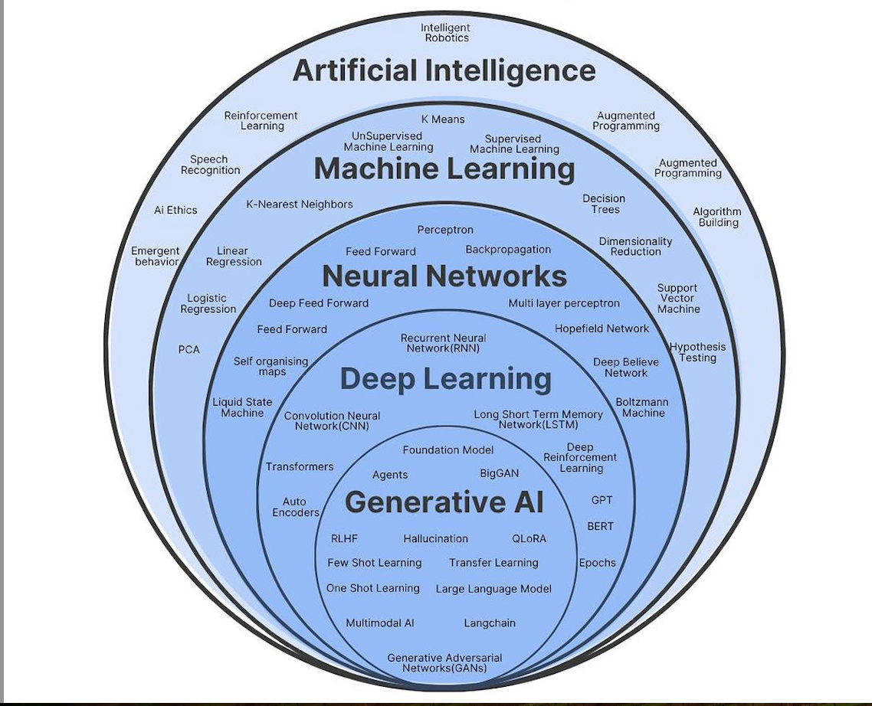
DB of Information
Data
Information
Intelligence
+
Adv. Processing (Query)
Human
Non-Human
Human Intelligence
Artificial Intelligence

Slide 3
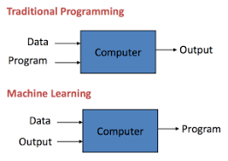
Machine Learning
Arthur Samuel, a pioneer in the field of artificial intelligence and computer gaming, coined the term “Machine Learning” as – “Field of study that gives computers the capability to learn without being explicitly programmed”.
How it is different from traditional Programming:
In Traditional Programming, we feed the Input, Program logic and run the program to get output.
In Machine Learning, we feed the input, output and run it on machine during training and the machine creates its own logic, which is being evaluated while testing.

Slide 4
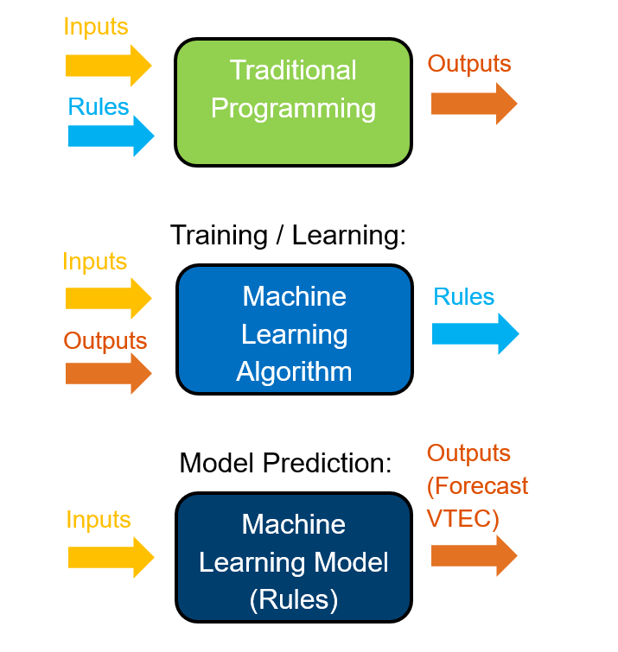

Slide 5
When are ML algorithms NOT needed?
When the relationships between all relevant system variables (input, output, and hidden) is adequately understood!
This is NOT the case for many complex real systems!

Slide 6
Terminologies that one should know before starting Machine Learning:
Model: A model is a specific representation learned from data by applying some machine learning algorithm. A model is also called hypothesis.
Feature: A feature is an individual measurable property of our data. A set of numeric features can be conveniently described by a feature vector. Feature vectors are fed as input to the model. For example, in order to predict a fruit, there may be features like color, smell, taste, etc.
Target(Label): A target variable or label is the value to be predicted by our model. For the fruit example discussed in the features section, the label with each set of input would be the name of the fruit like apple, orange, banana, etc.
Training: The idea is to give a set of inputs(features) and it’s expected outputs(labels), so after training, we will have a model (hypothesis) that will then map new data to one of the categories trained on.
Prediction: Once our model is ready, it can be fed a set of inputs to which it will provide a predicted output(label).

Slide 7
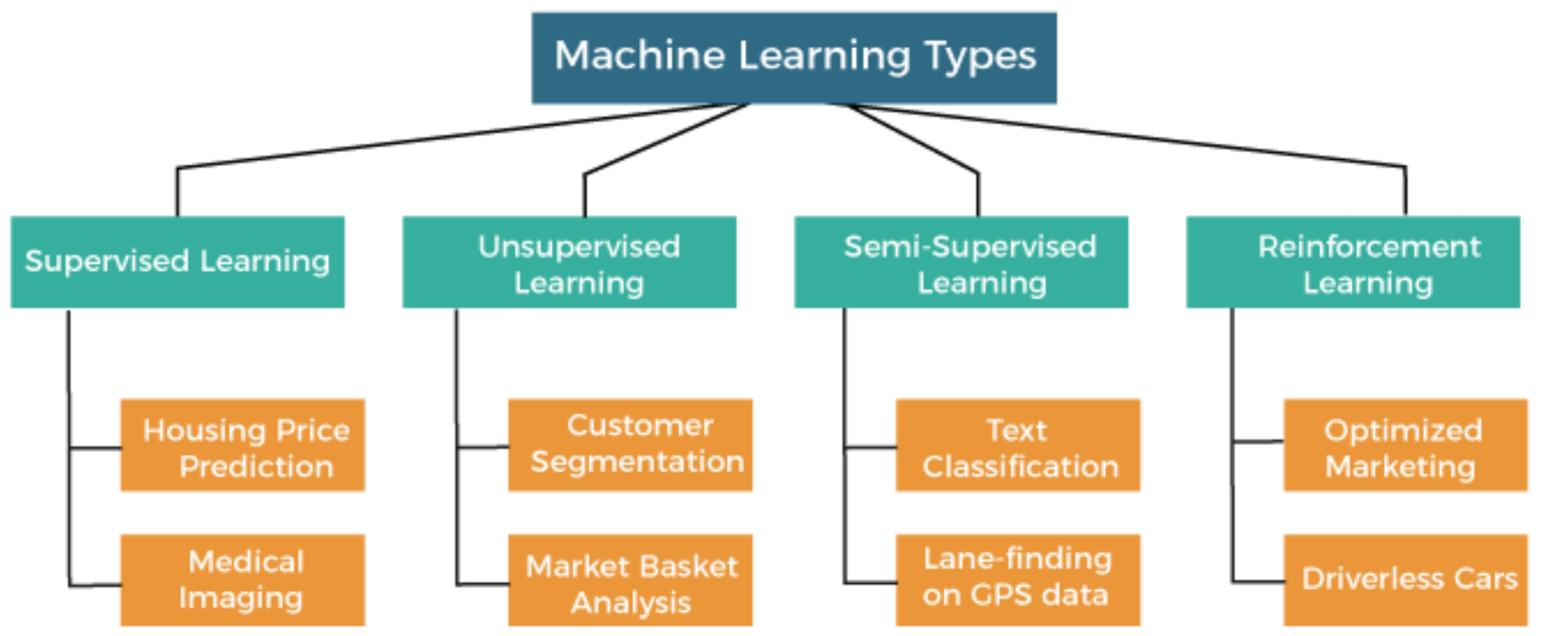

Slide 8
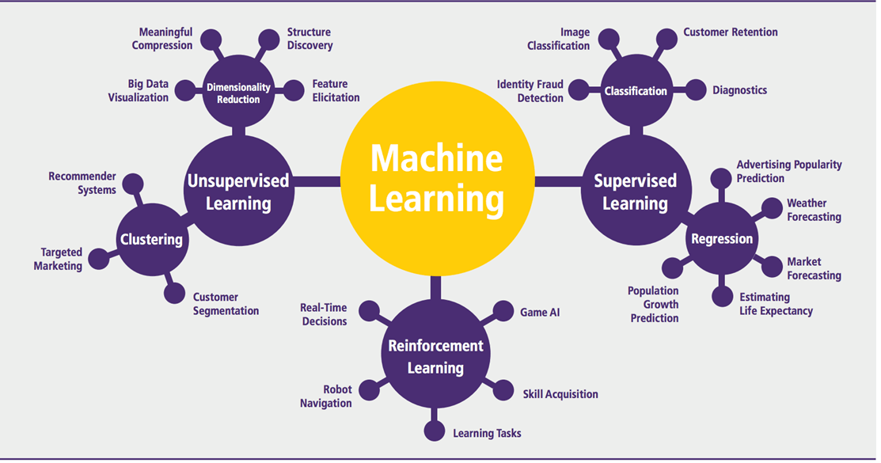

Slide 9
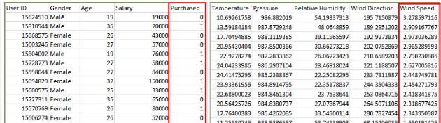
Types of Learning
Supervised Learning
Unsupervised Learning
Semi-Supervised Learning
Supervised Learning: Supervised learning is when the model is getting trained on a labelled dataset. Labelled dataset is one which have both input and output parameters. In this type of learning both training and validation datasets are labelled as shown in the figures below.
Classification
Regression

Slide 10
Types of Supervised Learning:
Classification
Regression
Classification : It is a Supervised Learning task where output is having defined labels(discrete value). For example in above Figure A, Output – Purchased has defined labels i.e. 0 or 1 ; 1 means the customer will purchase and 0 means that customer won’t purchase. It can be either binary or multi class classification. In binary classification, model predicts either 0 or 1 ; yes or no but in case of multi class classification, model predicts more than one class.
Example: Gmail classifies mails in more than one classes like social, promotions, updates, offers.
Regression : It is a Supervised Learning task where output is having continuous value. Example in before regression Figure, Output – Wind Speed is not having any discrete value but is continuous in the particular range. The goal here is to predict a value as much closer to actual output value as our model can and then evaluation is done by calculating error value. The smaller the error the greater the accuracy of our regression model.

Slide 11
Unsupervised Learning:
Unsupervised learning is the training of machine using information that is neither classified nor labeled and allowing the algorithm to act on that information without guidance. Here the task of machine is to group unsorted information according to similarities, patterns and differences without any prior training of data. Unsupervised machine learning is more challenging than supervised learning due to the absence of labels.
Types of Unsupervised Learning:
Clustering
Association

Slide 12
Clustering: A clustering problem is where you want to discover the inherent groupings in the data, such as grouping customers by purchasing behavior.
Association: An association rule learning problem is where you want to discover rules that describe large portions of your data, such as people that buy X also tend to buy Y.
Examples of unsupervised learning algorithms are:
k-means for clustering problems.
Apriori algorithm for association rule learning problems
The most basic disadvantage of any Supervised Learning algorithm is that the dataset has to be hand-labeled either by a Machine Learning Engineer or a Data Scientist. This is a very costly process, especially when dealing with large volumes of data. The most basic disadvantage of any Unsupervised Learning is that it’s application spectrum is limited.

Slide 13
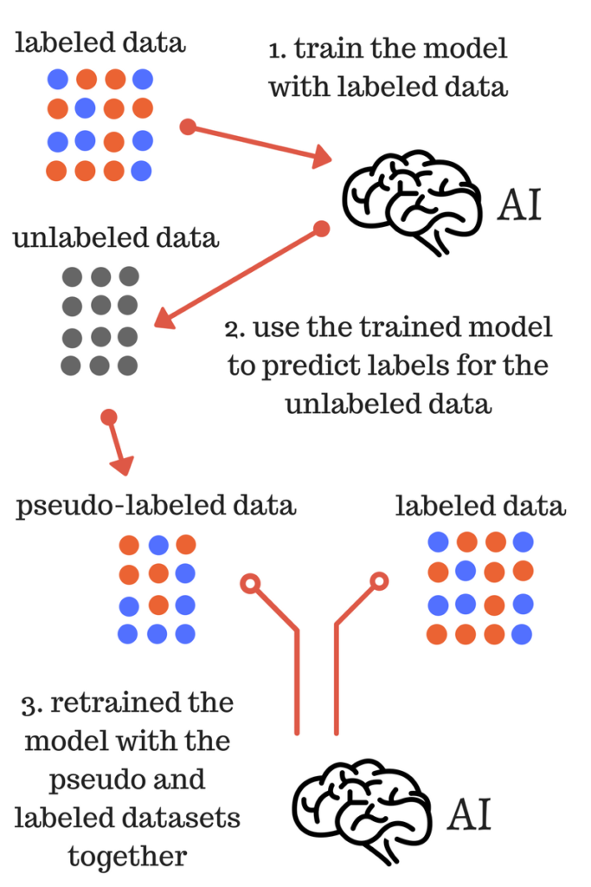
Semi-supervised machine learning:
To counter these disadvantages, the concept of Semi-Supervised Learning was introduced. In this type of learning, the algorithm is trained upon a combination of labeled and unlabeled data. Typically, this combination will contain a very small amount of labeled data and a very large amount of unlabeled data.
In semi supervised learning labelled data is used to learn a model and using that model unlabeled data is labelled called pseudo labelling now using whole data model is trained for further use

Slide 14
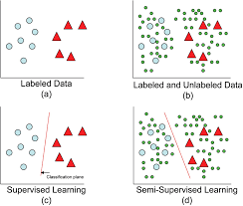
Model with labellled data and model with both labelled and unlabelled data
Intuitively, one may imagine the three types of learning algorithms as Supervised learning where a student is under the supervision of a teacher at both home and school, Unsupervised learning where a student has to figure out a concept himself and Semi-Supervised learning where a teacher teaches a few concepts in class and gives questions as homework which are based on similar concepts.

Slide 15
from sklearn import linear_model
regr = linear_model.LinearRegression()
train_x = np.asanyarray(train[['ENGINESIZE']])
train_y = np.asanyarray(train[['CO2EMISSIONS']])
regr.fit (train_x, train_y)
# The coefficients
print ('Coefficients: ', regr.coef_)
print ('Intercept: ',regr.intercept_)

Slide 16
from sklearn import linear_model
regr = linear_model.LinearRegression()
train_x = np.asanyarray(train[['ENGINESIZE','CYLINDERS']])
train_y = np.asanyarray(train[['CO2EMISSIONS']])
regr.fit (train_x, train_y)
# The coefficients
print ('Coefficients: ', regr.coef_)
print ('Intercept: ',regr.intercept_)

Slide 17
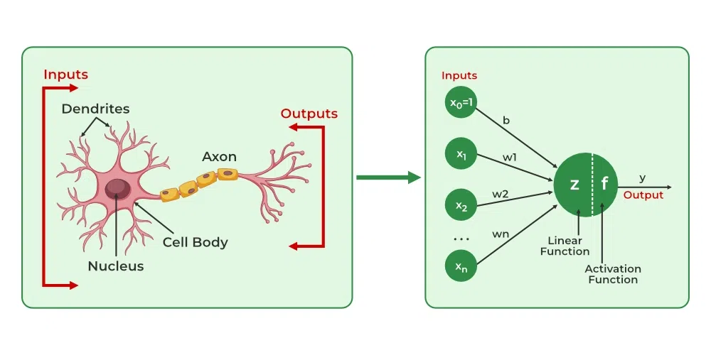
Biological Neuron vs Mathematical Neuron

Slide 18
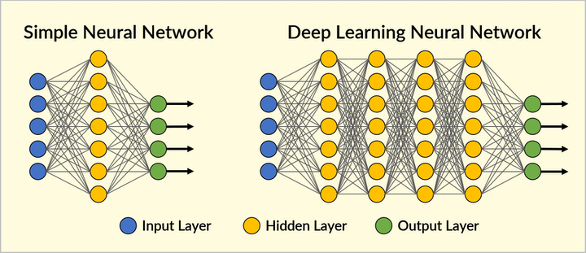

Slide 19
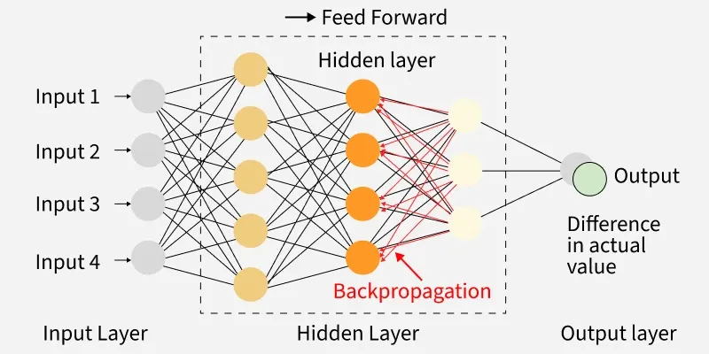

Slide 20


Slide 21
Artificial Neuron
W
Neuron
INPUTS
W
Σ
f(n)
Outputs
W
Activation
Function
W
W=Weight

Slide 22
Types of networks
Multiple Inputs and Single Layer
Multiple Inputs and layers

Slide 23
Types of Networks – Contd.
Feedback
Recurrent Networks

Slide 24
Multilayer Perceptron
Output Layer
Inputs
First Hidden layer
Second Hidden Layer

Slide 25
Signal Flow Backpropagation of Errors
Function Signals
Error Signals

Slide 26
Improving performance
Changing the number of layers and number of neurons in each layer.
Variation in Transfer functions.
Changing the learning rate.
Training for longer times.
Type of pre-processing and post-processing.

Slide 27
Artificial Neural Network
Key Components of an ANN
Input Layer: This is where the network receives information. For example, in an image recognition task, the input could be an image.
Hidden Layers: These layers process the data received from the input layer. The more hidden layers there are, the more complex patterns the network can learn and understand. Each hidden layer transforms the data into more abstract information.
Output Layer: This is where the final decision or prediction is made. For example, after processing an image, the output layer might decide whether it’s a cat or a dog.

Slide 28
Working of Artificial Neural Networks
ANNs work by learning patterns in data through a process called training. During training, the network adjusts itself to improve its accuracy by comparing its predictions with the actual results.
Lets see how the learning process works:
Input Layer: Data such as an image, text or number is fed into the network through the input layer.
Hidden Layers: Each neuron in the hidden layers performs some calculation on the input, passing the result to the next layer. The data is transformed and abstracted at each layer.
Output Layer: After passing through all the layers, the network gives its final prediction like classifying an image as a cat or a dog.
The process of backpropagation is used to adjust the weights between neurons. When the network makes a mistake, the weights are updated to reduce the error and improve the next prediction.

Slide 29
Common Activation Functions in ANNs
Activation functions are important in neural networks because they introduce non-linearity and helps the network to learn complex patterns. Lets see some common activation functions used in ANNs:
Sigmoid Function: Outputs values between 0 and 1. It is used in binary classification tasks like deciding if an image is a cat or not.
ReLU (Rectified Linear Unit): A popular choice for hidden layers, it returns the input if positive and zero otherwise. It helps to solve the vanishing gradient problem.
Tanh (Hyperbolic Tangent): Similar to sigmoid but outputs values between -1 and 1. It is used in hidden layers when a broader range of outputs is needed.
Softmax: Converts raw outputs into probabilities used in the final layer of a network for multi-class classification tasks.
Leaky ReLU: A variant of ReLU that allows small negative values for inputs helps in preventing “dead neurons” during training.

Slide 30
Optimization Algorithms in ANN Training
Optimization algorithms adjust the weights of a neural network during training to minimize errors. The goal is to make the network’s predictions more accurate. Lets see key algorithms:
Gradient Descent: Most basic optimization algorithm that updates weights by calculating the gradient of the loss function.
Adam (Adaptive Moment Estimation): An efficient version of gradient descent that adapts learning rates for each weight used in deep learning.
RMSprop: A variation of gradient descent that adjusts the learning rate based on the average of recent gradients, it is useful in training recurrent neural networks (RNNs).
Stochastic Gradient Descent (SGD): Updates weights using one sample at a time helps in making it faster but more noisy.

Slide 31
Applications of Artificial Neural Networks
Social Media: ANNs help social media platforms suggest friends and relevant content by analyzing user profiles, interests and interactions. They also assist in targeted advertising which ensures users to see ads tailored to their preferences.
Marketing and Sales: E-commerce sites like Amazon use ANNs to recommend products based on browsing history. They also personalize offers, predict customer behavior and segment customers for more effective marketing campaigns.
Healthcare: ANNs are used in medical imaging for detecting diseases like cancer and they assist in diagnosing conditions with accuracy similar to doctors. Additionally, they predict health risks and recommend personalized treatment plans.
Personal Assistants: Virtual assistants like Siri and Alexa use ANNs to process natural language, understand voice commands and respond accordingly. They help manage tasks like setting reminders helps in making calls and answering queries.
Customer Support: ANNs power chatbots and automated customer service systems that analyze customer queries and provide accurate responses helps in improving efficiency in handling customer inquiries.
Finance: In the financial industry, they are used for fraud detection, credit scoring and predicting market trends by analyzing large sets of transaction data and spotting anomalies.

Slide 32
Challenges in Artificial Neural Networks
Data Dependency: ANNs require large amounts of high-quality data to train effectively. Gathering and cleaning sufficient data can be time-consuming, expensive and often impractical especially in industries with limited access to quality data.
Computational Power: Training deep neural networks with many layers, demands significant computational resources. High-performance hardware (e.g GPUs) is often required which makes it expensive and resource-intensive.
Overfitting: It can easily overfit to the training data which means they perform well on the training set but poorly on new, unseen data. This challenge arises when the model learns to memorize rather than generalize, reducing its real-world applicability.
Interpretability: They are often referred to as "black boxes." It is difficult to understand how they make decisions which is a problem in fields like healthcare and finance where explainability and transparency are important.
Training Time: Training ANNs can take a long time, especially for deep learning models with many layers and vast datasets. This lengthy training process can delay the deployment of models and hinder their use in time-sensitive applications.

Slide 33
Thank You ALL!!!

