Slide 1
Programming – Interview Questions
Dr. Naveen Kumar
Associate Professor
Amity Institute of Information Technology
Amity University Patna

Slide 2
Which among the following operators cannot be overloaded?
-
+
?:
%

Slide 3
Which among the following operators cannot be overloaded?
-
+
?:
%
3 - ?: operator cannot be overloaded because it is not syntactically possible.

Slide 4
Operator Overloading in C++
Operator overloading in C++ is a feature that allows you to redefine the way existing operators (like +, -, *, ==, ++, etc.) work for user-defined data types such as classes and structures. This makes the code more intuitive and readable by allowing objects to be manipulated using familiar syntax, similar to built-in data types.

Slide 5
Key Concepts
Syntax: To overload an operator, you define a special function using the operator keyword followed by the operator symbol (e.g., operator+(), operator==()).
Polymorphism: Operator overloading is a form of compile-time polymorphism.
Operands: At least one operand of the overloaded operator must be of a user-defined type. You cannot overload operators for built-in types like int or float only.
Implementation: Overloaded operators can be implemented as:
Member functions: The left operand is the implicit object (this), and the function takes one less argument than the operator's arity.
Non-member functions (often declared as friend functions): This is recommended for binary operators that require symmetry (e.g., enabling 5 * complex_obj as well as complex_obj * 5).

Slide 6
returnType operator symbol (arguments) {
// implementation
}

Slide 7
Example Program
#include <iostream>
using namespace std;
class Complex {
private:
int real, imaginary;
public:
Complex(int r = 0, int i = 0) : real(r), imaginary(i) {}
// Overload the + operator
Complex operator+(Complex const& obj) {
Complex res;
res.real = real + obj.real;
res.imaginary = imaginary + obj.imaginary;
return res;
}
void print() {
cout << real << " + i" << imaginary << endl;
}
};
int main() {
Complex c1(10, 5), c2(2, 3);
Complex c3 = c1 + c2; // Calls c1.operator+(c2)
c3.print();
return 0;
}

Slide 8
Rules and Limitations
Only existing operators can be overloaded; you cannot create new operator symbols.
Precedence and associativity of operators cannot be changed.
Arity (number of operands) of an operator cannot be changed (e.g., you cannot make the binary + operator unary).
Certain operators cannot be overloaded:
Scope resolution operator (::)
Member selector operator (.)
Member selection through pointer to function operator (.*)
Ternary/conditional operator (?:)
sizeof operator
typeid operator

Slide 9
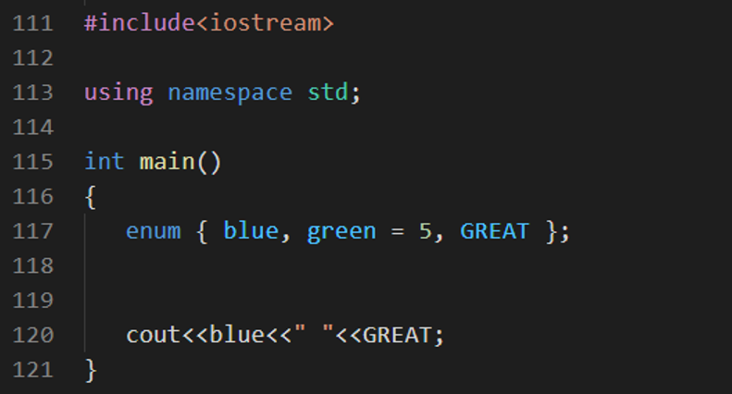
0 3
0 8
0 6
0 2

Slide 10
0 3
0 8
0 6
0 2
3 - 0 6. In enum, the element's value is one greater than the previous element. The value of blue is 0 by default, and the value of green is five, so the value of GREAT will become six automatically.

Slide 11
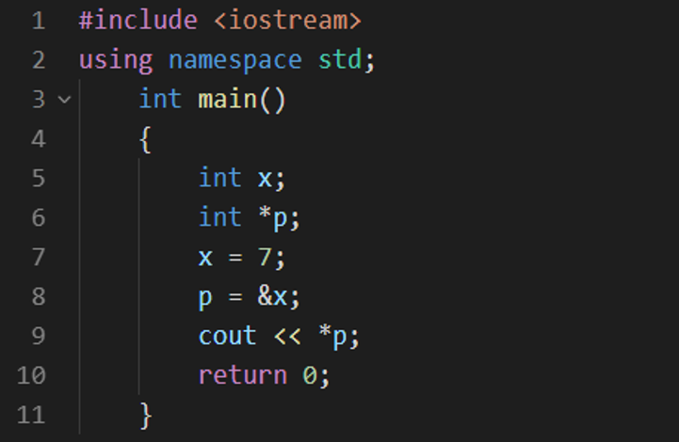
The output will be 7
The output will be 14
The output will be 0
The output will be 1

Slide 12
The output will be 7
The output will be 14
The output will be 0
The output will be 1
1 - Output will be 7. Pointer p has the memory address of x, and you display the pointer with a dereference operator that will display the value 7.

Slide 13
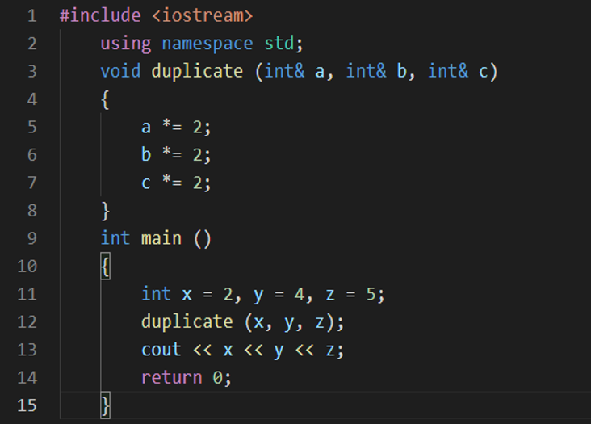
The output will be 245
The output will be 222
The output will be 4810
The output will be 4812

Slide 14
The output will be 245
The output will be 222
The output will be 4810
The output will be 4812
3 - Output will be 4810, because you are passing the references of the function here.

Slide 15
Which of the following is not a member of a class?
Static function
Virtual function
Const function
Friend function

Slide 16
Which of the following is not a member of a class?
Static function
Virtual function
Const function
Friend function
4 - Among the following, friend function is not a member of the class

Slide 17
Friend Function in C++
A friend function in C++ is a non-member function that is granted special permission to access the private and protected members of a class. Although its prototype is declared within the class using the friend keyword, it is defined outside the class's scope and is not considered a member function.

Slide 18
Key Characteristics
Non-Member Function: A friend function is not a member of the class it befriends, and therefore it is invoked like a normal function without using the dot (.) or arrow (->) operators on a class object.
Access Privileges: It can access all private, protected, and public members of the class directly, bypassing normal access control rules.
Declaration Location: A friend function can be declared anywhere in the class body (in the public, private, or protected section), and the location does not affect its access rights.
No this Pointer: Since it is not a member function, it does not have an implicit this pointer, so it must use a class object passed as an argument (usually by reference) to access the object's members.
Not Inherited or Transitive: Friendship is not inherited by derived classes and is not transitive (a friend of a friend is not a friend).
Not Mutual: Friendship must be explicitly granted by the class; if class A is a friend of class B, B is not automatically a friend of A.

Slide 19
#include <iostream>
using namespace std;
class Box {
private:
int width;
public:
Box(int w) : width(w) {}
// Declaration of the friend function inside the class
friend void printWidth(Box& b);
};
// Definition of the friend function outside the class
void printWidth(Box& b) {
// Can access private member 'width'
cout << "The width is: " << b.width << endl;
}
int main() {
Box boxObj(10);
printWidth(boxObj); // Called like a normal function, passing the object
return 0;
}

Slide 20
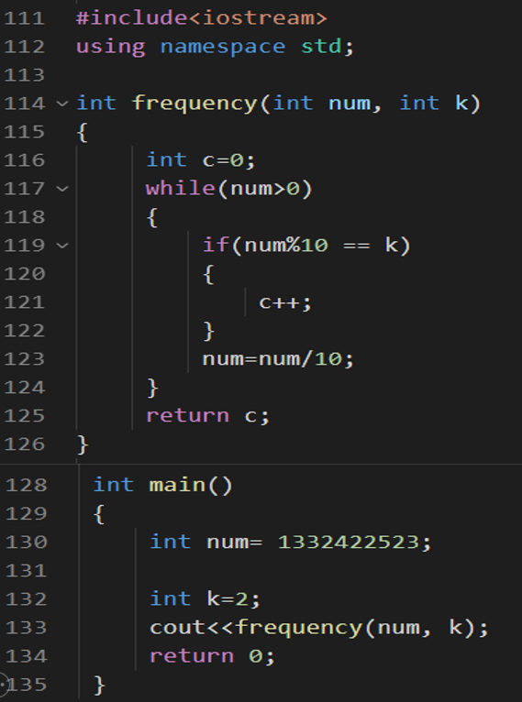
Sum of digits
Frequency of a digit
Reverse number

Slide 21
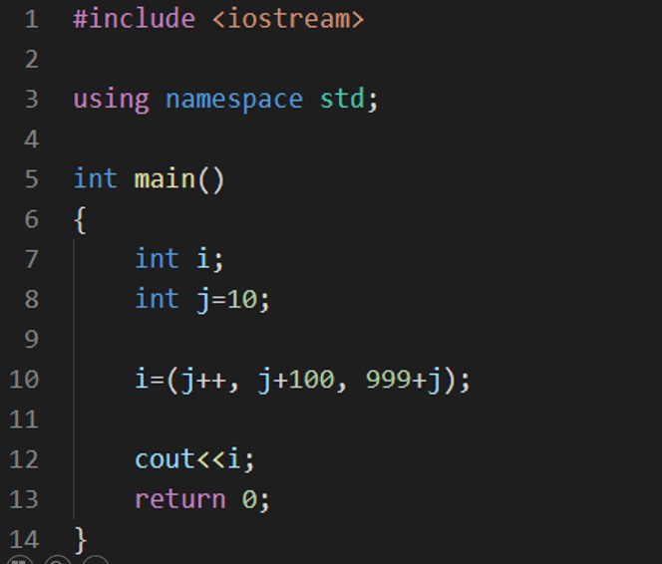
1010
1001
11
1000

Slide 22
1010
1001
11
1000
1 - 1010, the value of j is incremented to 11, then j value is added to 100 but not assigned, and at last the value of j i.e 11 is added to 999 which gives us 1010.

Slide 23
Pass by Value
#include <iostream>
using namespace std;
void modify(int x) {
x = x + 10;
}
int main() {
int a = 5;
modify(a);
cout << "Value after call by value: " << a << endl;
return 0;
}
#include <iostream>
using namespace std;
void modify(int &x) {
x = x + 10;
}
int main() {
int a = 5;
modify(a);
cout << "Value after call by reference: " << a << endl;
return 0;
}

Slide 24
Which statement checks if a number is negative?
A
if (x > 0)
B
if (x < 0)
C
if (x == 0)
D
if (x >= 0)

Slide 25
Which statement checks if a number is negative?
A
if (x > 0)
B
if (x < 0)
C
if (x == 0)
D
if (x >= 0)

Slide 26
What does the following code output?
int x = 4;
x *= 2 + 3;
cout << x;
A
20
B
14
C
10
D
Compilation Error

Slide 27
What does the following code output?
int x = 4;
x *= 2 + 3;
cout << x;
A
20
B
14
C
10
D
Compilation Error

Slide 28
What does the switch statement evaluate?
A. A float expression
B. A string expression
C. An integral or enumeration expression
D. A boolean expression

Slide 29
What does the switch statement evaluate?
A A float expression
B A string expression
C An integral or enumeration expression
D A boolean expression

Slide 30
What is the scope of a local variable?
A. Entire program
B. Function or block
C. File
D. Class

Slide 31
What is the scope of a local variable?
A. Entire program
B. Function or block
C. File
D. Class

Slide 32
What does the static keyword do in a function?
A. Makes the variable global
B. Preserves value between calls
C. Allocates dynamic memory
D. Makes it constant

Slide 33
What does the static keyword do in a function?
A. Makes the variable global
B. Preserves value between calls
C. Allocates dynamic memory
D. Makes it constant

Slide 34
What is the size of the array char arr[] = "geeksforgeeks";?
A. 12
B. 13
C. 15
D. 14

Slide 35
What is the size of the array char arr[] = "geeksforgeeks";?
A. 12
B. 13
C. 15
D. 14

Slide 36
#include <iostream>
using namespace std;
int main() {
int arr[3] = {1, 2};
for(int i = 0; i < 3; i++)
cout << arr[i] << " ";
return 0;
}

Slide 37
#include <iostream>
using namespace std;
int main() {
int arr[2][3] = {{1, 2, 3}, {4, 5, 6}};
cout << arr[1][1];
return 0;
}

Slide 38
#include <iostream>
using namespace std;
int main() {
int arr[5] = {1, 2, 3, 4, 5};
int* p = arr;
cout << *(p + 2);
return 0;
}

Slide 39
#include <iostream>
using namespace std;
int main() {
int arr[5] = {10, 20, 30, 40, 50};
int *p = arr + 1;
cout << p[2];
return 0;
}

Slide 40
#include <iostream>
using namespace std;
int main() {
int arr[] = {10, 20, 30, 40};
cout << sizeof(arr);
return 0;
}

Slide 41
#include<iostream>
using namespace std;
int main() {
int var = 5;
int *ptr = &var;
cout << *ptr;
return 0;
}

Slide 42
#include<iostream>
using namespace std;
void increment(int *ptr) {
(*ptr)++;
}
int main() {
int var = 5;
increment(&var);
cout << var;
return 0;
}

Slide 43
What is the correct way to dynamically create an object in C++?
A. ClassName obj = new ClassName();
B. ClassName *obj = new ClassName();
C. ClassName obj();
D. ClassName = new object();

Slide 44
What is the correct way to dynamically create an object in C++?
A. ClassName obj = new ClassName();
B. ClassName *obj = new ClassName();
C. ClassName obj();
D. ClassName = new object();

Slide 45
Which access specifier allows members to be accessed only within the class?
A. public
B. protected
C. private
D. none of them

Slide 46
Which access specifier allows members to be accessed only within the class?
A. public
B. protected
C. private
D. none of them

Slide 47
class Test {
int x;
};
int main()
{
Test t;
cout << t.x;
return 0;
}
A. 0
B. Garbage Value
C. Compiler Error
D. None of the Above

Slide 48
class Test {
int x;
};
int main()
{
Test t;
cout << t.x;
return 0;
}
A. 0
B. Garbage Value
C. Compiler Error
D. None of the Above

Slide 49
#include<stdio.h>
int main() {
int n;
for(n = 7; n!=0; n--)
printf("n = %d", n--);
getchar();
return 0;
}

Slide 50
#include<stdio.h>
int main()
{
printf("%x", -1<<1);
getchar();
return 0;
}

Slide 51
# include <stdio.h>
# define scanf "%s Geeks For Geeks "
main()
{
printf(scanf, scanf);
getchar();
return 0;
}

Slide 52
#include <stdlib.h>
#include <stdio.h>
enum {false, true};
int main()
{
int i = 1;
do
{
printf("%d\n", i);
i++;
if (i < 15)
continue;
} while (false);
getchar();
return 0;
}

Slide 53
#include<stdio.h>
char *getString()
{
char str[] = "Will I be printed?";
return str;
}
int main()
{
printf("%s", getString());
getchar();
}

Slide 54
#include<stdio.h>
int main()
{
static int var = 5;
printf("%d ",var--);
if(var)
main();
}

Slide 55
#include<stdio.h>
int main()
{
int x;
printf("%d",scanf("%d",&x));
/* Suppose that input value given
for above scanf is 20 */
return 1;
}

Slide 56
#include <stdio.h>
int main()
{
int i;
i = 1, 2, 3; //(1, 2, 3)
printf("i = %d\n", i);
getchar();
return 0;
}

Slide 57
#include <stdio.h>
int main()
{
int c = 5, no = 1000;
do {
no /= c;
} while(c--);
printf ("%d\n", no);
return 0;
}

Slide 58
int main()
{
unsigned int i=10;
while(i-- >= 0)
printf("%u ",i);
return 0;
}

Slide 59
int main()
{
unsigned int i=65000;
while ( i++ != 0 );
printf("%d",i);
return 0;
}

Slide 60
#define a 10
int main()
{
#define a 50
printf("%d",a);
getchar();
return 0;
}

Slide 61
int main()
{
char arr[] = "geeksforgeeks";
char *ptr = arr;
while(*ptr != '\0')
++*ptr++;
printf("%s %s", arr, ptr);
getchar();
return 0;
}
Postfix ++ left-to-right
Prefix ++ right-to-left
Dereference * right-to-left

Slide 62
int main()
{
signed char i=0;
for(; i >= 0; i++);
printf("%d\n", i);
getchar();
return 0;
}

Slide 63
1. Find the largest number among the three numbers.
#include <stdio.h>
int main(){
int a = 1, b = 2, c = 3;
// condition for a is greatest
if (a > b && a > c)
printf("%d", a);
// condition for b is greatest
else if (b > a && b > c)
printf("%d", b);
// remaining conditions // c is greatest
else
printf("%d", c);
return 0;
}

Slide 64
2. Write a Program to check whether a number is prime or not.
int main() {
int n = 91;
int cnt = 0;
// If number is less than/equal to 1, // it is not prime
if (n <= 1)
printf("%d is NOT prime\n", n);
else {
// Check for divisors from 1 to n
for (int i = 1; i <= n; i++) {
// Check how many number is divisible
// by n
if (n % i == 0)
cnt++;
}
// If n is divisible by more than 2 numbers
// then it is not prime
if (cnt > 2)
printf("%d is NOT prime\n", n);
// else it is prime
else
printf("%d is prime", n);
}
return 0;
}

Slide 65
4. Write a Program in C to Swap the values of two variables without using any extra variable.
#include <stdio.h>
int main()
{
int x = 10;
int y = 20;
printf("x: %d , y: %d\n", x, y);
// x hold 30
x = x + y;
// y hold 10
y = x - y;
// Now, x hold 20
x = x - y;
printf("x: %d , y: %d\n", x, y);
return 0;
}

Slide 66
5. Write a Program to Replace all 0’s with 1’s in a Number.
int main()
{
int N = 102301;
int ans = 0;
int i = 0;
while (N != 0) {
// Condition to change value
if (N % 10 == 0)
ans = ans + 1 * pow(10, i);
else
ans = ans + (N % 10) * pow(10, i);
N = N / 10;
i++;
}
printf("%d", ans);
return 0;
}

Slide 67
6. Write a Program to convert the binary number into a decimal number.
// C Program for converting
// binary to decimal
#include <stdio.h>
int main()
{
int N = 11011;
// Initializing base value a to 1
int a = 1;
int ans = 0;
while (N != 0) {
ans = ans + (N % 10) * a;
N = N / 10;
a = a * 2;
}
printf("%d", ans);
return 0;
}

Slide 68
7. Write a Program to check if the year is a leap year or not.
// C Program to check
// Year is leap year or not
#include <stdio.h>
// Function Declaration to check leap year
void leap_year(int year)
{
// If a year is multiple of 400, then leap year
if (year % 400 == 0)
printf("%d is a leap year.\n", year);
// If a year is multiple of 100, then not a leap year
else if (year % 100 == 0)
printf("%d is not a leap year.\n", year);
// If a year is multiple of 4, then leap year
else if (year % 4 == 0)
printf("%d is a leap year.\n", year);
// Not leap year
else
printf("%d is not a leap year.\n", year);
}
int main()
{
leap_year(2000);
leap_year(2002);
leap_year(2008);
return 0;
}

Slide 69
8. Write a program to Factorial of a Number.
void factorial_iteration(int N)
{
unsigned long long int ans = 1;
for (int i = 1; i <= N; i++) {
ans = ans * i;
}
printf("Factorial of %d is %lld\n", N, ans);
}
int factorial(int N)
{
if (N == 0)
return 1;
// Recursive call
return N * factorial(N - 1);
}
int main()
{
int n;
n = 13;
factorial_iteration(n);
n = 9;
printf("Factorial of %d using recursion:%d\n", n,
factorial(n));
return 0;
}

Slide 70
9. Write a Program to Check if a number is an Armstrong number or not.
int power(int x, unsigned int y)
{
if (y == 0)
return 1;
if (y % 2 == 0)
return power(x, y / 2) * power(x, y / 2);
return x * power(x, y / 2) * power(x, y / 2);
}
// Function to calculate order of the number
int order(int n)
{
int res = 0;
while (n) {
res++;
n = n / 10;
}
return res;
}
// Function to check whether the given number is
// Armstrong number or not
int isArmstrong(int x)
{
// Calling order function
int n = order(x);
int temp = x, sum = 0;
while (temp) {
int r = temp % 10;
sum += power(r, n);
temp = temp / 10;
}
// If satisfies Armstrong condition
if (sum == x)
return 1;
else
return 0;
}
// Driver Program
int main()
{
int x = 120;
if (isArmstrong(x) == 1)
printf("True\n");
else
printf("False\n");
x = 1634;
if (isArmstrong(x) == 1)
printf("True\n");
else
printf("False\n");
return 0;
}

Slide 71
10. Write a program to Find all the roots of a quadratic equation in C.
#include <math.h>
#include <stdio.h>
#include <stdlib.h>
// Prints roots of quadratic equation ax*2 + bx + x
void find_roots(int a, int b, int c)
{
// If a is 0, then equation is not quadratic, but
// linear
if (a == 0) {
printf("Invalid");
return;
}
int d = (b * b) - (4 * a * c);
double sqrt_val = sqrt(abs(d));
if (d > 0) {
printf("Roots are real and different \n");
printf("%f\n%f", (double)(-b + sqrt_val) / (2 * a),
(double)(-b - sqrt_val) / (2 * a));
}
else if (d == 0) {
printf("Roots are real and same \n");
printf("%f", -(double)b / (2 * a));
}
else if (d == 0) {
printf("Roots are real and same \n");
printf("%f", -(double)b / (2 * a));
}
else // d < 0
{
printf("Roots are complex \n");
printf("%f + i%f\n%f - i%f", -(double)b / (2 * a),
sqrt_val / (2 * a), -(double)b / (2 * a),
sqrt_val / (2 * a));
}
}
// Driver code
int main()
{
int a = 1, b = -16, c = 1;
// Function call
find_roots(a, b, c);
return 0;
}

Slide 72
11. Write a Program to reverse a number.
int reverse_iteration(int N){
int ans = 0;
while (N != 0) {
ans = ans * 10 + (N % 10);
N = N / 10;
}
return ans;
}
// recursive approach
int reverse(int n, int ans)
{
if (n == 0)
return ans;
ans = ans * 10 + n % 10;
return reverse(n / 10, ans);
}
int main()
{
int N = 15942;
printf("Initial number:%d\n", N);
N = reverse_iteration(N);
printf("%d after reverse using iteration\n", N);
int ans = 0;
ans = reverse(N, ans);
printf("%d after again reverse using recursion", ans);
return 0;
}

Slide 73
12. Check whether a number is a palindrome.
void check_palindrome(int N)
{
int T = N;
int rev = 0; // This variable stored reversed digit
// Execute a while loop to reverse digits of given
// number
while (T != 0) {
rev = rev * 10 + T % 10;
T = T / 10;
}
// Compare original_number with reversed number
if (rev == N)
printf("%d is palindrome\n", N);
else
printf("%d is not a palindrome\n", N);
}
int main()
{
int N = 13431;
int M = 12345;
// Function call
check_palindrome(N);
check_palindrome(M);
return 0;
}

Slide 74
13. Write a C Program to check if two numbers are equal without using the comparison operator.
// C Program for checking numbers
// are equal using bitwise operator
#include <stdio.h>
int main()
{
int x = 1;
int y = 2;
// Using XOR
// XOR of two equal numbers is 0
if (!(x ^ y))
printf(" %d is equal to %d ", x, y);
else
printf(" %d is not equal to %d ", x, y);
return 0;
}

Slide 75
14. Write a C program to find the GCD of two numbers.
// C program to find GCD of two numbers
#include <math.h>
#include <stdio.h>
// Function to return gcd of a and b
int gcd(int a, int b)
{
// Find Minimum of a and b
int result = ((a < b) ? a : b);
while (result > 0) {
if (a % result == 0 && b % result == 0) {
break;
}
result--;
}
return result; // return gcd of a and b
}
// Driver program to test above function
int main()
{
int a = 98, b = 56;
printf("GCD of %d and %d is %d ", a, b, gcd(a, b));
return 0;
}

Slide 76
15. Write a C program to find the LCM of two numbers.
// C program to find
// LCM of two numbers
#include <stdio.h>
// minimum of two numbers
int Min(int Num1, int Num2)
{
if (Num1 >= Num2)
return Num2;
else
return Num1;
}
int LCM(int Num1, int Num2, int K)
{
// If either of the two numbers
// is 1, return their product
if (Num1 == 1 || Num2 == 1)
return Num1 * Num2;
// If both the numbers are equal
if (Num1 == Num2)
return Num1;
// If K is smaller than the
// minimum of the two numbers
if (K <= Min(Num1, Num2)) {
// Checks if both numbers are
// divisible by K or not
if (Num1 % K == 0 && Num2 % K == 0) {
// Recursively call LCM() function
return K * LCM(Num1 / K, Num2 / K, 2);
}
// Otherwise
else
return LCM(Num1, Num2, K + 1);
}
// If K exceeds minimum
else
return Num1 * Num2;
}
int main()
{
// Given N & M
int N = 12, M = 9;
// Function Call
int ans = LCM(N, M, 2);
printf("%d", ans);
return 0;
}

Slide 77
Min and Max with no condition no loop
// C Program to check
// Maximum and Minimum
// Between two numbers
// Without any condition or loop
#include <stdio.h>
#include <stdlib.h>
int main()
{
int a = 55, b = 23;
// return maximum among the two numbers
printf("max = %d\n", ((a + b) + abs(a - b)) / 2);
// return minimum among the two numbers
printf("min = %d", ((a + b) - abs(a - b)) / 2);
return 0;
}

Slide 78
Print N natual numbers without semi-colon
// C program to print
// all natural numbers
// upto N without using semi-colon
#include <stdio.h>
#define N 10
int main(int val)
{
if (val <= N && printf("%d ", val) && main(val + 1)) {
}
}

Slide 79
19. Write a Program to create a pyramid pattern using C.
// C Program print Pyramid pattern
#include <stdio.h>
int main()
{
int N = 5;
// Outer Loop for number of rows
for (int i = 1; i <= N; i++) {
// inner Loop for space printing
for (int j = 1; j <= N - i; j++)
printf(" ");
// inner Loop for star printing
for (int j = 1; j < 2 * i; j++)
printf("*");
printf("\n");
}
return 0;
}

Slide 80
22. Write a program to reverse an Array.
#include <stdio.h>
void reverse(int* arr, int n){
// Swapping front and back elements.
for (int i = 0, j = n - 1; i < j; i++, j--) {
int ele = arr[i];
arr[i] = arr[j];
arr[j] = ele;
}
}
int main(){
int arr[] = { 1, 2, 3, 4, 5 };
// Function Call
reverse(arr, 5);
// reverse array element printing
for (int i = 0; i < 5; i++)
printf("%d ", arr[i]);
return 0;
}

Slide 81
23. Write a program to check the repeating elements in C.
#include <stdio.h>
int Sort(int arr[], int size){
for (int i = 0; i < size - 1; i++) {
for (int j = 0; j < size - i - 1; j++) {
if (arr[j] > arr[j + 1]) {
int temp = arr[j];
arr[j] = arr[j + 1];
arr[j + 1] = temp;
}
}
}
}
void findRepeating(int arr[], int n)
{
int count = 0;
for (int i = 0; i < n; i++) {
int flag = 0;
while (i < n - 1 && arr[i] == arr[i + 1]) {
flag = 1;
i++;
}
if (flag)
printf("%d ", (arr[i - 1]));
} return;
}
int main()
{
int arr[] = { 1, 3, 4, 1, 2, 3, 5, 5 };
int n = sizeof(arr) / sizeof(arr[0]);
Sort(arr,n);
findRepeating(arr,n);
return 0;
}

Slide 82
24. Write a Program to print the Maximum and Minimum elements in an array.
#include <stdio.h>
void find_small_large(int arr[], int n)
{
int min, max;
// assign first element as minimum and maximum
min = arr[0];
max = arr[0];
for (int i = 1; i < n; i++) {
// finding smallest here
if (arr[i] < min)
min = arr[i]; // finding largest here
if (arr[i] > max)
max = arr[i];
}
printf("Maximum: %d and Minimum: %d\n", min, max);
}
int main()
{
int arr[] = { 15, 14, 35, 2, 11, 83 };
int len = sizeof(arr) / sizeof(arr[0]);
// Function call
find_small_large(arr, len);
return 0;
}

Slide 83
25. Write a Program for the cyclic rotation of an array to k positions.
void printArray(int arr[], int n){
int i;
for (i = 0; i < n; i++)
printf("%d ", arr[i]); }
int gcd(int a, int b){
if (b == 0)
return a;
else
return gcd(b, a % b);}
// Rotate array
void Rotate(int arr[], int k, int N){
int i, j, a, temp;
k = k % N;
int rotate = gcd(k, N);
for (i = 0; i < rotate; i++) {
temp = arr[i];
j = i;
while (1) {
a = j + k;
if (a >= N)
a = a - N;
if (a == i)
break;
arr[j] = arr[a];
j = a;
}
arr[j] = temp;
}
}
int main()
{
int arr[] = { 1, 2, 3, 4, 5 };
// Rotating array
Rotate(arr, 2, 5);
// Printing array
printArray(arr, 5);
return 0;
}
void printArray(int arr[], int n){
int i;
for (i = 0; i < n; i++)
printf("%d ", arr[i]); }
int gcd(int a, int b){
if (b == 0)
return a;
else
return gcd(b, a % b);}
// Rotate array
void Rotate(int arr[], int k, int N){
int i, j, a, temp;
k = k % N;
int rotate = gcd(k, N);
for (i = 0; i < rotate; i++) {
temp = arr[i];
j = i;
while (1) {
a = j + k;
if (a >= N)
a = a - N;
if (a == i)
break;
arr[j] = arr[a];
j = a;
}
arr[j] = temp;
}
}
int main()
{
int arr[] = { 1, 2, 3, 4, 5 };
// Rotating array
Rotate(arr, 2, 5);
// Printing array
printArray(arr, 5);
return 0;
}

Slide 84
26. Write a Program to sort First half in Ascending order and the Second in Descending order.

Slide 85
27. Write a Program to print sums of all subsets in an array.

Slide 86
28. Write a Program to Find if there is any subarray with a sum equal to 0.

Slide 87
29. Write a C program to Implement Kadane's Algorithm

Slide 88
30. Write a Program to find the transpose of a matrix.

Slide 89
31. Write a Program to Rotate a matrix by 90 degrees in the clockwise direction in C.

Slide 90
32. Write a Program to find the Spiral Traversal of a Matrix in C.

Slide 91
33. Write a program to count the sum of numbers in a string.

Slide 92
34. Program to calculate the length of the string.

Slide 93
35. Write a program to check string is a palindrome.

Slide 94
36. Write a program to print all permutations of a given string in lexicographically sorted order in C.

Slide 95
37. Write a program to calculate the Power of a Number using Recursion in C.

Slide 96
38. Write a Code to print the Fibonacci series using recursion.

Slide 97
39. Write a Program to find the HCF of two Numbers using Recursion.

Slide 98
40. Write a Program in C to reverse a string using recursion.

Slide 99
The best data structure to check whether an arithmetic expression has balanced parenthesis is a
A
Queue
B
Stack
C
Tree
D
List

Slide 100
The best data structure to check whether an arithmetic expression has balanced parenthesis is a
A
Queue
B
Stack
C
Tree
D
List

Slide 101
The minimum number of stacks needed to implement a queue is
A. 3
B. 1
C. 2
D. 4

Slide 102
The minimum number of stacks needed to implement a queue is
A. 3
B. 1
C. 2
D. 4

Slide 103
The five items: A, B, C, D, and E are pushed in a stack, one after other starting from A. The stack is popped four items and each element is inserted in a queue. The two elements are deleted from the queue and pushed back on the stack. Now one item is popped from the stack. The popped item is
A. A
B. B
C. C
D. D

Slide 104
The five items: A, B, C, D, and E are pushed in a stack, one after other starting from A. The stack is popped four items and each element is inserted in a queue. The two elements are deleted from the queue and pushed back on the stack. Now one item is popped from the stack. The popped item is
A. A
B. B
C. C
D. D

Slide 105
Which one of the following is an application of Stack Data Structure?
A. Managing function calls
B. The stock span problem
C. Arithmetic expression evaluation
D. All of the above

Slide 106
Which one of the following is an application of Stack Data Structure?
A. Managing function calls
B. The stock span problem
C. Arithmetic expression evaluation
D. All of the above

Slide 107
Which of the following is true about linked list implementation of stack?
A. In push operation, if new nodes are inserted at the beginning of linked list, then in pop operation, nodes must be removed from end.
B. In push operation, if new nodes are inserted at the end, then in pop operation, nodes must be removed from the beginning.
C. Both of the above
D. None of the above

Slide 108
Which of the following is true about linked list implementation of stack?
A. In push operation, if new nodes are inserted at the beginning of linked list, then in pop operation, nodes must be removed from end.
B. In push operation, if new nodes are inserted at the end, then in pop operation, nodes must be removed from the beginning.
C. Both of the above
D. None of the above

Slide 109
Consider the following sequence of operations on an empty stack.
Push(54);push(52);pop();push(55);push(62);s=pop(); Consider the following sequence of operations on an empty queue.
enqueue(21);enqueue(24);dequeue();enqueue(28);enqueue(32);q=dequeue(); The value of s+q is ___________.
A. 86
B. 68
C. 24
D. 94

Slide 110
Consider the following sequence of operations on an empty stack.
Push(54);push(52);pop();push(55);push(62);s=pop(); Consider the following sequence of operations on an empty queue.
enqueue(21);enqueue(24);dequeue();enqueue(28);enqueue(32);q=dequeue(); The value of s+q is ___________.
A. 86
B. 68
C. 24
D. 94

Slide 111
Convert the following infix expression into its equivalent post fix expression (A + B^ D) / (E – F) + G
A. ABD^ + EF – / G+
B. ABD + ^EF – / G+
C. ABD + ^EF / – G+
D. ABD^ + EF / – G+

Slide 112
Convert the following infix expression into its equivalent post fix expression (A + B^ D) / (E – F) + G
A. ABD^ + EF – / G+
B. ABD + ^EF – / G+
C. ABD + ^EF / – G+
D. ABD^ + EF / – G+

Slide 113
Which of the following is not an inherent application of stack?
A. Implementation of recursion
B. Evaluation of a postfix expression
C. Job scheduling
D. Reverse a string

Slide 114
Which of the following is not an inherent application of stack?
A. Implementation of recursion
B. Evaluation of a postfix expression
C. Job scheduling
D. Reverse a string

Slide 115
Consider the following operations performed on a stack of size 5 : Push (a); Pop() ; Push(b); Push(c); Pop(); Push(d); Pop();Pop(); Push (e) Which of the following statements is correct?
A. Underflow occurs
B. Stack operations are performed smoothly
C. Overflow occurs
D. None of the above

Slide 116
Consider the following operations performed on a stack of size 5 : Push (a); Pop() ; Push(b); Push(c); Pop(); Push(d); Pop();Pop(); Push (e) Which of the following statements is correct?
A. Underflow occurs
B. Stack operations are performed smoothly
C. Overflow occurs
D. None of the above

Slide 117
If the sequence of operations - push (1), push (2), pop, push (1), push (2), pop, pop, pop, push (2), pop are performed on a stack, the sequence of popped out values
A. 2,2,1,1,2
B. 2,2,1,2,2
C. 2,1,2,2,1
D. 2,1,2,2,2

Slide 118
If the sequence of operations - push (1), push (2), pop, push (1), push (2), pop, pop, pop, push (2), pop are performed on a stack, the sequence of popped out values
A. 2,2,1,1,2
B. 2,2,1,2,2
C. 2,1,2,2,1
D. 2,1,2,2,2

Slide 119
The seven elements A, B, C, D, E, F and G are pushed onto a stack in reverse order, i.e., starting from G. The stack is popped five times and each element is inserted into a queue.Two elements are deleted from the queue and pushed back onto the stack. Now, one element is popped from the stack. The popped item is ________.
A. A
B. B
C. F
D. G

Slide 120
The seven elements A, B, C, D, E, F and G are pushed onto a stack in reverse order, i.e., starting from G. The stack is popped five times and each element is inserted into a queue.Two elements are deleted from the queue and pushed back onto the stack. Now, one element is popped from the stack. The popped item is ________.
A. A
B. B
C. F
D. G

Slide 121
Following is a pseudo code of a function that takes a number as an argument, and uses a stack S to do processing.
def fun(n):
S = [] # Say it creates an empty stack S
while n > 0: # This line pushes the value of n%2 to stack S
S.append(n % 2)
n = n // 2 # Run while Stack S is not empty
while S:
print(S.pop(), end=' ') # pop an element from S and print it
What does the above function do in general?
A. Prints binary representation of n in reverse order
B. Prints binary representation of n
C. Prints the value of Logn
D. Prints the value of Logn in reverse order

Slide 122
Following is a pseudo code of a function that takes a number as an argument, and uses a stack S to do processing.
def fun(n):
S = [] # Say it creates an empty stack S
while n > 0: # This line pushes the value of n%2 to stack S
S.append(n % 2)
n = n // 2 # Run while Stack S is not empty
while S:
print(S.pop(), end=' ') # pop an element from S and print it
What does the above function do in general?
A. Prints binary representation of n in reverse order
B. Prints binary representation of n
C. Prints the value of Logn
D. Prints the value of Logn in reverse order

Slide 123
The result evaluating the postfix expression 10 5 + 60 6 / * 8 – is
A. 284
B. 213
C. 142
D. 71

Slide 124
The result evaluating the postfix expression 10 5 + 60 6 / * 8 – is
A. 284
B. 213
C. 142
D. 71

Slide 125
To evaluate an expression without any embedded function calls :
A. As many stacks as the height of the expression tree are needed
B. One stack is enough
C. Two stacks are needed
D. A Turing machine is needed in the general case

Slide 126
To evaluate an expression without any embedded function calls :
A. As many stacks as the height of the expression tree are needed
B. One stack is enough
C. Two stacks are needed
D. A Turing machine is needed in the general case

Slide 127
The following postfix expression with single digit operands is evaluated using a stack:
8 2 3 ^ / 2 3 * + 5 1 * -
Note that ^ is the exponentiation operator. The top two elements of the stack after the first * is evaluated are:
A. 6, 1
B. 5, 7
C. 3, 2
D. 1, 5

Slide 128
The following postfix expression with single digit operands is evaluated using a stack:
8 2 3 ^ / 2 3 * + 5 1 * -
Note that ^ is the exponentiation operator. The top two elements of the stack after the first * is evaluated are:
A. 6, 1
B. 5, 7
C. 3, 2
D. 1, 5

Slide 129
C - Overview
Basic Syntax
Consider the below Hello World program:
// C Hello World program
#include <stdio.h>
int main()
{
printf("Hello World!");
return 0;
}

Slide 130
Here,
#include <stdio.h>: The header file inclusion to use printf() function.
int main(): The main() function is the entry point of any C program.
printf("Hello World"): Function to print hello world.
return 0: Value returned by the main() function.

Slide 131
Variables
A variable is the name given to the memory location that stores some data.
Syntax of Variable
data_type variable_name;
data_type variable_name = initial_value;
A variable can be of the following types:
Local Variable
Global Variable
Static Variable
Extern Variable
Auto Variable
Register Variable
Note: There are a few rules which we have to follow while naming a variable.

Slide 132
Data Types
The data type is the type of data that a given variable can store. Different data types have different sizes. There are 3 types of data types in C:
Basic Data Types
Derived Data Types
User Defined Data Types

Slide 133
1. Basic Data Types
Basic data types are built-in in the C programming language and are independent of any other data type. There are x types of basic data types in C:
char: Used to represent characters.
int: Used to represent integral numbers.
float: Used to represent decimal numbers up to 6-7 precision digits.
double: Used to represent decimal numbers up to 15 precision digits.
void: Used to represent the valueless entity.

Slide 134
Example of Basic Data Types
char c = 'a’;
int integer = 24;
float f = 24.32;
double d = 24.3435;
void v;
The size of these basic data types can be modified using data type modifiers which are:
short
long
signed
Unsigned
Example of Data Type Modifiers
unsigned int var1;
long double var2;
long int var3;

Slide 135
2. Derived Data Types
Derived data types are derived from the basic data types. There are 2 derived data types in C:
Arrays
Pointers

Slide 136
3. User-Defined Data Types
The user-defined data types are the data types that are defined by the programmers in their code. There are 3 user-defined data types in C:
Structure
Union
Enumeration

Slide 137
Identifiers
Identifiers is the name given to the variables, functions, structure, etc. Identifiers should follow the following set of rules:
A variable name must only contain alphabets, digits, and underscore.
A variable name must start with an alphabet or an underscore only. It cannot start with a digit.
No whitespace is allowed within the variable name.
A variable name must not be any reserved word or keyword.
Example of Identifiers
var, any_other_name, __this_var, var22;

Slide 138
Keywords
Keywords are the reserved words that have predefined meanings in the C compiler. They cannot be used as identifiers.
Example of Keywords
auto, float, int, return, switch

Slide 139
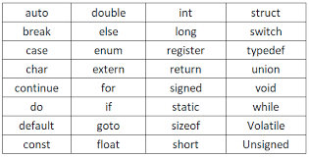

Slide 140
Basic Input and Output
The basic input and output in C are done using two <stdio.h> functions namely scanf() and print() respectively.
Basic Output - print()
The printf() function is used to print the output on the standard output device which is generally the display screen.
Syntax of printf()
printf("formatted-string", ...{arguments-list});
where,
formatted-string: String to be printed. It may contain format specifiers, escape sequences, etc.
arguments-list: It is the list of data to be printed.

Slide 141
Basic Input and Output
Basic Input - scanf()
The scanf() function is used to take input from the standard input device such as the keyboard.
Syntax of scanf()
scanf("formatted-string", {address-argument-list});
where,
formatted-string: String that describes the format of the input.
address-of-arguments-list: It is the address list of the variables where we want to store the input.

Slide 142
// C program to illustrate the basic input and output using
// printf() and scanf()
#include <stdio.h>
int main()
{
int roll_num;
char name[50];
// taking input using scanf
scanf("Enter Roll No.: %d", &roll_num);
scanf("Enter Name: %s", name);
// printing output using printf
printf("Name is %s and Roll Number is %d", name,
roll_num);
return 0;
}

Slide 143
Format Specifiers
Format specifiers are used to describe the format of input and output in formatted string. It is different for different data types. It always starts with %
The following is the list of some commonly used format specifiers in C:
Format Specifier | Description
%c | For b type.
%d | For signed integer type.
%f | For float type.
%lf | Double
%p | Pointer
%s | String
%u | Unsigned int
%% | Prints % character

Slide 144
Escape Sequence
Escape sequences are the characters that are used to represent those characters that cannot by represented normally. They start with ( \ ) backslash and can be used inside string literals.
The below table list some commonly used escape sequences:
Escape Sequence | Name | Description
\b | Backspace | It is used to move the cursor backward.
\n | New Line | It moves the cursor to the start of the next line.
\r | Carriage Return | It moves the cursor to the start of the current line.
\t | Horizontal Tab | It inserts some whitespace to the left of the cursor and moves the cursor accordingly.
\v | Vertical Tab | It is used to insert vertical space.
\\ | Backlash | Use to insert backslash character.
\” | Double Quote | It is used to display double quotation marks.
\0 | NULL | It represents the NLL character.

Slide 145
Operators
Operators are the symbols that are used to perform some kind of operation. Operators can be classified based on the type of operation they perform.
There are the following types of operators in C:
S.No. | Operator Type | Description | Example
1. | Arithmetic Operators | Operators that perform arithmetic operations. | +, -, *, /, %
2. | Relational Operators | They are used to compare two values. | <, >, <=, >=, ==, !=
3. | Bitwise Operators | They are used to perform bit-level operations on integers. | &, ^, |, <<, >>, ~
4. | Logical Operators | They perform logical operations such as logical AND, logical OR, etc. | &&, ||, !
5. | Conditional Operators | The conditional Operator is used to insert conditional code. | ? :
6. | Assignment Operators | They are used to assign some value to the variables. | =, +=, -=, <<=
7. | Miscellaneous Operators | comma, addressof, sizeof, etc. are some other types of operators. | , sizeof, &, *, ->, .

Slide 146
Conditional Statements
Conditional statements are used to execute some block of code based on whether the given condition is true. There are the following conditional statements in C:
1. if Statement
if statement contains a block of code that will be executed if and only if the given condition is true.
Syntax of if
if (condition) { // statements }

Slide 147
2. if-else Statements
The if-else statement contains the else block in addition to the if block which will be executed if the given condition is false.
Syntax if-else
if (expression)
{ // if block }
else
{ // else block }

Slide 148
3. if-else-if Ladder
The if-else-if ladder is used when we have to test multiple conditions and for each of these conditions, we have a separate block of code.
Syntax of if-else-if
if (expression)
{ // block 1 }
else if (expression)
{ // block 1 }
. . .
else
{ // else block }

Slide 149
4. switch Case Statement
The switch case statement is an alternative to the if-else-if ladder that can execute different blocks of statements based on the value of the single variable named switch variable.
Syntax of switch
switch (expression)
{ case value1: // statements break;
case value2: // statements break;
. . .
default: // defualt block break;
}

Slide 150
5. Conditional Operator
The conditional operator is a kind of single-line if-else statement that tests the condition and executes the true and false statements.
Syntax of Conditional Operator
(condition) ? (true-exp) : (false-exp);

Slide 151
// C program to illustrate conditional statements
#include <stdio.h>
int main()
{
// conditional operator will assign 10 if 5 < 25,
// otherwise it will assign 20
int i = 5 < 25 ? 10 : 20;
if (i == 10)
printf("i is 10");
else if (i == 15)
printf("i is 15");
else if (i == 20)
printf("i is 20");
else
printf("i is not present");
}

Slide 152
Loops
Loops are the control statements that are used to repeat some block of code till the specified condition is false. There are 3 loops in C:
1. for Loop
The for loop is an entry-controlled loop that consists initialization, condition, and updating as a part of itself.
Syntax of for
for (initialization; condition; updation)
{ // statements }

Slide 153
2. while Loop
The while loop is also an entry-controlled loop but only the condition is the part of is syntax.
Syntax of while
while (condition)
{
// statement to be repeated
}

Slide 154
3. do-while Loop
The do-while loop is an exit-controlled loop in which the condition is checked after the body of the loop.
Syntax of do-while
do {
// statements
} while (condition);

Slide 155
Jump Statements
Jump statements are used to override the normal control flow of the program. There are 3 jump statements in C:
1. break Statement
It is used to terminate the loop and bring the program control to the statements after the loop.
Syntax of break
break;
It is also used in the switch statement.

Slide 156
2. continue Statement
The continue statement skips the current iteration and moves to the next iteration when encountered in the loop.
Syntax of continue
continue;

Slide 157
3. goto Statement
The goto statement is used to move the program control to the predefined label.
Syntax of goto
goto label; | label:
. | .
. | .
. | .
label: | goto label;

Slide 158
// C program to illustrate loops
#include <stdio.h>
// Driver code
int main(){
int i = 0;
// for loop with continue
for (i = 1; i <= 10; i++) {
if (i == 5 || i == 7) {
continue;
}
printf("%d ", i);
}
printf("\n");
// while loop with break
i = 1;
while (i <= 10) {
if (i == 7) {
break;
}
printf("%d ", i++);
}
printf("\n");
// do_while loop
i = 1;
do {
printf("%d ", i++);
} while (i <= 10);
printf("\n");
// goto statement
i = 1;
any_label:
printf("%d ", i++);
if (i <= 10) {
goto any_label;
}
return 0;
}

Slide 159
Arrays
An array is a fixed-size homogeneous collection of items stored at a contiguous memory location. It can contain elements from type int, char, float, structure, etc. to even other arrays.
Array provides random access using the element index.
Array size cannot change.
Array can have multiple dimensions in which it can grow.
Syntax of Arrays
data_type arr_name [size1]; // 1D array data_type arr_name [size1][size2]; // 2D array data_type arr_name [size1][size2][size3]; // 3D array

Slide 160
// C Program to demonstrate the use of array
#include <stdio.h>
int main()
{
// array declaration and initialization
int arr[5] = { 10, 20, 30, 40, 50 };
// modifying element at index 2
arr[2] = 100;
// traversing array using for loop
printf("Elements in Array: ");
for (int i = 0; i < 5; i++) {
printf("%d ", arr[i]);
}
return 0;
}

Slide 161
Strings
Strings are the sequence of characters terminated by a '\0' NULL character. It is stored as the array of characters in C.
Syntax of Strings
char string_name [] = "any_text";

Slide 162
// C program to illustrate strings
#include <stdio.h>
#include <string.h>
int main()
{
// declare and initialize string
char str[] = "Geeks";
// print string
printf("%s\n", str);
int length = 0;
length = strlen(str);
// displaying the length of string
printf("Length of string str is %d", length);
return 0;
}

Slide 163
C String Functions
C language provides some useful functions for string manipulation in <string.h> header file. Some of them are as follows:
S. No. | Function | Description
1. | strlen() | Find the length of the string
2. | strcmp() | Compares two strings.
3. | strcpy() | Copy one string to another.
4. | strcat() | Concatenate one string with another.
5. | strchr() | Find the given character in the string.
6. | strstr() | Find the given substring in the string.

Slide 164
Pointers
Pointers are the variables that store the address of another variable. They can point to any data type in C
Syntax of Pointers
data_type * ptr_name;
Note: The addressof (&) operator is used to get the address of a variable.
We can dereference (access the value pointed by the pointer) using the same * operator.

Slide 165
// C program to illustrate Pointers
#include <stdio.h>
// Driver program
int main()
{
int var = 10;
// declare pointer variable
int* ptr;
// note that data type of ptr and var must be same
ptr = &var;
// assign the address of a variable to a pointer
printf("Value at ptr = %p \n", ptr);
printf("Value at var = %d \n", var);
printf("Value at *ptr = %d \n", *ptr);
return 0;
}

Slide 166
There are different types of pointers based on different classification parameters. Some of them are:
Double Pointers
Function Pointers
Structure Pointers
NULL Pointers
Dangling Pointers
Wild Pointers

Slide 167
Functions
Functions are the block of statements enclosed within { } braces that perform some specific task. They provide code reusability and modularity to the program.
Function Syntax is divided into three parts:
1. Function Prototype
It tells the compiler about the existence of the function.
return_type function_name ( parameter_type_list... );
where,
Return Type: It is the type of optional value returned by the function. Only one value can be returned.
Parameters: It is the data passed to the function by the caller.

Slide 168
2. Function Definition
It contains the actual statements to be executed when the function is called.
return_type function_name ( parameter_type_name_list... ) { // block of statements . . }

Slide 169
3. Function Call
Calls the function by providing arguments. A function call must always be after either function definition or function prototype.
function_name (arguments);

Slide 170
// C program to show function // call and definition
#include <stdio.h>
// Function that takes two parameters
// a and b as inputs and returns
// their sum
int sum(int a, int b) { return a + b; }
// Driver code
int main()
{
// Calling sum function and
// storing its value in add variable
int add = sum(10, 30);
printf("Sum is: %d", add);
return 0;
}

Slide 171
Type of Function
A function can be of 4 types based on return value and parameters:
Function with no return value and no parameters.
Function with no return value and parameters.
Function with return value and no parameters.
Function with return value and parameters.
There is another classification of function in which there are 2 types of functions:
Library Functions
User-Defined Functions

Slide 172
Dynamic Memory Management
Dynamic memory management allows the programmer to allocate the memory at the program's runtime. The C language provides four <stdlib.h> functions for dynamic memory management which are malloc(), calloc(), realloc() and free().
1. malloc()
The malloc() function allocates the block of a specific size in the memory. It returns the void pointer to the memory block. If the allocation is failed, it returns the null pointer.
Syntax
malloc (size_t size);
2. calloc()
The calloc() function allocates the number of blocks of the specified size in the memory. It returns the void pointer to the memory block. If the allocation is failed, it returns the null pointer.
Syntax
calloc (size_t num, size_t size);
3. realloc()
The realloc() function is used to change the size of the already allocated memory. It also returns the void pointer to the allocated memory.
Syntax
realloc (void *ptr, size_t new_size);
4. free()
The free function is used to deallocate the already allocated memory.
Syntax
free (ptr);

Slide 173
// C program to illustrate the dynamic memory allocation
#include <stdio.h>
#include <stdlib.h>
int main(){
// using malloc to allocate the int array of size 10
int* ptr = (int*)malloc(sizeof(int) * 10);
// allocating same array using calloc
int* ptr2 = (int*)calloc(10, sizeof(int));
printf("malloc Array Size: %d\n", 10);
printf("calloc Array Size: %d\n", 10);
// reallocating the size of first array
ptr = realloc(ptr, sizeof(int) * 5);
printf("malloc Array Size after using realloc: %d", 5);
// freeing all memory
free(ptr);
return 0;
}

Slide 174
Structures
A structure is a user-defined data type that can contain items of different types as its members. In C, struct keyword is used to declare structures and we can use ( . ) dot operator to access structure members.
Structure Template
To use structure, we first have to define its template.
struct struct_name {
member_type1 name1;
member_type1 name1; . .
};

Slide 175
Structure Variable Syntax
...{ ...structure template... }var1, var2..., varN;
Or
strcut str_name var1, var2,...varN;

Slide 176
// C program to illustrate the use of structures
#include <stdio.h>
// declaring structure with name str1
struct str1 {
int i;
char c;
float f;
char s[30];
};
// declaring structure with name str2
struct str2 {
int ii;
char cc;
float ff;
} var; // variable declaration with structure template
// Driver code
int main()
{
// variable declaration after structure template
// initialization with initializer list and designated
// initializer list
struct str1 var1 = { 1, 'A', 1.00, "GeeksforGeeks" },
var2;
struct str2 var3 = { .ff = 5.00, .ii = 5, .cc = 'a' };
// copying structure using assignment operator
var2 = var1;
printf("Struct 1:\n\ti = %d, c = %c, f = %f, s = %s\n",
var1.i, var1.c, var1.f, var1.s);
printf("Struct 2:\n\ti = %d, c = %c, f = %f, s = %s\n",
var2.i, var2.c, var2.f, var2.s);
printf("Struct 3\n\ti = %d, c = %c, f = %f\n", var3.ii,
var3.cc, var3.ff);
return 0;
}

Slide 177
Union
A union is also a user-defined data type that can contain elements of different types. However, unlike structure, a union stores its members in a shared memory location rather than having separate memory for each member.
Syntax of Union
union union_name
{ // members . . }
Union members can be accessed using dot operator ( . ) but only one member can store the data at a particular instance in time.

Slide 178
// C Program to demonstrate how to use union
#include <stdio.h>
// union template or declaration
union un {
int member1;
char member2;
float member3;
};
// driver code
int main()
{
// defining a union variable
union un var1;
// initializing the union member
var1.member1 = 15;
printf("The value stored in member1 = %d",
var1.member1);
return 0;
}

Slide 179
Enumeration (enum)
Enumeration, also known as enum is a user-defined data type that is used to assign some name to the integral constant. By default, the enum members are assigned values starting from 0 but we can also assign values manually.
Syntax of enum
enum { name1, name2, name3 = value };

Slide 180
// An example program to demonstrate working
// of enum in C
#include <stdio.h>
enum week { Mon, Tue, Wed, Thur, Fri, Sat, Sun };
int main()
{
enum week day;
day = Wed;
printf("%d", day);
return 0;
}

Slide 181
C Math Functions
S.No. | Function Name | Function Description
1. | ceil(x) | Returns the smallest integer larger than or equal to x.
2. | floor(x) | Returns the largest integer smaller than or equal to x.
3. | fabs(x) | Returns the absolute value of x.
4. | sqrt(x) | Returns the square root of x.
5. | cbrt(x) | Returns the cube root of x.
6. | pow(x , y) | Returns the value of x raised to the power y.
7. | exp(x) | Returns the value of e(Euler’s Number) raised to the power x.
8. | fmod(x , y) | Returns the remainder of x divided by y.
9. | log(x) | Returns the natural logarithm of x.
10. | log10(x) | Returns the common logarithm of x.
11. | cos(x) | Returns the cosine of radian angle x.
12. | sin(x) | Returns the sine of radian angle x.
13. | tan(x) | Returns the tangent of radian angle x.

Slide 182
Stack

Slide 183
Theoretical Questions
These questions assess your understanding of the core concepts.
What is a stack and the LIFO principle?
A stack is a linear data structure that follows the Last-In, First-Out (LIFO) principle, meaning the last element added is the first one to be removed.
What are the primary operations on a stack and their time complexities?
The main operations are push (add an element), pop (remove the top element), peek or top (view the top element without removing it), and isEmpty (check if the stack is empty). All these operations typically have a time complexity of O(1).
What are some real-world applications of a stack?
Common applications include managing function calls in program execution (the call stack), the undo/redo functionality in text editors, browser history (the back button), and expression evaluation/parentheses checking.
Explain "stack overflow" and "stack underflow".
An underflow occurs when you try to perform a pop or peek operation on an empty stack. An overflow occurs (typically in fixed-size implementations) when you try to push an element onto a full stack.
How is memory managed during function calls?
The system uses a call stack to store "stack frames," which hold local variables, parameters, and the return address for each active function. The LIFO nature ensures that the most recently called function is the first to complete and be removed from the stack.
When would you use a stack instead of an array or linked list?
A stack is preferred when the problem requires data to be processed in a strict LIFO order, whereas arrays/lists offer random access, which is not a characteristic of a stack.

Slide 184
Implementation and Design Questions
These questions test your ability to implement or modify the data structure.
How can you implement a stack using an array versus a linked list? Compare their pros and cons.
Array-based: Uses contiguous memory, efficient due to cache locality, but has a fixed size (unless dynamically resized, which adds overhead).
Linked list-based: Uses dynamic memory allocation, handles fluctuating size well, but has extra memory overhead for pointers.
How do you implement a queue using two stacks (or a stack using two queues)? These are classic problems that require understanding how to invert the natural LIFO/FIFO order using the operations of the other data structure.
Design a stack that supports retrieving the minimum element in O(1) time. This usually involves using an auxiliary stack to keep track of the minimum value encountered so far.

Slide 185
Coding Challenges
These focus on using a stack to solve algorithmic problems.
Check if an expression has balanced parentheses/brackets. Use a stack to push opening brackets and pop them when the corresponding closing bracket is found.
Reverse a string using a stack. Push all characters onto a stack and then pop them off into a new string.
Evaluate a postfix or prefix expression. The stack is used to hold operands and apply operators as they are encountered.
Implement an "undo" feature in a text editor. Use one stack for actions performed and another for "redo" actions.

Slide 186
Queue

Slide 187
Conceptual and Theoretical Questions
What is a Queue? A queue is a linear data structure that follows the FIFO (First-In, First-Out) principle, meaning the first element added is the first one to be removed. Elements are added at the rear and removed from the front.
What are the basic operations of a Queue? The primary operations are enqueue (add element to the rear), dequeue (remove element from the front), peek or front (view the front element without removing it), isEmpty (check if the queue is empty), and isFull (check if the queue has reached capacity).
What are some real-world applications of Queues? Common applications include CPU task scheduling in operating systems, printer queues, call center systems, and the Breadth-First Search (BFS) algorithm in graphs.
What is the difference between a Queue and a Stack? A queue follows the FIFO principle, while a stack follows the Last-In-First-Out (LIFO) principle. Queues use two pointers (front and rear), while a stack uses a single pointer (top).
Name some different types of Queues. Types include Simple Queue, Circular Queue, Priority Queue, and Double-Ended Queue (Deque).
What is a Circular Queue and why is it useful? A circular queue is a queue implemented in a fixed-size array where the last element points back to the first element, forming a circle. This efficiently reuses empty space created by dequeue operations, solving the "false full" problem of a linear array-based queue.
What is a Priority Queue? A priority queue is a special type of queue where elements are dequeued based on an assigned priority, not necessarily their arrival order. It is often implemented using a binary heap.

Slide 188
Implementation and Problem-Solving Questions
How can a Queue be implemented? Queues can be implemented using arrays (static or dynamic, and circular) or linked lists. Linked list implementations are generally more efficient for dynamic resizing.
What is the time complexity of Queue operations? For an optimized implementation (linked list or circular array):
Enqueue: O(1)
Dequeue: O(1)
Peek: O(1)
Search: O(n) (linear scan required)
How would you implement a Queue using two Stacks? This classic problem can be solved by making either the enqueue or dequeue operation costly (O(n) complexity for that specific operation, O(1) for the other).
How do you reverse a Queue? A queue can be reversed using an auxiliary stack or through recursion, both typically with O(n) time and space complexity.
Coding Challenge: Implement a Queue with O(1) time complexity for enqueue, dequeue, and finding the maximum element. This advanced problem requires using an auxiliary data structure, like a monotonic deque, alongside the main queue to track the maximum element efficiently.
What problem does the "Sliding Window Maximum" problem solve, and how are queues involved? This problem (a common hard coding question) involves finding the maximum element in a fixed-size window as it slides across an array. A deque is used to efficiently keep track of potential maximums within the current window in O(1) average time.

Slide 189
Linked List

Slide 190
Foundational Questions
What is a linked list, and how does it differ from an array?
A linked list is a sequence of nodes, where each node contains data and a pointer (or reference) to the next node.
Unlike arrays, linked lists use dynamic memory allocation (nodes can be stored anywhere in memory, not in contiguous blocks) and do not require pre-allocation of a fixed size.
Insertion and deletion are more efficient in linked lists (O(1) at the head, O(n) in the middle/end) than in arrays, which often require shifting elements.
Random access to an element is O(n) for a linked list (requiring traversal from the head), while it is O(1) for an array.
What are the different types of linked lists?
Singly Linked List: Nodes have a single pointer to the next node.
Doubly Linked List: Nodes have pointers to both the next and the previous node, allowing for traversal in both directions.
Circular Linked List: The last node points back to the first (head) node, forming a loop.
Doubly Circular Linked List: Combines the properties of both doubly linked lists and circular linked lists.
What are some common applications of linked lists?
Implementing other data structures like stacks and queues.
Managing dynamic memory allocation in operating systems.
Storing browser history for forward and backward navigation.
Representing polynomials and sparse matrices.

Slide 191
Problem-Solving Questions
How do you find the middle element of a singly linked list in a single pass?
Use the two-pointer (tortoise and hare) method.
Initialize two pointers, slow and fast, to the head.
Move slow one step at a time, and fast two steps at a time.
When fast reaches the end of the list (or fast->next is NULL for odd-length lists), slow will be at the middle node.
How do you reverse a singly linked list?
Use three pointers (prev, curr, next) to iterate through the list, changing the direction of the next pointer at each node.
How do you detect a cycle (loop) in a linked list, and find the starting node of the cycle?
Use Floyd's Cycle Detection Algorithm (two pointers at different speeds) to detect the cycle.
To find the start of the cycle, move one pointer back to the head and then advance both pointers at the same speed. The point where they meet again is the start of the loop.
How do you find the intersection point of two linked lists (which may be of different lengths)?
Calculate the lengths of both lists. Move the pointer of the longer list forward by the difference in lengths. Then, move both pointers simultaneously; the node where they meet is the intersection point.
Why is Merge Sort generally preferred over Quick Sort for sorting a linked list?
Merge Sort accesses data sequentially, which works well with linked lists where random access is inefficient (O(n)). Quick Sort requires frequent random access to elements for partitioning, making it perform poorly on linked lists.
How do you delete a node with only a pointer to that node (and no head pointer)?
Copy the data from the next node into the current node, then delete the next node (adjusting the pointers to skip it). This approach doesn't work if the node to be deleted is the last one in the list.

Slide 192
Tree Data Structure

Slide 193
Conceptual & Theoretical Questions
These questions test your foundational knowledge of tree data structures:
What is a tree data structure?
Explain that it is a hierarchical, non-linear data structure consisting of nodes connected by edges, with a single root node at the top and leaf nodes at the bottom (nodes without children).
What is the difference between a tree and a graph?
A tree is a specialized form of a graph that does not contain cycles, and there is only one path between any two nodes.
Explain the different types of binary trees.
Discuss full (every node has 0 or 2 children), perfect (all internal nodes have 2 children and all leaves are at the same level), complete (every level is filled except possibly the last, which is filled from left to right), and balanced (height difference of left/right subtrees is at most 1, e.g., AVL, Red-Black) binary trees.
What is a Binary Search Tree (BST) and its properties?
Explain that a BST is a binary tree where all elements in the left subtree of a node have a value less than or equal to the parent node's value, and all elements in the right subtree have a value greater than or equal to the parent node's value.
What are tree traversals?
Describe the three main types of Depth-First Search (DFS) traversals:
In-order: Left, Root, Right (yields sorted elements in a BST).
Pre-order: Root, Left, Right.
Post-order: Left, Right, Root.
Mention Breadth-First Search (BFS), also known as Level-Order Traversal, which uses a queue to visit nodes level by level.
What are the applications of tree data structures in real life?
Examples include file systems, database indexing, expression evaluation in compilers, and routing algorithms in networking.

Slide 194
Problem-Solving & Coding Questions
These questions require you to write or explain algorithms:
Calculate the height or depth of a binary tree.
Write a function to perform an in-order, pre-order, or post-order traversal (both recursively and iteratively).
Implement Breadth-First Search (level-order traversal).
Determine if a binary tree is balanced or a valid BST.
Find the Lowest Common Ancestor (LCA) of two nodes in a binary tree.
Find the diameter of a binary tree.
Connect nodes at the same level of a binary tree (using a queue for BFS is a common approach).
Convert a sorted array or linked list into a balanced BST.
Serialize and Deserialize a binary tree.

Slide 195
Advanced & Specialized Questions
For more experienced candidates, interviewers might ask about:
AVL Trees, Red-Black Trees, B-Trees, Tries, and Heaps: Explain their properties, operations (insertion, deletion), and specific use cases.
How does a HashMap handle collisions using chaining (which often involves linked lists or potentially balanced trees in Java 8+ for large chains)?
Implement an LRU cache (often uses a combination of a hash map and a doubly linked list).

Slide 196
Binary Tree Data Structure

Slide 197
Conceptual Questions
What is a Binary Tree? A hierarchical data structure where each node has at most two children (a left and a right child).
Explain the difference between a Binary Tree and a Binary Search Tree (BST). A BST is a specific type of binary tree where all nodes in the left subtree have values less than the parent node, and all nodes in the right subtree have values greater than the parent node.
Define key terms:
Root: The topmost node in the tree.
Leaf Node: A node with no children.
Height/Depth: The height of a tree is the number of edges on the longest path from the root to a leaf, while the depth of a node is its distance from the root.
What are the different types of binary trees? Full, complete, perfect, and balanced binary trees, each with specific structural properties.
Why is balancing important in a BST? Balancing ensures that operations like search, insertion, and deletion run in optimal O(log n) time complexity, preventing the tree from degenerating into a linked list structure with O(n) complexity.
Name some applications of binary trees. File systems, expression evaluation, decision-making algorithms, and database indexing often use tree structures.

Slide 198
Algorithm & Coding Questions
Implement tree traversals (Pre-order, In-order, Post-order, Level-order). Be prepared to implement these both recursively (which is more common for DFS) and iteratively (which typically requires using a stack or queue).
Find the height or maximum depth of a binary tree. This is a classic recursive problem.
Determine if a binary tree is a valid Binary Search Tree. A common approach is to use an in-order traversal and check if the elements are sorted, or a recursive approach with min and max bounds.
Find the Lowest Common Ancestor (LCA) of two nodes. This problem requires traversing the tree to find the node that is the parent to both target nodes at the lowest possible level.
Check if two binary trees are identical or a mirror image of each other (Symmetric Tree). These problems test your ability to compare structures and values recursively.
Calculate the diameter of a binary tree. This is the length of the longest path between any two nodes in the tree, which may or may not pass through the root.
Convert a Binary Search Tree into a Sorted Doubly Linked List.
Construct a binary tree from its given inorder and preorder (or postorder) traversals.
Serialize and Deserialize a binary tree. This involves converting the tree into a storable format (like a string) and reconstructing it later.

Slide 199
Advanced & Specialized Topics
Explain how self-balancing trees like AVL or Red-Black trees work. Be familiar with the concepts of balance factors and rotations (left, right, etc.) used to maintain O(log n) time complexity.
Discuss B-Trees and their use in databases and file systems. B-trees are multi-way trees optimized for disk storage to minimize I/O operations, which is a common system design question.

Slide 200
Binary Search Tree
Conceptual & Theoretical Questions
What is a Binary Search Tree (BST)? Explain that it is a binary tree with the property that for any given node, all values in its left subtree are less than the node's value, and all values in its right subtree are greater.
What is the difference between a Binary Tree and a BST? The key difference is the ordering property in a BST, which allows for efficient searching, insertion, and deletion operations (average time complexity of O(log n)). A general binary tree has no specific ordering.
What are the time complexities for search, insert, and delete operations in a balanced BST vs. a skewed BST?
Balanced BST: O(log n) for all three operations.
Skewed BST: O(n) in the worst case, as it degenerates into a linked list.
What is a self-balancing BST (e.g., AVL tree, Red-Black tree) and why is it important? Self-balancing trees automatically adjust their structure (using rotations) to maintain a minimal height, ensuring that operations consistently run in O(log n) time, preventing the worst-case O(n) scenario of a skewed tree.
Can a BST contain duplicate values? Clarify with the interviewer how duplicates should be handled, as standard BST implementations typically assume unique values. Variations might place them in the left or right subtree.
Core Operations & Implementation Questions
How do you implement the insert() and search() functions in a BST? Be prepared to write the recursive or iterative code for these basic operations.
How do you delete a node from a BST? Explain the three main cases for deletion:
Node has no children: Simply remove the node.
Node has one child: Replace the node with its only child.
Node has two children: Replace the node with its inorder successor (smallest node in the right subtree) or predecessor, and then delete the successor/predecessor node.
Explain the different tree traversal methods and when to use them.
Inorder Traversal: Visits the left subtree, then the root, then the right subtree. It yields the nodes in sorted order in a BST.
Preorder Traversal: Visits the root, then the left subtree, then the right subtree.
Postorder Traversal: Visits the left subtree, then the right subtree, then the root.
Level Order Traversal (BFS): Visits nodes level by level using a queue data structure.
Advanced Problems & Coding Challenges
Given a binary tree, determine if it is a valid Binary Search Tree. This is a common problem, often solved by an in-order traversal and checking if the resulting sequence is sorted, or by passing valid range limits down the recursive calls.
Find the Lowest Common Ancestor (LCA) of two given nodes in a BST. The solution leverages the BST property to efficiently narrow down the search.
Find the Kth smallest element in a BST. This can be solved efficiently using in-order traversal.
Convert a sorted array or sorted linked list into a balanced BST. This tests your ability to construct an optimal tree structure from ordered data.
Find the height or diameter of a binary tree. These problems test recursive thinking and understanding of tree dimensions.
Serialize and Deserialize a BST. This involves converting the tree into a storable format (like a string or array) and reconstructing it later.
Recover a BST where two nodes are swapped. A classic problem that involves leveraging the properties of in-order traversal to identify the misplaced nodes.

Slide 201
AVL Tree
Conceptual Questions
What is an AVL Tree?
An AVL tree is a self-balancing Binary Search Tree (BST) where the heights of the two child subtrees of any node differ by at most one.
What is the "balance factor," and what are its possible values in a valid AVL tree?
The balance factor is the height of the left subtree minus the height of the right subtree. In a valid AVL tree, the balance factor for every node must be -1, 0, or 1.
Why is self-balancing important, and what problem does it solve?
Self-balancing ensures that the tree's height remains logarithmic (
O(logn)cap O open paren log n close paren
𝑂(log𝑛)
), even with sequential insertions/deletions, thus preventing the degradation to a skewed tree (which has
O(n)cap O open paren n close paren
𝑂(𝑛)
time complexity for operations).
Can an AVL tree have duplicate keys?
Generally, no; standard AVL trees do not allow duplicates, though variations can be implemented to handle them.
Operational and Implementation Questions
Explain the different types of rotations used in AVL trees.
Left-Left (LL) Case: Handled by a single right rotation.
Right-Right (RR) Case: Handled by a single left rotation.
Left-Right (LR) Case: Handled by a left rotation on the child, followed by a right rotation on the node.
Right-Left (RL) Case: Handled by a right rotation on the child, followed by a left rotation on the node.
When do rotations occur during insertion or deletion?
Rotations occur after an insertion or deletion operation, starting from the affected node and moving up the path to the root, whenever the balance factor of an ancestor node becomes greater than 1 or less than -1.
Describe the process of inserting a node into an AVL tree.
First, perform standard BST insertion. Then, traverse back up the path to the root, checking the balance factor at each node and performing the appropriate rotations (LL, RR, LR, or RL) if an imbalance is detected.
How does deletion in an AVL tree work?
It uses standard BST deletion logic, followed by a process of rebalancing the tree from the point of deletion up to the root, similar to the insertion process.
Complexity and Application Questions
What is the time complexity for search, insertion, and deletion operations in an AVL tree?
All three operations have a time complexity of
O(logn)cap O open paren log n close paren
𝑂(log𝑛)
, where
nn
𝑛
is the number of nodes, due to the tree's balanced height.
How does an AVL tree differ from a Red-Black tree?
AVL trees are more strictly balanced, which results in faster read (search) operations. Red-Black trees are more lenient in their balance, requiring fewer rotations during write (insert/delete) operations, making them a better choice for applications with frequent updates.
What are some real-world applications of AVL trees?
AVL trees are used in applications requiring frequent lookups and efficient, predictable search performance, such as in-memory databases, file systems, and symbol tables in compilers.
What is the maximum height of an AVL tree with n nodes in the worst case?
The maximum height of an AVL tree with n nodes is approximately
1.44×log2(n)1.44 cross log base 2 of n
1.44×log2(𝑛)
, which is a stricter bound than the
O(logn)cap O open paren log n close paren
𝑂(log𝑛)
for red-black trees.
Coding Challenges
Implement the insert function for an AVL tree, including the logic for all four types of rotations.
Write a function to check if a given binary tree is a valid AVL tree (i.e., verifying the BST property and the balance factor at every node).
Given a set of numbers, how would you construct an optimal AVL tree without performing any rotations during the initial build? (Hint: sort the numbers and find the median recursively to build a perfectly balanced tree).

Slide 202
1. Process of inserting an element in stack is called ____________ a) Create b) Push c) Evaluation d) Pop

Slide 203
2. Process of removing an element from stack is called __________ a) Create b) Push c) Evaluation d) Pop

Slide 204
3. In a stack, if a user tries to remove an element from an empty stack it is called _________ a) Underflow b) Empty collection c) Overflow d) Garbage Collection

Slide 205
4. Pushing an element into stack already having five elements and stack size of 5, then stack becomes ___________ a) Overflow b) Crash c) Underflow d) User flow

Slide 206
5. Entries in a stack are “ordered”. What is the meaning of this statement? a) A collection of stacks is sortable b) Stack entries may be compared with the ‘<‘ operation c) The entries are stored in a linked list d) There is a Sequential entry that is one by one

Slide 207
6. Which of the following is not the application of stack? a) A parentheses balancing program b) Tracking of local variables at run time c) Compiler Syntax Analyzer d) Data Transfer between two asynchronous process

Slide 208
7. Consider the usual algorithm for determining whether a sequence of parentheses is balanced. The maximum number of parentheses that appear on the stack AT ANY ONE TIME when the algorithm analyzes: (()(())(()))? a) 1 b) 2 c) 3 d) 4 or more

Slide 209
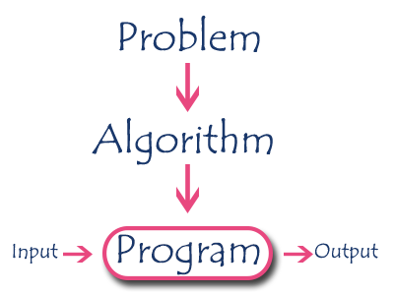
Algorithm
An algorithm is a sequence of unambiguous instructions used for solving a problem, which can be implemented (as a program) on a computer.

Slide 210
Specifications of Algorithms
Every algorithm must satisfy the following specifications:
Input - Every algorithm must take zero or more number of input values from external.
Output - Every algorithm must produce an output as result.
Definiteness - Every statement/instruction in an algorithm must be clear and unambiguous (only one interpretation).
Finiteness - For all different cases, the algorithm must produce result within a finite number of steps.
Effectiveness - Every instruction must be basic enough to be carried out and it also must be feasible.

Slide 211
Recursive Algorithm
The function which is called by itself is known as Direct Recursive function (or Recursive function).
The function which calls a function and that function calls its called function is known Indirect Recursive function (or Recursive function).

Slide 212
Performance Analysis
Performance of an algorithm is a process of making evaluative judgement about algorithms.
Performance of an algorithm means predicting the resources which are required to an algorithm to perform its task.
Performance analysis of an algorithm is the process of calculating space and time required by that algorithm.
Space Complexity: Total amount of computer memory required by an algorithm to complete its execution is called as space complexity of that algorithm.
If any algorithm requires a fixed amount of space for all input values then that space complexity is said to be Constant Space Complexity.
If the amount of space required by an algorithm is increased with the increase of input value, then that space complexity is said to be Linear Space Complexity.

Slide 213
Time Complexity
The time complexity of an algorithm is the total amount of time required by an algorithm to complete its execution.
If any program requires a fixed amount of time for all input values then its time complexity is said to be Constant Time Complexity.
If the amount of time required by an algorithm is increased with the increase of input value then that time complexity is said to be Linear Time Complexity.

Slide 214
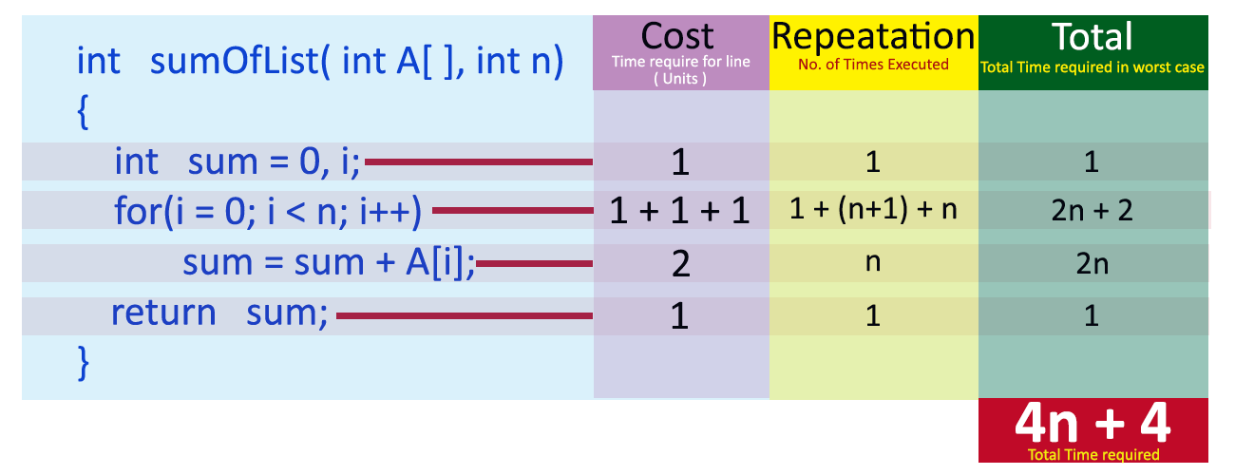

Slide 215
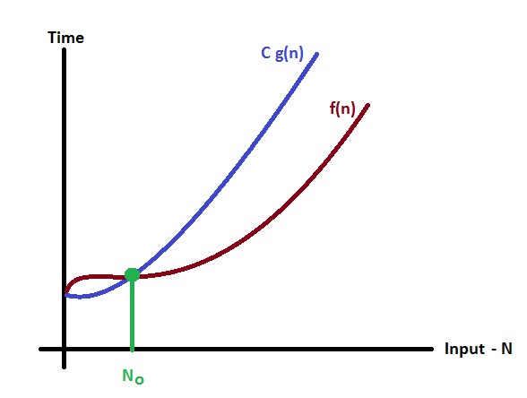
Asymptotic Notations
Asymptotic notation of an algorithm is a mathematical representation of its complexity.
Big - Oh Notation (O)
Consider function f(n) as time complexity of an algorithm and g(n) is the most significant term. If f(n) <= C g(n) for all n >= n₀, C > 0 and n₀ >= 1. Then we can represent f(n) as O(g(n)). f(n) = O(g(n))

Slide 216
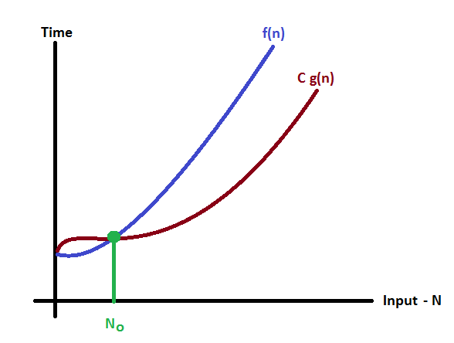
Asymptotic Notations
Big - Omege Notation (Ω)
Consider function f(n) as time complexity of an algorithm and g(n) is the most significant term. If f(n) >= C g(n) for all n >= n₀, C > 0 and n₀ >= 1. Then we can represent f(n) as Ω(g(n)). f(n) = Ω(g(n))

Slide 217
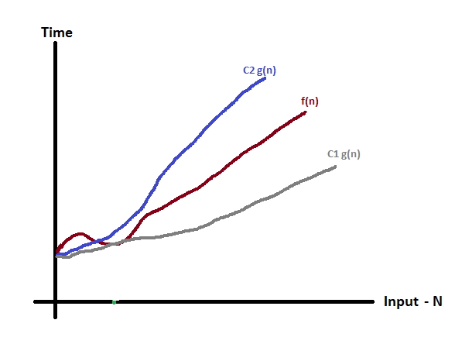
Big - Theta Notation (Θ)
Consider function f(n) as time complexity of an algorithm and g(n) is the most significant term. If C₁ g(n) <= f(n) <= C₂ g(n) for all n >= n₀, C₁ > 0, C₂ > 0 and n₀ >= 1. Then we can represent f(n) as Θ(g(n)). f(n) = Θ(g(n))

Slide 218
Linear & Non-Linear Data Structures
Data Structure is a method of organizing a large amount of data more efficiently so that any operation on that data becomes easy
Linear Data Structures: If a data structure organizes the data in sequential order, then that data structure is called a Linear Data Structure.
Arrays
List (Linked List)
Stack
Queue
Non - Linear Data Structures: If a data structure organizes the data in random order, then that data structure is called as Non-Linear Data Structure.
Tree
Graph
Dictionaries
Heaps
Tries, Etc.,

Slide 219

Single Linked List
Single linked list is a sequence of elements in which every element has link to its next element in the sequence.

Slide 220
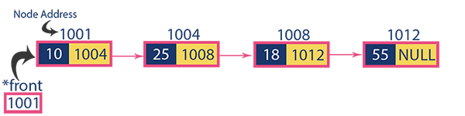

Slide 221
Operations on Single Linked List
The following operations are performed on a Single Linked List
Insertion
Deletion
Display

Slide 222
Insertion
Inserting At Beginning of the list
Inserting At End of the list
Inserting At Specific location in the list (Before a Note/ After a Node)

Slide 223
Inserting At Beginning of the list
Step 1 - Create a newNode with given value.
Step 2 - Check whether list is Empty (head == NULL)
Step 3 - If it is Empty then, set newNode→next = NULL and head = newNode.
Step 4 - If it is Not Empty then, set newNode→next = head and head = newNode.

Slide 224
Inserting At End of the list
We can use the following steps to insert a new node at end of the single linked list...
Step 1 - Create a newNode with given value and newNode → next as NULL.
Step 2 - Check whether list is Empty (head == NULL).
Step 3 - If it is Empty then, set head = newNode.
Step 4 - If it is Not Empty then, define a node pointer temp and initialize with head.
Step 5 - Keep moving the temp to its next node until it reaches to the last node in the list (until temp → next is equal to NULL).
Step 6 - Set temp → next = newNode.

Slide 225
Inserting At Specific location in the list (After a Node)
We can use the following steps to insert a new node after a node in the single linked list...
Step 1 - Create a newNode with given value.
Step 2 - Check whether list is Empty (head == NULL)
Step 3 - If it is Empty then, set newNode → next = NULL and head = newNode.
Step 4 - If it is Not Empty then, define a node pointer temp and initialize with head.
Step 5 - Keep moving the temp to its next node until it reaches to the node after which we want to insert the newNode (until temp1 → data is equal to location, here location is the node value after which we want to insert the newNode).
Step 6 - Every time check whether temp is reached to last node or not. If it is reached to last node then display 'Given node is not found in the list!!! Insertion not possible!!!' and terminate the function. Otherwise move the temp to next node.
Step 7 - Finally, Set 'newNode → next = temp → next' and 'temp → next = newNode'

Slide 226
Deletion
Deleting from Beginning of the list
Deleting from End of the list
Deleting a Specific Node from the list

Slide 227
Deleting from Beginning of the list
We can use the following steps to delete a node from beginning of the single linked list...
Step 1 - Check whether list is Empty (head == NULL)
Step 2 - If it is Empty then, display 'List is Empty!!! Deletion is not possible' and terminate the function.
Step 3 - If it is Not Empty then, define a Node pointer 'temp' and initialize with head.
Step 4 - Check whether list is having only one node (temp → next == NULL)
Step 5 - If it is TRUE then set head = NULL and delete temp (Setting Empty list conditions)
Step 6 - If it is FALSE then set head = temp → next, and delete temp.

Slide 228
Deleting from End of the list
We can use the following steps to delete a node from end of the single linked list...
Step 1 - Check whether list is Empty (head == NULL)
Step 2 - If it is Empty then, display 'List is Empty!!! Deletion is not possible' and terminate the function.
Step 3 - If it is Not Empty then, define two Node pointers 'temp1' and 'temp2' and initialize 'temp1' with head.
Step 4 - Check whether list has only one Node (temp1 → next == NULL)
Step 5 - If it is TRUE. Then, set head = NULL and delete temp1. And terminate the function. (Setting Empty list condition)
Step 6 - If it is FALSE. Then, set 'temp2 = temp1 ' and move temp1 to its next node. Repeat the same until it reaches to the last node in the list. (until temp1 → next == NULL)
Step 7 - Finally, Set temp2 → next = NULL and delete temp1.

Slide 229
Deleting a Specific Node from the list
We can use the following steps to delete a specific node from the single linked list...
Step 1 - Check whether list is Empty (head == NULL)
Step 2 - If it is Empty then, display 'List is Empty!!! Deletion is not possible' and terminate the function.
Step 3 - If it is Not Empty then, define two Node pointers 'temp1' and 'temp2' and initialize 'temp1' with head.
Step 4 - Keep moving the temp1 until it reaches to the exact node to be deleted or to the last node. And every time set 'temp2 = temp1' before moving the 'temp1' to its next node.
Step 5 - If it is reached to the last node then display 'Given node not found in the list! Deletion not possible!!!'. And terminate the function.
Step 6 - If it is reached to the exact node which we want to delete, then check whether list is having only one node or not
Step 7 - If list has only one node and that is the node to be deleted, then set head = NULL and delete temp1 (free(temp1)).
Step 8 - If list contains multiple nodes, then check whether temp1 is the first node in the list (temp1 == head).
Step 9 - If temp1 is the first node then move the head to the next node (head = head → next) and delete temp1.
Step 10 - If temp1 is not first node then check whether it is last node in the list (temp1 → next == NULL).
Step 11 - If temp1 is last node then set temp2 → next = NULL and delete temp1 (free(temp1)).
Step 12 - If temp1 is not first node and not last node then set temp2 → next = temp1 → next and delete temp1 (free(temp1)).

Slide 230
Displaying a Single Linked List
We can use the following steps to display the elements of a single linked list...
Step 1 - Check whether list is Empty (head == NULL)
Step 2 - If it is Empty then, display 'List is Empty!!!' and terminate the function.
Step 3 - If it is Not Empty then, define a Node pointer 'temp' and initialize with head.
Step 4 - Keep displaying temp → data with an arrow (--->) until temp reaches to the last node
Step 5 - Finally display temp → data with arrow pointing to NULL (temp → data ---> NULL).

Slide 231
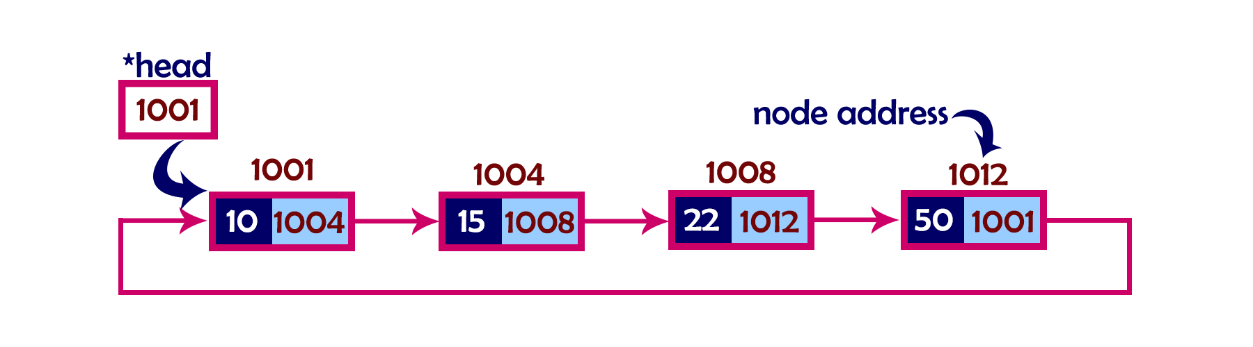
Circular Linked List
A circular linked list is a sequence of elements in which every element has a link to its next element in the sequence and the last element has a link to the first element.

Slide 232
Operations
In a circular linked list, we perform the following operations...
Insertion
Deletion
Display

Slide 233
Insertion
Inserting At Beginning of the list
Inserting At End of the list
Inserting At Specific location in the list (After a Node)

Slide 234
Inserting At Beginning of the list
We can use the following steps to insert a new node at beginning of the circular linked list...
Step 1 - Create a newNode with given value.
Step 2 - Check whether list is Empty (head == NULL)
Step 3 - If it is Empty then, set head = newNode and newNode→next = head .
Step 4 - If it is Not Empty then, define a Node pointer 'temp' and initialize with 'head'.
Step 5 - Keep moving the 'temp' to its next node until it reaches to the last node (until 'temp → next == head').
Step 6 - Set 'newNode → next =head', 'head = newNode' and 'temp → next = head'.

Slide 235
Inserting At End of the list
We can use the following steps to insert a new node at end of the circular linked list...
Step 1 - Create a newNode with given value.
Step 2 - Check whether list is Empty (head == NULL).
Step 3 - If it is Empty then, set head = newNode and newNode → next = head.
Step 4 - If it is Not Empty then, define a node pointer temp and initialize with head.
Step 5 - Keep moving the temp to its next node until it reaches to the last node in the list (until temp → next == head).
Step 6 - Set temp → next = newNode and newNode → next = head.

Slide 236
Inserting At Specific location in the list (After a Node)
We can use the following steps to insert a new node after a node in the circular linked list...
Step 1 - Create a newNode with given value.
Step 2 - Check whether list is Empty (head == NULL)
Step 3 - If it is Empty then, set head = newNode and newNode → next = head.
Step 4 - If it is Not Empty then, define a node pointer temp and initialize with head.
Step 5 - Keep moving the temp to its next node until it reaches to the node after which we want to insert the newNode (until temp1 → data is equal to location, here location is the node value after which we want to insert the newNode).
Step 6 - Every time check whether temp is reached to the last node or not. If it is reached to last node then display 'Given node is not found in the list!!! Insertion not possible!!!' and terminate the function. Otherwise move the temp to next node.
Step 7 - If temp is reached to the exact node after which we want to insert the newNode then check whether it is last node (temp → next == head).
Step 8 - If temp is last node then set temp → next = newNode and newNode → next = head.
Step 8 - If temp is not last node then set newNode → next = temp → next and temp → next = newNode.

Slide 237
Deletion
Deleting from Beginning of the list
Deleting from End of the list
Deleting a Specific Node from the list

Slide 238
Deleting from Beginning of the list
We can use the following steps to delete a node from beginning of the circular linked list...
Step 1 - Check whether list is Empty (head == NULL)
Step 2 - If it is Empty then, display 'List is Empty!!! Deletion is not possible' and terminate the function.
Step 3 - If it is Not Empty then, define two Node pointers 'temp1' and 'temp2' and initialize both 'temp1' and 'temp2' with head.
Step 4 - Check whether list is having only one node (temp1 → next == head)
Step 5 - If it is TRUE then set head = NULL and delete temp1 (Setting Empty list conditions)
Step 6 - If it is FALSE move the temp1 until it reaches to the last node. (until temp1 → next == head )
Step 7 - Then set head = temp2 → next, temp1 → next = head and delete temp2.

Slide 239
Deleting from End of the list
We can use the following steps to delete a node from end of the circular linked list...
Step 1 - Check whether list is Empty (head == NULL)
Step 2 - If it is Empty then, display 'List is Empty!!! Deletion is not possible' and terminate the function.
Step 3 - If it is Not Empty then, define two Node pointers 'temp1' and 'temp2' and initialize 'temp1' with head.
Step 4 - Check whether list has only one Node (temp1 → next == head)
Step 5 - If it is TRUE. Then, set head = NULL and delete temp1. And terminate from the function. (Setting Empty list condition)
Step 6 - If it is FALSE. Then, set 'temp2 = temp1 ' and move temp1 to its next node. Repeat the same until temp1 reaches to the last node in the list. (until temp1 → next == head)
Step 7 - Set temp2 → next = head and delete temp1.

Slide 240
Deleting a Specific Node from the list
We can use the following steps to delete a specific node from the circular linked list...
Step 1 - Check whether list is Empty (head == NULL)
Step 2 - If it is Empty then, display 'List is Empty!!! Deletion is not possible' and terminate the function.
Step 3 - If it is Not Empty then, define two Node pointers 'temp1' and 'temp2' and initialize 'temp1' with head.
Step 4 - Keep moving the temp1 until it reaches to the exact node to be deleted or to the last node. And every time set 'temp2 = temp1' before moving the 'temp1' to its next node.
Step 5 - If it is reached to the last node then display 'Given node not found in the list! Deletion not possible!!!'. And terminate the function.
Step 6 - If it is reached to the exact node which we want to delete, then check whether list is having only one node (temp1 → next == head)
Step 7 - If list has only one node and that is the node to be deleted then set head = NULL and delete temp1 (free(temp1)).
Step 8 - If list contains multiple nodes then check whether temp1 is the first node in the list (temp1 == head).
Step 9 - If temp1 is the first node then set temp2 = head and keep moving temp2 to its next node until temp2 reaches to the last node. Then set head = head → next, temp2 → next = head and delete temp1.
Step 10 - If temp1 is not first node then check whether it is last node in the list (temp1 → next == head).
Step 1 1- If temp1 is last node then set temp2 → next = head and delete temp1 (free(temp1)).
Step 12 - If temp1 is not first node and not last node then set temp2 → next = temp1 → next and delete temp1 (free(temp1)).

Slide 241
Displaying a circular Linked List
We can use the following steps to display the elements of a circular linked list...
Step 1 - Check whether list is Empty (head == NULL)
Step 2 - If it is Empty, then display 'List is Empty!!!' and terminate the function.
Step 3 - If it is Not Empty then, define a Node pointer 'temp' and initialize with head.
Step 4 - Keep displaying temp → data with an arrow (--->) until temp reaches to the last node
Step 5 - Finally display temp → data with arrow pointing to head → data.

Slide 242
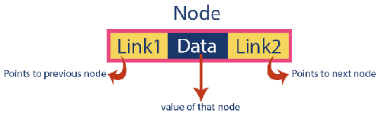

Double Linked List
Double linked list is a sequence of elements in which every element has links to its previous element and next element in the sequence.

Slide 243
Operations on Double Linked List
In a double linked list, we perform the following operations...
Insertion
Deletion
Display

Slide 244
Insertion
Inserting At Beginning of the list
Inserting At End of the list
Inserting At Specific location in the list (After a Node)

Slide 245
Inserting At Beginning of the list
We can use the following steps to insert a new node at beginning of the double linked list...
Step 1 - Create a newNode with given value and newNode → previous as NULL.
Step 2 - Check whether list is Empty (head == NULL)
Step 3 - If it is Empty then, assign NULL to newNode → next and newNode to head.
Step 4 - If it is not Empty then, assign head to newNode → next and newNode to head.

Slide 246
Inserting At End of the list
We can use the following steps to insert a new node at end of the double linked list...
Step 1 - Create a newNode with given value and newNode → next as NULL.
Step 2 - Check whether list is Empty (head == NULL)
Step 3 - If it is Empty, then assign NULL to newNode → previous and newNode to head.
Step 4 - If it is not Empty, then, define a node pointer temp and initialize with head.
Step 5 - Keep moving the temp to its next node until it reaches to the last node in the list (until temp → next is equal to NULL).
Step 6 - Assign newNode to temp → next and temp to newNode → previous.

Slide 247
Inserting At Specific location in the list (After a Node)
We can use the following steps to insert a new node after a node in the double linked list...
Step 1 - Create a newNode with given value.
Step 2 - Check whether list is Empty (head == NULL)
Step 3 - If it is Empty then, assign NULL to both newNode → previous & newNode → next and set newNode to head.
Step 4 - If it is not Empty then, define two node pointers temp1 & temp2 and initialize temp1 with head.
Step 5 - Keep moving the temp1 to its next node until it reaches to the node after which we want to insert the newNode (until temp1 → data is equal to location, here location is the node value after which we want to insert the newNode).
Step 6 - Every time check whether temp1 is reached to the last node. If it is reached to the last node then display 'Given node is not found in the list!!! Insertion not possible!!!' and terminate the function. Otherwise move the temp1 to next node.
Step 7 - Assign temp1 → next to temp2, newNode to temp1 → next, temp1 to newNode → previous, temp2 to newNode → next and newNode to temp2 → previous.

Slide 248
Deletion
Deleting from Beginning of the list
Deleting from End of the list
Deleting a Specific Node from the list

Slide 249
Deleting from Beginning of the list
We can use the following steps to delete a node from beginning of the double linked list...
Step 1 - Check whether list is Empty (head == NULL)
Step 2 - If it is Empty then, display 'List is Empty!!! Deletion is not possible' and terminate the function.
Step 3 - If it is not Empty then, define a Node pointer 'temp' and initialize with head.
Step 4 - Check whether list is having only one node (temp → previous is equal to temp → next)
Step 5 - If it is TRUE, then set head to NULL and delete temp (Setting Empty list conditions)
Step 6 - If it is FALSE, then assign temp → next to head, NULL to head → previous and delete temp.

Slide 250
Deleting from End of the list
We can use the following steps to delete a node from end of the double linked list...
Step 1 - Check whether list is Empty (head == NULL)
Step 2 - If it is Empty, then display 'List is Empty!!! Deletion is not possible' and terminate the function.
Step 3 - If it is not Empty then, define a Node pointer 'temp' and initialize with head.
Step 4 - Check whether list has only one Node (temp → previous and temp → next both are NULL)
Step 5 - If it is TRUE, then assign NULL to head and delete temp. And terminate from the function. (Setting Empty list condition)
Step 6 - If it is FALSE, then keep moving temp until it reaches to the last node in the list. (until temp → next is equal to NULL)
Step 7 - Assign NULL to temp → previous → next and delete temp.

Slide 251
Deleting a Specific Node from the list
We can use the following steps to delete a specific node from the double linked list...
Step 1 - Check whether list is Empty (head == NULL)
Step 2 - If it is Empty then, display 'List is Empty!!! Deletion is not possible' and terminate the function.
Step 3 - If it is not Empty, then define a Node pointer 'temp' and initialize with head.
Step 4 - Keep moving the temp until it reaches to the exact node to be deleted or to the last node.
Step 5 - If it is reached to the last node, then display 'Given node not found in the list! Deletion not possible!!!' and terminate the fuction.
Step 6 - If it is reached to the exact node which we want to delete, then check whether list is having only one node or not
Step 7 - If list has only one node and that is the node which is to be deleted then set head to NULL and delete temp (free(temp)).
Step 8 - If list contains multiple nodes, then check whether temp is the first node in the list (temp == head).
Step 9 - If temp is the first node, then move the head to the next node (head = head → next), set head of previous to NULL (head → previous = NULL) and delete temp.
Step 10 - If temp is not the first node, then check whether it is the last node in the list (temp → next == NULL).
Step 11 - If temp is the last node then set temp of previous of next to NULL (temp → previous → next = NULL) and delete temp (free(temp)).
Step 12 - If temp is not the first node and not the last node, then set temp of previous of next to temp of next (temp → previous → next = temp → next), temp of next of previous to temp of previous (temp → next → previous = temp → previous) and delete temp (free(temp)).

Slide 252
Displaying a Double Linked List
We can use the following steps to display the elements of a double linked list...
Step 1 - Check whether list is Empty (head == NULL)
Step 2 - If it is Empty, then display 'List is Empty!!!' and terminate the function.
Step 3 - If it is not Empty, then define a Node pointer 'temp' and initialize with head.
Step 4 - Display 'NULL <--- '.
Step 5 - Keep displaying temp → data with an arrow (<===>) until temp reaches to the last node
Step 6 - Finally, display temp → data with arrow pointing to NULL (temp → data ---> NULL).

Slide 253
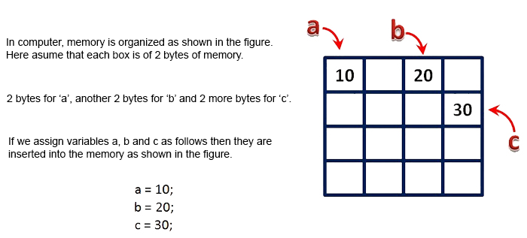
Arrays
An array is a variable which can store multiple values of same data type at a time.
"Collection of similar data items stored in continuous memory locations with single name".

Slide 254
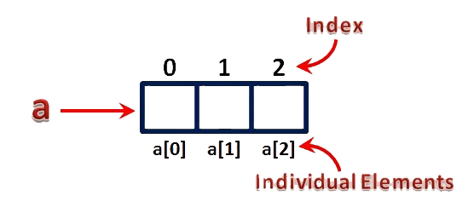
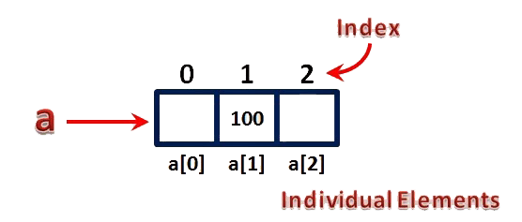

Slide 255
Types of Arrays
Single Dimensional Array
Declaration of Single Dimensional Array
datatype arrayName [ size ] ;
Initialization of Single Dimensional Array
datatype arrayName [ size ] = {value1, value2, ...} ;
datatype arrayName [ ] = {value1, value2, ...} ;
Accessing Elements of Single Dimensional Array
arrayName [ indexValue ]
Multi Dimensional Array
Declaration of Two Dimensional Array
datatype arrayName [ rowSize ] [ columnSize ] ;
Initialization of Two Dimensional Array
datatype arrayName [rows][colmns] = {{r1c1value, r1c2value, ...},{r2c1, r2c2,...}...} ;
Accessing Individual Elements of Two Dimensional Array
arrayName [ rowIndex ] [ columnIndex ]

Slide 256
Sparse Matrix
Sparse matrix is a matrix which contains very few non-zero elements.
Sparse Matrix Representations
Triplet Representation (Array Representation)
Linked Representation

Slide 257
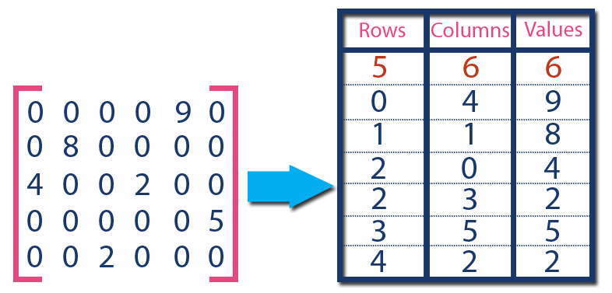

Slide 258
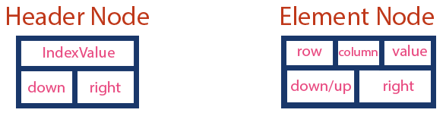

Slide 259
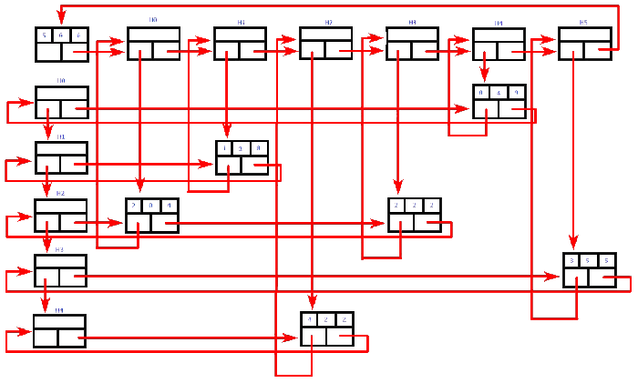

Slide 260
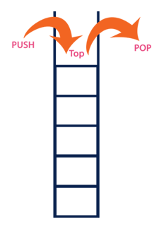
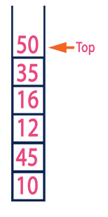
Stack ADT
Stack is a linear data structure in which the operations are performed based on LIFO principle.
"A Collection of similar data items in which both insertion and deletion operations are performed based on LIFO principle".

Slide 261
Operations on a Stack
The following operations are performed on the stack.
Push (To insert an element on to the stack)
Pop (To delete an element from the stack)
Display (To display elements of the stack)
Stack data structure can be implemented in two ways.
Using Array
Using Linked List

Slide 262
push(value) - Inserting value into the stack
In a stack, push() is a function used to insert an element into the stack.
In a stack, the new element is always inserted at top position. Push function takes one integer value as parameter and inserts that value into the stack.
We can use the following steps to push an element on to the stack...
Step 1 - Check whether stack is FULL. (top == SIZE-1)
Step 2 - If it is FULL, then display "Stack is FULL!!! Insertion is not possible!!!" and terminate the function.
Step 3 - If it is NOT FULL, then increment top value by one (top++) and set stack[top] to value (stack[top] = value).

Slide 263
pop() - Delete a value from the Stack
In a stack, pop() is a function used to delete an element from the stack. In a stack, the element is always deleted from top position. Pop function does not take any value as parameter. We can use the following steps to pop an element from the stack...
Step 1 - Check whether stack is EMPTY. (top == -1)
Step 2 - If it is EMPTY, then display "Stack is EMPTY!!! Deletion is not possible!!!" and terminate the function.
Step 3 - If it is NOT EMPTY, then delete stack[top] and decrement top value by one (top--).

Slide 264
display() - Displays the elements of a Stack
We can use the following steps to display the elements of a stack...
Step 1 - Check whether stack is EMPTY. (top == -1)
Step 2 - If it is EMPTY, then display "Stack is EMPTY!!!" and terminate the function.
Step 3 - If it is NOT EMPTY, then define a variable 'i' and initialize with top. Display stack[i] value and decrement i value by one (i--).
Step 3 - Repeat above step until i value becomes '0'.

Slide 265
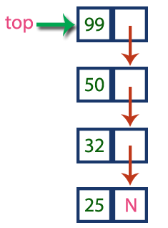
Stack Using Linked List

Slide 266
Stack Operations using Linked List

Slide 267
push(value) - Inserting an element into the Stack
We can use the following steps to insert a new node into the stack...
Step 1 - Create a newNode with given value.
Step 2 - Check whether stack is Empty (top == NULL)
Step 3 - If it is Empty, then set newNode → next = NULL.
Step 4 - If it is Not Empty, then set newNode → next = top.
Step 5 - Finally, set top = newNode.

Slide 268
pop() - Deleting an Element from a Stack
We can use the following steps to delete a node from the stack...
Step 1 - Check whether stack is Empty (top == NULL).
Step 2 - If it is Empty, then display "Stack is Empty!!! Deletion is not possible!!!" and terminate the function
Step 3 - If it is Not Empty, then define a Node pointer 'temp' and set it to 'top'.
Step 4 - Then set 'top = top → next'.
Step 5 - Finally, delete 'temp'. (free(temp)).

Slide 269
display() - Displaying stack of elements
We can use the following steps to display the elements (nodes) of a stack...
Step 1 - Check whether stack is Empty (top == NULL).
Step 2 - If it is Empty, then display 'Stack is Empty!!!' and terminate the function.
Step 3 - If it is Not Empty, then define a Node pointer 'temp' and initialize with top.
Step 4 - Display 'temp → data --->' and move it to the next node. Repeat the same until temp reaches to the first node in the stack. (temp → next != NULL).
Step 5 - Finally! Display 'temp → data ---> NULL'.

Slide 270
Expressions
An expression is a collection of operators and operands that represents a specific value.
Expression Types
Based on the operator position, expressions are divided into THREE types. They are as follows...
Infix Expression
Postfix Expression
Prefix Expression

Slide 271

Infix Expression

Slide 272

Postfix Expression

Slide 273

Prefix Expression

Slide 274
Infix to Postfix Conversion
To convert any Infix expression into Postfix or Prefix expression we can use the following procedure...
Find all the operators in the given Infix Expression.
Find the order of operators evaluated according to their Operator precedence.
Convert each operator into required type of expression (Postfix or Prefix) in the same order.

Slide 275
Example
Consider the following Infix Expression to be converted into Postfix Expression...
D = A + B * C
Step 1 - The Operators in the given Infix Expression : = , + , *
Step 2 - The Order of Operators according to their preference : * , + , =
Step 3 - Now, convert the first operator * ----- D = A + B C *
Step 4 - Convert the next operator + ----- D = A BC* +
Step 5 - Convert the next operator = ----- D ABC*+ =
Finally, given Infix Expression is converted into Postfix Expression as follows...
D A B C * + =

Slide 276
Infix to Postfix Conversion using Stack Data Structure
To convert Infix Expression into Postfix Expression using a stack data structure, We can use the following steps...
Read all the symbols one by one from left to right in the given Infix Expression.
If the reading symbol is operand, then directly print it to the result (Output).
If the reading symbol is left parenthesis '(', then Push it on to the Stack.
If the reading symbol is right parenthesis ')', then Pop all the contents of stack until respective left parenthesis is poped and print each poped symbol to the result.
If the reading symbol is operator (+ , - , * , / etc.,), then Push it on to the Stack. However, first pop the operators which are already on the stack that have higher or equal precedence than current operator and print them to the result.

Slide 277
Postfix Expression Evaluation

Slide 278
Postfix Expression Evaluation using Stack Data Structure
A postfix expression can be evaluated using the Stack data structure. To evaluate a postfix expression using Stack data structure we can use the following steps...
Read all the symbols one by one from left to right in the given Postfix Expression
If the reading symbol is operand, then push it on to the Stack.
If the reading symbol is operator (+ , - , * , / etc.,), then perform TWO pop operations and store the two popped oparands in two different variables (operand1 and operand2). Then perform reading symbol operation using operand1 and operand2 and push result back on to the Stack.
Finally! perform a pop operation and display the popped value as final result.

Slide 279

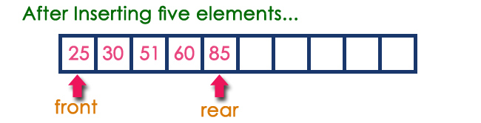
Queue ADT
Queue data structure is a linear data structure in which the operations are performed based on FIFO principle.
"Queue data structure is a collection of similar data items in which insertion and deletion operations are performed based on FIFO principle".

Slide 280
Operations on a Queue
The following operations are performed on a queue data structure...
enQueue(value) - (To insert an element into the queue)
deQueue() - (To delete an element from the queue)
display() - (To display the elements of the queue)
Queue data structure can be implemented in two ways. They are as follows...
Using Array
Using Linked List

Slide 281
Queue Datastructure Using Array
enQueue(value) - Inserting value into the queue
deQueue() - Deleting a value from the Queue
display() - Displays the elements of a Queue
isEmpty() – Checks whether Queue is empty.
isFull() – Checks whether Queue is Full.

Slide 282
enQueue(value) - Inserting value into the queue
In a queue data structure, enQueue() is a function used to insert a new element into the queue. In a queue, the new element is always inserted at rear position. The enQueue() function takes one integer value as a parameter and inserts that value into the queue. We can use the following steps to insert an element into the queue...
Step 1 - Check whether queue is FULL. (rear == SIZE-1)
Step 2 - If it is FULL, then display "Queue is FULL!!! Insertion is not possible!!!" and terminate the function.
Step 3 - If it is NOT FULL, then increment rear value by one (rear++) and set queue[rear] = value.

Slide 283
deQueue() - Deleting a value from the Queue
In a queue data structure, deQueue() is a function used to delete an element from the queue. In a queue, the element is always deleted from front position. The deQueue() function does not take any value as parameter. We can use the following steps to delete an element from the queue...
Step 1 - Check whether queue is EMPTY. (front == rear)
Step 2 - If it is EMPTY, then display "Queue is EMPTY!!! Deletion is not possible!!!" and terminate the function.
Step 3 - If it is NOT EMPTY, then increment the front value by one (front ++). Then display queue[front] as deleted element. Then check whether both front and rear are equal (front == rear), if it TRUE, then set both front and rear to '-1' (front = rear = -1).

Slide 284
display() - Displays the elements of a Queue
We can use the following steps to display the elements of a queue...
Step 1 - Check whether queue is EMPTY. (front == rear)
Step 2 - If it is EMPTY, then display "Queue is EMPTY!!!" and terminate the function.
Step 3 - If it is NOT EMPTY, then define an integer variable 'i' and set 'i = front+1'.
Step 4 - Display 'queue[i]' value and increment 'i' value by one (i++). Repeat the same until 'i' value reaches to rear (i <= rear)

Slide 285

Queue Using Linked List

Slide 286
Operations of Queue Using Linked List
enQueue(value) - Inserting an element into the Queue
deQueue() - Deleting an Element from Queue
display() - Displaying the elements of Queue
isEmpty() – Checks whether Queue is empty.
isFull() – Checks whether Queue is Full.

Slide 287
enQueue(value) - Inserting an element into the Queue
We can use the following steps to insert a new node into the queue...
Step 1 - Create a newNode with given value and set 'newNode → next' to NULL.
Step 2 - Check whether queue is Empty (rear == NULL)
Step 3 - If it is Empty then, set front = newNode and rear = newNode.
Step 4 - If it is Not Empty then, set rear → next = newNode and rear = newNode.

Slide 288
deQueue() - Deleting an Element from Queue
We can use the following steps to delete a node from the queue...
Step 1 - Check whether queue is Empty (front == NULL).
Step 2 - If it is Empty, then display "Queue is Empty!!! Deletion is not possible!!!" and terminate from the function
Step 3 - If it is Not Empty then, define a Node pointer 'temp' and set it to 'front'.
Step 4 - Then set 'front = front → next' and delete 'temp' (free(temp)).

Slide 289
display() - Displaying the elements of Queue
We can use the following steps to display the elements (nodes) of a queue...
Step 1 - Check whether queue is Empty (front == NULL).
Step 2 - If it is Empty then, display 'Queue is Empty!!!' and terminate the function.
Step 3 - If it is Not Empty then, define a Node pointer 'temp' and initialize with front.
Step 4 - Display 'temp → data --->' and move it to the next node. Repeat the same until 'temp' reaches to 'rear' (temp → next != NULL).
Step 5 - Finally! Display 'temp → data ---> NULL'.

Slide 290
isEmpty()

Slide 291
isFull()

Slide 292
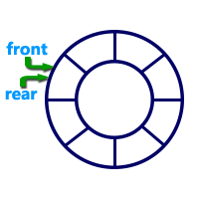
Circular Queue Datastructure
A circular queue is a linear data structure in which the operations are performed based on FIFO (First In First Out) principle and the last position is connected back to the first position to make a circle.

Slide 293
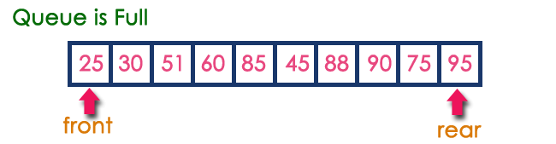
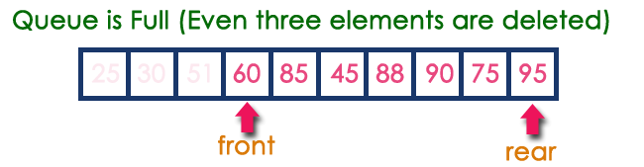
Circular Queue Datastructure
A circular queue is a linear data structure in which the operations are performed based on FIFO (First In First Out) principle and the last position is connected back to the first position to make a circle.

Slide 294
enQueue(value) - Inserting value into the Circular Queue
In a circular queue, enQueue() is a function which is used to insert an element into the circular queue. In a circular queue, the new element is always inserted at rear position. The enQueue() function takes one integer value as parameter and inserts that value into the circular queue. We can use the following steps to insert an element into the circular queue...
Step 1 - Check whether queue is FULL. ((rear == SIZE-1 && front == 0) || (front == rear+1))
Step 2 - If it is FULL, then display "Queue is FULL!!! Insertion is not possible!!!" and terminate the function.
Step 3 - If it is NOT FULL, then check rear == SIZE - 1 && front != 0 if it is TRUE, then set rear = -1.
Step 4 - Increment rear value by one (rear++), set queue[rear] = value and check 'front == -1' if it is TRUE, then set front = 0.

Slide 295
deQueue() - Deleting a value from the Circular Queue
In a circular queue, deQueue() is a function used to delete an element from the circular queue. In a circular queue, the element is always deleted from front position. The deQueue() function doesn't take any value as a parameter. We can use the following steps to delete an element from the circular queue...
Step 1 - Check whether queue is EMPTY. (front == -1 && rear == -1)
Step 2 - If it is EMPTY, then display "Queue is EMPTY!!! Deletion is not possible!!!" and terminate the function.
Step 3 - If it is NOT EMPTY, then display queue[front] as deleted element and increment the front value by one (front ++). Then check whether front == SIZE, if it is TRUE, then set front = 0. Then check whether both front - 1 and rear are equal (front -1 == rear), if it TRUE, then set both front and rear to '-1' (front = rear = -1).

Slide 296
display() - Displays the elements of a Circular Queue
We can use the following steps to display the elements of a circular queue...
Step 1 - Check whether queue is EMPTY. (front == -1)
Step 2 - If it is EMPTY, then display "Queue is EMPTY!!!" and terminate the function.
Step 3 - If it is NOT EMPTY, then define an integer variable 'i' and set 'i = front'.
Step 4 - Check whether 'front <= rear', if it is TRUE, then display 'queue[i]' value and increment 'i' value by one (i++). Repeat the same until 'i <= rear' becomes FALSE.
Step 5 - If 'front <= rear' is FALSE, then display 'queue[i]' value and increment 'i' value by one (i++). Repeat the same until'i <= SIZE - 1' becomes FALSE.
Step 6 - Set i to 0.
Step 7 - Again display 'cQueue[i]' value and increment i value by one (i++). Repeat the same until 'i <= rear' becomes FALSE.

Slide 297
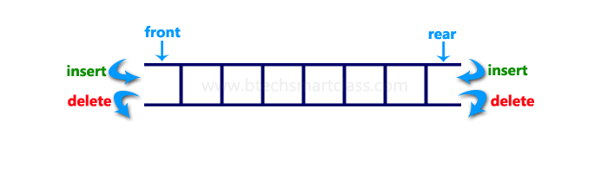
Double Ended Queue Datastructure
Double Ended Queue can be represented in TWO ways:
Input Restricted Double Ended Queue
Output Restricted Double Ended Queue

Slide 298
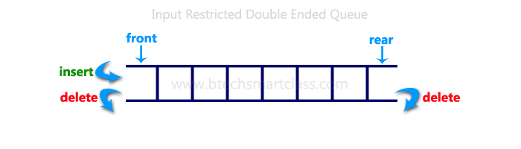
Input Restricted Double Ended Queue

Slide 299
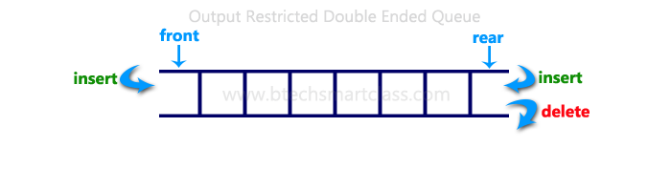
Output Restricted Double Ended Queue

Slide 300
Tree - Terminology
Tree is a non-linear data structure which organizes data in hierarchical structure and this is a recursive definition.
Tree data structure is a collection of data (Node) which is organized in hierarchical structure recursively

Slide 301
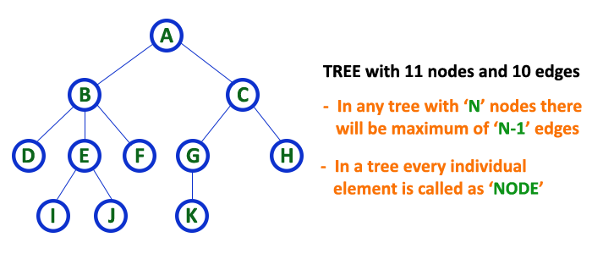

Slide 302
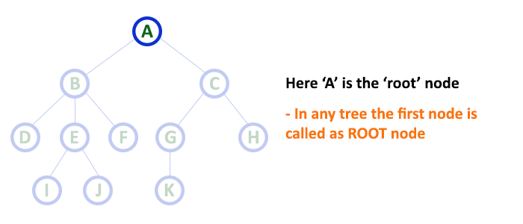
1. Root
The first node is called as Root Node. Every tree must have a root node. We can say that the root node is the origin of the tree data structure. In any tree, there must be only one root node. We never have multiple root nodes in a tree.

Slide 303
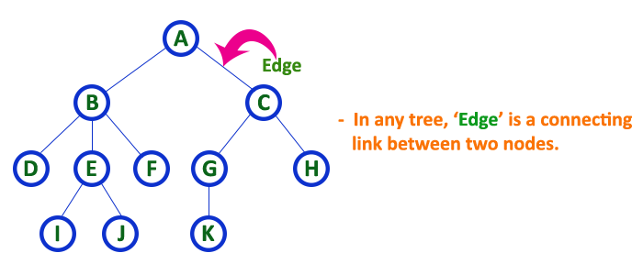
2. Edge
The connecting link between any two nodes is called as EDGE. In a tree with 'N' number of nodes there will be a maximum of 'N-1' number of edges.

Slide 304
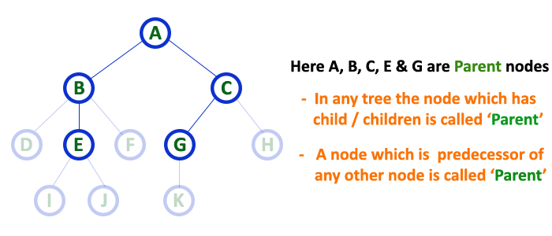
3. Parent
The node which is a predecessor of any node is called as PARENT NODE. In other words, the node which has a branch from it to any other node is called a parent node. Parent node can also be defined as "The node which has child / children".

Slide 305
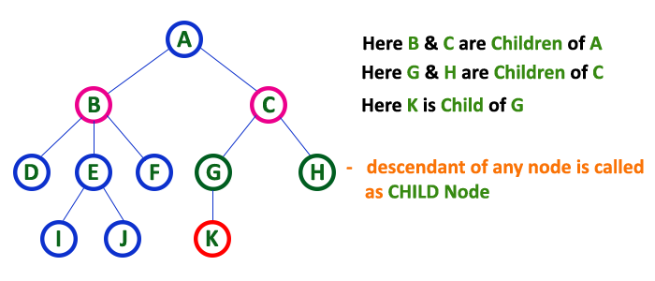
4. Child
Node which is descendant of any node is called as CHILD Node.
The node which has a link from its parent node is called as child node. In a tree, any parent node can have any number of child nodes. In a tree, all the nodes except root are child nodes.

Slide 306
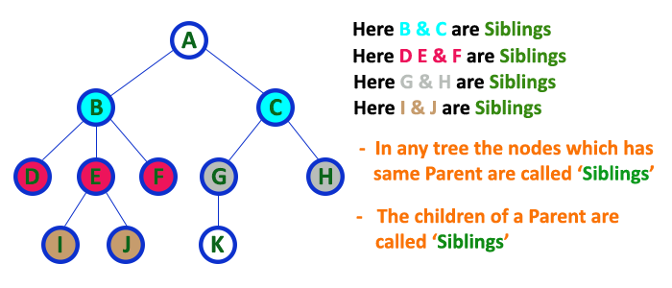
5. Siblings
Nodes which belong to same Parent are called as SIBLINGS. In simple words, the nodes with the same parent are called Sibling nodes.

Slide 307
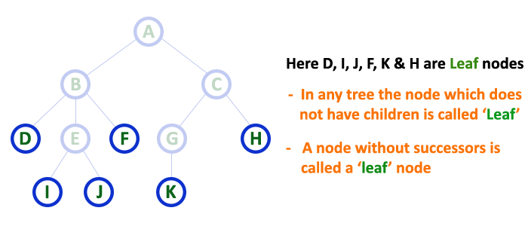
6. Leaf
The node which does not have a child is called as LEAF Node.
Leaf nodes are also called as External Nodes. In a tree, leaf node is also called as 'Terminal' node.

Slide 308
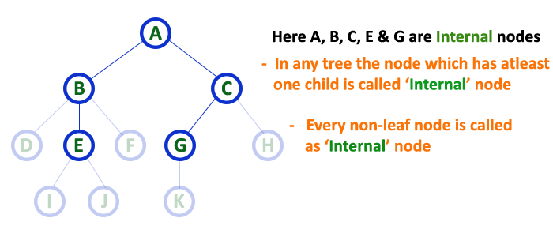
7. Internal Nodes
The node which has atleast one child is called as INTERNAL Node.
Nodes other than leaf nodes are called as Internal Nodes. The root node is also said to be Internal Node if the tree has more than one node. Internal nodes are also called as 'Non-Terminal' nodes.

Slide 309
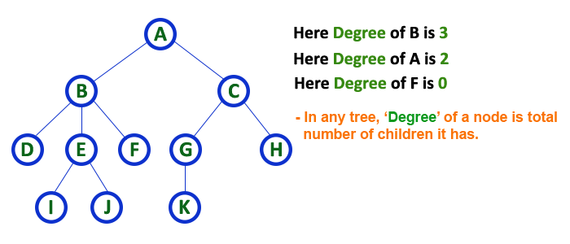
8. Degree
The total number of children of a node is called as DEGREE of that Node. In simple words, the Degree of a node is total number of children it has. The highest degree of a node among all the nodes in a tree is called as 'Degree of Tree'

Slide 310
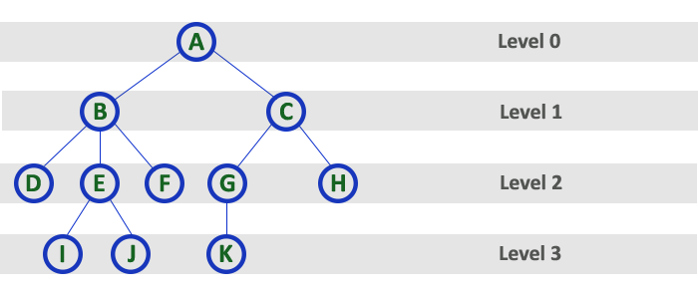
9. Level
The root node is said to be at Level 0 and the children of root node are at Level 1 and the children of the nodes which are at Level 1 will be at Level 2 and so on... In simple words, in a tree each step from top to bottom is called as a Level and the Level count starts with '0' and incremented by one at each level (Step).

Slide 311
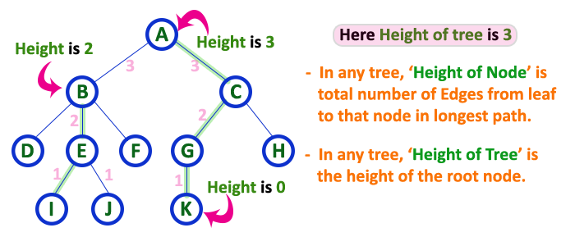
10. Height
The total number of edges from leaf node to a particular node in the longest path is called as HEIGHT of that Node. In a tree, height of the root node is said to be height of the tree. In a tree, height of all leaf nodes is '0'.

Slide 312
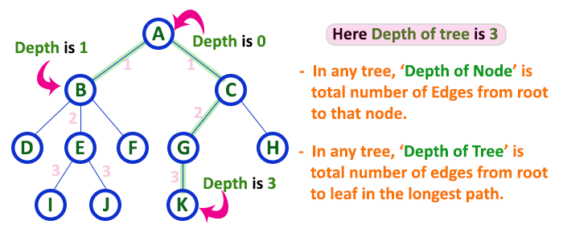
11. Depth
The total number of egdes from root node to a particular node is called as DEPTH of that Node. In a tree, the total number of edges from root node to a leaf node in the longest path is said to be Depth of the tree. In simple words, the highest depth of any leaf node in a tree is said to be depth of that tree. In a tree, depth of the root node is '0'.

Slide 313
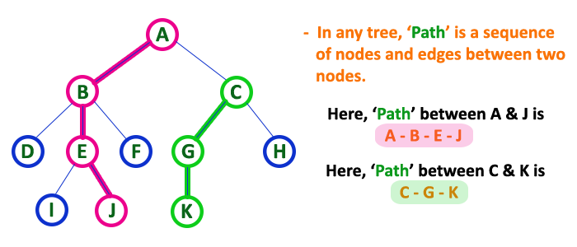
12. Path
In a tree data structure, the sequence of Nodes and Edges from one node to another node is called as PATH between that two Nodes. Length of a Path is total number of nodes in that path. In below example the path A - B - E - J has length 4.

Slide 314
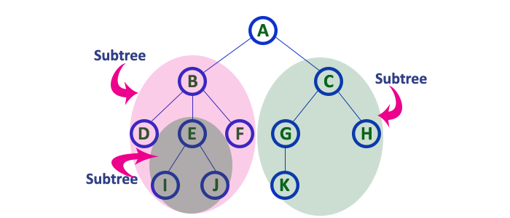
13. Sub Tree
In a tree data structure, each child from a node forms a subtree recursively. Every child node will form a subtree on its parent node.

Slide 315
Tree Representations
A tree data structure can be represented in two methods.
List Representation
Left Child - Right Sibling Representation

Slide 316
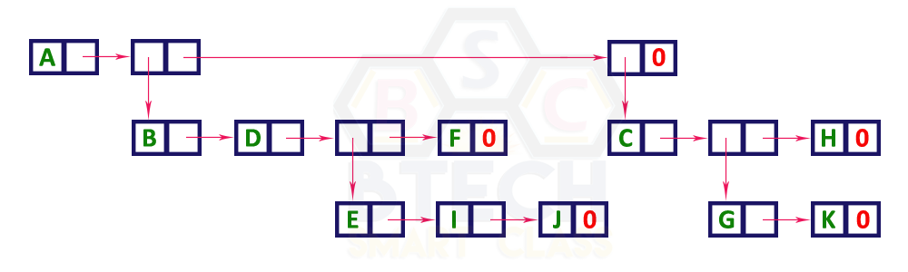

Slide 317
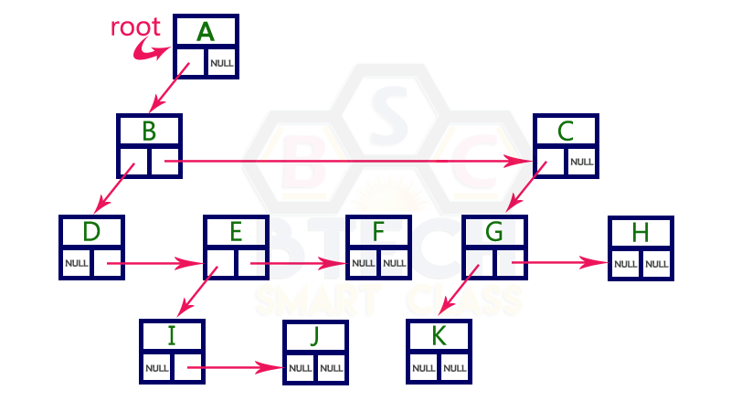
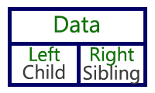

Slide 318
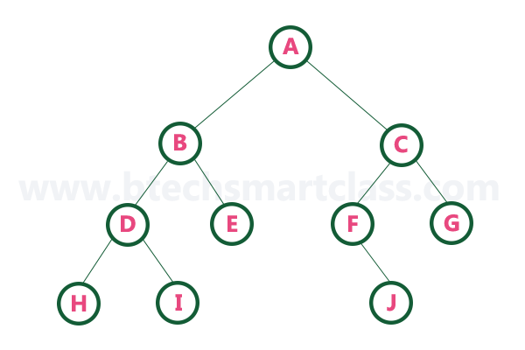
Binary Tree Datastructure
A tree in which every node can have a maximum of two children is called Binary Tree.

Slide 319
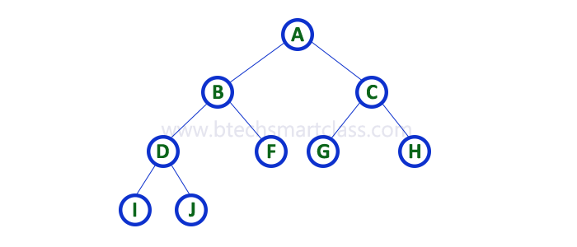
1. Strictly Binary Tree
A binary tree in which every node has either two or zero number of children is called Strictly Binary Tree.
Strictly binary tree data structure is used to represent mathematical expressions.

Slide 320
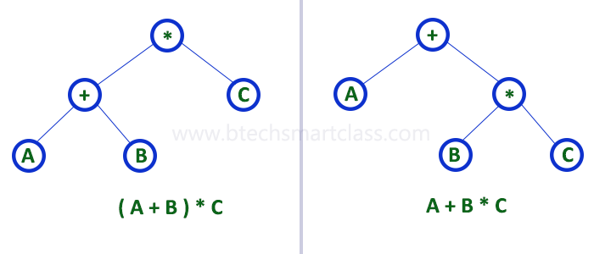

Slide 321

2. Complete Binary Tree
A binary tree in which every internal node has exactly two children and all leaf nodes are at same level is called Complete Binary Tree.

Slide 322
Full Binary Tree

Slide 323

3. Extended Binary Tree
The full binary tree obtained by adding dummy nodes to a binary tree is called as Extended Binary Tree.

Slide 324

Binary Tree Representations
A binary tree data structure is represented using two methods.
Array Representation
Linked List Representation

Slide 325

1. Array Representation of Binary Tree

Slide 326


2. Linked List Representation of Binary Tree

Slide 327
Binary Tree Traversals
Displaying (or) visiting order of nodes in a binary tree is called as Binary Tree Traversal.
There are three types of binary tree traversals.
In - Order Traversal
Pre - Order Traversal
Post - Order Traversal

Slide 328
1. In - Order Traversal ( leftChild - root - rightChild )
I - D - J - B - F - A - G - K - C - H

Slide 329
2. Pre - Order Traversal ( root - leftChild - rightChild )
A - B - D - I - J - F - C - G - K - H

Slide 330
3. Post - Order Traversal ( leftChild - rightChild - root )
I - J - D - F - B - K - G - H - C - A

Slide 331
Threaded Binary Trees
Threaded Binary Tree is also a binary tree in which all left child pointers that are NULL (in Linked list representation) points to its in-order predecessor, and all right child pointers that are NULL (in Linked list representation) points to its in-order successor.
If there is no in-order predecessor or in-order successor, then it points to the root node.

Slide 332
In-Order: H - D - I - B - E - A - F - J - C - G

Slide 333

Threaded Binary Trees

Slide 334

Binary Search Tree
A binary tree in which every node contains only smaller values in its left subtree and only larger values in its right subtree.

Slide 335


Slide 336
Operations on a Binary Search Tree
The following operations are performed on a binary search tree...
Search
Insertion
Deletion

Slide 337
Search Operation in BST
In a binary search tree, the search operation is performed with O(log n) time complexity.
Step 1 - Read the search element from the user.
Step 2 - Compare the search element with the value of root node in the tree.
Step 3 - If both are matched, then display "Given node is found!!!" and terminate the function
Step 4 - If both are not matched, then check whether search element is smaller or larger than that node value.
Step 5 - If search element is smaller, then continue the search process in left subtree.
Step 6- If search element is larger, then continue the search process in right subtree.
Step 7 - Repeat the same until we find the exact element or until the search element is compared with the leaf node
Step 8 - If we reach to the node having the value equal to the search value then display "Element is found" and terminate the function.
Step 9 - If we reach to the leaf node and if it is also not matched with the search element, then display "Element is not found" and terminate the function.

Slide 338
Insertion Operation in BST
In a binary search tree, the insertion operation is performed with O(log n) time complexity. In binary search tree, new node is always inserted as a leaf node. The insertion operation is performed as follows...
Step 1 - Create a newNode with given value and set its left and right to NULL.
Step 2 - Check whether tree is Empty.
Step 3 - If the tree is Empty, then set root to newNode.
Step 4 - If the tree is Not Empty, then check whether the value of newNode is smaller or larger than the node (here it is root node).
Step 5 - If newNode is smaller than or equal to the node then move to its left child. If newNode is larger than the node then move to its right child.
Step 6- Repeat the above steps until we reach to the leaf node (i.e., reaches to NULL).
Step 7 - After reaching the leaf node, insert the newNode as left child if the newNode is smaller or equal to that leaf node or else insert it as right child.

Slide 339
Deletion Operation in BST
In a binary search tree, the deletion operation is performed with O(log n) time complexity. Deleting a node from Binary search tree includes following three cases...
Case 1: Deleting a Leaf node (A node with no children)
Case 2: Deleting a node with one child
Case 3: Deleting a node with two children

Slide 340
Case 1: Deleting a leaf node
We use the following steps to delete a leaf node from BST...
Step 1 - Find the node to be deleted using search operation
Step 2 - Delete the node using free function (If it is a leaf) and terminate the function.

Slide 341
Case 2: Deleting a node with one child
We use the following steps to delete a node with one child from BST...
Step 1 - Find the node to be deleted using search operation
Step 2 - If it has only one child then create a link between its parent node and child node.
Step 3 - Delete the node using free function and terminate the function.

Slide 342
Case 3: Deleting a node with two children
We use the following steps to delete a node with two children from BST...
Step 1 - Find the node to be deleted using search operation
Step 2 - If it has two children, then find the largest node in its left subtree (OR) the smallest node in its right subtree.
Step 3 - Swap both deleting node and node which is found in the above step.
Step 4 - Then check whether deleting node came to case 1 or case 2 or else goto step 2
Step 5 - If it comes to case 1, then delete using case 1 logic.
Step 6- If it comes to case 2, then delete using case 2 logic.
Step 7 - Repeat the same process until the node is deleted from the tree.

Slide 343


Slide 344

AVL Tree Datastructure
An AVL tree is a balanced binary search tree. In an AVL tree, balance factor of every node is either -1, 0 or +1.
Balance factor = heightOfLeftSubtree - heightOfRightSubtree
Every AVL Tree is a binary search tree but
every Binary Search Tree need not be AVL tree.

Slide 345

AVL Tree Rotations
Rotation is the process of moving nodes either to left or to right to make the tree balanced.

Slide 346

Single Left Rotation (LL Rotation)

Slide 347

Single Right Rotation (RR Rotation)

Slide 348

Left Right Rotation (LR Rotation)

Slide 349

Right Left Rotation (RL Rotation)

Slide 350
Operations on an AVL Tree
The following operations are performed on AVL tree...
Search
Insertion
Deletion

Slide 351
Search Operation in AVL Tree
In an AVL tree, the search operation is performed with O(log n) time complexity. The search operation in the AVL tree is similar to the search operation in a Binary search tree. We use the following steps to search an element in AVL tree...
Step 1 - Read the search element from the user.
Step 2 - Compare the search element with the value of root node in the tree.
Step 3 - If both are matched, then display "Given node is found!!!" and terminate the function
Step 4 - If both are not matched, then check whether search element is smaller or larger than that node value.
Step 5 - If search element is smaller, then continue the search process in left subtree.
Step 6 - If search element is larger, then continue the search process in right subtree.
Step 7 - Repeat the same until we find the exact element or until the search element is compared with the leaf node.
Step 8 - If we reach to the node having the value equal to the search value, then display "Element is found" and terminate the function.
Step 9 - If we reach to the leaf node and if it is also not matched with the search element, then display "Element is not found" and terminate the function.

Slide 352
Insertion Operation in AVL Tree
In an AVL tree, the insertion operation is performed with O(log n) time complexity. In AVL Tree, a new node is always inserted as a leaf node. The insertion operation is performed as follows...
Step 1 - Insert the new element into the tree using Binary Search Tree insertion logic.
Step 2 - After insertion, check the Balance Factor of every node.
Step 3 - If the Balance Factor of every node is 0 or 1 or -1 then go for next operation.
Step 4 - If the Balance Factor of any node is other than 0 or 1 or -1 then that tree is said to be imbalanced. In this case, perform suitable Rotation to make it balanced and go for next operation.

Slide 353


Slide 355
Deletion Operation in AVL Tree
The deletion operation in AVL Tree is similar to deletion operation in BST.
But after every deletion operation, we need to check with the Balance Factor condition.
If the tree is balanced after deletion go for next operation otherwise perform suitable rotation to make the tree Balanced.

Slide 356
Red - Black Tree Datastructure
Red Black Tree is a Binary Search Tree in which every node is colored either RED or BLACK.
Properties of Red Black Tree
Property #1: Red - Black Tree must be a Binary Search Tree.
Property #2: The ROOT node must be colored BLACK.
Property #3: The children of Red colored node must be colored BLACK. (There should not be two consecutive RED nodes).
Property #4: In all the paths of the tree, there should be same number of BLACK colored nodes.
Property #5: Every new node must be inserted with RED color.
Property #6: Every leaf (e.i. NULL node) must be colored BLACK.

