Slide 1

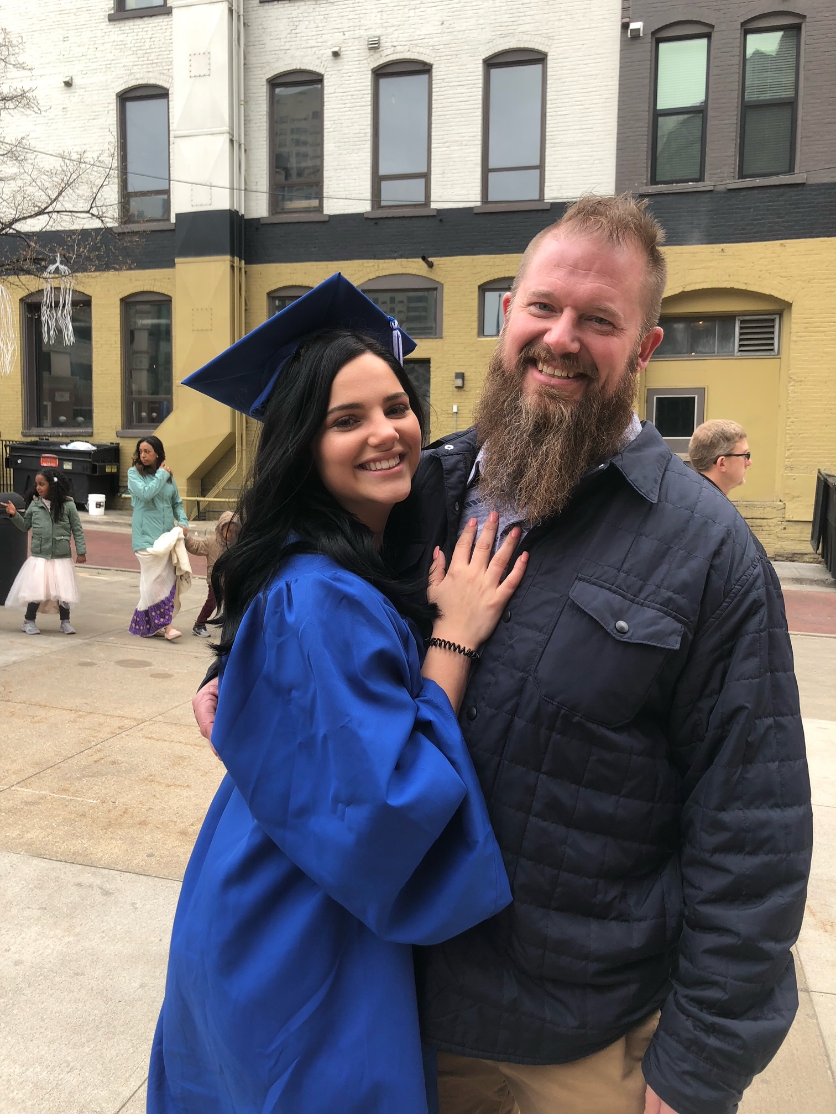
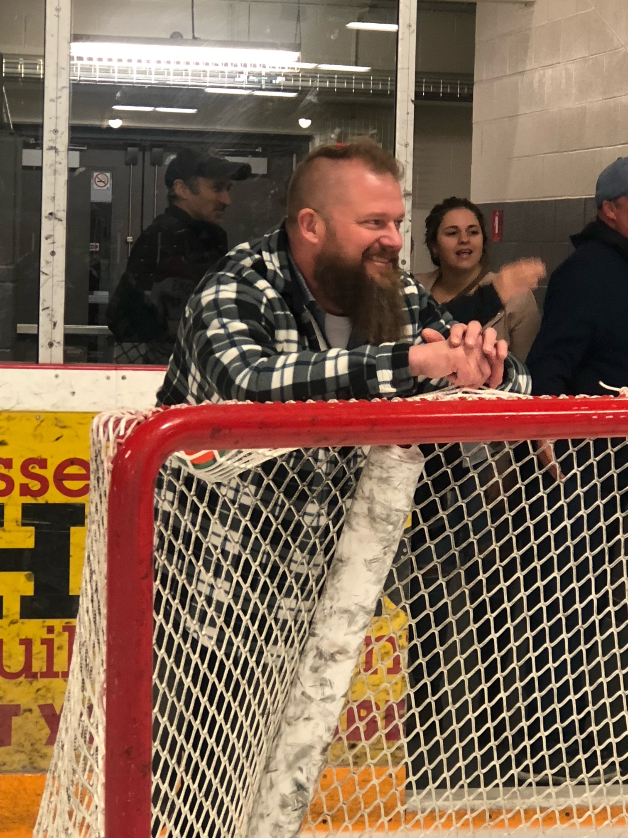
Recent New Hires
Welcome new hire bryan skulley
Position Title
Current: IT/OT Support Tech
Previous:
LAN Tech (DTE Energy/Fermi Nuclear)
Server Build Tech (Scalable Informatics)
LAN Tech (DTE Energy)
Data Center Admin (DTE Energy)
Work Experience
3 years, Fermi Nuclear; Newport, MI
2 years, Scalable Informatics; Plymouth, MI
2 years, DTE Energy; Detroit, MI
2 years, DTE Energy; Detroit, MI
Hobbies / Interests / Family
Hockey, Golf, Archery/Hunting, Motorcycles, Rat Rods

