Slide 1

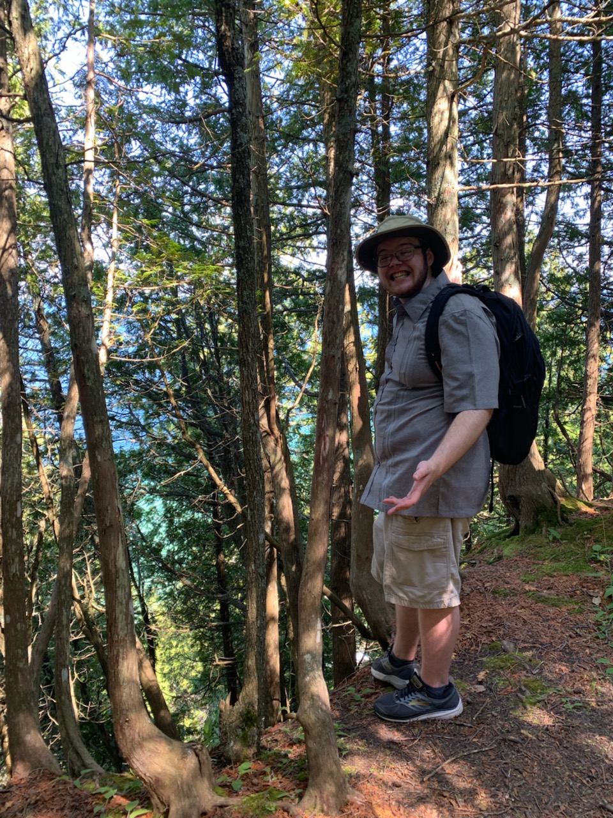
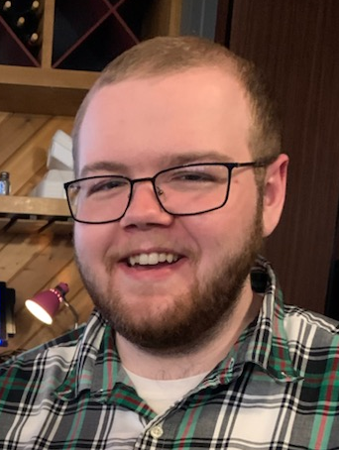

Recent New Hires
Welcome new hire David Vidler
Position Title
Current: Manufacturing Engineer C&I
Previous Experience
  WMU Sunseeker Solar Car
  Plymouth USA Hockey Arena
Education
Bachelor of Science in Mechanical Engineering (Western Michigan)
Hobbies / Interests / Family
Golf, hunting, hiking/camping, cars, sporting clays, music

