Slide 1

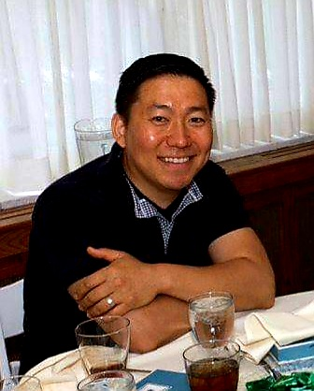
Recent New Hires
Welcome new hire MICHAEL LEWANDOWSKI
Position Title
Current: Electronics CAD Designer
Previous:
CAD Design (Motiv Power Systems)
New Product Design Engineer (Hamilton Engineering)
Team Lead Software Support Analyst (Paramount Workplace)
Work Experience
7 months, Motiv Power Systems; Novi, MI
2 years, Hamilton Engineering; Livonia, MI
3 years, Paramount Workplace; Walled Lake, MI
Education
BS in Liberal Studies (Grand Valley State University)
Hobbies / Interests / Family
Soccer, Exercise, Music, Woodworking, Tinkering

