Slide 1

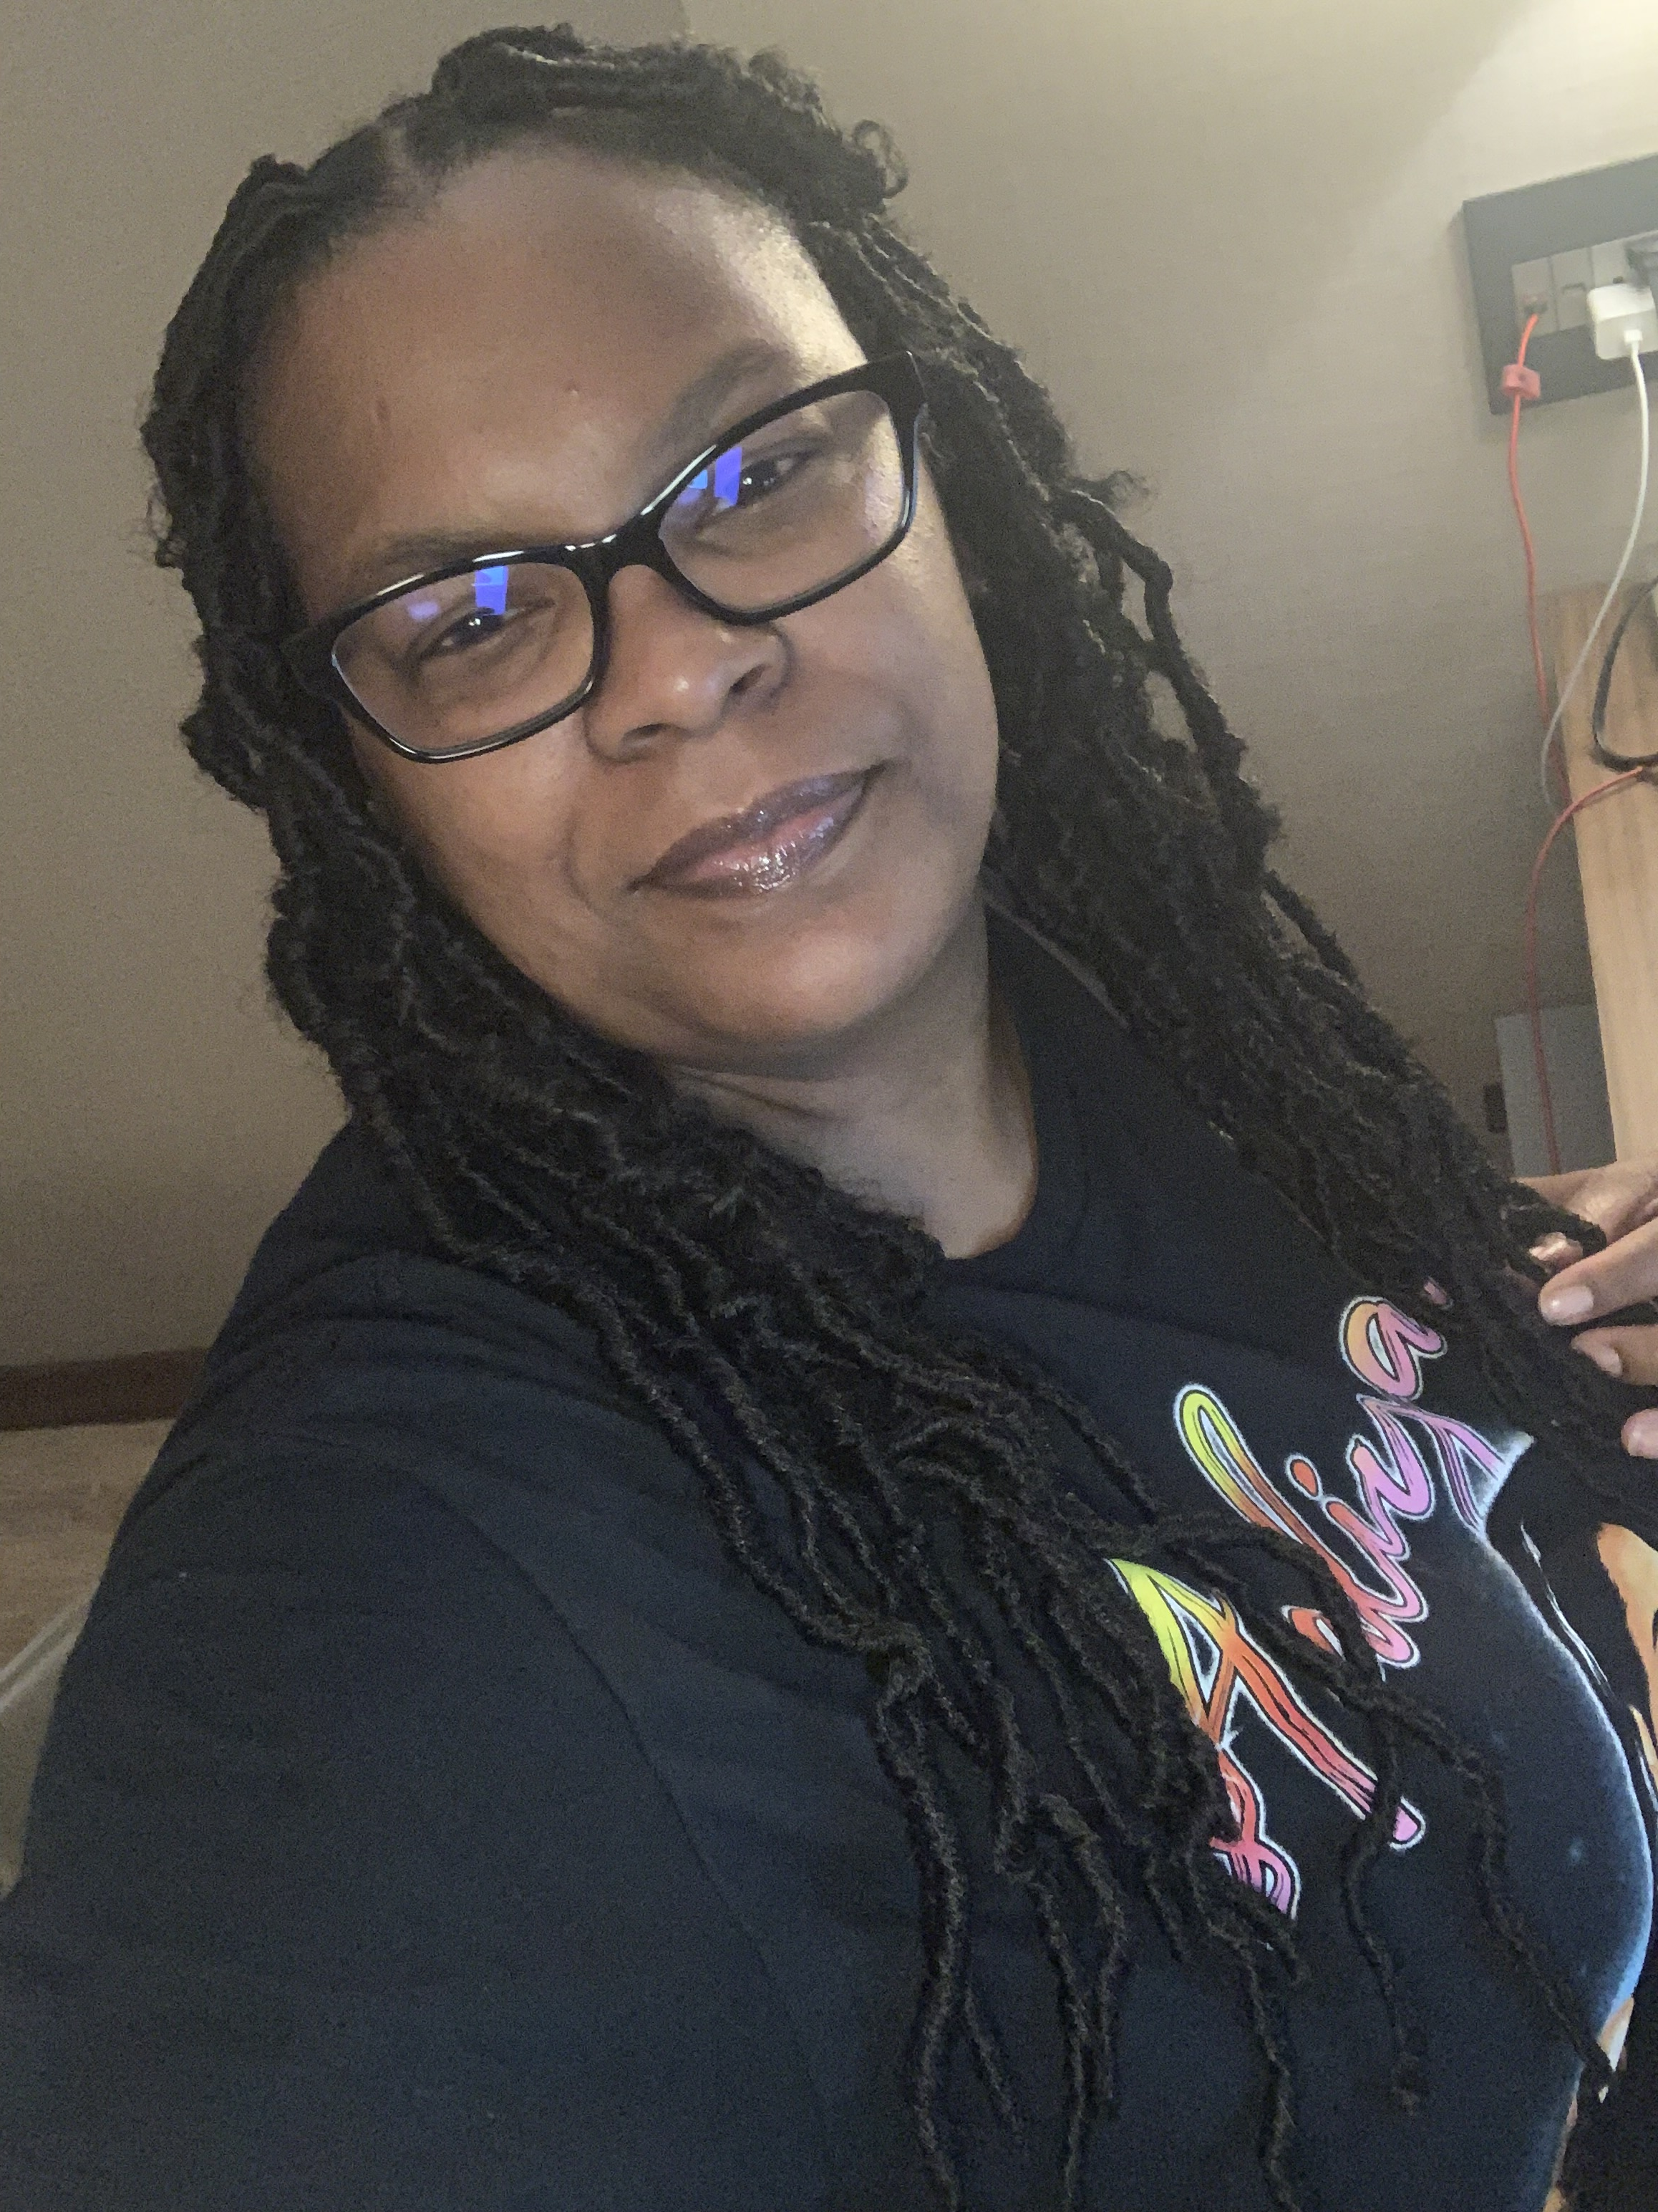
Recent New Hires
Welcome new hire Tamica Baylis
Position Title
Current: HR Generalist
Previous:
Corporate Recruiter/ HR (Precision Vehicle logistics)
Recruiter/ HR (RNA Facilities Management)
Production Team Lead- Quality/Repair(Chrysler LLC)
Paraprofessional (Ypsilanti Public Schools)
Admission’s Processor (University of Michigan)
Production Associate (Ford Motor Company)
Work Experience
4 years, Precision Vehicle Logistics; Wayne, MI
2 years, RNA Facilities management; Ann Arbor, MI
7 years, Chrysler LLC; Detroit, MI
7 Years, Ypsilanti Public Schools; Ypsilanti, MI
5 Years, University of Michigan; Ann Arbor, MI
3 Years, Ford Motor Company; Ypsilanti, MI
Education
BS in Human Resources Management (Ashford University)
Hobbies / Interests / Family
Yoga, Traveling, Interior design, Music

