Slide 1
TypeScript
by Navdeep Kumar | @navdeepdhull

Slide 2
About Me
IT Professional 9+ Years Experience in Web Technologies
Full Stack Developer, Consultant, Technical Lead @HytechPro
Expertise in building systems from Scratch to Enterprise Level
Software System Design & Architecture
Community Member & Contributor

Slide 3
Agenda
History & Evolution of Client Side Scripting Languages
Introduction to TypeScript
TypeScript Features
Typing Basics, Language Overview & Advanced
Walkthrough & Demo
Summary & Conclusion

Slide 4
Evolution
World Wide Web
Web Browser
1951 - First Genration Computers
1989 - Tim Berners-Lee proposed WWW
1990 - First Web Server was Developed
WorldWideWeb - First Web Browser
1993 – WWW free and open source
Web 1.0 - Static, Images, Url
Web 2.0
Dynamic Page
Client Side – Javascript, Ajax, Flash, Flex
Server Side – ASP, Php, Jsp, Ruby, perl

Slide 5
Javascript
ECMA Script
Advantages
1995 - Brendan Eich, Netscape
First web Scripting Language
Standardization in language specification by W3
LiveScript/ECMAScript/JavaScript
VB Script Etc.
Runs at Client Side
Dynamic & Interactive Web pages
React to events
Validate Data, modify HTML
Detect visitor Broswer

Slide 6
Javascript
Advancements
DHTML, HTML5
XHR, AJAX , JSON
JQUERY
Javacript Frameworks – Angular, Backbone, React, Amber
NodeJs, NPM

Slide 7
Why Typescript ?
Limitations of JavaScript
Not design as a programming language for big application, We now use to do big things
Does not have static typing
Lack structuring mechanisms like classes, modules, interfaces
AJAX and REST = never refresh the page
Your JavaScript code gets complex; it becomes extremely unwieldy
Dart, CoffeeScript, ClojureScript, Script#
“You can write large programs in JavaScript. You just can’t maintain them.”
Anders Hejlsberg (father of C#)

Slide 8
Introduction TypeScript?
Typed superset of JavaScript
Is built on, and compiles to, JavaScript
Produces idiomatic JavaScript
Supports any ES3 to ES6-compatible environment
Free and open source, strongly supported by Microsoft
Created by the father of C# Anders Hejlsberg

Slide 9
Features
Type safety at compile time
Encapsulation though classes, modules and interfaces
Constructors, properties and functions (public, private)
Enums
Lambda and generics support
Intellisense and syntax checking
Support standard JavaScript code with static typing

Slide 10
Code Time

Slide 11
Summary
No learning curve if you already know JavaScript, or if you know C# very well.
Visual Studio Code is amazing
Modules and classes enable large projects and code reuse
Compile-time checking prevents errors
Definition files for common JavaScript libraries makes them very easy to work with, and provides strong type checking
Source map debugging makes debug easy

Slide 12
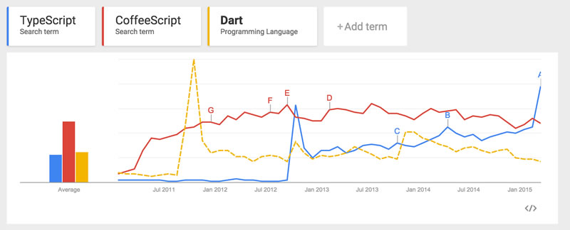
Typescript Usage Statistics

Slide 13
Further Reading
TypeScript 2.0
TypeScript Official website
TypeScript language specifications
Anders Hejlsberg - Introducing TypeScript on Channel 9
Source Code on GitHub
Definitely Typed - repository for type definitions

Slide 14
Questions ?

Slide 15
Thanks
@navdeepdhull

