Slide 1
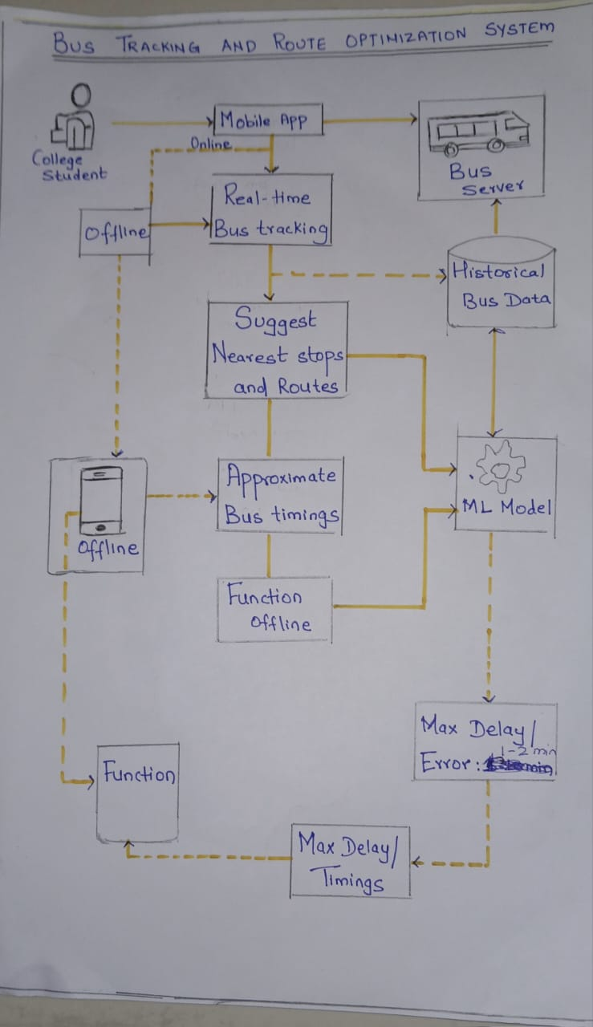
ARCHITECTURE DIGRAM

Slide 2
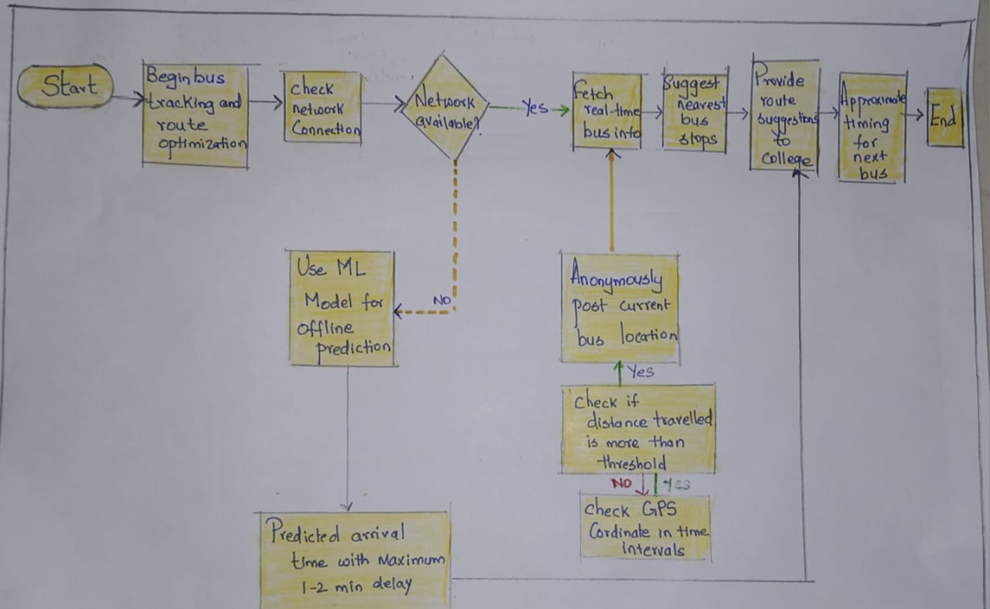
PROCESS FLOW DIGRAM:

