Slide 1


Slide 2
Problem Statement
Proposed Solution
Educational institutions with dedicated bus fleets often lack a reliable, privacy-focused way to track vehicle locations in real time. This creates uncertainty for students, parents, and administrators who rely on accurate arrival information.
Our solution is a privacy-focused, real-time bus tracking system designed for educational institutions.
Built on a customized MERN-based architecture, it enables drivers to share live bus locations using only a bus ID, protecting personal data.
Without a clear and efficient live tracking system, students often face unpredictable arrival times, longer waiting periods at stops, and frequent miscommunication about bus schedules.
Hosted securely within college infrastructure, the platform ensures full control over sensitive information while providing students with clear, battery-efficient tracking on their phones.
Most existing systems depend on special hardware and external cloud services. This increases costs and limits control over sensitive location data. Many solutions also require constant GPS tracking linked to drivers’ phones, which drains battery life and can create privacy issues.

Slide 3
Tech stacks: • Artificial Intelligence: Scikit-Learn, Pandas , TensorFlow. • Frontend and Design: HTML, CSS, JavaScript, React.js , React Native(Mobile App). • Backend and Databases: MongoDB, Node.js, Next.js Express.js.

Slide 4
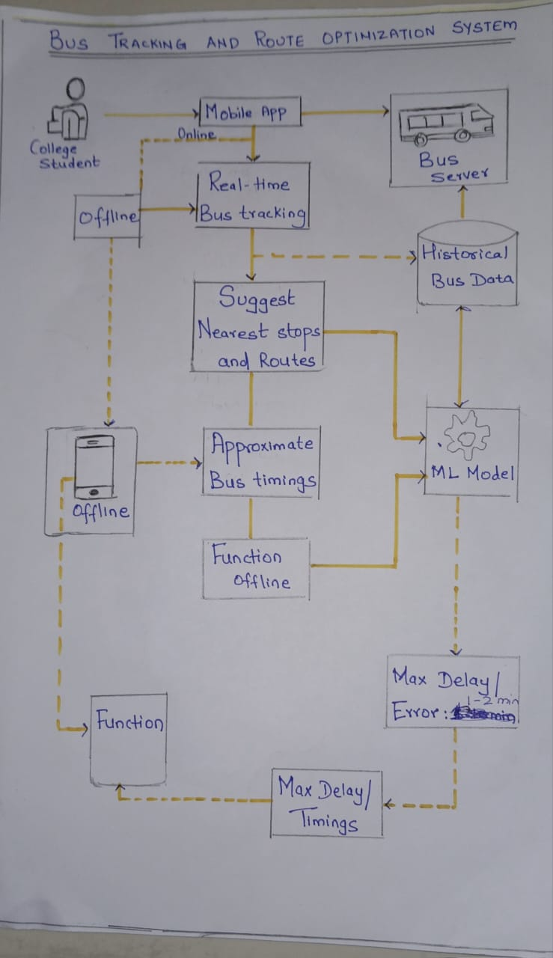
ARCHITECTURE DIAGRAM

Slide 5
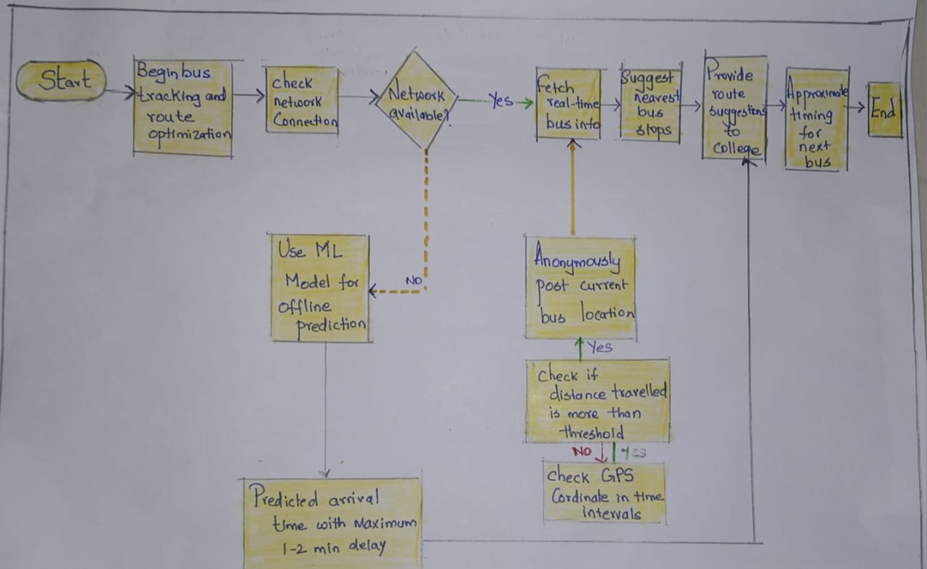
PROCESS FLOW DIAGRAM:

Slide 6
Prominent Features
Real-Time Bus Location
Historical Data
Bus ID based Identification
Next Stop Notifications
Route Generation
Student Mobile App

Slide 7
What Makes Our Approach Different?(USP’s)
Privacy-first
No driver personal tracking.
Institution level organization.
Low hardware requirement
No inbuilt GPS unit required.
Uses driver’s phone.
Self-hosted
College IT can host alongside their website.
No third-party cloud dependency.
Simple route representation
Since routes are fixed, they can be recorded by institution easily during set up.
Offline Prediction accuracy
Ensures accuracy of 1 to 2 min to ensure no delay

Slide 8
IMPACT
1)Institution-Centric Deployment
Designed for educational institutions—campus-wide, not personal user-based. Empowers colleges to control, customize, and deploy without third-party reliance.
2)Low Hardware Footprint
No GPS hardware installation needed—reduces deployment cost by using the driver’s smartphone as a lightweight tracking device.
3) Easy to Host on Campus Systems
No need for external cloud setup—just run it on the college’s own servers, even alongside the existing website.
4) Effortless Route Configuration
Minimal setup with fixed-route simplicity—routes can be recorded once by staff or admin and reused indefinitely, with no need for complex map integrations.
5) Robust Offline Prediction System
Reliable ETA predictions even without internet, maintaining 1–2 minute accuracy using on-device ML (TensorFlow Lite) for seamless offline experience.

