Slide 1
VKraft Software Services
- Crafting Possibilities. Igniting Potential.
Notes:
Topic wise title

Slide 2


Apache Kafka with webMethods

Slide 3
Content
Introduction to webMethods Adapter for Apache Kafka
Architecture and Components
Adapter Connections
Adapter Services
Adapter Notifications
Installation Guide
Configure Producer Connection
Configure Consumer Connection

Slide 4
Introduction webMethods Adapter for Apache Kafka
Add-on to webMethods Integration Server.
Enables data/message exchange with Apache Kafka, a distributed publish-subscribe messaging system.
Unified, high-throughput, and low-latency platform.
Handles real-time data feeds efficiently.
Allows Integration Server clients to create and run services.
Supports operations like reading and writing data into Apache Kafka clusters.

Slide 5
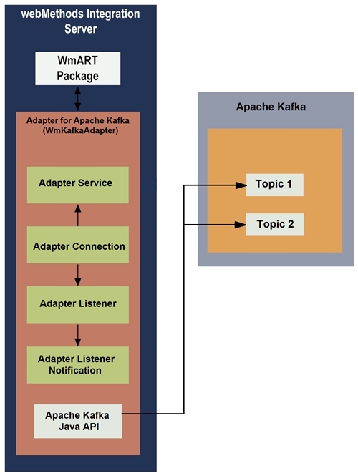
Architecture and Components

Slide 6
Adapter Connections
Facilitates runtime connectivity between Integration Server and Apache Kafka via Java API.
Created at design time for use in integrations; number and type depend on topics and integration needs.
Managed using parameters in Integration Server Administrator.

Slide 7
Adapter Services
Purpose: Adapter services connect Integration Server to Apache Kafka resources for messaging operations using the Kafka Java API.
How it works: Call adapter services from flow or Java services to interact with Kafka via predefined adapter connections.
Produce Service: Publishes messages to a Kafka topic.
Consume Service: Consumes messages from a Kafka topic.

Slide 8
Adapter Notifications (Listeners)
Continuously monitors a Kafka topic for messages in real-time.
Fetches messages based on configured filter criteria.
Passes messages to the listener notification for processing.
Key Difference: Unlike Produce/Consume Services, listeners are not invoked directly by services or clients.

Slide 9
Adapter Notifications (Listener Notifications)
Works with listeners to process messages from Kafka topics.
Messages are lost if no notifications are configured or enabled; enable notifications before listeners.
Configure one notification per listener; if multiple, enable only the intended one.
Types of Listener Notifications:
- Asynchronous
- Synchronous

Slide 10
Types of Listener Notifications
Asynchronous:
Creates a publishable document (msgBody, msgHeader).
Publishes to Broker (default) or locally to Integration Server.
Requires an Integration Server trigger for processing.
Synchronous:
Creates Request (msgBody, msgHeader, etc.) and Reply (replyMsgBody, msgHeader) documents.
Invokes a service, waits for completion before processing the next message.
Does not publish documents.

Slide 11
Installing Adapter for Apache Kafka
Copy JAR files from Apache Kafka’s lib folder to WmKafkaAdapter\code\jars:
zkclient-0.10.jar (for Kafka 2.12-2.3.1 or lower)
kafka-tools-2.0.0.jar
kafka-clients-2.0.0.jar
kafka_2.12-2.0.0.jar
Note: Higher versions of JARs are supported.
Restart the Integration Server after installation.

Slide 12
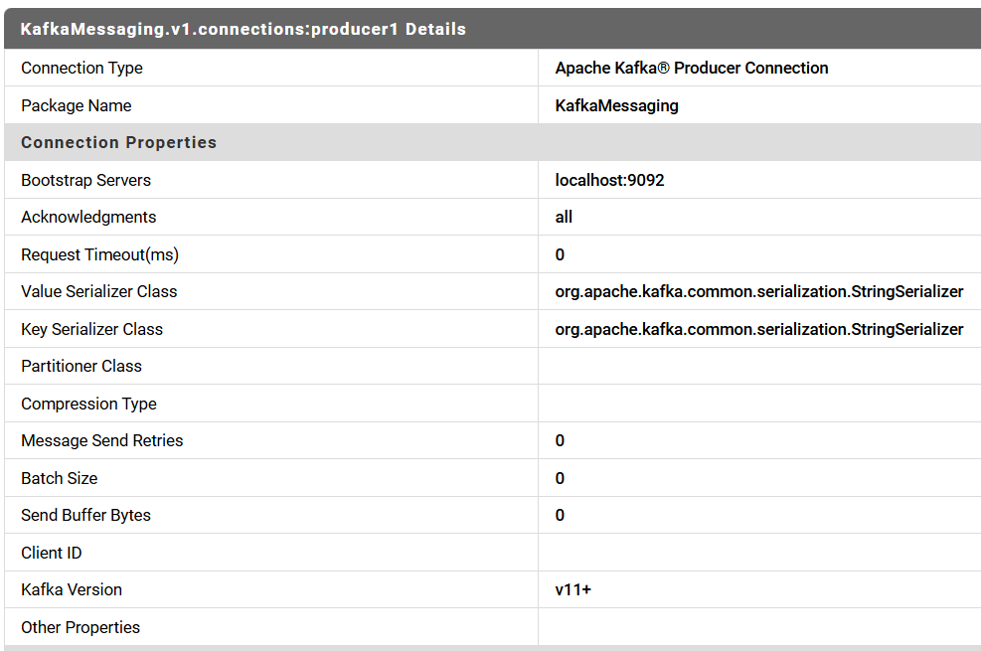
Configuring Apache Kafka Producer Connection in Adapter
Navigate to Adapters > webMethods Adapter for Apache Kafka in Integration Server Administrator.
Click Configure New Connection > Apache Kafka Producer Connection.

Slide 13
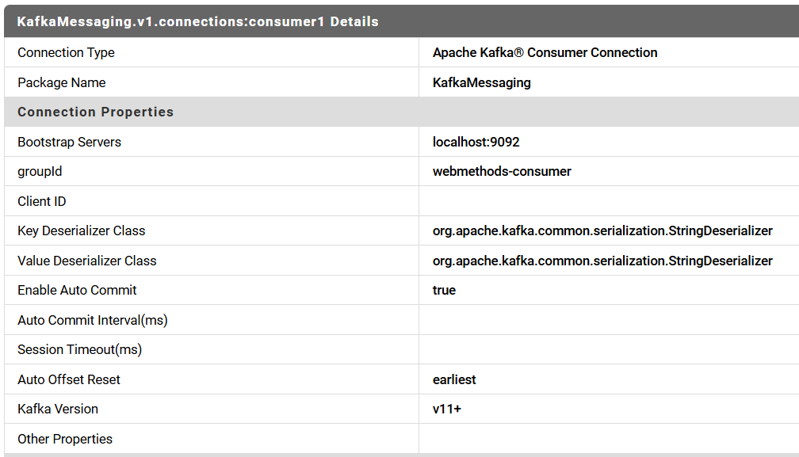
Configuring Apache Kafka Producer Connection in Adapter
Navigate to Adapters > webMethods Adapter for Apache Kafka in Integration Server Administrator.
Click Configure New Connection > Apache Kafka Producer Connection.

Slide 14
Have Questions? Let’s Discuss…

Slide 15


We travel with you as part of your business, taking the lead in promoting your brand to achieve new heights in the digital market.

