Slide 1
Ch 10. Web Proxies
Naveen Kumar Lekkalapudi

Slide 2
What to expect?
Functionality
Evidence
Squid!!
Web Proxy analysis
Encrypted web traffic

Slide 3
Why investigate
A web proxy can literally contain the web browsing history of an entire organization all in one place.
It’s possible to reconstruct web pages from the cache.
Provides performance and security
Examples:
Caching proxy
Content filter
TLS/SSL proxy
Anonymizing proxy
Reverse proxy

Slide 4
Functionality
Functions:
Caching—Locally storing web objects for limited amounts of time and serving them in response to client web requests to improve performance.
URI Filtering—Filtering web requests from clients in real-time according to a blacklist, whitelist, keywords, or other methods.
Content Filtering—Dynamically reconstructing and ﬁltering content of web requests and responses based on keywords, antivirus scan results, or other methods.
Distributed Caching—Caching web pages in a distributed hierarchy consisting of multiple caching web proxies in order to provide locally customized web content, serve advertisements, and improve performance.

Slide 5
Caching
Caching is a way of reusing data to reduce bandwidth use and load on web servers, and speed up web application performance from the end-user perspective.
Can be used to know:
How recently a cached web object was retrieved from the server
Whether a web object is likely to exist in the web proxy cache
Whether a cached version of a web object was actually viewed by a speciﬁc web client

Slide 6
Caching
Expiration
Expires Header – lists date and time after which the object will be considered stale
Cache-Control – supports granular specifications for caching
Validation
Last-modified header – Cache validation based on absolute date
Entity Tag(Etag) – Unique value assigned by web server to a web object

Slide 7
Functionality
Content Filtering
Web proxies are set up in order to restrict and log web surfing activity.
Content ﬁlters are often used to dynamically scan web objects for viruses and malware.
Distributed Caching
Internet Cache protocol(ICP):
The Internet Cache Protocol (ICP) is a mechanism for communication between web cache servers in a distributed web cache hierarchy
Internet Content Adaption Protocol(ICAP):
ICAP is used to translate web pages into local languages, dynamically insert advertisements into web pages, scan web objects for viruses and malware, censor web responses, and ﬁlter web requests

Slide 8
Evidence
Persistent
History of all HTTP, HTTPs, blocked web traffic attempts, config files
Volatile
Cached content in RAM
Cached content in disk, based on capacity
Authentication information
Off-System
Central log server

Slide 9
Obtaining Evidence
Log files stored on the web proxy server or a logging server
Web cache ﬁles stored on the web proxy server
Reports from tools built into the web proxy server

Slide 10
SQUID
Popular proxy server and web cache tool.
Open sourced.
Components:
Conﬁguration: Squid is conﬁgured using a ﬁle that is by default called “squid.conf.” Other conﬁguration ﬁles may be included by reference.
Logfiles: Squid is capable of storing several types of logﬁles, including access.log (a record of web access history), squid.out (maintains startup times and fatal errors), cache.log (program debugging and error messages), store.log (a list of all objects stored to disk or removed), and useragent.log (information about client browsers).
Cache: Squid also stores copies of web objects themselves, for a limited time. Typically, the cache is stored in /var/spool/squid/

Slide 11
SQUID
Configuration
Which clients are allowed to browse the Internet or speciﬁc web sites
What traffic is processed by the web proxy
What restrictions exist for user web access
How easily the web proxy can be circumvented
What types of objects may exist in the cache (both on disk and in memory)
The location of the cache and log ﬁles
The storage format of the disk cache
How long objects may be stored in the cache, and what algorithms are used to purge data
What data is stored in the log ﬁles

Slide 12
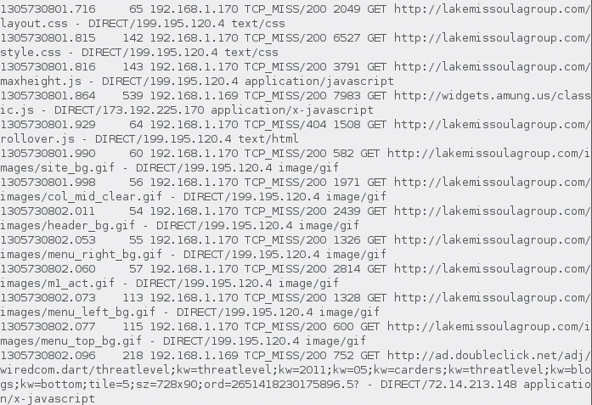
SQUID
Access Log file

Slide 13
SQUID
Can cache:
200 OK
203 Non-Authoritative Information
300 Multiple Choices
301 Moved Permanently
410 Gone
Disk Cache
Each Squid proxy can store cached objects in one or more cache directories.

Slide 14
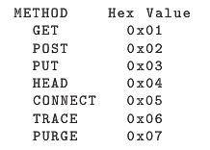
SQUID
Swap.state
The swap.state ﬁle is Squid’s database, which contains a record of every object that has been added to or removed from the cache
Keys →
Memory Cache
cache_mem can be configured for size of cache

Slide 15
Web Proxy Analysis
Tools:
Internet Access Monitor
Blue Coat Reporter
Squidview
SARG
Splunk
Shell

Slide 16
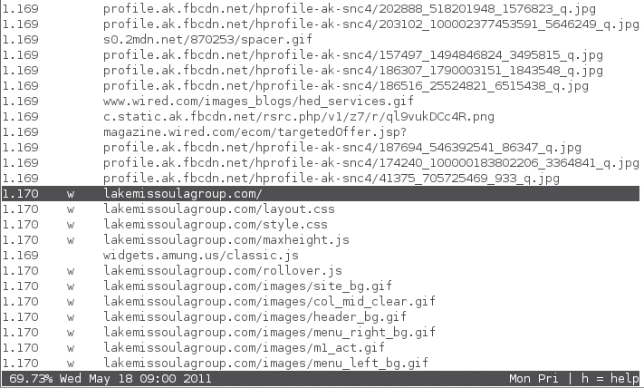
Web Proxy analysis
Squidview

Slide 17
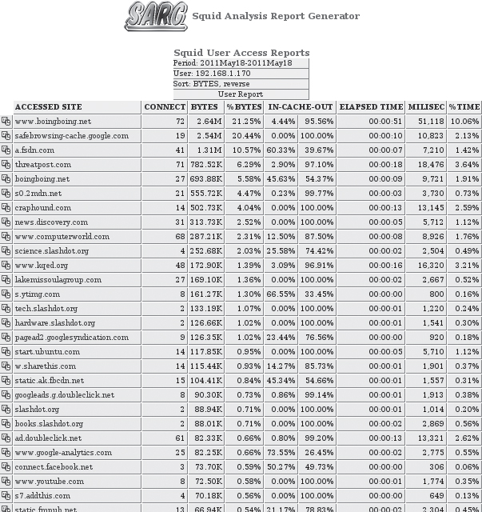
Web Proxy Analysis
SARG

Slide 18
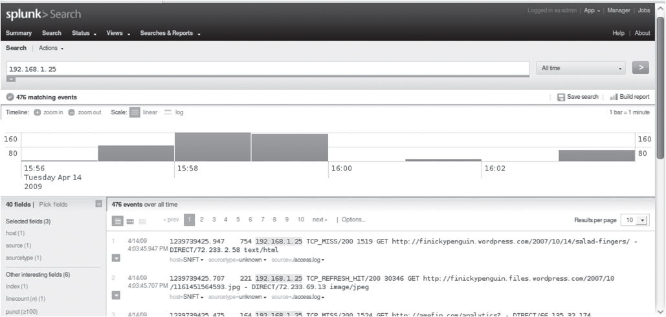
Web Proxy Analysis
Splunk

Slide 19
Web Proxy Analysis
$ grep '192\.168\.1\.4\|192\.168\.10\.42 ' access.log
$ date -d @1239739126.845
Tue Apr 14 13:58:46 MDT 2009
$ while read line; do unixdate=`echo $line | awk '{print $1 }'`; humandate=`date -d @$unixdate `; echo $humandate $line; done< access.log > access-humandate.log

Slide 20
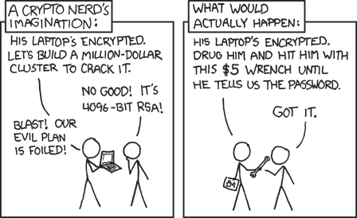
Encrypted Web Traffic

Slide 21
Encrypted Web Traffic
Why?
Regulations
Employee privacy
Disguise payload
How can we help?
Identify encrypted traffic
How effective can it be
Circumvent or break encryption

Slide 22
Encrypted Web Traffic
Transport Layer Security
The Transport Layer Security (TLS) protocol is an IETF standard designed to “provide communications security over the Internet.
Predecessor of SSL
Purpose:
Confidentiality and integrity
Means to verify clients

Slide 23
Encrypted Web Traffic
How it works:
The client and server agree on the protocol version and algorithms to be used.
The server sends the client a certiﬁcate that includes its public key and information about the server (including its canonical name). A digital signature is attached to the certiﬁcate. The purpose of the digital signature is to enable the client to cryptographically verify the validity of the information in the certiﬁcate itself, including the server’s public key.
The client optionally provides its certiﬁcate to the server for client authentication.
The client computes a cryptographic hash of the information in the web server’s certiﬁcate. It then uses the public key of the appropriate certiﬁcate authority to check the digital signature of the cryptographic hash.
The client checks that the certiﬁcate is currently valid and that the host name listed in the certiﬁcate matches the web server’s host name.
The client uses the web server’s public key to encrypt a random secret number, known as the “premaster secret,” and sends it to the web server. The web server uses its private key to decrypt the message and retrieve the premaster secret, which is now shared only by the client and server. The shared premaster secret is used as the basis to generate session keys for subsequent symmetric key encryption of communications.

Slide 24
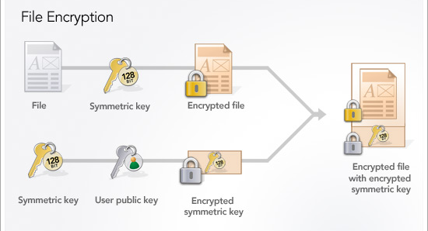
Encrypted Web Traffic

Slide 25
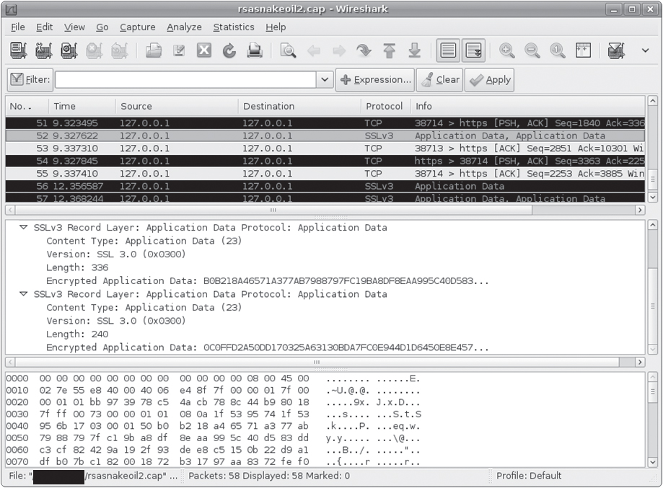
Encrypted Web Traffic
How to gain access
Server’s private key using packet capture

Slide 26
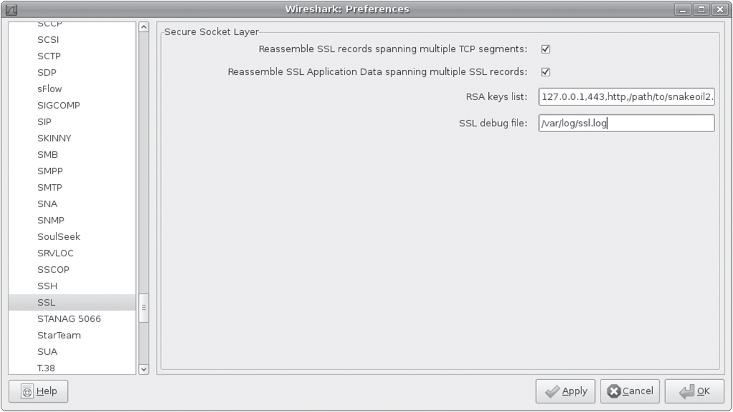
Encrypted Web Traffic
How to gain access
Wireshark SSL configuration

Slide 27
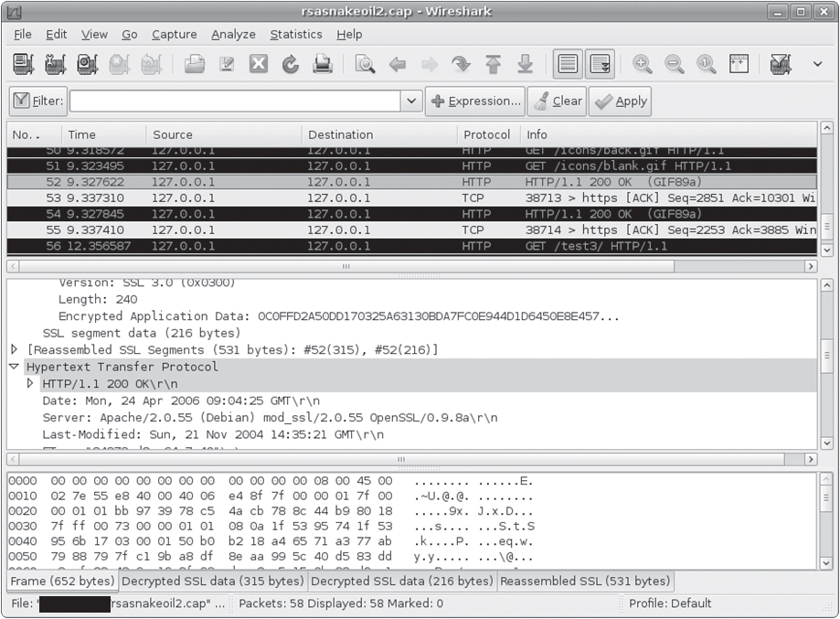
Encrypted Web Traffic
Intercepting Proxy

Slide 28
Encrypted Web Traffic
Commercial TLS/SSL interception tools
Commercial web proxies are manufactured by blue coat and others.
Blue Coat’s ProxySG includes SSL interception and content filtering features.

