Slide 1
Ch 3. Evidence Acquisition
Naveen Kumar Lekkalapudi

Slide 2
What to expect?
Active vs passive evidence acquisition
Tools used to acquire evidence.
Different types of media that can be used in that process.
Common interfaces to interact with network devices.

Slide 3
Passive Acquisition
Physical Interception: Cables.
Radio Frequency.
Hubs.
Switches.

Slide 4
Cables
Cables connect stations together providing point to point communication.
Two types:
Copper
Optical
Copper wires are two types again:
Coaxial: single copper wire wrapped with insulation. Can tap when core copper is accessed.
Twisted Pair (TP): Multiple pairs of copper wires twisted together with insulation. Can tap using commercial TP network tap inline.
1 copper wire = 1 communication between 2 stations.

Slide 5
Cables
Optical:
Thin strands of glass carrying light. Can be tapped but optical regenerator must be used.
Types of taps:
Inline Network taps:
Tapped at layer 1.
Short disruption.
Has 4 ports, 2 inline for normal traffic, 2 for sniffing that traffic.
Can also load-balance.
Wires need to be cut for sniffing.

Slide 6
Cables: Types of taps
Vampire taps:
No physical cuts of cables necessary.
Butt kits are used to tap into punchdown blocks in wiring closet.
Can punch through wires.
Easily available at hardware store.
Induction coils:
Voltage through copper → magnetic properties.
Replicate that in original form to eavesdrop

Slide 7
Cables: Types of taps
Fiber optic taps:
Splice optical cable.
Short disruption
Optical time domain reflectometers(OTDR) can be used to locate breaks in cable.
Bend couplers can be used which capture stray photons and gain some information about the signal.

Slide 8
Radio Frequency
Wireless transmissions. Standard 802.11 is used for WLAN communication.
2.4, 3.7,5 GHz frequency ranges are used.
Wi-Fi is also IEEE 802.11
Illegal to use 802.11 frequency ranges for over certain distances in US.
Yet, off the shelf components can be used to build transreceivers to eavesdrop on wireless communications.

Slide 9
Radio Frequency
WLAN can be tapped from long distance off physical perimeter.
When connecting to those communications, own activity can also be monitored.
If encrypted, key can be obtained or cracked to analyze data.
Control data sent with data:
SSID
WAP MAC addresses.
Encryption/authentication algorithms
Client MAC addresses
Layer3+ contents
Many drivers support monitor mode. Even most of your laptops. USB adaptors can also be used. Backtrack is your friend.

Slide 10
Hubs
Physically connects stations together.
Hubs are switches sending incoming data to many stations.
Difference:
Hub is multi-port repeater, no control on data.
Switches can control data and ports.
Can trivially sniff a hub, WAP is a hub.
Traffic can be captured by everyone on hub.

Slide 11
Switches
Unlike hub, other computers on switch can not listen to your communications.
CAM tables are used to map MAC addresses to ports on switch.
SPAN/RSPAN can be used which are commercially available.
Port mirroring can be used. But administrative access is needed.
Attackers methods:
MAC flooding: corrupt CAM tables by sending bogus MAC addresses.
ARP spoofing: ARP packets are broadcasted with victims IP address and attackers MAC address. Victims traffic → attackers

Slide 12
Switches Ex:
Configure port mirroring for a Cisco ASA 5500 (IOS 8.3)
Traﬃc on Ethernet ports 2, 3, 4, 5, and 6 are all copied to port 7.
Ant-fw is hostname:
ant-fw(config)# interface ethernet 0/7
ant-fw(config-if)# switchport monitor ethernet 0/6
ant-fw(config-if)# switchport monitor ethernet 0/5
ant-fw(config-if)# switchport monitor ethernet 0/4
ant-fw(config-if)# switchport monitor ethernet 0/3
ant-fw(config-if)# switchport monitor ethernet 0/2

Slide 13
Traffic Acquisition Software
Libpcap and winpcap
BPF language
Tcpdump
Wireshark
Tshark
Dumpcap

Slide 14
Traffic acquisition Software
Libpcap – linux c library
Winpcap- windows library.
Free to download and install.
Used by wireshark, snort, nmap, ngrep and many others.
Can use it to design your own sniffing software.

Slide 15
Traffic acquisition Software
BPF language:
Libpcap uses Berkeley packet filter language to filter huge amounts of data in network.
Primitives:
Type: host, net, port, portrange
Dir: src, dest, addr1,addr2
Proto: tcp, udp
Filter packets by bytes: ip[8] < 64
Filter packets by bits: ip[0] & 0x0F > 0x05

Slide 16
Tcp dump
Can capture, filter and analyze network traffic.
Tcp dump in action
http://www.youtube.com/watch?v=i6NnC3Kari8
Standard examples:
Tcpdump –D
Tcpdump –n
Tcpdump –I eth0
Fidelity:
Admissable in court.
Can act as evidence
Snaplen = 1500 MTU + 14 header

Slide 17
Tcp dump
Filtering packets:
# tcpdump -nni eth0 'not (tcp and port 80)’
tcpdump -i eth0 -s 0 -w targeted_full_packet_dump.pcap 'host 10.10.10.10’
Here we introduce a simple BPF ﬁlter to grab and store in their entirety only those packets sent to or from the host at the address “10.10.10.10.”

Slide 18
Wireshark
Has a GUI!
Open sourced.
Capture packets, filters data.
Analyzes protocols.
http://www.youtube.com/watch?v=rGHN-O4qJwY

Slide 19
tshark
CLI of wireshark.
Uses libpcap.
Example:
tshark -i eth0 -w test.pcap 'not port 22’
Capturing traffic on eth0 network interface.

Slide 20
Dumpcap
Captures packets.
Aids investigation.
Few system resources, maximizes capture capabilities.
Example:
$ dumpcap -i eth0 -w test.pcap 'not port 22'

Slide 21
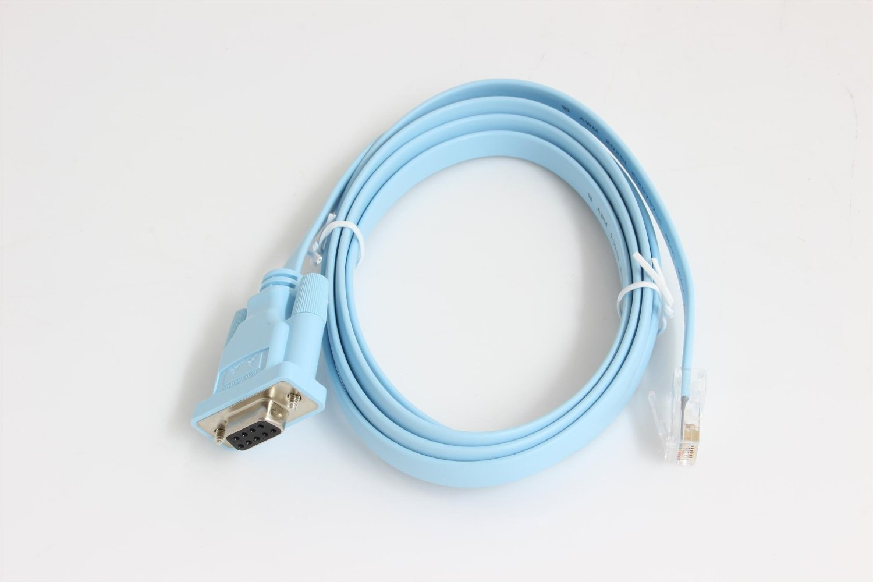
Active Acquisition
Console:
Connect
Dmesg | tail
Screen –L /dev/ttyUSB0

Slide 22
Active Acquisition
SSH (Secure Shell login)
OpenSSH is a widely used implementation of SSH, which has been released free and open-source under a BSD license.
Can connect to another system remotely and run commands.
Example:
$ ssh -p 4022 sherri@remote.lmgsecurity.com
$ ssh root@192.168.20.1 -p 22
Default port 22

Slide 23
Active Acquisition
Secure Copy (SCP) and SFTP
Works with SSH.
Copies files between local and remote systems.
Example:
$ scp -P 4022 jonathan@remote.lmgsecurity.com:/etc/passwd .
Telnet:
Telnet is a command-line remote communications interface, which was originally developed in 1969 and eventually standardized by the IETF in RFCs 854 and 855
Mainly used as utility to test connection to servers.

Slide 24
Active Acquisition
Telnet example:
$ telnet lmgsecurity.com 80
Trying 204.11.246.1...
Connected to lmgsecurity.com.
Escape character is '^]'.
GET / HTTP/1.1
Host: lmgsecurity.com
HTTP/1.1 200 OK
Date: Sun, 26 Jun 2011 21:39:33 GMT
Server: Apache/2.2.9 (Debian) PHP/5.2.6-1+lenny10 with Suhosin –Patch
mod_python/3.3.1 Python/2.5.2 mod_ssl/2.2.9 OpenSSL/0.9.8g mod_perl/2.0.4
Perl/v5.10.0
Last-Modified: Thu, 23 Jun 2011 22:40:55 GMT
ETag: "644284-17da-4a668c728ebc0”
Accept-Ranges: bytes
Content -Length: 6106
Content -Type: text/html

Slide 25
Active Acquisition
SNMP:
Simple Network Management Protocol
You can poll networked devices from a central server, or push SNMP information from remote agents to such a central aggregation point.
SNMP was designed to be extensible through the deﬁnition of the “management information base” (MIB), which basically describes the database of managed information.
Here’s a list of the basic SNMP operations:
Polling: GET, GETNEXT, GETBULK
Interrupt: TRAP, INFORM
Control: SET

Slide 26
Active Acquisition
TFTP:
Trivial File transfer protocol.
simple, automated means of transferring files between remote systems.
TFTP is often used as a means through which distributed devices can download updates from a central server within an organization.
Web and Proprietary interfaces
DSL routers.
HTTP and HTTPS, webserver logs, accesses and events.
Standard java interfaces for commonly used devices such as Cisco.

Slide 27
Active Acquisition
Inspection without Access:
Port scanning: nmap, others on network will know you are scanning.
Vulnerability scanning: Nessus, etc. Scans for known vulnerabilities by comparing against standard defects in servers.
Strategy:
Refrain from rebooting/ powering down.
Connect via console than over network.
Record system time.
Collect evidence according to level of volatility
Record your investigative activities.

