Slide 1
Ch 8. Event Log Aggregation, Correlation and Analysis
Naveen Kumar Lekkalapudi

Slide 2
What to expect?
Sources of logs
Network log architecture
Collection and analyzing evidence

Slide 3
Sources of Logs
Operating systems of servers and workstations, such as Windows, Linux, or UNIX-based operating systems
Applications, such as web, database, and DNS servers
Network equipment, such as switches, routers, and ﬁrewalls
Physical devices, such as cameras, access control systems, and HVAC systems

Slide 4
OS Logs
OS event logs can include records of:
Logins/logouts
Execution of privileged commands
System startup/shutdown
Service activities and errors
Microsoft Windows Logs
Event Log Service and Event Viewer
Application
Security
system
Windows Eventing 6.0
Windows logs and applications and services logs.

Slide 5
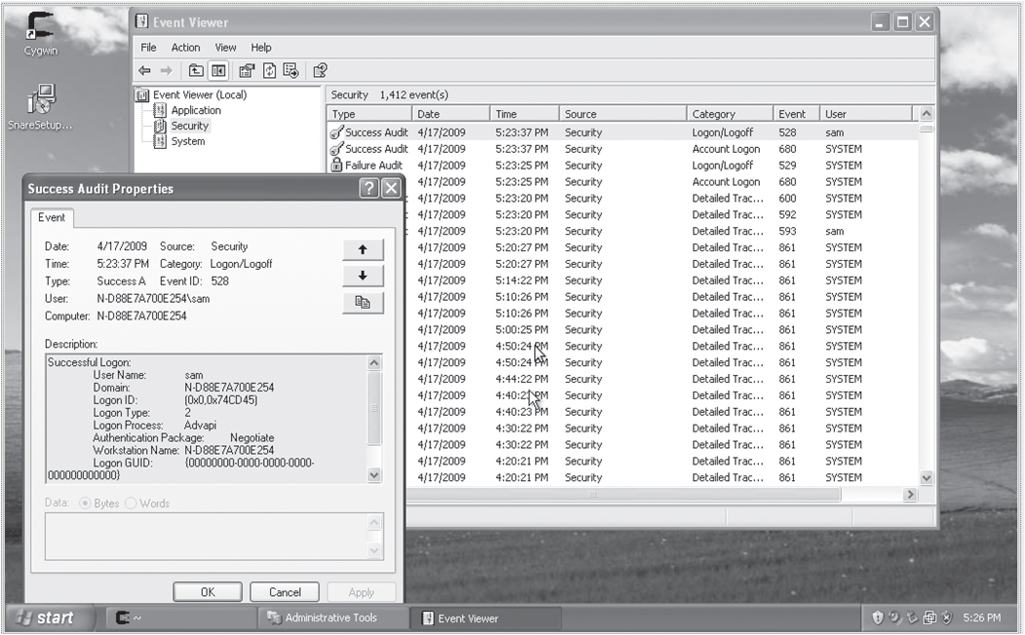
OS Logs

Slide 6
Windows Event Logging Ex:
> Apr 17 11:49:54 192.168.1.26 MSWinEventLog 1 Security 40 Fri Apr 17 11:49:54 2009 683 Security SYSTEM User Success Audit N-D88E7A700E254 Logon/Logoff Session disconnected from winstation: User Name: sam Domain: N-D88E7A700E254 Logon ID: (0x0,0x55A21C) Session Name: RDP-Tcp#2 Client Name: student –desktop Client Address: 192.168.1.25
> 2011-04-25T15:19:29-06:00 fox-ws MSWinEventLog#0111#011Security#0112610#011 Mon Apr 25 15:19:27 2011#0114776#011Microsoft -Windows -Security –Auditing #011bob#011N/A#011Success Audit#011fox-ws#011None#011#011The computer attempted to validate the credentials for an account. Authentication Package: MICROSOFT_AUTHENTICATION_PACKAGE_V1_0 Logon Account: bob Source Workstation: FOX-WS Error Code: 0x0#0112467

Slide 7
UNIX/ Linux Event Logging
Syslog
Syslog is a client/server protocol designed for transmitting event notiﬁcations in an IP network.
Syslog can also be conﬁgured to receive event logs from other systems over a network socket
Facilities in syslog are diﬀerent categories for messages.
Priorities indicate the severity or importance of the message. Syslog message priorities include:
debug, info, notice, warning, warn (same as warning), err, error (same as err), crit, alert, emerg, and panic (same as emerg).

Slide 8
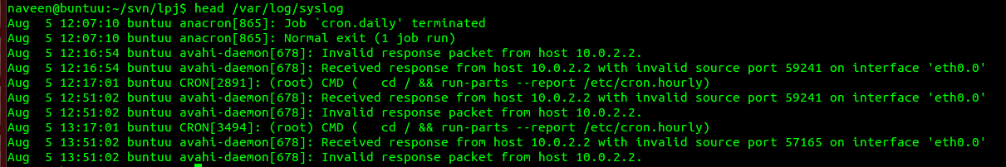
UNIX/ Linux Event Logging
Syslog

Slide 9
UNIX/ Linux Event Logging
Syslog-ng
Syslog-ng is the “next generation” syslog daemon
Encryption during transmission (TLS)
/etc/syslog-ng/syslog-ng.conf
Ex:
#Define remote message sources
source s_remote { udp(); };
#Define destination filename
destination df_auth_remote { file("/var/log/remote.auth.log"); };
# Filter all messages from the auth and authpriv facilities
filter f_auth { facility(auth, authpriv); };
# Put it all together
log {
source(s_remote);
filter(f_auth);
destination(df_auth_remote);
};

Slide 10
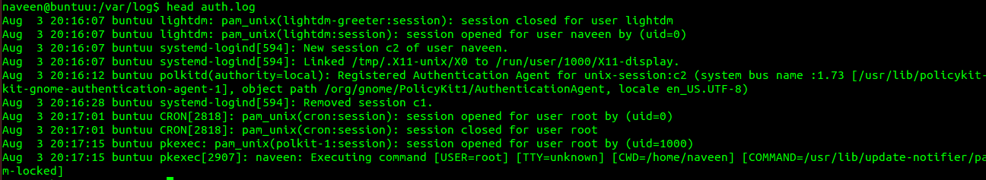
Auth log ex

Slide 11
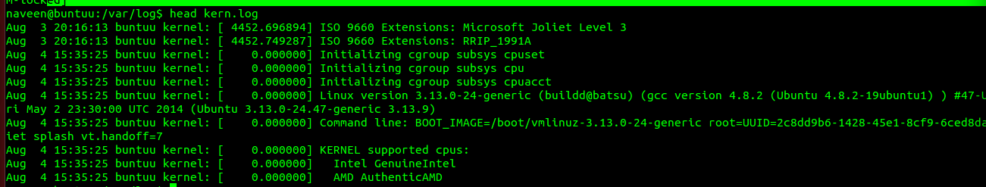
Kern log ex

Slide 12
Application Logs
Although some applications create logs in well-documented, published formats, network forensic analysts constantly run into new log formats, or formats that are simply not well documented.
Application logs in real life are just different from the documented format or outdated.
Many applications allow local system administrators to customize log contents and formatting

Slide 13
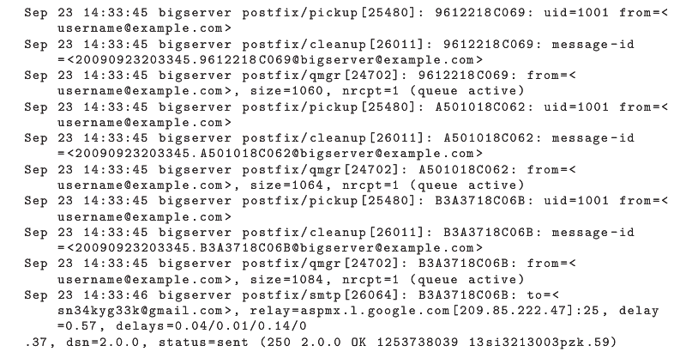
SMTP Logs

Slide 14
Physical Device logs
Devices include:
Cameras
Access control systems, such as RFID readers on doors
HVAC systems
Uninterruptible power supplies (UPSs)
Intensive care units at hospitals
Electrical systems
Laundry machines
Bathrooms

Slide 15
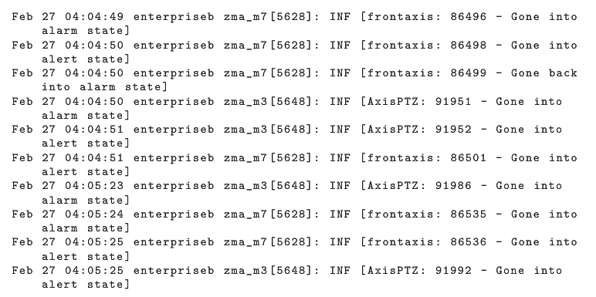
Physical Device Logs - Camera

Slide 16
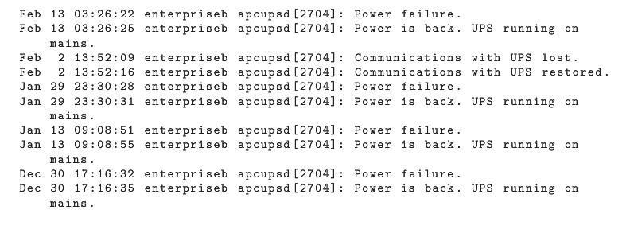
Physical Device Logs UPS

Slide 17
Network Equipment logs
Often these logs aredesigned to be sent to a remote server via syslog or SNMP because the network devices themselves have very limited storage capacity.
Network equipment can include, among other things:
Firewalls
Switches
Routers
Wireless access points

Slide 18
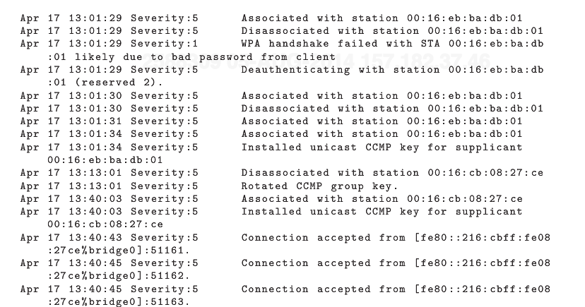
Network Equipment Logs
Apple airport extreme logs

Slide 19
Network Log Architecture
Three types:
Local
Logs stored locally on a compromised or potentially compromised system may be modiﬁed or deleted. Even if there is no evidence to indicate modiﬁcation, logs stored on compromised systems cannot be trusted.
Remote Decentralized
Time skew can be partially mitigated by having the logging servers timestamp incoming logs, although time skew between servers may still be an issue.
Collecting logs from a logging server is usually far less work than collecting logs from endpoint devices, especially since the logging server is more likely to be under direct administrative control.

Slide 20
Network log Architecture
Centralized
Logs are stored on a remote server, where they are not subject to modiﬁcation or deletion in the event of an endpoint device compromise.
Centralized management typically allows for easy access to log data, and also facilitates on-the-ﬂy configuration changes when needed to support an ongoing investigation.

Slide 21
Network Log Architecture
Common Pitfalls
Reliability
Time skew
Confidentiality
Integrity

Slide 22
Log Analysis Tools
Common agents at end-points:
Syslog
SNARE
Aggregation and analysis software includes:
Splunk
SCOM
DAD
MARS
Arcsight

Slide 23
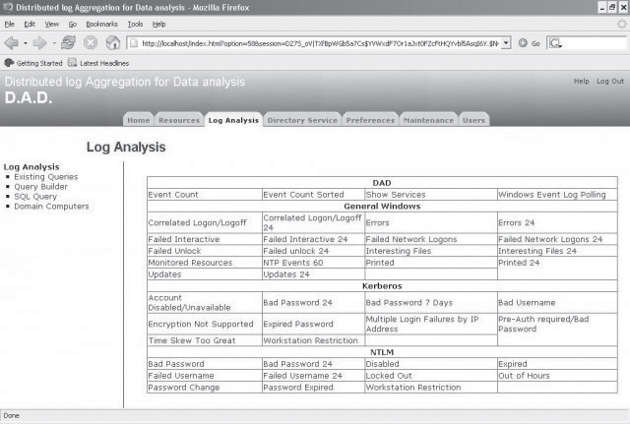
Log analysis tools
DAD

Slide 24
Collecting and analyzing evidence
Obtain Information
Sources of event logs
Resources
Senstivity
Strategize
Review Information
Prioritize Sources of Evidence
Plan Acquisition
Communicate

Slide 25
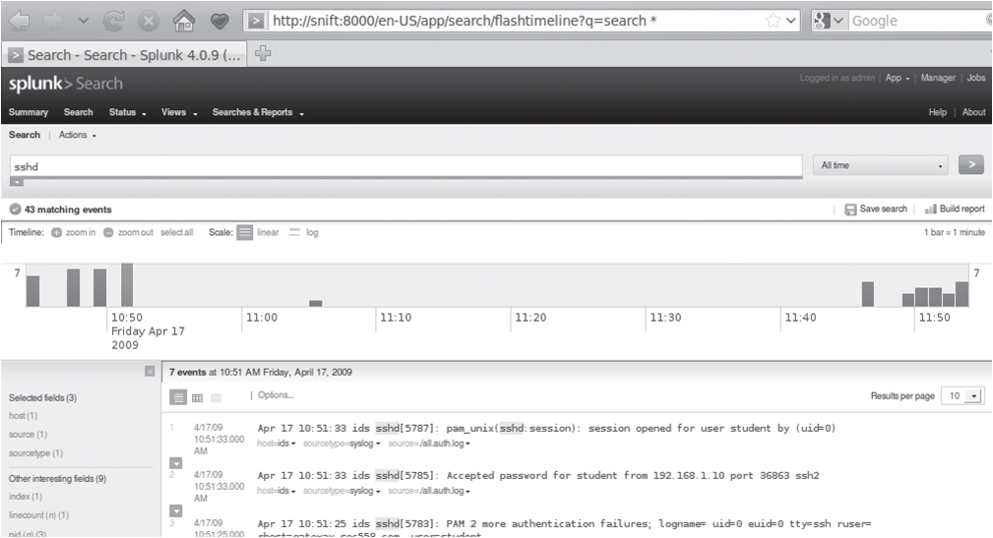
Log analysis tools
SPLUNK

Slide 26
Collecting and analyzing evidence
Collect Evidence
Physical Connection
Manual Remote Connection
Central Log Aggregation
Web interface
Proprietary Interface
Passive Evidence Acquisition
Analyze
Dirty Values—Searching for speciﬁc keywords in logs.
Filtering—Narrowing down your search space by selecting logs based on time, source/destination, content, or other factors.
Activity Patterns—Analyzing logs for patterns of activity and identifying suspicious activity based on the results.
Fingerprinting—Creating a catalog of complex patterns and correlating these with speciﬁc activities to facilitate later analysis.

Slide 27
Report
Tips:
Pictures
Detailed info about sources of event logs and process in collecting them. Remember Computer Incident Reponse?
Information regarding your methodology and analysis tools.
Retain and reference original sources.

