Slide 1
Ch5. Statistical Flow Analysis
Naveen Kumar Lekkalapudi

Slide 2
What to expect
Overview of analysis process
Sensors
Glow Record Export Protocols
Collection and Aggregation
Analysis

Slide 3
Purpose of flow analysis
Identify Compromised Hosts
Often, compromised hosts send out more traﬃcthan normal, transmit or receive traﬃc on unusual ports, or communicate with other systems that are known to be malicious.
Confirming or Disproving Data Leakage
Network investigators often receive ﬂow records with requests to determine whether an unknown attacker exported sensitive information across the network perimeter.
Individual Profiling
Flow data can provide a surprisingly rich picture of an individual’s activity.

Slide 4
Process Overview
A “ﬂow record” is simply a summary of information about a ﬂow, which typically includes the source and destination IP address, ports, date and time, and the amount of data transmitted.
Components:
Sensor: monitors flow of traffic
Collector: listens and stores
Aggregator: multiple flow records are summed to central server
Analysis: commercial, open sourced tools

Slide 5
Sensors
Depends on architecture of network. May already be present.
If not, configure them!
Resources may effect flow data records.
Types:
Network Equipment
Most Routers, Switches vendors support exporting of flow data record.
comprehensive inspection of flow is needed and not sampling.
Standalone Appliances
Software based sensor can be deployed.
Standalone central server can be maintained.

Slide 6
Sensor Software
Cisco, Juniper, SonicWALL, and others can be conﬁgured to act as sensors and export ﬂow record data across the network to collectors.
Argus:
“Audit Record Generation and Utilization System.”
Libpcap-based network ﬂow sensing, collection, and analysis toolkit.
It is open-source software, copyrighted by QoSient, LLC and released under the GNU Public License

Slide 7
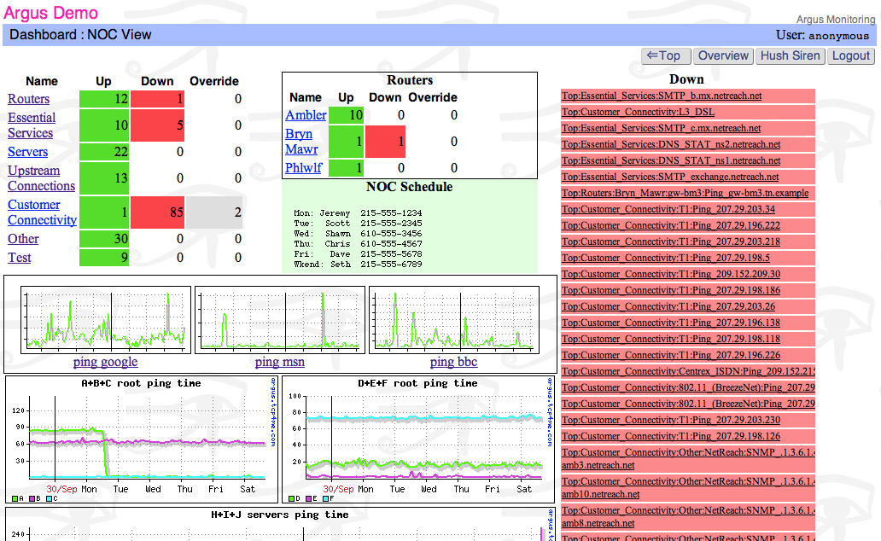
Sensor Software

Slide 8
Sensor Software
Softflowd:
“Softﬂowd” is an open-source ﬂow monitoring tool developed by Damien Miller.
passively monitor traﬃc and export ﬂow record data in NetFlow format
can be installed on Linux and OpenBSD operating systems, and is based on libpcap.

Slide 9
Sensor Software
Yaf:
“Yaf,” stands for “Yet Another Flowmeter.”
yaf is based on libpcap and can read packets from live interfaces or packet captures.
One of the most powerful features of yaf is that it supports BPF ﬁlters for the purposes of ﬁltering incoming traﬃc.

Slide 10
Sensor Placement
Network engineers and forensic investigators can work together to design a network that will facilitate ﬂow record collection and analysis.
Factors:
Duplication
Time synchronization
Perimeter vs internal traffic
Resources
Capacity

Slide 11
Modifying the environment
When an investigative team has decided to gather additional ﬂow record data by modifying the environment, there are a few general options available:
Leverage existing equipment
Upgrade network equipment
Deploy additional sensors

Slide 12
Flow Record Export Protocols
Flow records can be exported in a variety of formats:
NetFlow:
Cisco’s very own.
Sends over UDP,TCP or even SCTP
IPFIX:
Also cisco’s. Successor of NetFlow
Extensible support for flow data record using data templates.
sFlow:
Conducts statistical packet sampling.
Supports large scale networks with high throughput.

Slide 13
Collection and Aggregation
Once you have exported ﬂow record data from a sensor, you need a collector or multiple collectors to receive data in the export format and store it on disk.
Collection Placement and Architecture:
Congestion: exportation generates traffic.
Security: sniffed or modified in transit
Reliability: packets may be dropped
Capacity: how many collectors to setup
Strategy for analysis: strategy affects everything.

Slide 14
Collection Systems
SiLK
The “System for Internet Level Knowledge” (SiLK) is a suite of command-line tools for the collection and storage of ﬂow data that provides a very powerful toolset for the ﬁltering and analysis of ﬂow records.
Flow-tools
The ﬂow-capture utility is designed to collect NetFlow traﬃc exported by sensors via UDP.
Nfdump/NfSen
It can read ﬂow export data from a UDP network socket or pcap ﬁles, and it allows for extensive customization of the data ﬁles stored on disk.
Argus
The Argus “radium” (“Argus Record multiplexor”) client program is particularly useful for collection and distribution of ﬂow export data

Slide 15
Analysis
Although each ﬂow record contains only a very limited set of information about each ﬂow, aggregated over time, this information can be used to create a detailed picture of activity on the network, predict normal behavior, and identify anomalies.

Slide 16
Analysis Techniques
Highlights
Goals and Resources
Are you trying to identify compromised systems? Evaluate whether a data breach occurred? Investigate an HR violation?
Starting Indicators
IP Address/ports
Time frame
Flow records

Slide 17
Analysis Techniques
Techniques:
Filtering
Filtering is a general term for narrowing down a large pool of evidence to a subset—or groups of subsets—that are of interest.
Baselining
Forensic investigators can compare ﬂow record traﬃc to the baseline proﬁle in order to identify anomalies.
Dirty values
Includes IP addresses, ports or protocols
Activity Pattern Matching
Simple patterns, such as large unidirectional volumes of traffic flow, can indicate speciﬁc activities that may be suspicious given the context
More complex patterns may match the behaviors of known worms or viruses.

Slide 18
Analysis Tools
SiLK
Rwfilter: returns flows of interest
Rwstats,rwcount,rwcut,rwuniq: filters flow records
Rwidquery: snort rule or alert file can used to search
Rwpmatch
Advanced SiLK
Flow-tools
Flow-nfilter
Flow-dscan

Slide 19
Analysis Tools
Argus client tools
Ra: reading, filtering, printing data
Racluster: sort using ip src/dest port
Ragrep: searches with patterns
Rahisto: generates frequency tables
Ragraph: visual plots of activities
Nfdump/NfSen
Aggregate ﬂow record ﬁelds by speciﬁc ﬁelds
Limit by time range
Generate statistics about IP addresses, interfaces, ports, and much more
Anonymize IP addresses

Slide 20
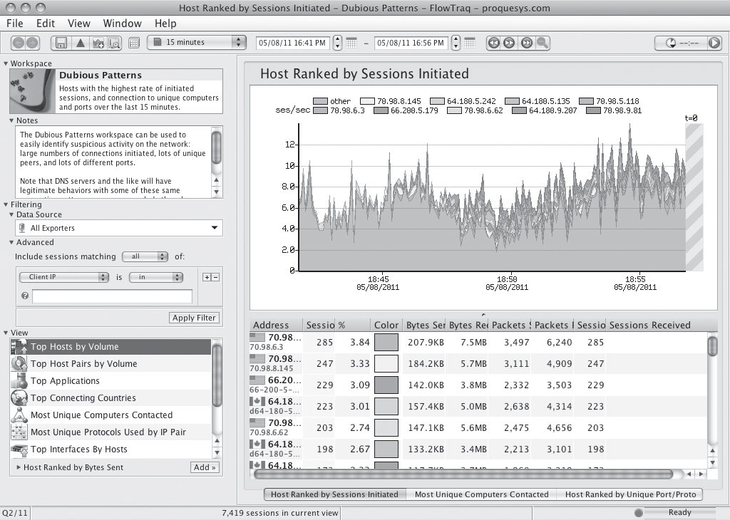
Analysis Tools
FlowTraq

Slide 21
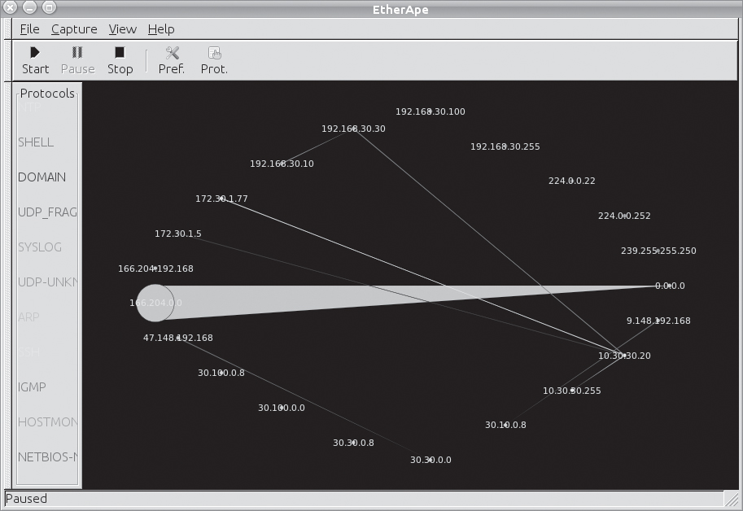
Analysis Tools
Etherape

Slide 22
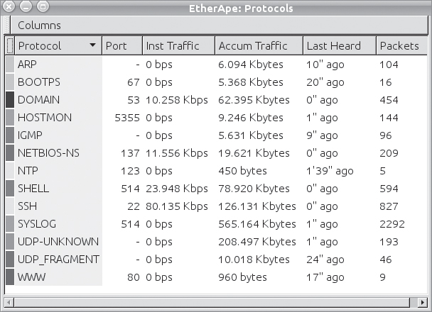
Analysis Tools
Etherape protocols window

Slide 23
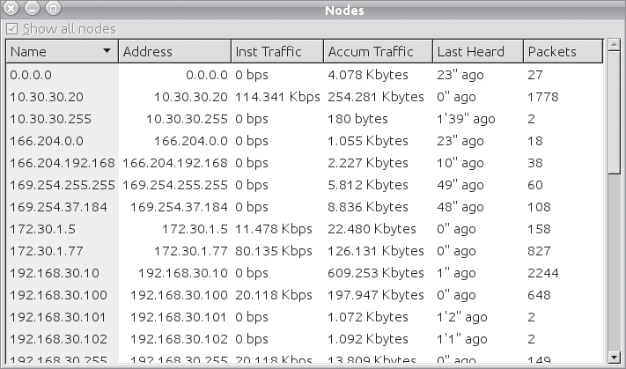
Analysis Tools
Etherape nodes window

