Slide 1
Packet Analysis
Naveen Kumar Lekkalapudi

Slide 2
What to expect?
Protocol analysis
Packet analysis
Flow analysis
Higher-Layer Traffic Analysis

Slide 3
Well,….
From last chapter, you know how to capture information flowing in a network.
Now that you have all your pcaps (data files), what can you do with it?
Analyze
Search
Extract
Carve out files

Slide 4
Protocol Analysis
Welcome to real world, with little/no documentation, hidden never before seen protocols, protocols not implemented correctly.
Deviations from defined protocol standards lead to exploits form attackers.
Protocol analysis is a challenging art.

Slide 5
Protocol Analysis
Information about Protocols:
IETF RFC:
Requests for Comments (RFC)’s were used during ARPANET to get feedback on the different aspects of network.
Internet Engineering Task Force (IETF) has been developing and distributing RFC’s and also proposing new standards.
Internet Society(ISOC), sponsors IETF and IAB and IANA.
Other bodies:
IEEE-SA
ISO

Slide 6
Protocol Analysis
Information about protocols:
Vendors:
RFC 2784, developed by cisco employees for Generic Routing Encapsulation for open trunking protocol.
Sometimes not published outside, like OSCAR.
Researchers:
What happens when you want to keep a secret?
People break into it.
Alexandr Shutko published unofficial OSCAR for “some fun”.
You can do your own protocol research.

Slide 7
Protocol Analysis
Tools for protocol analysis:
PDML and PSML:
Part of NetBee library.
Packet details markup language(PDML) helps readability between machine and human parser.
High level languages can be used to interpret markup language.
Pack summary markup language(PSML) expresses most important details about a protocol.
Copyrighted!

Slide 8
Protocol Analysis
Tools:
Wireshark:
Auto packet dissectors and allows filters.
Packet list:
On top
List of packets captured with source and destination.
Packet Details:
Middle
Shows details of protocols in all layers
Packet Bytes:
Hexadecimal and ASCII representation of the packet.

Slide 9
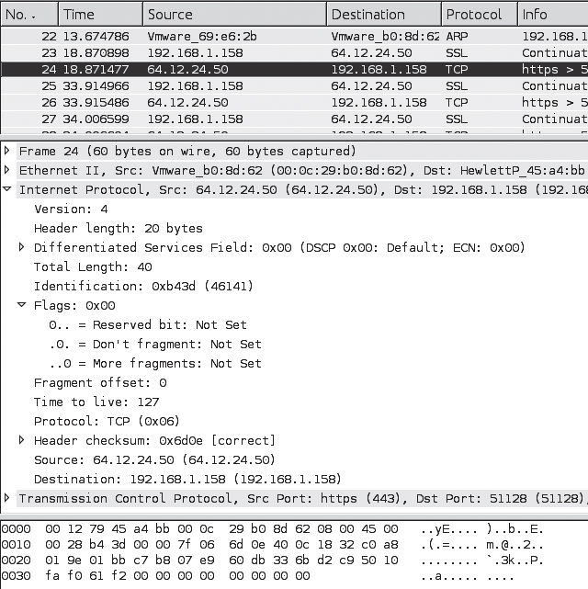
Protocol analysis

Slide 10
Protocol analysis
Tools:
Tshark:
$ tshark -r capturefile.pcap
-n network object name resolution
-T outputs in text
Pdml in XML format
$ tshark -r capturefile.pcap -T fields -e frame.number -e ip.addr -e udp
$ tshark -r capturefile.pcap -R 'ip.addr == 192.168.1.1 '

Slide 11
Protocol Analysis
Techniques to analyze protocols:
Examine 1 or more fields within a protocol’s data structure.
Protocol identification
Protocol decoding
Data extraction

Slide 12
Protocol Analysis
Techniques:
Protocol identification
Search for common binary/hexadecimal/ASCII values that are typically associated with a speciﬁc protocol
Leverage information in the encapsulating protocol
Leverage the TCP/UDP port number, many of which are associated with standard default services
Analyze the function of the source or destination server (speciﬁed by IP address or hostname)
Test for the presence of recognizable protocol structures

Slide 13
Protocol Analysis
Techniques:
Protocol identification
Search for common binary/hexadecimal/ASCII values that are typically associated with a speciﬁc protocol
0x4500 associates to IPv4 packet
Example:
$ tcpdump -nn -AX -r evidence01.pcap
22:57:22.022972 IP 64.12.24.50.443 > 192.168.1.158.51128: Flags [.], ack 6, win 64240, length 0
0x0000: 4500 0028 b43d 0000 7f06 6d0e 400c 1832 E..(.=....m.@..2
0x0010: c0a8 019e 01bb c7b8 07e9 60db 336b d2c9 .......... `.3k..
0x0020: 5010 faf0 61f2 0000 0000 0000 0000 P...a.........

Slide 14
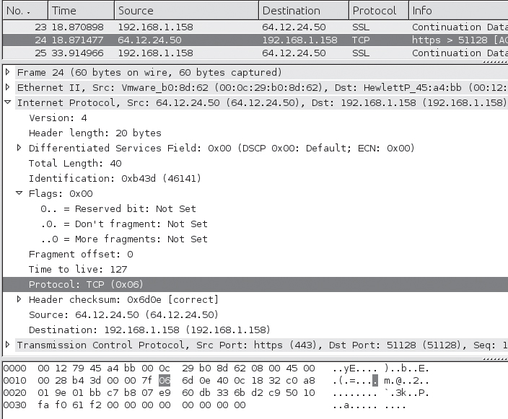
Protocol Analysis
Techniques:
Protocol identification
Leverage information in the encapsulating protocol
Byte 9 in IP header indicates protocol encapsulated within IP packet
0x06 refers to TCP

Slide 15
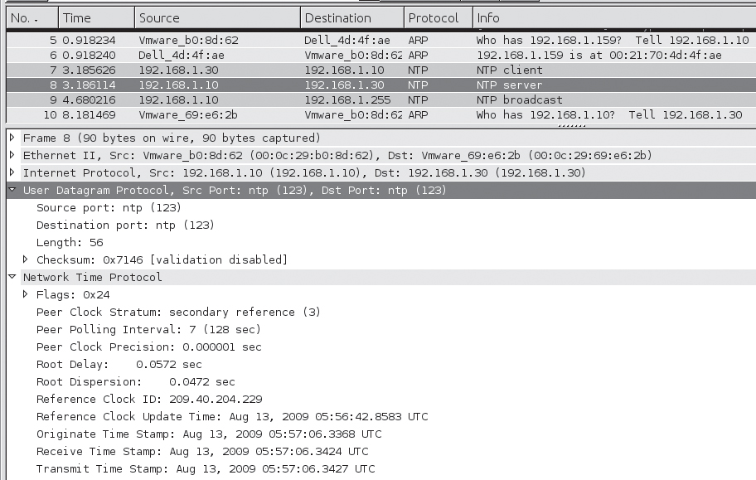
Protocol Analysis
Techniques:
Protocol identification
Leverage the TCP/UDP port number, many of which are associated with standard default services
Port 123 – NTP
Port 443 – https

Slide 16
Protocol Analysis
Techniques:
Protocol identification
Analyze the function of the source or destination server (speciﬁed by IP address or hostname)
Whois IP address

Slide 17
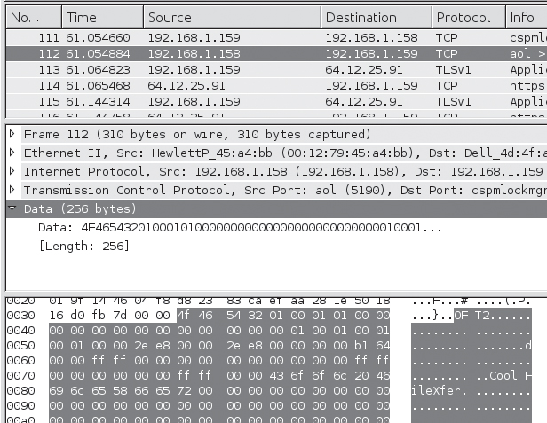
Protocol Analysis
Techniques:
Protocol identification
Test for the presence of recognizable protocol structures
Trial and error
Example

Slide 18
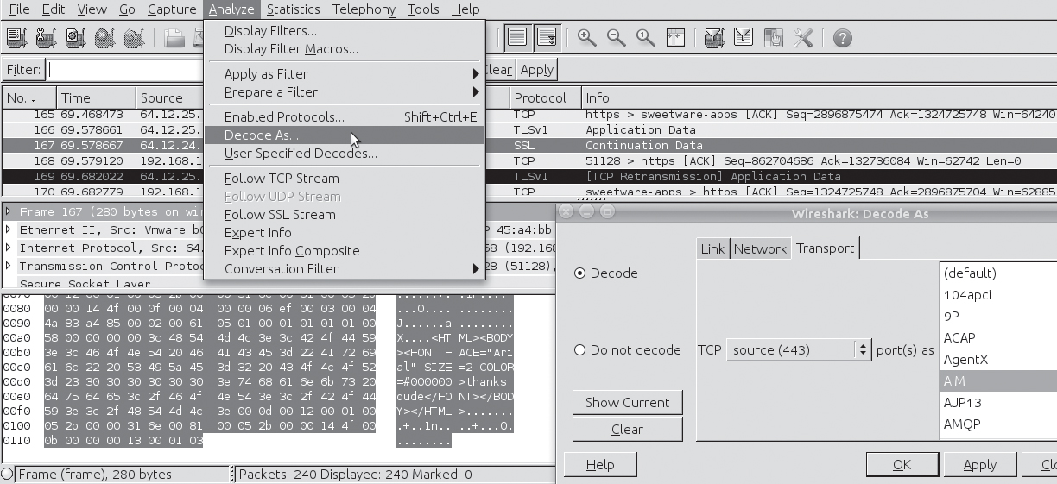
Protocol Analysis
Protocol Decoding:
Technique of interpreting data in a frame according to a specific known structure
Leverage publicly available automated decoders and tools
Refer to publicly available documentation and manually decode the traﬃc
Write your own decoder

Slide 19
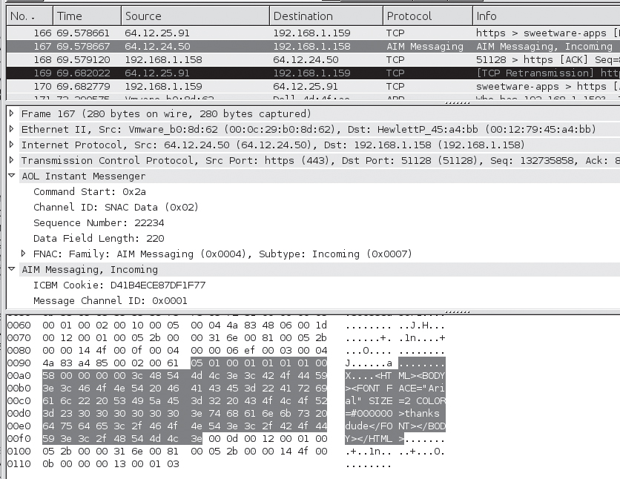
Protocol Analysis

Slide 20
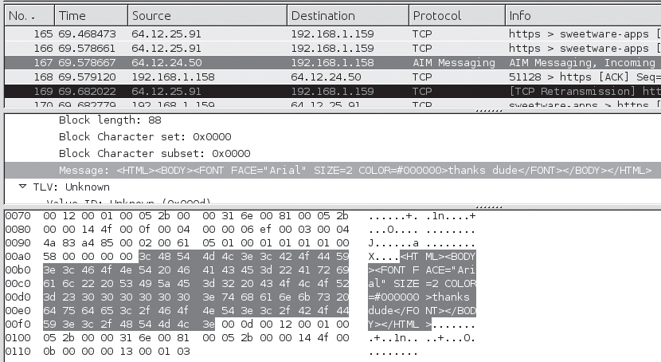
Protocol Analysis
Exporting fields:
Once you have identiﬁed the protocol in use and determined your method for decoding it, the next step is to extract the values of speciﬁc ﬁelds of interest.

Slide 21
Packet Analysis
Packet analysis refers to the art and science of inspecting the protocols within a set of packets.
To identify packets of interest, investigators generally use ﬁltering techniques to isolate packets based on protocol ﬁelds or their contents.
“Examination of contents and/or metadata of one or more packets. Packet analysis is typically conducted in order to identify packets of interest and develop a strategy for ﬂow analysis and content reconstruction.”

Slide 22
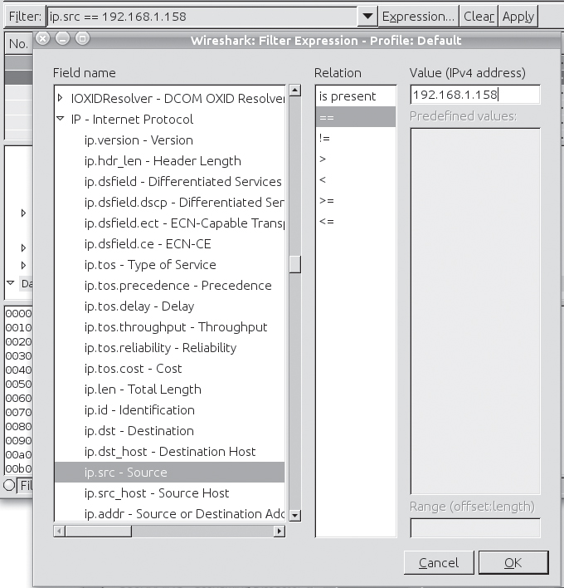
Packet Analysis
Tools:
Wireshark filters:
$ tshark -r capturefile.pcap -R "ip.src==192.168.1.158 && ip.dst==10.1.1.10"

Slide 23
Packet Analysis
Tools:
Ngrep:
Libpcap based tool.
$ ngrep -I capturefile.pcap "string to search for”
$ ngrep -I capturefile.pcap "string to search for" 'src host 192.168.1.20 and dst port 80'

Slide 24
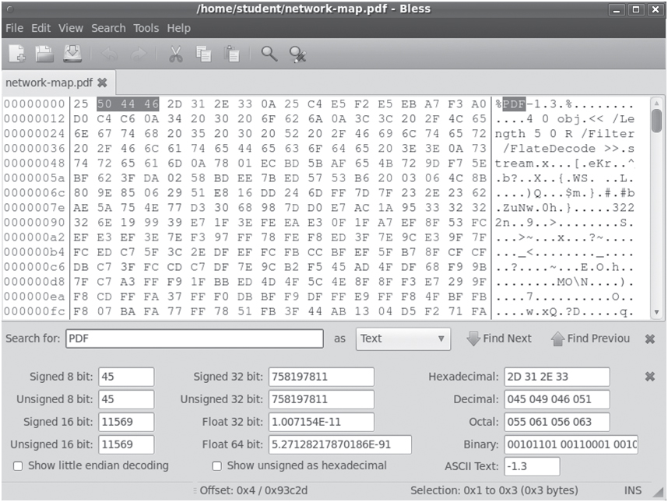
Packet Analysis
Tools:
Hex Editors:
Bless

Slide 25
Packet Analysis
Techniques:
Pattern Matching—Identify packets of interest by matching speciﬁc values within the packet capture.
$ ngrep -I evidence01.pcap 'secret|recipe|Ann'
Parsing Protocol Fields—Extract the contents of protocol fields.
$ tshark -r evidence01.pcap -d tcp.port==443,aim -T fields -n -e "aim.messageblock.message”

Slide 26
Packet Analysis
Techniques:
Packet Filtering—Separate packets based on the values of fields in protocol meta-data.
Filtering with BPF:
$ tcpdump -s 0 -r evidence01.pcap -w evidence01 -talkers.pcap 'host 64.12.24.50 and host 192.168.1.158 '
Wireshark Display filters:
browse to Frame 3 to see something we’ve seen before: cleartext traﬃc on port 443.
Packet Bytes window displays the message containing “Here’s the secret recipe ...”

Slide 27
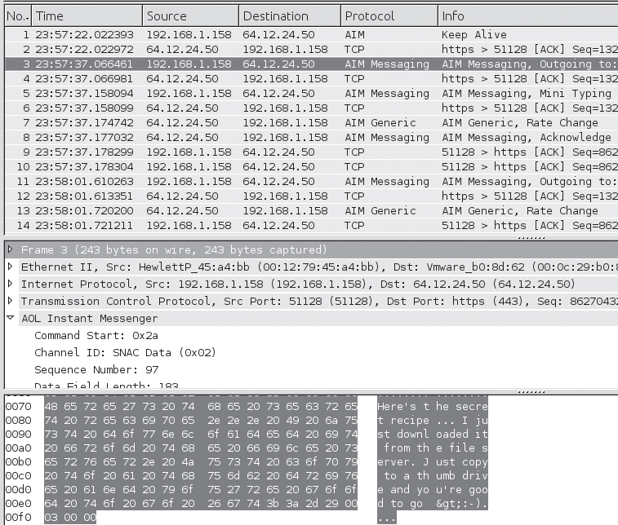
Packet Analysis

Slide 28
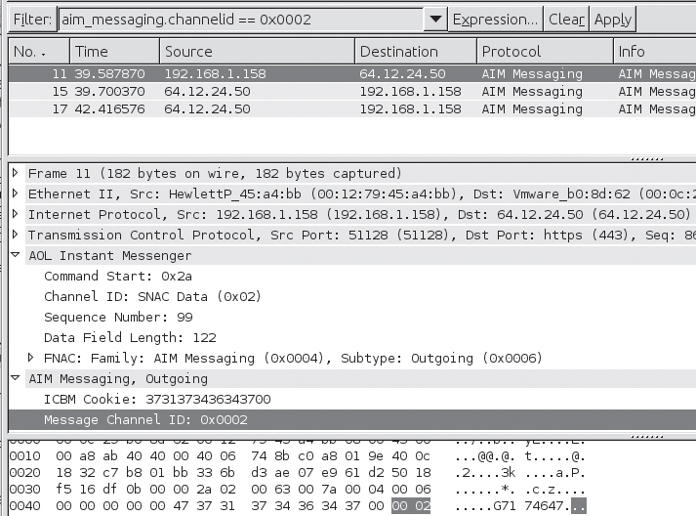
Packet Analysis
Wireshark filters:
Fig shows the display ﬁlter, aim messaging.channelid==0x0002, which picks out ICBM channel 2 messages. After applying this ﬁlter, three packets are displayed.

Slide 29
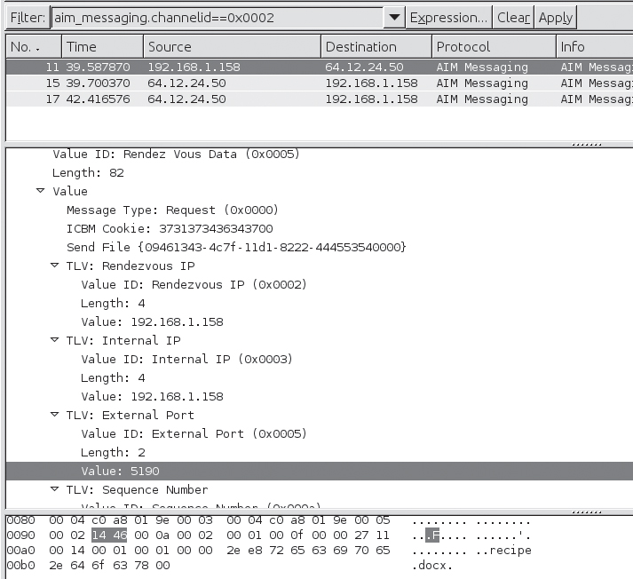
Packet Analysis
Wireshark filters:
Packet Details window shows the inbound IP address (192.168.1.158) and port (TCP port 5190) oﬀered by the initiating client

Slide 30
Flow Analysis
Flow analysis is the practice of examining related groups of packets in order to identify patterns, analyze higher-layer protocols, or extract data.
A “ﬂow” is deﬁned as “a sequence of packets sent from a particular source to a particular unicast, manycast, or multicast destination that the source desires to label as a ﬂow.

Slide 31
Flow analysis
Tools:
Wireshark: Follow TCP stream
GUI
Tcpflow
CLI
Pcapcat
CLI
Tcpxtract
CLI
$ tcpxtract -f capturefile.pcap

Slide 32
Flow Analysis
Techniques:
List conversations and ﬂows—List all conversations and/or ﬂows within a packet capture, or only speciﬁc ﬂows based on their characteristics.
Export a ﬂow—Isolate a ﬂow, or multiple ﬂows, and store the ﬂow(s) of interest to disk for further analysis.
File and data carving—Extract ﬁles or other data of interest from the reassembled ﬂow.

Slide 33
Flow analysis
Example:
$ pcapcat -r evidence01.pcap
[1] TCP 192.168.1.2:54419 -> 192.168.1.157:80
[2] TCP 192.168.1.159:1271 -> 205.188.13.12:443
[3] TCP 192.168.1.159:1272 -> 192.168.1.158:5190
[4] TCP 192.168.1.159:1273 -> 64.236.68.246:80
Enter the index number of the conversation to dump or press enter to quit:

Slide 34
Higher-Layer Traffic Analysis
HTTP:
OPTIONS—Obtain information about communicating with the remote server.
GET—Retrieve the information identiﬁed by the URI.
HEAD—Retrieve the information identiﬁed by the URI, without returning a message body. Helpful for URI validation and debugging.
POST—Send data to the resource speciﬁed by the URI for processing.
PUT—Upload information to be stored under the speciﬁed URI.
DELETE—Delete the resource speciﬁed by the URI.
TRACE—Echo a request message back to the client. Helpful for debugging (can also facilitate cross-site scripting attacks).
CONNECT—Reserved “for use with a proxy that can dynamically switch to being a tunnel.”

Slide 35
Higher-Layer Traffic Analysis
DHCP:
MAC Addresses As discussed, every network card on an Ethernet network has a 6-byte MAC address, assigned by the manufacturer.
Can be spoofed*!
Conversation:
Client: DHCPDISCOVER (Layer 2 broadcast)
Server: DHCPOFFER
Client: DHCPREQUEST
Server: DHCPACK

Slide 36
Higher-Layer Traffic Analysis
SMTP:
HELO—Opens the connection
MAIL—Speciﬁes the return address
RCPT—Speciﬁes the recipient address(es)
DATA—The contents of the message. This includes the message header and the message body.

Slide 37
Higher-Layer Traffic Analysis
DNS:
DNS Recursion DNS queries that seek to map names to IP addresses (which is the most common case) start out with a client making a query of the server it considers to be most knowledgeable.
DNS Queries It can be extremely important to collect name-to-address mapping.
$ dig www.google.com

Slide 38
Higher-Layer Traffic Analysis
Tools:
Oftcat:
OFT protocol dissector and data carving tool.
Smtpdump:
$ smtpdump –[AebXmsfrch]
Findsmtpinfo.py
findsmtpinfo.py -p evidence02.pcap -r ./report
NetworkMiner

Slide 39
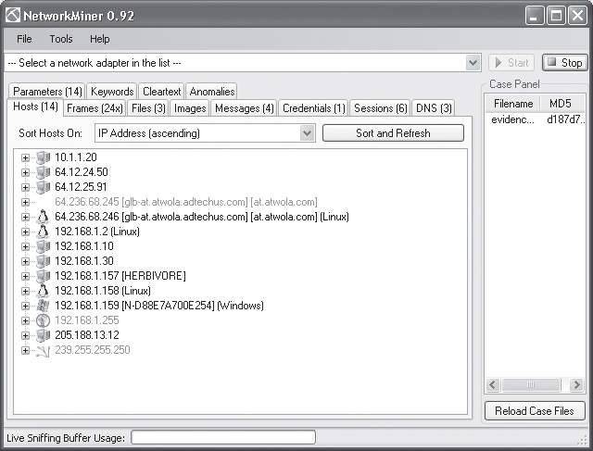
Higher-Layer Traffic Analysis
Use small, specialized tools that are each speciﬁcally designed to analyze a particular higher-layer protocol;
$ oftcat -r 192.168.001.158.05190-192.168.001.159.01272
Use a multipurpose tool to quickly gather a wide range of information about the traﬃc.

