Slide 1
Ch 6. Wireless: Network Forensics Unplugged
Naveen Kumar Lekkalapudi

Slide 2
What to expect?
Protocol series
WAPs
Wireless Traffic Capture and Analysis
Common Attacks
Locating Wireless devices

Slide 3
Why investigate wireless networks?
Recover a stolen laptop by tracking it on the wireless network.
Identify rogue wireless access points that have been installed by insiders for convenience or to bypass enterprise security.
Investigate malicious or inappropriate activity that occurred via a wireless network.
Investigate attacks on the wireless network itself, including denial-of-service, encryption-cracking, and authentication bypass attacks.

Slide 4
Types of Layer 2 protocols
CSMA/CD:
Carrier Sense Multiple Access/Collision Detection
All stations share same medium.
Transmits one signal at a time
Jamming signal Is used to reset network.
CSMA/CA:
Collision Avoidance
Before transmitting, stations listens to see if any network is transmitting.
Request-to-send and clear-to-send messages can be used.

Slide 5
802.11 Protocol Suite
Frame Types:
Management Frames—Govern communications between stations, except ﬂow control;
Control Frames—Support ﬂow control over a variably available medium (such as RF);
Data Frames—Encapsulate the Layer 3+ data that moves between stations actively engaged in communication on a wireless network.

Slide 6
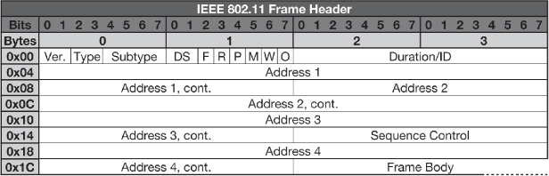
802.11 Frame Header

Slide 7
802.11 Frames
Management Frames:
0xB — Authentication
0xC — Deauthentication
Control Frames:
0x1B—Request-to-send (RTS)
0x1C—Clear-to-send (CTS)
0x1D—Acknowledgment
Data Frames:
Wireless network is not encrypted, or if you have access to the encryption key and can gain access to unencrypted data frames, then you can capture and analyze the wireless traﬃc at Layer 3 and above.
Even encrypted data frames can still be analyzed using statistical ﬂow analysis techniques to reveal volumes and directionality of traﬃc and stations involved.

Slide 8

802.11 Frame Analysis
Endianness The term “endianness” emerged from the tale Gulliver’s Travels, in which Gulliver encounters two groups of people: the Lilliput and the Blefuscu.
Little people crack eggs at little end –little endian

Slide 9
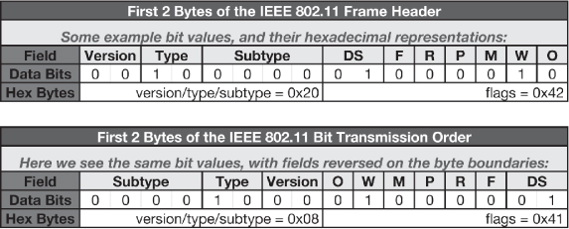
802.11 Frame Analysis
802.11 is neither big-endian nor little-endian, but is best described as “mixed-endian.”

Slide 10
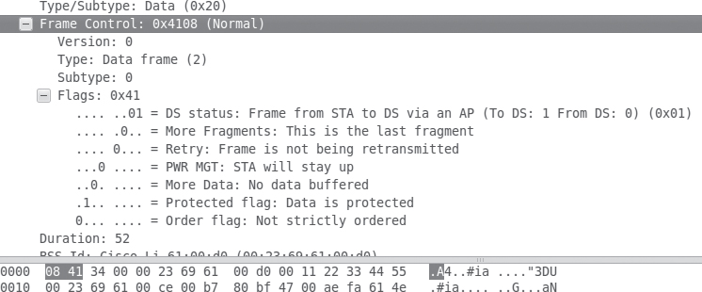
802.11 Frame Analysis

Slide 11
802.11 Wired Equivalent Privacy
To gain access to a WEP-encrypted wireless network, users need knowledge of a “shared secret” key to gain access to the wireless hub’s service at Layer 2.
Crack?
Capture packets
40000 packets→ 50% success rate
60000 packets→ 80% success rate
Aircrack-ng
Dictionary Attack
Simple dictionary word ~1-2 minutes
Complex never heard seen or meaning word ~days

Slide 12
802.11 WEP
Broken? Still we use it anyways
Management frames: If privacy bit set to 1, it is encrypted
Data Frames:
802.11 data frames include a “Protected” bit within the ﬁrst byte oﬀset of the 802.11 MAC framing, which indicates whether encryption is in use.

Slide 13
TKIP, AES, WPA, and WPA2
Temporal Key Integrity Protocol(TKIP)
AES(Advanced Encryption Standard)
WPA(Wifi Protected Access)
WPA is:
Designed to work with legacy 802.11 hardware.
Intended to compensate for keying weaknesses (using TKIP).
Already broken.
WPA2 is:
Required next generation hardware.
Built to utilize AES-CCMP (real crypto!).
Currently considered secure when used with strong preshared keys or in combination with strong 802.1X authentication mechanisms.

Slide 14
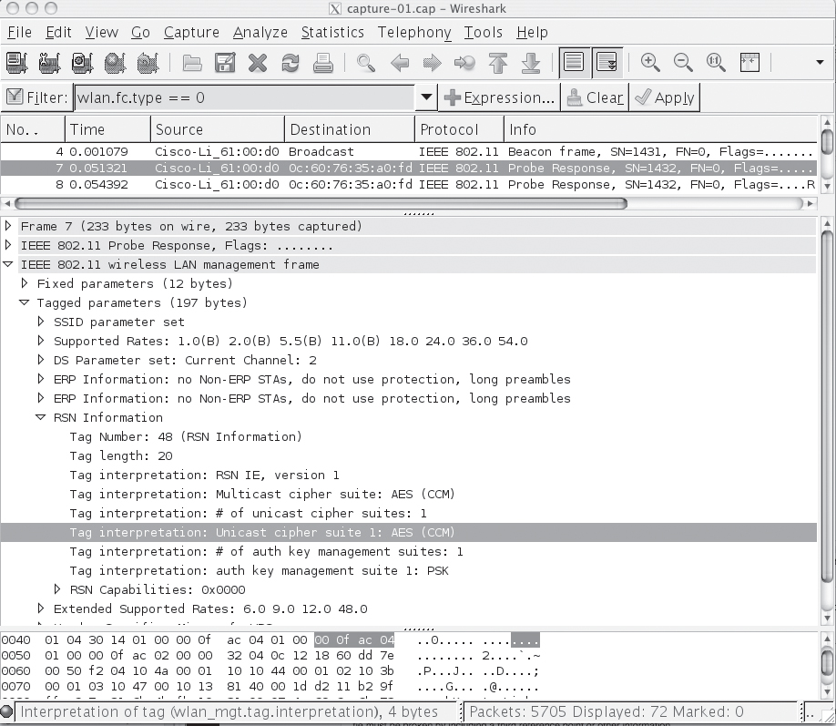
Wireshark Capture and filtering

Slide 15
802.1X
802.1X was designed to provide a modular, extensible authentication framework for LANs
PPP- Point to point protocol
EAP- Extensible Authentication Protocol
CHAP and PAP transmitts passwords in clear text
The back-end authentication system in use—whether a RADIUS system or an Active Directory/LDAP server—is much more likely to be producing an audit trail than a stand-alone WAP with a static key shared by all.

Slide 16
Wireless Access Points
Enterprise:
Wider geographic range
RF waves
Centralized authentication
Auditable logs
Tracking of stations
Consumer:
Logging (locally and sometimes remotely)
Often contain Layer 3+ functionality, including:
Limited routing
DHCP service
NATing
Limited filtering

Slide 17
Wireless Access Points
Evidence
Volatile
History of MACs
List of Ips
Logs of wireless events
ACL
Configuration
Persistent
OS image
Boot loader
Startup configuration files
Off-system
can be conﬁgured to send event logs to remote systems for oﬀ-site aggregation and storage.

Slide 18
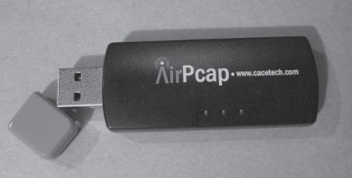
Wireless Traffic Capture and Analysis
Spectrum analysis
Identify frequency:
2.4 GHz (802.11b/g/n)19
3.6 GHz (802.11y)20
5 GHz (802.11a/h/j/n)21
Spectrum analyzers are designed to monitor RF frequencies and report on usage.
Wireless passive Evidence Acquisition
Monitor mode
Info:
Broadcast SSIDs (and sometimes even nonbroadcast ones)
WAP MAC addresses
Supported encryption/authentication algorithms
Associated client MAC addresses

Slide 19
Analysis
Analyzing 802.11 Efficiently:
Are there any beacons in the wireless traﬃc?
Are there any probe responses?
Can you ﬁnd all the BSSIDs/SSIDs from authenticated/associated traﬃc?
Can you ﬁnd malicious traﬃc? What does that look like?
Is the captured traﬃc encrypted using WEP/WPA? Is anyone trying to break the encryption?

Slide 20
Analysis
Tcpdump and tshark
Find the WAPs
'wlan[0] = 0x80’
$ tshark -nn -r wlan.pcap -R '((wlan.fc.type_subtype == 0x08 || wlan.fc.type_subtype == 0x05) && (wlan_mgt.fixed.capabilities.ess == 1) && (wlan_mgt.fixed.capabilities.ibss == 0))’
Find the Encrypted Data Frames:
'wlan[0] = 0x08 and wlan[1] & 0x40 = 0x40 '

Slide 21
Common Attacks
Sniffing
Eavesdropping on wireless traﬃc is extremely common, in part because it is so easy to do! From script kiddies in coﬀeeshops to professional surveillance teams.
Eavesdropping on telecommunications (including those transmitted over RF) is a violation of wiretap statutes in many jurisdictions.
Rogue Wireless Access Points
By staff for convenience
Criminals also deliberately plant wireless access points that allow them to bypass the pesky ﬁrewall and remotely access the network later on.

Slide 22
Common attacks
Changing channel
the FCC has licensed 11 channels for 802.11b/g/n, which have center frequencies between 2.412 GHz to 2.462 GHz.
802.11n Greenﬁeld Mode
“Mixed mode,” which allows it to work with legacy 802.11a/b/g networks,
“Greenfield” (GF) or “high-throughput-only” mode, which takes full advantage of the enhanced throughput but is not visible to 802.11a/b/g devices. Older devices will see GF-mode traﬃc only as noise.

Slide 23
Common Attacks
Bluetooth Access Point
Most Wireless IDS systems and security teams simply don’t look for it (yet)
Wireless Port Knocking
l33t h4x0rs installed rootkits that would wait for a particular sequence of ports to be scanned, at which point the knocker’s IP address would be granted access.
Evil Twin
The “Evil Twin” attack is when an attacker sets up a WAP with the same SSID as one that is used in the local environment, usually in order to conduct a man-in-the-middle attack on an 802.11 client’s traﬃc.

Slide 24
Common Attacks
WEP Cracking
Weak Encryption Protocol
Dictionary attacks
As it turns out, however, after only a few thousand packets you can reliably guess that at least some of those packets have been encrypted with the same IV, but have diﬀerent plain text input and ciphertext output.

Slide 25
Locating Wireless Devices
Strategies:
Gather station descriptors, such as MAC addresses, which can help provide a physical description so that you know what to look for;
For clients, identify the WAP that the station is associated with (by SSID);
Leverage commericial enterprise wireless mapping software;
Poll the device’s signal strength; and
Triangulate on the signal.

Slide 26
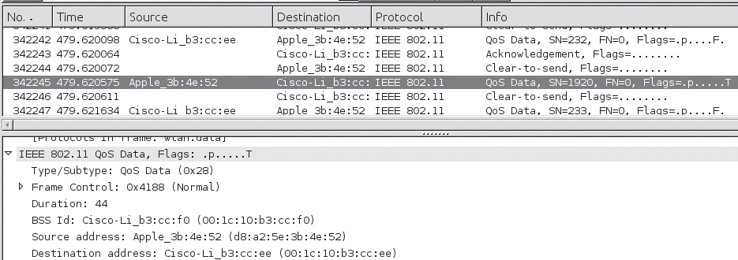
Locating Wireless Devices
Strategies:
Gather station descriptors, such as MAC addresses, which can help provide a physical description so that you know what to look for;
Identify Nearby Wireless Access Points
Wireshark detects manufacturer automatically

Slide 27
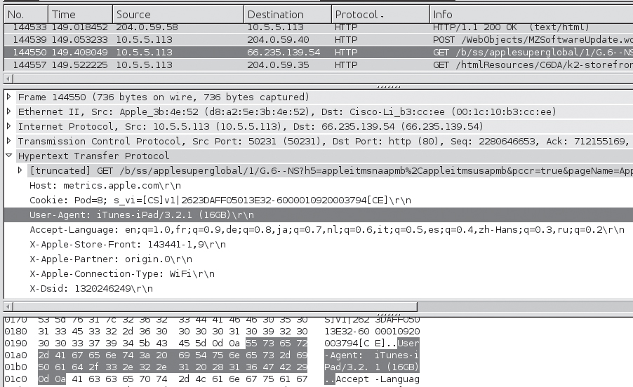
Locating Wireless Devices
Strategies:
Gather station descriptors, such as MAC addresses, which can help provide a physical description so that you know what to look for;
Decrypted HTTP header

Slide 28
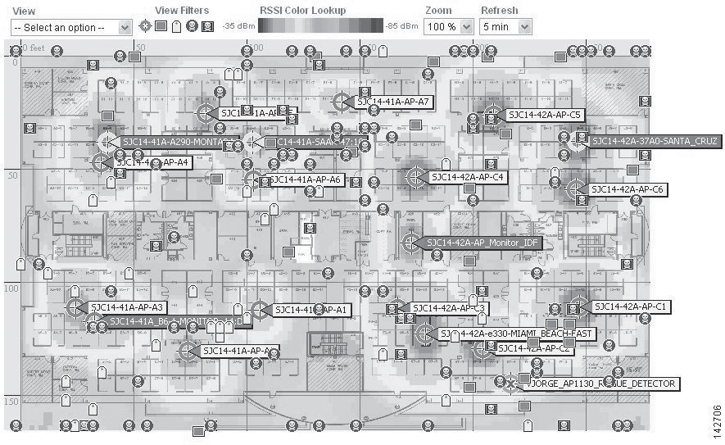
Locating Wireless Devices
Strategies:
For clients, identify the WAP that the station is associated with (by SSID);
NetStumbler
KitMet
KisMAC
Cisco
Commercial
tools
Skyhook

