Slide 1
Network Intrusion Detection & Analysis
Naveen Kumar Lekkalapudi

Slide 2
What to expect?
Why investigate NIPS/ NIDS?
Typical functionality
Modes of detection
Evidence Acquisition
Logging
Snort

Slide 3
Why?
NIDS/NIPS alerts/logs may include details regarding illicit connections
NIDS/NIPS can be conﬁgured to alert on, or at least log traﬃc that ﬁrewalls deem perfectly acceptable.
An investigator could potentially modify a NIDS/NIPS conﬁguration to begin detecting events it wasn’t previously conﬁgured to record.

Slide 4
Typical Functionality
NIDS/NIPS are specialized sniffers.
They include:
Rules
Alerts
Packet Captures

Slide 5
Typical Functionality
Sniffing
Must have access to traffic to collect and inspect
Mirroring port on switch or inline tap
Between 2 devices in a choke point position
If device is inline of traffic, noticeable latency can be experienced.
Can be passively used, delay is little to no consequence.

Slide 6
Typical Functionality
Higher-Layer Protocol Awareness
Protocol Reassembly
In order for either a NIDS or a NIPS to accurately detect a wide range of malicious traﬃc, these devices must be programmed to properly parse a wide range of protocols.
Attack traffic can be intentionally fragmented to avoid detection. Fragment reassembly can be performed to assist.
Normalization
Strings to services such as HTTP must be normalized to canonical form.

Slide 7
Typical Functionality
Alerting on suspicious bits
Sending email alerts
Logging events to a syslog server
Sending SNMP traps
Logging events directly to a query-able database
Can produce very “hi-fidelity” event logs, capturing and storing the packets in their entirety.

Slide 8
Modes of Detection
Signature-Based Analysis
Oldest-Most common strategy.
Compare headers, contents of packets, streams to known malicious ones to alert.
Protocol Awareness
Protocol-aware NIDS/NIPS reassemble fragments (Layer 3), reassemble streams (Layer 4), and even reconstruct entire protocols (Layer 7) because they have to understand how the endpoint of the communication will interpret the data.

Slide 9
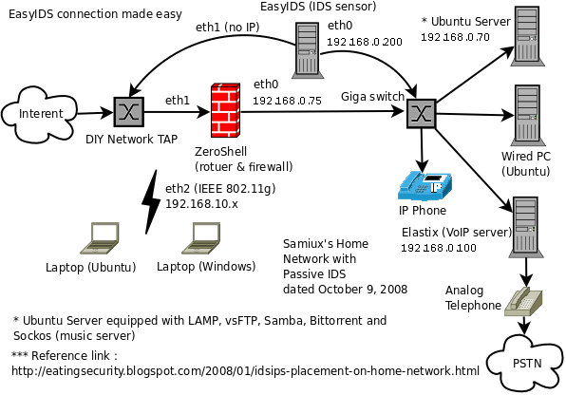
Modes of Detection
Behavioral Analysis
Build “baseline” of normal network behavior against which traffic can be compared to get malicious ones.

Slide 10
Types of NIDS/NIPS
Commercial
Check Point IPS-13
Cisco IPS4
Corero Network Security5
Enterasys IPS6
HP TippingPoint IPS7
IBM Security NIPS8
Sourceﬁre 3D System9
Roll-your-own
Snort is open sourced
Bro is open sourced
Robust communities to help you out.

Slide 11
Evidence Acquisition
Types of evidence
Configuration
If a NIDS/NIPS has not been conﬁgured to alert upon a particular event, then the absence of alerts for that event is meaningless.
Gather boot configuration and current running configuration
Volatile configs!!
Alert Data
Even when alerts are aggregated from multiple sources, it can be a real challenge to discover that the manner in which a NIDS/NIPS reports an event on one segment of a network is not at all the same way an older model on a diﬀerent segment reports it.

Slide 12
Evidence Acquisition
Types of evidence:
Packet Header and/or Flow Record information
Flow may trigger alert and logs of that is necessary.
Content Data
Packet contents can be invaluable to the investigator, allowing you to carve out the malware that triggered an alert or view the actual obfuscated Javascript that an attacker attempted to serve a client.
Activities correlated across multiple sensors
Common practice is to direct information from NIPS/NIDS to third party monitoring service.

Slide 13
Evidence Acquisition
Interfaces:
GUI
Nearly all modern NIDS/NIPS systems can be accessed, inspected, and conﬁgured via some sort of graphical user interface, whether it’s a web application that can be accessed by a web client, or a proprietary interface that requires a special client.
CLI
SSH
API’s
Off-System Logging
Many NIDS/NIPS are also conﬁgured to send alerts via email to system administrators.
Local dev configuration also helps.

Slide 14
Comprehensive Packet Logging
NIPS/NIDS logs entire packets only when event is triggered.
Separate sniffer can be used to sniff data all the time pre-configured to sniff for unknown patterns of traffic.
However:
Requires lot of CPU
Requires lot of disk
Huge security risk!!

Slide 15
Comprehensive Packet Logging
Collected evidence may be used as:
Packet headers
Suitable for traﬃc analysis
Similar to pen registers, trap/trace
Packet payloads
Suitable for full transaction reconstruction
Similar to full wiretap

Slide 16
Snort
“If you know what you’re looking for and where to look, nothing is hidden.”
Most widely used NIDS
Open-source code
Open rule language
Extremely versatile
Actively improving, partly due to commercial support

Slide 17
Snort
Basic Architecture
Pulls packets from libpcap
Preprocessor:
At layer3, reassembles fragments
At layer4, reassembles streams
At layer5, reassembles circuits/sessions
At layer7, reassembles transactions
Alerts if an anomaly is detected
Analyzed information is handed off to snort rule engine
All alerts will be communicated to end-user

Slide 18
Snort
Configuration
/etc/snort/snort.conf
This file is where global values for Snort are declared, including the internal/external network deﬁnitions, how the preprocessors will be conﬁgured, how the output processors will be conﬁgured for logging, and the inclusion of major chunks of rules.
/etc/snort/rules/
This directory contains the rules ﬁles themselves. Within each file, rules can be individually disabled or enabled.
/var/log/snort/
This directory contains the native alerts ﬁle, where Snort records text-based alerts, and the libpcap ﬁles with corresponding packet captures.

Slide 19
Snort
Language
Text-based language one-line per rule.
Rules by source-fire’s vulnerability research team(VRT)
Rule header
Action: what snort should do, alert, log, pass and drop
Protocol: tcp, icmp, udp, ip
Source IP/network and port: source of packet
Directionality operator: -> and <>
Destination IP/network and port: destination of packet
Example
Alert tcp any any -> 192.168.2.1 80 (…)

Slide 20
Snort
Language
Rule body
General options
Msg
Sid
Rev
Reference
Detection options
Nonpayload detection rule options
Payload detection rule options
Post detection rule options

Slide 21
Snort
Example:
alert icmp $EXTERNAL_NET any -> $HOME_NET any (msg:"ICMP PING"; icode:0; itype:8; classtype:misc-activity; sid:384; rev:5;)
alert on any inbound ICMP traﬃc that is of type 8 code 0: an “Echo Request.”
fifth revision of the VRT’s rule number 384
Priority of 3

