Slide 1
Ch9. Switches, Routers and Firewalls
Naveen Kumar Lekkalapudi

Slide 2
What to expect?
Storage media
Switches
Routers
Firewalls
Interfaces
Logging

Slide 3
Storage Media
Types of Storage:
DRAM (Dynamic Random-Access Memory)
Volatile, looses memory when power is turned off.
Stores OS configuration, process memory, routing tables
CAM(Content Access Memory)
Very Fast memory to access.
Used to store MAC tables in switches,
NVRAM (Non-volatile Random-Access Memory)
NVRAM retains data when power is turned off.
Flash memory.
Used in routers to store OS, boot and startup config files.

Slide 4
Storage Media
Types of storage:
Hard Drive:
Most of Network equipment do not include a hard drive.
Servers acting as firewall/routers can have drives to store OS, startup config, firewall log and extensive other data.
Read-only Memory(ROM):
Permanently store data without modification.
Can be reprogrammed to store data.
Normally contains bootloader.

Slide 5
Switches
Switches are Layer 2/3 devices that connect multiple computers together to form a network.
Unlike hubs, switches isolate traﬃc on diﬀerent switch ports, so that each switch port is a separate collision domain.
Why investigate?
Sniffs traffic
Contains MAC tables which map port to computer.
Attacks which confuse switches

Slide 6
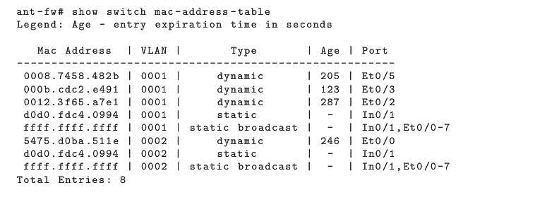
Switches
Content-Addressable Memory Table
Used for quick access to MAC tables.
Volatile and changes quickly
CAM tables contains evidence of sniffing.

Slide 8
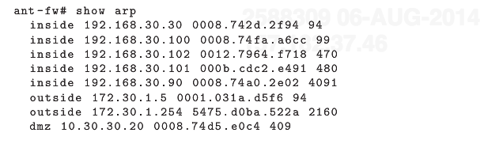
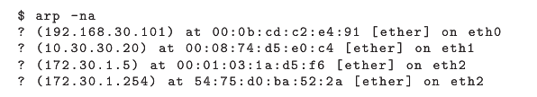
Switches
Address Resolution Protocol
The Ethernet Address Resolution Protocol (ARP)2 is designed to dynamically distribute Layer 2 Ethernet addresses to systems on the local subnet.
In Cisco ASA:
In linux server:

Slide 9
Switches
Types:
Managed –ACL, caching, logging.
Smart –performance monitoring
Unmanaged –plug-and-play
Evidence:
Volatile –CAM,ARP tables, ACL, configs, processor memory
Persistent –OS image, bootloader, startup configuration
Off-system –log data, flow data.

Slide 10
Routers
Routers are (by deﬁnition) Layer 3 devices designed to pass packets between networks.
Why investigate:
Traffic traverses through router
Network topology helps!
Routing tables
Types:
Enterprise
Packet filtering, DHCP, NAT, QoS, Logging, monitoring.
CLI, web, remote console, SNMP.
Consumer
Port filtering, DHCP, NAT
Roll-your-own with *nix! -iptables

Slide 11
Routers
Evidence:
Volatile –Routing tables, ARP table, DHCP leases, configs
Persistent –OS image, bootloader, startup config, access logs and DHCP logs.
Off-system –exports data through syslog, FTP, TFTP.

Slide 12
Firewalls
Firewalls are essentially souped-up routers capable of inspecting and ﬁltering traﬃc to a much higher degree.
Why investigate:
Logs have attempts to break in
Configuration helps understanding services and their scope.
Can be modified to collect more

Slide 13
Firewalls
Types:
Categories:
Packet Filters
Session-layer Proxies
Application proxies
Enterprise-class:
NAT, DHCP, VPN tunneling, logging, Load balancing.
Consumer-class:
NAT packet-filtering.
802.11 interface.
Roll-your-own with *nix and windows.

Slide 14
Firewalls
Evidence:
Volatile
Interface configs, ACLs, Command history, I/O memory
Persistent
Bootloaders, startup config.
Off-system
Firewall logs, Access history, backup configs.

Slide 15
Interfaces
How to get evidence from equipment?
Interfaces secured with username and passwords.
Default passwords published online.
Web Interface:
Portable
Easy to manage
Cannot easily export data.
Browsing modifies volatile memory

Slide 16
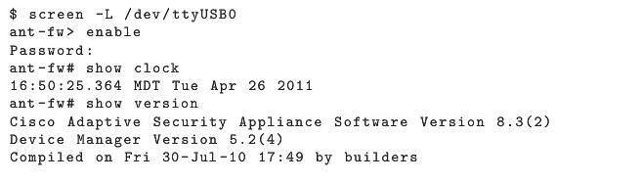
Interfaces
CLI:
Can connect using serial cables
Can do
List contents of flash memory
Output CAM and ARP tables

Slide 17
Interfaces
Remote CLI
Telnet or ssh
Same commands as CLI
SNMP (Simple Network Management Protocol)
Gather info or set configs
CAMs, ACLs, routing tables, all and all
Proprietary Interface:
Apple airport
Cisco VMS, ASDM

Slide 18
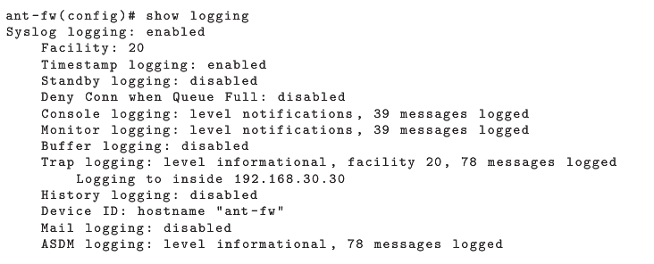
Logging
Forensic investigators may ﬁnd device logs to be useful repositories of evidence relevant to a case.

Slide 19
Logging
Local Logging
Virtually all switches, routers, and ﬁrewalls perform some amount of event recording by default, and do so by writing out event logs to whatever local media is available.
Console → screen –L /dev/ttyUSB0
Terminal → $script –a logfile.txt
Buffered → volatile and lost with power
SNMP
Gather data using Get, GETNEXT and GETBULK

Slide 20

Logging
Syslog
Inside interface of Cisco ASA
Authentication, Authorization and account logging
AAA servers at back end
All transactions recorded at some level.
Central accounting database reveals all.

