Slide 1
Packet Analysis
Naveen Kumar Lekkalapudi

Slide 2
What to expect?
Protocol analysis
Packet analysis
Flow analysis
Higher-Layer Traffic Analysis

Slide 3
Well,….
From last chapter, you know how to capture information flowing in a network.
Now that you have all your pcaps (data files), what can you do with it?
Analyze
Search
Extract
Carve out files

Slide 4
Protocol Analysis
Welcome to real world, with little/no documentation, hidden never before seen protocols, protocols not implemented correctly.
Deviations from defined protocol standards lead to exploits form attackers.
Protocol analysis is a challenging art.

Slide 5
Protocol Analysis
Information about Protocols:
IETF RFC:
Requests for Comments (RFC)’s were used during ARPANET to get feedback on the different aspects of network.
Internet Engineering Task Force (IETF) has been developing and distributing RFC’s and also proposing new standards.
Internet Society(ISOC), sponsors IETF and IAB and IANA.
Other bodies:
IEEE-SA
ISO

Slide 6
Protocol Analysis
Information about protocols:
Vendors:
RFC 2784, developed by cisco employees for Generic Routing Encapsulation for open trunking protocol.
Sometimes not published outside, like OSCAR.
Researchers:
What happens when you want to keep a secret?
People break into it.
Alexandr Shutko published unofficial OSCAR for “some fun”.
You can do your own protocol research.

Slide 7
Protocol Analysis
Tools for protocol analysis:
PDML and PSML:
Part of NetBee library.
Packet details markup language(PDML) helps readability between machine and human parser.
High level languages can be used to interpret markup language.
Pack summary markup language(PSML) expresses most important details about a protocol.
Copyrighted!

Slide 8
Protocol Analysis
Tools:
Wireshark:
Auto packet dissectors and allows filters.
Packet list:
On top
List of packets captured with source and destination.
Packet Details:
Middle
Shows details of protocols in all layers
Packet Bytes:
Hexadecimal and ASCII representation of the packet.

Slide 9
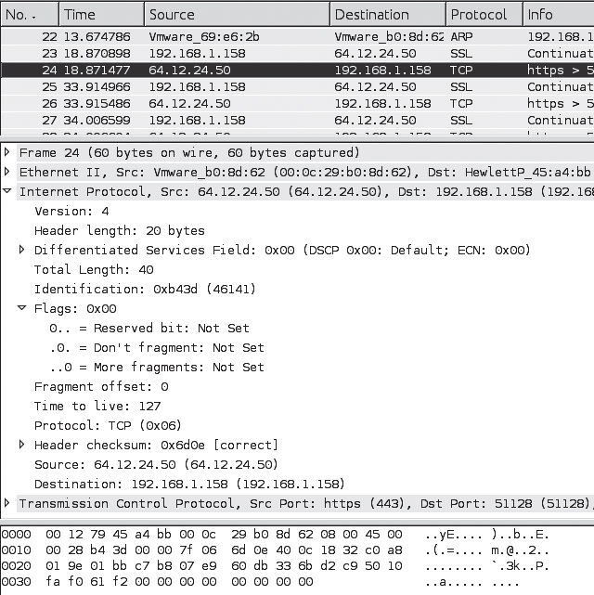
Protocol analysis

Slide 10
Protocol analysis
Tools:
Tshark:
$ tshark -r capturefile.pcap
-n network object name resolution
-T outputs in text
Pdml in XML format
$ tshark -r capturefile.pcap -T fields -e frame.number -e ip.addr -e udp
$ tshark -r capturefile.pcap -R 'ip.addr == 192.168.1.1 '

Slide 11
Protocol Analysis
Techniques to analyze protocols:
Examine 1 or more fields within a protocol’s data structure.
Protocol identification
Protocol decoding
Data extraction

Slide 12
Protocol Analysis
Techniques:
Protocol identification
Search for common binary/hexadecimal/ASCII values that are typically associated with a speciﬁc protocol
Leverage information in the encapsulating protocol
Leverage the TCP/UDP port number, many of which are associated with standard default services
Analyze the function of the source or destination server (speciﬁed by IP address or hostname)
Test for the presence of recognizable protocol structures

Slide 13
Protocol Analysis
Techniques:
Protocol identification
Search for common binary/hexadecimal/ASCII values that are typically associated with a speciﬁc protocol
0x4500 associates to IPv4 packet
Example:
$ tcpdump -nn -AX -r evidence01.pcap
22:57:22.022972 IP 64.12.24.50.443 > 192.168.1.158.51128: Flags [.], ack 6, win 64240, length 0
0x0000: 4500 0028 b43d 0000 7f06 6d0e 400c 1832 E..(.=....m.@..2
0x0010: c0a8 019e 01bb c7b8 07e9 60db 336b d2c9 .......... `.3k..
0x0020: 5010 faf0 61f2 0000 0000 0000 0000 P...a.........

Slide 14
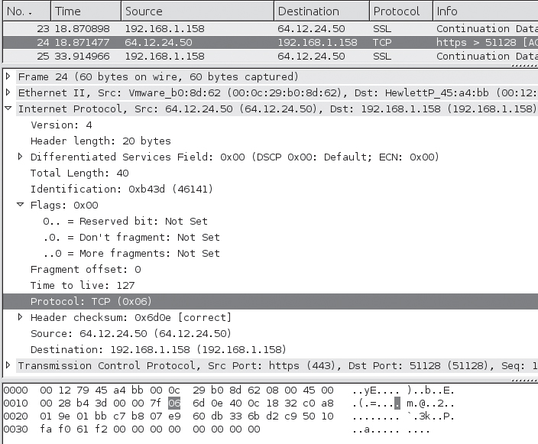
Protocol Analysis
Techniques:
Protocol identification
Leverage information in the encapsulating protocol
Byte 9 in IP header indicates protocol encapsulated within IP packet
0x06 refers to TCP

Slide 15
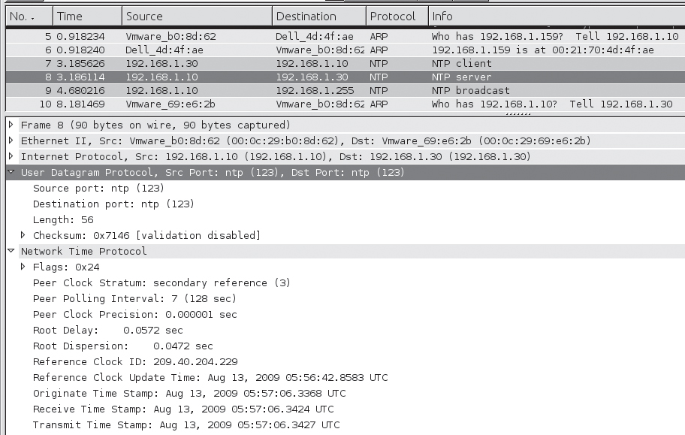
Protocol Analysis
Techniques:
Protocol identification
Leverage the TCP/UDP port number, many of which are associated with standard default services
Port 123 – NTP
Port 443 – https

Slide 16
Protocol Analysis
Techniques:
Protocol identification
Analyze the function of the source or destination server (speciﬁed by IP address or hostname)
Whois IP address

Slide 17
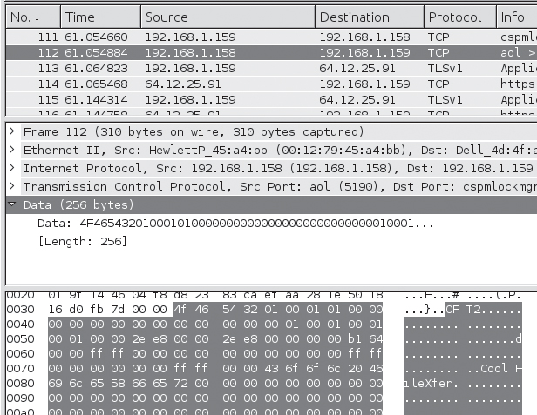
Protocol Analysis
Techniques:
Protocol identification
Test for the presence of recognizable protocol structures
Trial and error
Example

Slide 18
Protocol Analysis
Protocol Decoding:

