Slide 1
Ch 11. Network Tunneling
Naveen kumar lekkalapudi

Slide 2
What to expect?
Functionality
Tunneling for confidentiality
Covert Tunneling

Slide 3
Tunneling for functionality
Network tunneling generally refers to the practice of encapsulating traﬃc in unusual ways, diﬀerent from the order described by standard layered models such as the OSI model.
VLAN Trunking
Network engineers would like to partition the network traffic for various groups of users without having to create multiple physical networks for each of them.
It is done by deploying “smart switches” that support the 802.1Q protocol, which can be programmed to aggregate the appropriate stations into the desired VLAN.

Slide 4
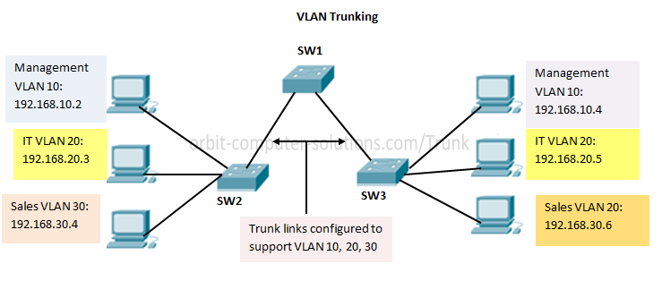
Tunneling for functionality
VLAN Trunking

Slide 5
Tunneling for functionality
Inter-Switch Link
ISL works by encapsulating the Ethernet frames in a proprietary format prior to being sent over a WAN by the router.
The ISL protocol is deciphered by the router that receives it, and the Ethernet frame’s original VLAN tags are restored
Generic Routing Encapsulation
“For performing encapsulation of an arbitrary network layer protocol over another arbitrary network layer protocol.”

Slide 6
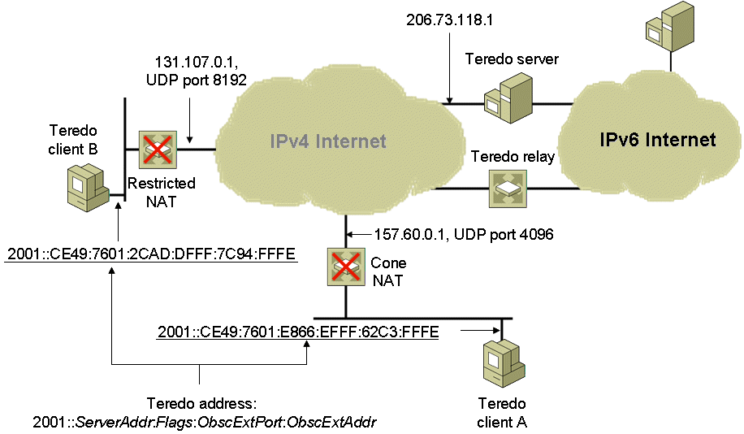
Tunneling for functionality
IPv6 over IPv4 with Teredo
Teredo is an open IETF standard that speciﬁes a method for tunneling IPv6 over IPv4 networks.6It does this by encapsulating IPv6 packets in UDP traﬃc, within IPv4

Slide 7
Tunneling for Confidentiality
Organizations also want to make sure that their tunneled traﬃc remains conﬁdential, even when routed over public segments.
Organizations purchased leased lines to connected remote sites-not feasible!!
IPSec, SSL, TLS were designed to provide end-to-end encryption of traffic regardless of route traversed.

Slide 8
Tunneling for Confidentiality
IPSec
Implements VPN.
Mutual authentication between nodes
Message integrity
Confidentiality
Three protocols:
Security Associations - Internet Key Exchange
Authentication Header
Encapsulated Security Payload

Slide 9
Tunneling for Confidentiality
Transport Layer Security(TLS) and Secure Socket Layer(SSL)
SSL was originally developed by Netscape in the early 1990s
TLS can be used as a generic VPN protocol
Ex: OpenVPN
Implications for Investigator
Tunneling protocols may encrypt just the payload of the tunneled traﬃc, leaving the Layer 2/3 endpoints of the tunneled traﬃc exposed.
In these situations, the investigator is left to conduct timing-based analysis of the volume of traffic sent and received. Ex Tor exit nodes?

Slide 10
Covert Tunneling
Strategies:
The most common approach for creating covert tunnels is to embed arbitrary IP traffic in protocols with data fields large enough to accommodate reasonable throughput.
ICMP is a good choice because of the near-ubiquitous allowance of outbound echo requests and inbound echo replies.

Slide 11
Covert Tunneling
TCP Sequence Numbers
For every SYN packet that a system sends, it must generate a random 32-bit initial sequence number.
Someone wishing to tunnel data outbound in a very covert way could encrypt their data, thus making it appear pseudo-random, chop it up into 32-bit chunks, and embed it as the initial sequence number of TCP SYN connection attempts to an external server.

Slide 12
Covert Tunneling
DNS Tunnels
For web browsing, clients resolve new domains recursively.
Can be used to communicate clients to external remote servers.
Several fields to smuggle data. NULL,TXT,SRV or MX.
Iodine
Open source data through DNS server.
ICMP Tunnels
Any arbitrary data is allowed beyond standard type defs.
Hping3
Loki

Slide 13
Covert Tunneling
Implications for investigator:
Statistical flow record analysis
In particular, look for unusual volumes of traffic with unknown purpose.
Unexpected values in protocol field
Search for meaningful values in reserved fields or infrequently used fields. In addition, check for unexpected values in frequently used fields, such as nonrandomized numbers in fields that are supposed to contain random values.
Recognizable content in unexpected places
Keep an eye out for magic numbers, ASCII text, honeytokens, or other signs of meaningful data in ﬁelds that normally do not contain that type of data.

