Slide 1
Chapter 2: Technical Fundamentals
Naveen Kumar Lekkalapudi

Slide 2
What to expect?
Sources of evidence
Principles of networking.
IP Suite

Slide 3
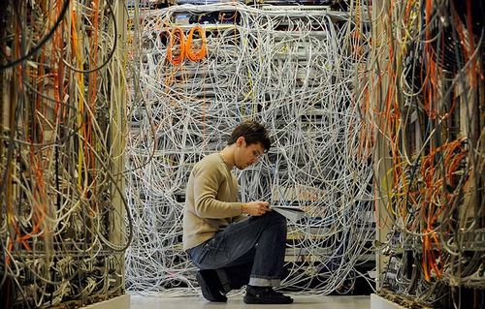
Sources of Network-based evidence
Depends on environment.
Depends on staff.
Depends on where network is at.
Depends on network topology.

Slide 4
Infinite Sources
Routers.
Switches.
Web proxies.
IDS.
ASA.

Slide 5
Examples
On the wire:
TP or coaxial cables are used to provide connectivity between stations.
Can tap into live traffic to copy and record.
Vampire taps: literally puncture physical wire to cut through sheathing revealing light going in bended cable.
Infrastructure taps which duplicate signal are also available.

Slide 6
Examples
In the air:
Wireless networking, RF signals, IR signals.
WAP points help to traverse traffic.
Data might be encrypted which can be decrypted by legal obtaining key or by cracking it (eg: airmon-ng,airdump-ng,fern)
Data might be encrypted, control frames may not be. Highly useful for forensics.
Can obtain IP addresses, MAC addresses.
MAC addresses can be spoofed.

Slide 7
Examples
Switches:
Switches connect several machines together.
Switches are connected to switches which are connected to switches in modern networks.
Core switches connect switches with other switches.
Edge switches connect switches to stations.
Content Addressable memory (CAM) table stores MAC to physical ports.
Can sniff or monitor individual ports.

Slide 8
Examples
Routers:
Connects different network element’s together.
Connects LAN, WAN, MAN, together.
Routing tables helps trace IP address across networks.
May function as packet filters.
Can send/store logs.
Volatile memory.

Slide 9
Examples
Servers
DHCP: Dynamically assigns IP
Name Servers: Maps IP to name and name to IP.
Authentication Servers: Logs authentication events.
Application Servers: Information and logs can be useful.
Central Log Servers: Logs at one place. High forensic value.

Slide 10
Examples
Network Intrusion detection systems:
NIDS’s gives information about security related events.
Where, how many and capacity of sensors affect its performance.
Designed for forensics and control over security.
Data is helpful for recovery and also investigation

Slide 11
Examples
Firewalls:
Helps monitor and control traffic in a network.
Payloads, port numbers and protocols can also be used to firewall data.
Event alert has more precedence over logging.
New firewalls have advanced granular logging capabilities as well.
Can serve as evidence for forensic analysts.

Slide 12
Principles of Internetworking
Internet is a network of millions of computers communicating with each other.
Standards need to maintained for communication and also modularity is provided for scope of development.
Layered standards are used:
OSI
TCP/IP

Slide 13
Protocols
A set of formal rules describing how to transmit data, especially across a network.
Simplest connection is set with Three way handshakes.
->>>Hi Jack
Hi Jill, This is Jack<<<-
->>>Great Jill. Prepare to receive data.
…

Slide 14
Protocol Mismatch
A Japanese and an American diplomat are scheduled to meet one another and work together on an item of transcontinental importance. Unfortunately, neither has been appropriately briefed about the other’s customary manner of polite greeting. At the precise moment that the Japanese diplomat bows, extremely respectfully and deeply, the American enthusiastically thrusts out his hand. Unhappily, the combined ignorance of the two results in a painful jab in the eye for the Japanese and a figurative black eye for the American. This is clearly no way to begin a useful relationship.

Slide 15
Protocols
Rules for successful communication between different systems
Prearranged specifications for actions
Designed to avoid implementation dependence
Designed to avoid ambiguity
Designed to recover gracefully from errors
A perpetual attack target . . .

Slide 16
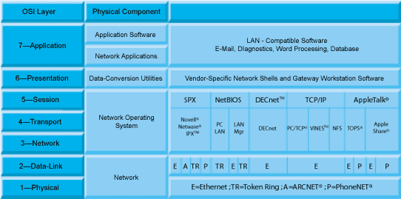
OSI Model

Slide 17
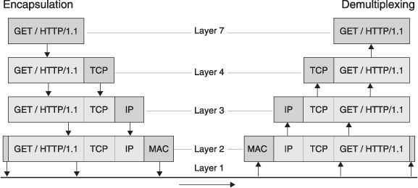
How data flows

Slide 18
What forensic expert should know?
Number and names of different protocols.
Brief idea on how protocol works.
Where to look when something goes wrong/bad.
Different set of network devices and how they access them.

Slide 19
TCP/IP
OSI is great but is not real TCP/IP is!
The purpose of the original protocol was to allow processes on different computers in different networks to easily communicate with each other. Vint Cerf later recalled that “[t]he initial concept behind [TCP/IP] was very simple. Two processes wishing to communicate had only to know the other’s ‘address
“We are screwing up in our design of internet protocols by violating the principle of layering. Specifically we are trying to use TCP to do two things: serve as a host level end to end protocol, and to serve as an internet packaging and routing protocol. These two things should be provided in a layered and modular way. I suggest that a new distinct internetwork protocol is needed, and that TCP be used strictly as a host level end to end protocol.” –Jon postel

Slide 20
Internet protocol
Connectionless
Unreliable
Includes a header (no footer)
Header plus payload is called an IP packet
IP v4: 10.0.0.23
IP v6: 2001:db8:85a3::8a2e:370:7334.

Slide 21
IP v4
32 bit addresses
Binary:
00001010.00000001.00110010.10010110
Human-readable:
10.1.50.150
10.0.0.0 - 10.255.255.255 (10/8 prefix) 172.16.0.0 - 172.31.255.255 (172.16/12 prefix) 192.168.0.0 - 192.168.255.255 (192.168/16 prefix)

Slide 22
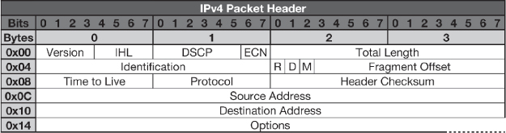
IP packet

Slide 23
IP v6
Here is an example of a human-readable IPv6 address:
2001:0db8:0000:0000:0001:0000:0000:0001
Here is a shorthand way of writing the same IPv6 address:
2001:db8::1:0:0:1
Larger address space (128 bits)
No packet header checksums
Fixed-length IP packet header
Designed to interoperate with IPSEC

Slide 24
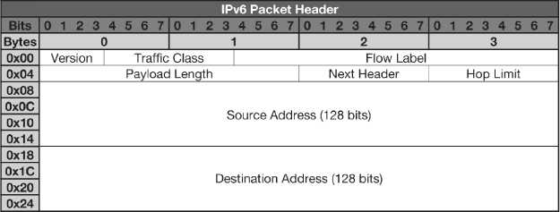
IPv6 packet

Slide 25
Transmission control protocol
Reliable
Connection-oriented
Handles sequencing
Port numbers range from 0 to 65535
Includes a header (no footer)
Header plus payload is called a TCP segment

Slide 26
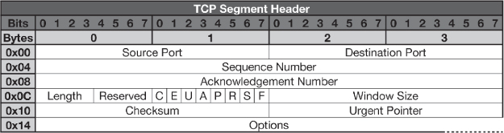
TCP

Slide 27
User datagram protocol
Unreliable
Connectionless
Port numbers range from 0 to 65535
Includes a header (no footer)
Header plus payload is called a UDP datagram

Slide 28

UDP

