Slide 1


AI-POWERED SEARCH WITH ORACLE 26 AI DATABASE ON AIX
Modernizing Search: From Keywords to AI-Driven Insights
Enterprise-Grade AI Infrastructure | IBM Power Systems

Slide 2



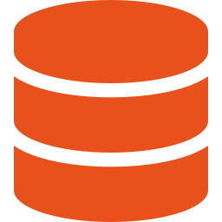

Vector Similarity Search — Pipeline Architecture
Oracle 26ai on AIX
INPUT
MODEL
INFERENCE
STORAGE
OUTPUT
Kaggle Dataset
CLIP Model
Flask API
Oracle 26ai
APEX App
44K+ Fashion
Product Images
CLIP Embeddings
ONNX Runtime
Port 5001 · AIX
Vector Store
HNSW Index
Vector Similarity
Search UI
Oracle AI Vector Search

Slide 3

THE PROBLEM WITH TRADITIONAL KEYWORD SEARCH
Exact Match Dependency
Systems like "LIKE" search require users to know the precise database terminology, creating a barrier to discovery.
Search: "FIFA T-shirt"
0 RESULTS FOUND
The "No Results" Trap
Searching for "FIFA T-shirt" fails if the database only contains "Men's Football Jersey," leading to lost sales opportunities.
User Query
Database Content
Match?
FIFA T-shirt
Men's Football Jersey
No
The Semantic Gap
Office Wear
Formal Suit
No
Traditional databases lack the ability to understand the intent or meaning behind user queries, relying solely on character matching.
Luxury Bag
Designer Tote
No

Slide 4

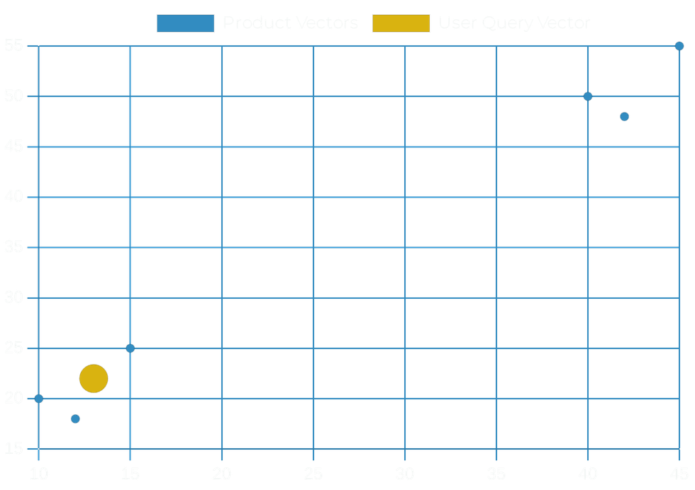




SEMANTIC SEARCH: UNDERSTANDING INTENT WITH VECTORS
Beyond Literal Matching
User queries are converted into high-dimensional embedding vectors that capture the underlying meaning of the request.
Vector Similarity Functions
Oracle uses the
VECTOR_DISTANCE
function with
cosine similarity to find the closest matches in the
vector space.
Native Database Execution
All similarity computations happen directly inside the Oracle 26 AI database, ensuring high performance and data security.
QUERY
EMBEDDING
ORACLE AI
RESULT

Slide 5




IMAGE-BASED SEARCH: BEYOND TEXT QUERIES
Visual Querying
Instead of typing, users upload an image. The system answers: "Show me products that look like this."
IMAGE UPLOAD
User provides a visual reference
CLIP Model Integration
CLIP EMBEDDING
The image is converted into a high-dimensional embedding vector using the CLIP model.
Conversion to numerical vector
Vector Comparison
VECTOR DISTANCE
Similarity search in Oracle 26 AI
Oracle compares the query vector against product image embeddings stored directly in the database.
"Show me products that look like this image"

Slide 6

BRIDGING BROWSING AND SEARCH
Hybrid Data Handling
UNIFIED QUERY RESULT
Oracle combines AI-driven similarity search with traditional structured data like inventory levels in a single, high-performance query.
PRODUCT
SIMILARITY
STOCK
ACTION
Men's Office Blazer
0.98
12
ADD TO CART
Formal Silk Tie
0.94
0
NOTIFY ME
Operational Intelligence
Leather Oxfords
0.89
5
ADD TO CART
Ensures recommendations are not only relevant but also available for purchase, enhancing the user experience and conversion rates.
SELECT product_name, stock_count, VECTOR_DISTANCE(embedding, :query_vec) as sim FROM products WHERE category = 'Office' AND sim < 0.5 ORDER BY sim ASC;
Seamless Integration
Displaying stock counts and "Notify Me" options alongside AI results directly from the database core.

Slide 7




THE CHALLENGE OF PURE IMAGE SIMILARITY
Visual Ambiguity
Pure image search prioritizes shape, color, and texture, which can lead to category confusion in complex catalogs.
SIMILAR PIXELS
The "Cufflinks vs. Earrings" Problem
Small, shiny objects like cufflinks can be visually indistinguishable from earrings to a model focused only on pixels.
CUFFLINKS
EARRINGS
CATEGORY MISMATCH
Context Blindness
Visually similar items often belong to entirely different product categories, leading to irrelevant user experiences.
Without semantic metadata, the system lacks the functional understanding required for precise e-commerce recommendations.

Slide 8





HYBRID VECTOR SEARCH: THE POWER OF LATE FUSION
Multi-Signal Intelligence
Oracle combines multiple signals—image similarity and description similarity—into a single, unified query.
IMAGE EMBEDDING
TEXT EMBEDDING
Late Fusion Technique
The database calculates separate scores for different modalities and merges them into a final hybrid ranking.
FUSION
Superior Search Precision
Eliminates irrelevant results by understanding both visual appearance and semantic product meaning simultaneously.
HYBRID RANKING
"Show me cufflinks that look like this image"

Slide 9
ARCHITECTURE: AI-DRIVEN SEARCH ON ENTERPRISE INFRASTRUCTURE
Model Execution & Optimization
CLIP models run on the ONNX runtime, specifically optimized for high-performance execution on the AIX platform.
AI APPLICATION LAYER
CLIP MODEL (ONNX RUNTIME)
Native Vector Storage
ORACLE 26 AI DATABASE
Embeddings are stored directly within Oracle 26 AI Database, eliminating the complexity of external vector stores.
AIX OPERATING SYSTEM
Enterprise-Grade Foundation
IBM POWER SYSTEMS
The entire stack leverages IBM Power Systems with AIX, providing the reliability and scale required for mission-critical AI.
UNIFIED ENTERPRISE AI STACK

Slide 10




SUMMARY: THE FUTURE OF DATABASE SEARCH
Unified Intelligence
Simplified Stack
Visual similarity combined with semantic understanding in a single, native database environment.
No external AI search engines or specialized vector databases required, reducing architectural complexity.
Performance & Scale
Business Value
Leveraging Oracle's native vector capabilities on robust IBM Power Systems with AIX infrastructure.
Delivering more relevant, available, and intuitive search experiences that drive customer conversion.
ENTERPRISE AI NATIVELY ON ORACLE 26 AI & AIX

