Slide 1
PHYSICAL LAYER SECURITY FOR IoT
PROJECT GUIDE: MRS. N. VIJAYA
NARAYANAN B – 2016105053
VENKAT KRISHNAN B K J – 2016105077
ASHOK KUMAR M – 2016105513

Slide 2
WHAT IS IoT?
The Internet of Things (IoT) is a system of interrelated computing devices, mechanical and digital machines, objects, animals or people that are provided with unique identifiers (UIDs) and the ability to transfer data over a network without requiring human-to-human or human-to-computer interaction.
APPLICATIONS:
Smart Homes – Automated lighting, heating, air-conditioning etc.,
Elder Care – assistance for those with disabilities and elderly individuals.
Smart Healthcare – Remote patient monitoring and emergency notification systems.
Internet of Military Things (IoMT): Application of IoT technologies in the military domain for the purposes of reconnaissance, surveillance, and other combat-related objectives.

Slide 3
THE CRITICISMS
Security is the biggest concern in adopting Internet of things technology.
Most of the technical security concerns are similar to those of conventional servers, workstations and smartphones, and include weak authentication, forgetting to change default credentials, unencrypted messages sent between devices, SQL injections and poor handling of security updates.
Many IoT devices have severe operational limitations on the computational power available to them. These constraints often make them unable to directly use basic security measures such as implementing firewalls or using strong cryptosystems to encrypt their communications with other devices - and the low price and consumer focus of many devices makes a robust security patching system uncommon.

Slide 4
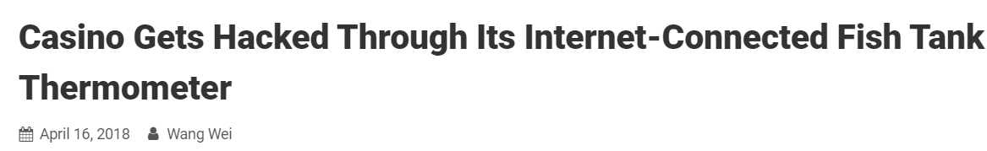

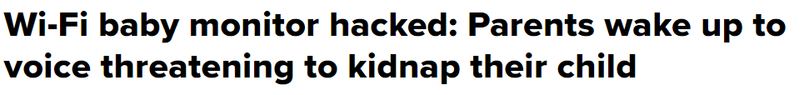


Slide 5
OUR PROPOSAL
It is necessary to develop new security primitives for the vulnerable IoT applications.
There are emerging techniques, which exploit the unique features and characteristics of the transceiver hardware and wireless channels for security purposes.

Slide 6
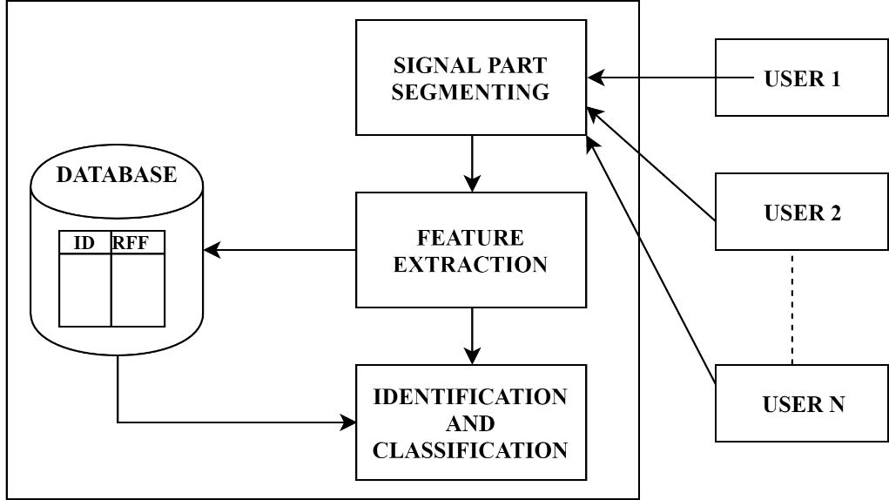
RFF
RF fingerprint is the reflection of differences between hardware components of transmitters, and it contains rich nonlinear characteristics of internal components within transmitter.
The RF fingerprints work in physical layer within transmission devices, so they cannot be destroyed or copied.

Slide 7
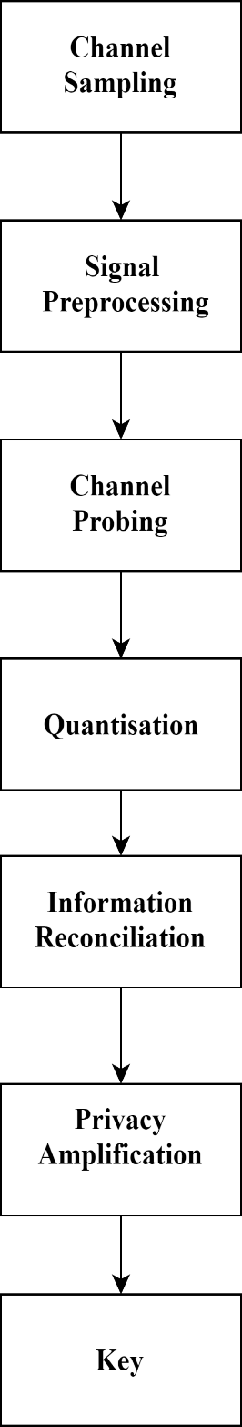
KEY GENERATION FROM WIRELESS CHANNELS
The channel between any two users, i.e., h(t), is determined by the propagation environment, which is also affected by the user/object movements.
The random nature of the wireless channel between users can be exploited as common information and employed as the cryptographic key, which is termed as key generation from wireless channels.

Slide 8
RFF identiﬁcation and key generation are eminently suitable for IoT.
Both these techniques are not energy-hungry, hence they can be applied for power-constrained IoT devices.
RFF identiﬁcation does not involve complex computations at the devices.
These techniques can be implemented in the context of a real system by exploiting the existing data transmissions, without incurring modiﬁcation to the standard procedures.

Slide 9
REFERENCES
Physical Layer Security for the Internet of Things by Junqing Zhang, Sekhar Rajendran, Zhi Sun, Member, IEEE, Roger Woods, Senior Member, IEEE, and Lajos Hanzo, Fellow, IEEE. Published in: IEEE Wireless Communications
( Volume: 26 , Issue: 5 , October 2019 )
Radio Frequency Fingerprint Extraction Based on Multidimension Permutation Entropy by Shouyun Deng, Zhitao Huang, Xiang Wang, and Guangquan Huang. Published in: International Journal of Antennas and Propagation, Vol. 2017

Slide 10
THANK YOU !

