Slide 1
IoT Security Enhancement using Physical Layer signatures
PROJECT GUIDE : MRS. N. VIJAYA
NARAYANAN B - 2016105053
VENKAT KRISHNAN B K J - 2016105077
ASHOK KUMAR M - 2016105513

Slide 2
INTRODUCTION
Wireless networks are susceptible to various attacks due to the “open air” nature of the wireless communication
A secure wireless communication system involves authentication and secure transmission
Authentication verifies the user identity and prevents malicious users from accessing the network
Secure transmission protects data integrity and confidentiality using encryption schemes
IoT Security
Devices are low powered and mostly battery operated
Flawed because of the operational limitations on the computational power
Physical layer signatures
Fine-grained values derived from the physical layer, such as RSS and CSI.
Very sensitive to location and time
Presents an excellent quality of randomness

Slide 3
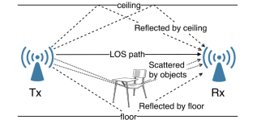
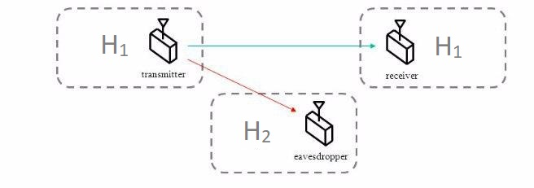
Various factors affecting the signal
Channel Model

Slide 4
MOTIVATION
Drawbacks of Conventional Cryptography Techniques
Due to the “open-air” nature, key distribution is more susceptible to attacks in wireless communications.
Mathematically Complex in the case of IoT devices
Physical Layer Security
It involves physical layer signatures which are very random, unique and doesn’t involves complex mathematical computations
Physical Layer Security + Cryptographic Techniques
Existing cryptographic securities can be enhanced with the incorporation of physical layer signatures

Slide 5
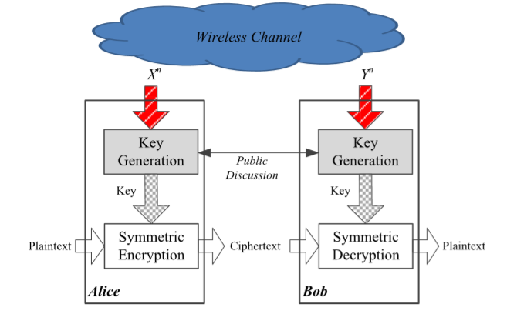
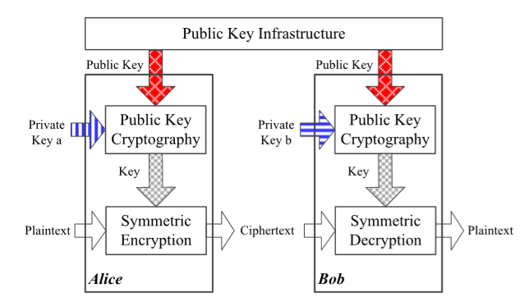
Existing Method Proposed Method

Slide 6
OBJECTIVE
To develop a new secret key generation algorithm using physical layer signatures (Channel State Information).
To overcome key exchange, key distribution and key management overhead at legitimate users.
To provide significant improvement in secrecy.

Slide 7
METHODOLOGY
CSI
CSI
K
K
MAC
E
||
D
MAC
Hash
Hash
E
E
K
K
Verification
 | Encryption
K | Key
 | Decryption
E
Yes
D
Authenticated User

Slide 8
FLOWCHART
CSI EXTRACTION
S_{i}
QUANTIZATION
K_{u}
PRIVACY AMPLIFICATION
SHA - 256
K

Slide 9
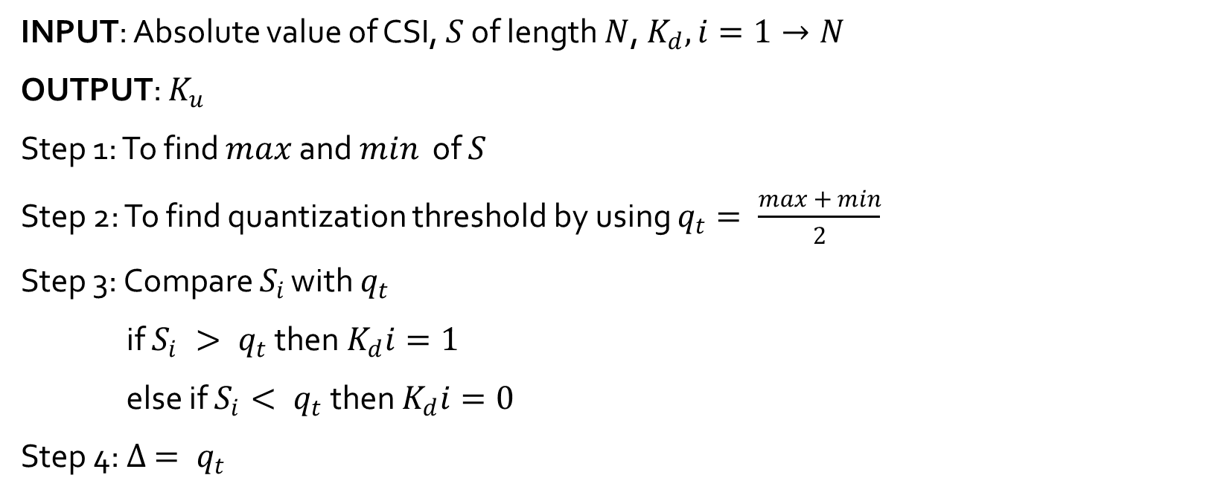
QUANTIZATION ALGORITHM
INPUT: Absolute value of CSI, $S$ of length $N$, $K_{d}, i=1→N$
OUTPUT: $K_{u}$
Step 1: To find $max$ and $min$ of $S$
Step 2: To find quantization threshold by using $q_{t}= \frac{\max{+ min}}{2}$
Step 3: Compare $S_{i}$ with $q_{t}$
if $S_{i} > q_{t}$ then $K_{d}i=1$
else if $S_{i}< q_{t}$ then $K_{d}i=0$
Step 4: $∆ = q_{t}$

Slide 10

Step 5: while$\left(no. of zeros in K_{d} ==no. of ones in K_{d}\right)$
$∆=\frac{∆}{2}$
if $no. of zeros in Kd > \frac{N}{2}$
$q_{t}=q_{t}− ∆$
if $no. of ones in Kd > \frac{N}{2}$
$q_{t}=q_{t}+ ∆$
Compare $S_{i}$ with $q_{t}$
if $S_{i} > q_{t}$ then $K_{d}i=1$
else if $S_{i}< q_{t}$ then $K_{d}i=0$
Step 6: $K_{u}= K_{d}$

Slide 11
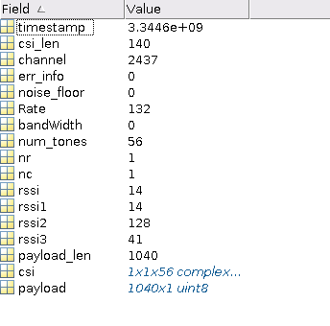
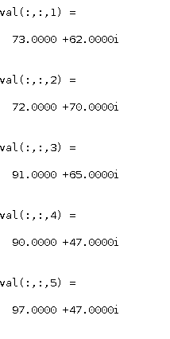
RESULTS
Data extracted from NIC
Sample CSI data

Slide 12
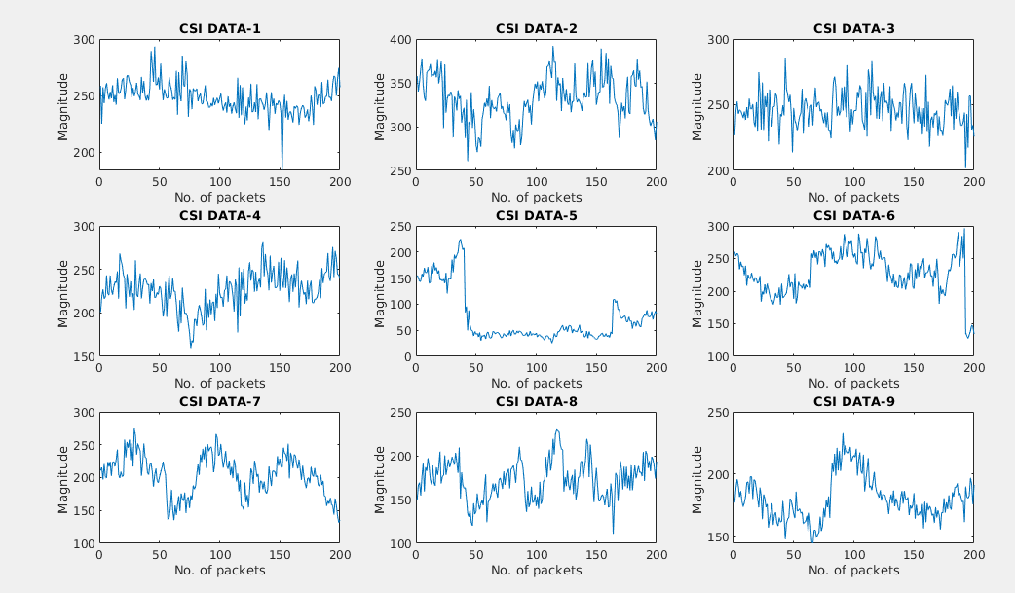
CSI Samples varying with respect to distance and time

Slide 13
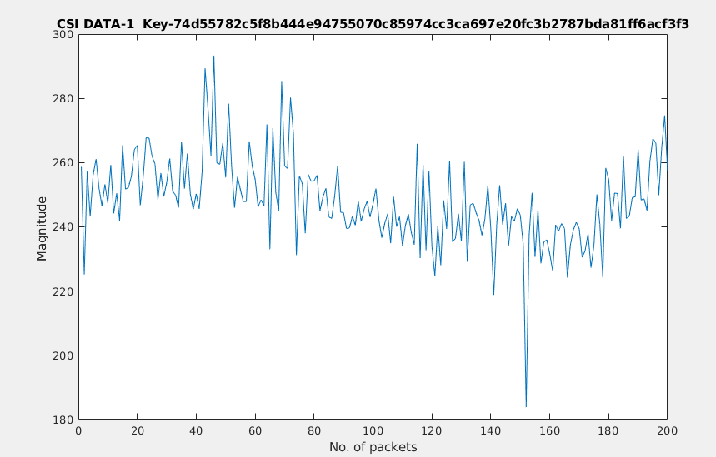
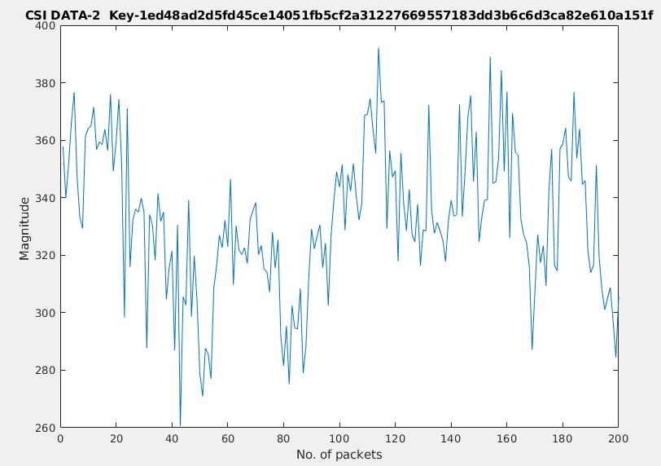
Keys generated for different CSI values

Slide 14
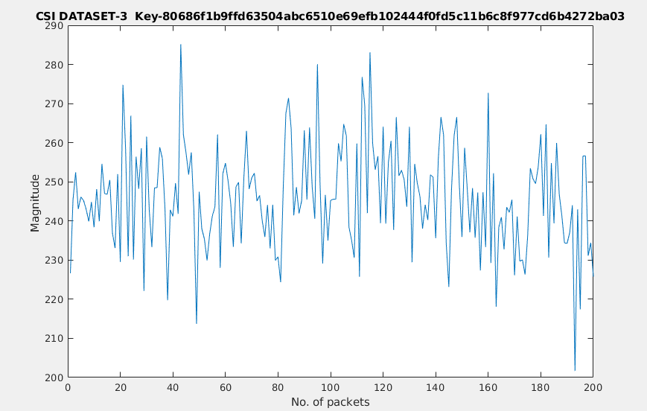
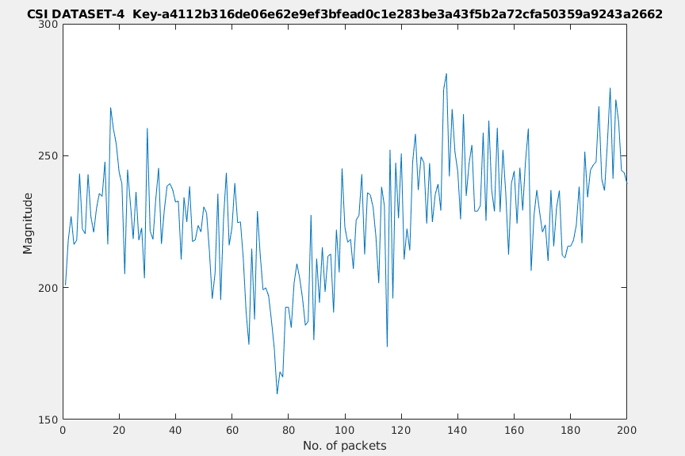
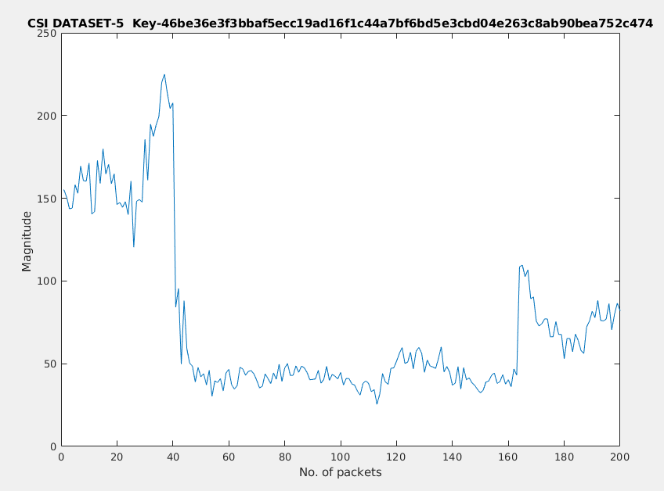
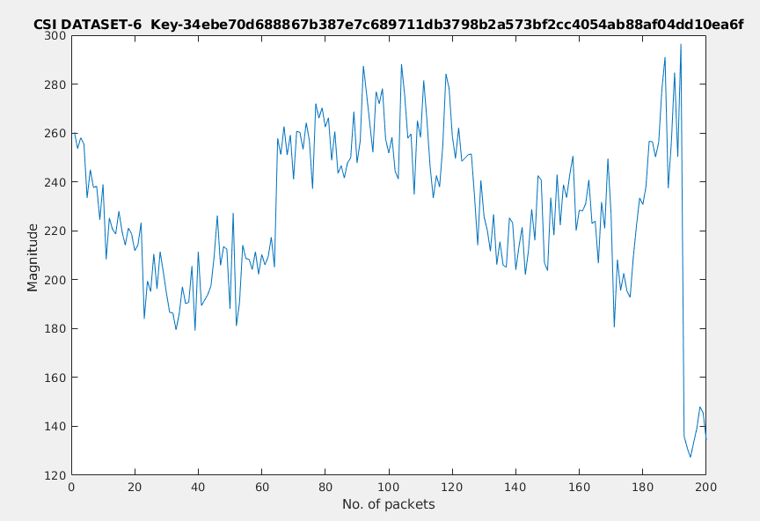

Slide 15
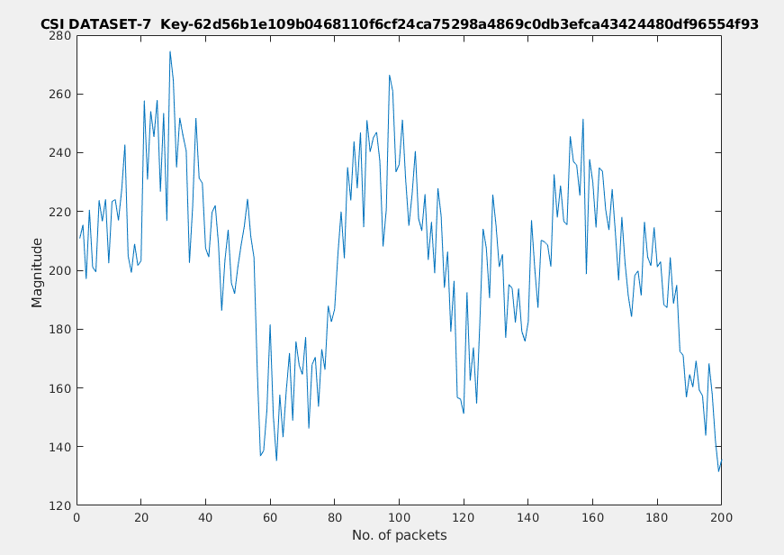
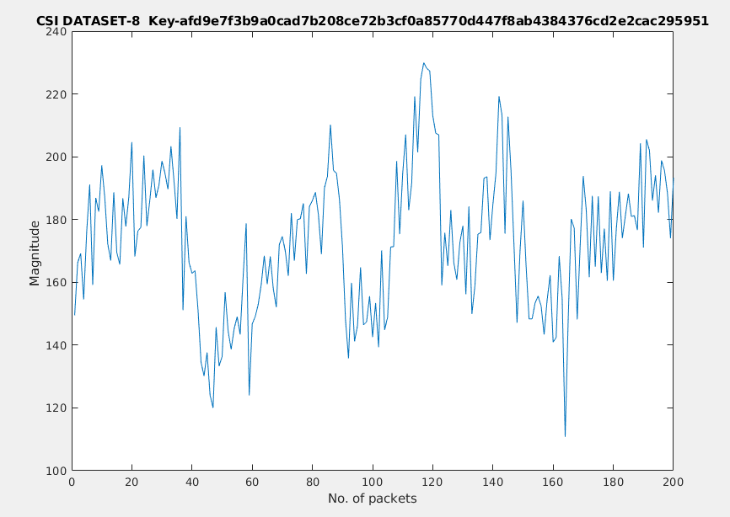
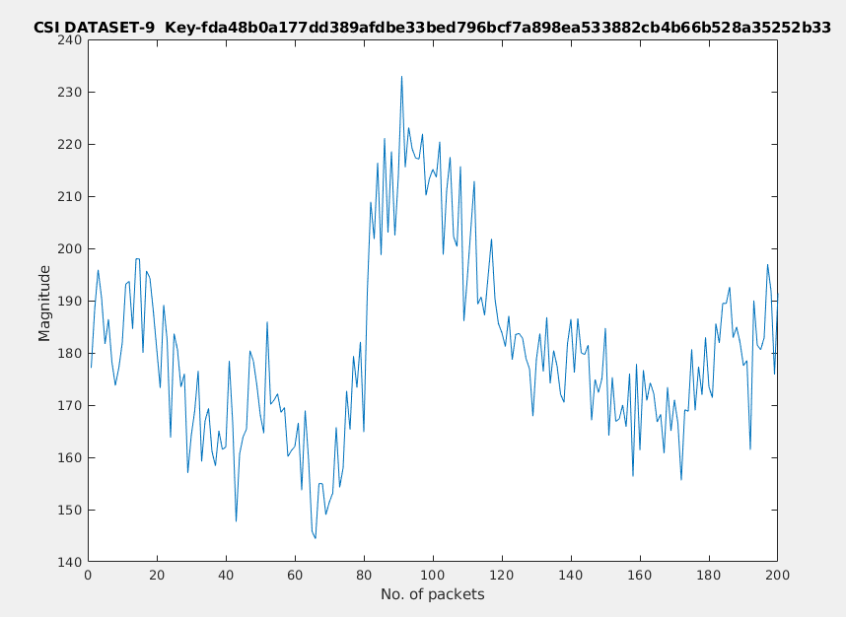

Slide 16
TIME FRAME CHART
 | Understanding and Implementation of the proposed key exchange scheme | Implementation and Integration of Authentication protocol with the key exchange scheme.
First Review
Second Review
Completed

Slide 17
FUTURE WORK
Implementation of Authentication protocol using the proposed methodology.
Integration of Authentication protocol with the key exchange scheme.
Evaluation of the generated keys using the following performance metrics
Leakage with respect to position
Mismatch Rate

Slide 18
REFERENCES
Physical Layer Security for the Internet of Things by Junqing Zhang, Sekhar Rajendran, Zhi Sun, Member, IEEE, Roger Woods, Senior Member, IEEE, and Lajos Hanzo, Fellow, IEEE. Published in: IEEE Wireless Communications (Volume:26, Issue: 5, October 2019)
Key Generation From Wireless Channels: A Review by Junqing Zhang, Trung Q. Duong, (Senior Member, IEEE), Alan Marshall, (Senior Member, IEEE), and Roger Woods, (Senior Member, IEEE) 2016. Published in: IEEE Access (Vol. 4)
Wireless Physical Layer Identiﬁcation : Modeling and Validation, by W.Wang, Z.Sun, S. Piao, B. Zhu, and K. Ren, IEEE Trans. Inf. Forensics Security, vol. 11, no. 9, pp. 2091–2106, 2016
Efﬁcient and Secure Key Extraction using CSI without Chasing down Errors
Jizhong Zhao, Wei Xi, Jinsong Han, Shaojie Tang, Xiangyang Li, Yunhao Liu, Yihong Gong, Zehua Zhou

