Slide 1
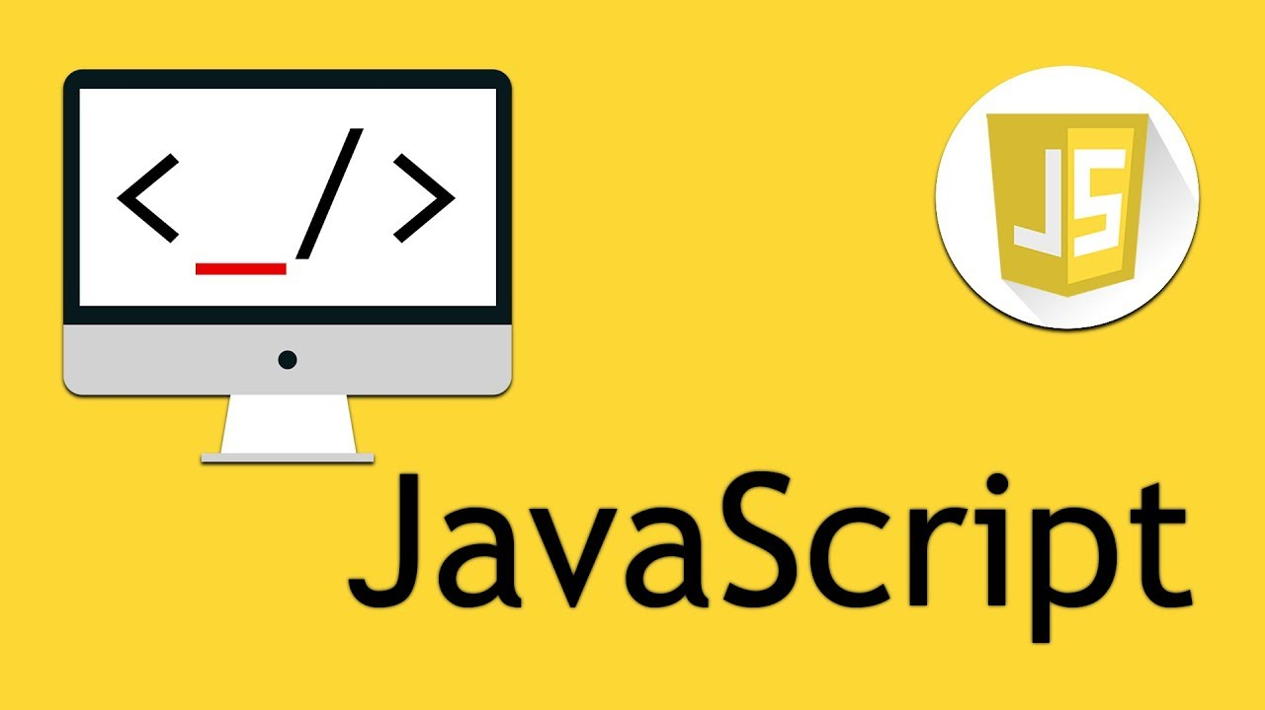

Slide 2
Introduction To JavaScript
lecture-1

Slide 3

Variable
Variables are the names you give to computer memory locations which are used to store values in a computer program.
It works like a box that can hold can any value

Slide 4
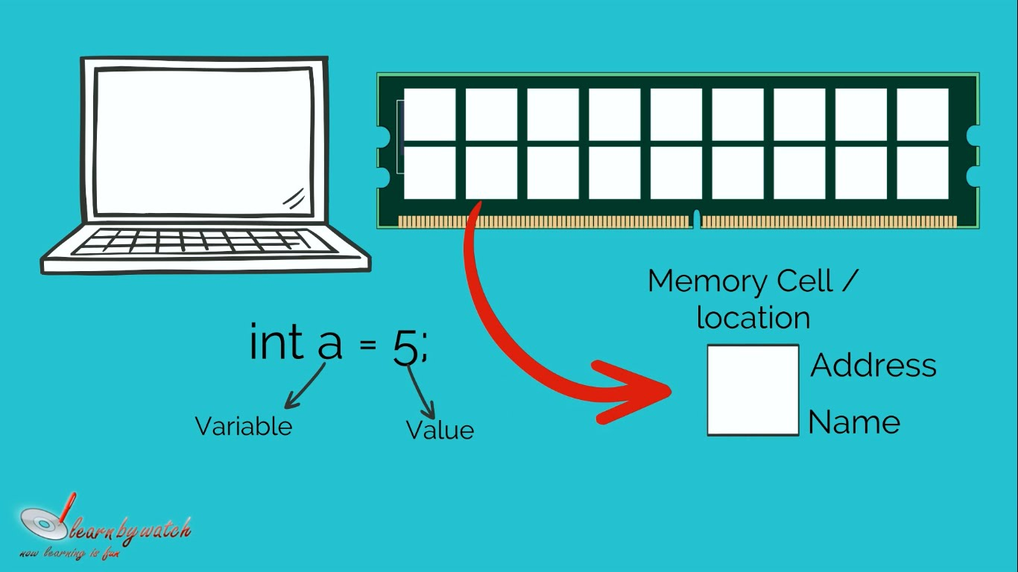
Variable

Slide 5
Data type of a variable
›Boolean. ( e.g. true, false)
var flag=true;
› Null. (e.g. means a variable with no value)
var TestVar =null;
› Undefined. (e.g. means variable not defined)
var TestVar ;
› Number. (e.g. 1,2,3,4,5, 8.9)
var TestVar =12;
› String. (e.g. “anything”)
var TestVar =“naveed”;

Slide 6
Data type of a variable
JavaScript automatically detects the data type of variable and perform according to the data type.
Example:
var num1 = 3;
var fruit = “Eat”; var num2 = 4;
var fruit2 = “Apple”;

Slide 7
Printing variables
JavaScript provides us some built-in tools for printing which helps us in developing, improving and debugging our code.
Example:
alert, console
Using alert:
var number = 10;
alert(number);
Using Console:
var name = “naveed”;
console.log(name);

Slide 8
Variable Name Legal and Illegal
1- A variable name can't contain any spaces.
2- A variable name can contain only letters, numbers, dollar signs, and underscores.
3-A variable name can't be any of JavaScript's keywords.
4-Capital letters are fine, but be careful. Variable names are case sensitive. A rose is not a Rose.
5-camelCase naming convention preferred .
Example camelCase:
userResponse
userResponseTime
userResponseTimeLimit

Slide 9
Math expressions: Familiar operators
›Wherever you can use a number, you can use a math expression. For example, you're familiar with this kind of statement
var popularNumber = 2 + 2;
alert(2 + 2);
var popularNumber = 12 - 24;
var num = 10;
var popularNumber = num + 200;
Console.log(popularNumber );

Slide 10
Math expressions: Unfamiliar operators
›There are several specialized math expressions you need to know. Here's the first one.
num++;
This is a short way of writing...
num = num + 1;
num--;
num = num - 1;

Slide 11
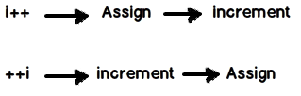
Math expressions: Unfamiliar operators
› Quiz
var num = 1;
var newNum = num++;
Q: what is the value of newNum?
var num = 1;
var newNum = ++num;
Q: what is the value of newNum?

Slide 12
Math expressions: Unfamiliar operators
› Quiz
var num = 1;
var newNum = num--;
Q: what is the value of newNum?
var num = 1;
var newNum = --num;
Q: what is the value of newNum?

Slide 13
Math expressions: Eliminating ambiguity
› Quiz
var totalCost = 1 + 3 * 4;
Q: what is the value of totalCost ?
var num = 3*1 + “naveed”;
Q: what is the value of num?

Slide 14
Concatenating text strings
›var message = "Thanks, ";
var banger = "!";
Var username=“naveed”
alert(message +userName+ banger);
You can assign a concatenation to a variable
var customMess = message + userName + banger;
alert(customMess);

Slide 15

Concatenating :
› Quiz
alert("2 plus 2 equals " + 2 + 2);
Q: what is the value of alert?

Slide 16
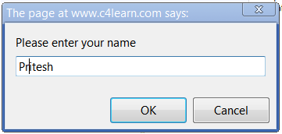
Prompts:
The prompt() method displays a dialog box that prompts the visitor for input.
A prompt box is often used if you want the user to input a value before entering a page.
Syntax:
var person = prompt("Please enter your name");

Slide 17
Prompts:
›var numberOfCats = prompt("How many cats?");
var tooManyCats = numberOfCats + 1;
Q: value of toomanyCats?

Slide 18


