Slide 1
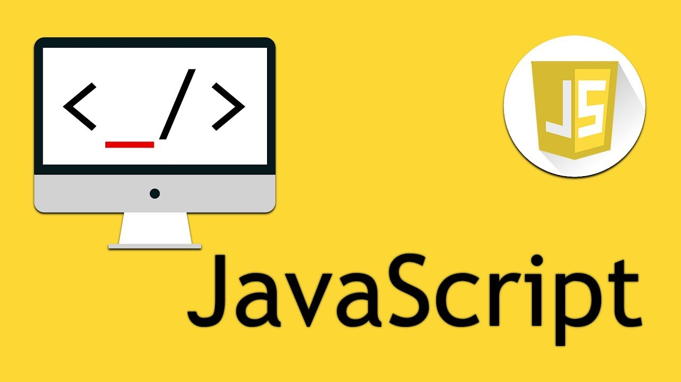

Slide 2
Introduction To JavaScript
lecture-2

Slide 3

Condition
Conditional expressions and conditional constructs are features of a programming language, which perform different computations or actions depending on whether a programmer-specified boolean condition evaluates to true or false.
Very often when you write code, you want to perform different actions for different decisions.

Slide 4
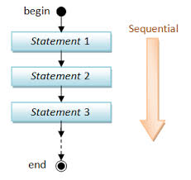
Sequential Control

Slide 5
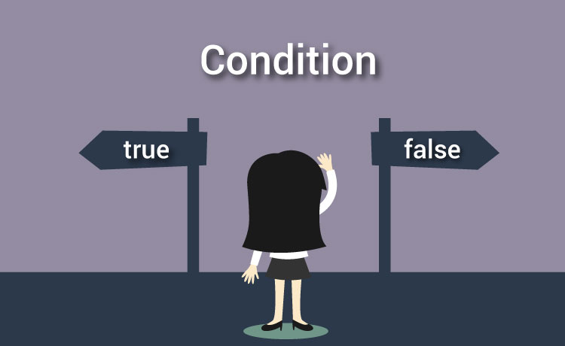
Condition

Slide 6
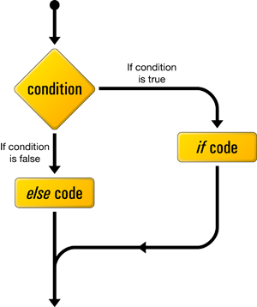
If statement
›Use the if statement to specify a block of JavaScript code to be executed if a condition is true.

Slide 7
If statement syntax
if (condition) { block of code to be executed if the condition is true
………………. }
Example:
if(5<10){
alert(“yes 5 is less than 10 ’’);
}

Slide 8
Comparison operators
Type of comparison operator, specifically an equality operator.
== | equal to
!= | not equal
> | greater than
< | less than
>= | greater than or equal to
<= | less than or equal to

Slide 9
How Can it be Used
Comparison operators can be used in conditional statements to compare values and take action depending on the result:
Example:
var age = +prompt(“please enter your age?”);
if (age < 18) {
console.log("Too young“);
};

Slide 10
if...else and else if statements
Let start with example,
Example:
var age = 20;
if (age < 18) {
console.log("Too young“);
};
if (age > 18) {
console.log(“yes age is greater than 18“);
};

Slide 11
If else statements
Let start with example,
Example:
var age = 20;
if (age <= 18) {
console.log("Too young“);
};
But question is here if age is not less than 18 definitely age is greater than 18.
we can do it as follows
else {
console.log(“your age is greater than 18“); }

Slide 12
The else if Statement
›Use the else if statement to specify a new condition if the first condition is false.
Syntax
if (condition1) { block of code to be executed if condition1 is true } else if (condition2) { block of code to be executed if the condition1 is false and condition2 is true } else { block of code to be executed if the condition1 is false and condition2 is false }

Slide 13
The else if Statement
›Example
if (number >=48) { alert(“GRADE: A”);}
else if (number >=39) { alert(“GRADE: B”);}
else if (number >=30) { alert(“GRADE: C”);}
else { alert(“GRADE: F”); }

Slide 14
Testing sets of conditions
Using the if statement, you've learned to test for a condition. If the condition is met, one or more statements execute. But suppose not one but two conditions have to be met in order for a test to succeed.
Example:
&& | and | Var x=8; var y=0; (x < 10 && y > 1) | ? True or False
|| | or | (x <10 || y >0) | ? True or False

Slide 15
Nested if
›Check out this code.
if ((4<10 || 4>10) && 10=== 10) {
Alert(“Naveed”);
}
if (10 === 10) {
if (4 < 10) {
alert(“Naveed”)
}
else if ( 4>10) {
alert(“Naveed”);
}}

Slide 16
Comparison operators
› Quiz1
var age = “20”;
if(age == 20){
alert(“your age is exactly 20 year.”);
}
else {
alert(“No, your are not 20 year old.”);
}
Q: what is the output of this code ?

Slide 17
Comparison operators
› Quiz2
var age = “20”;
if(age === 20){
alert(“your age is exactly 20 year.”);
}
else {
alert(“No, your are not 20 year old.”);
}
Q: what is the output of this code ?

Slide 18
Comparison operators
› Quiz3
var age = 20;
if(age === 20){
alert(“your age is exactly 20 year.”);
}
else {
alert(“No, your are not 20 year old.”);
}
Q: what is the output of this code ?

Slide 19
Arrays
Arrays a kind of data structure that can store a fixed-size sequential collection of elements of the same type. An array is used to store a collection of data, but it is often more useful to think of an array as a collection of variables of the same type.

Slide 20
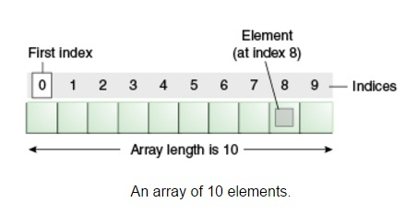
Array

Slide 21
Array why?
›Let's assign some string values to some variables.
var city0 = "Atlanta";
var city1 = "Baltimore";
var city2 = "Chicago";
var city3 = "Denver";
var city4 = "Los Angeles";
var city5 = "Seattle";
………………….
alert("Welcome to " + city3);

Slide 22
Array why?
›syntax
var cities = [];
var cities = ["Atlanta", "Baltimore", "Chicago", "Denver", "Los Angeles", "Seattle"];
alert("Welcome to " + cities[3]);

Slide 23


