Slide 1
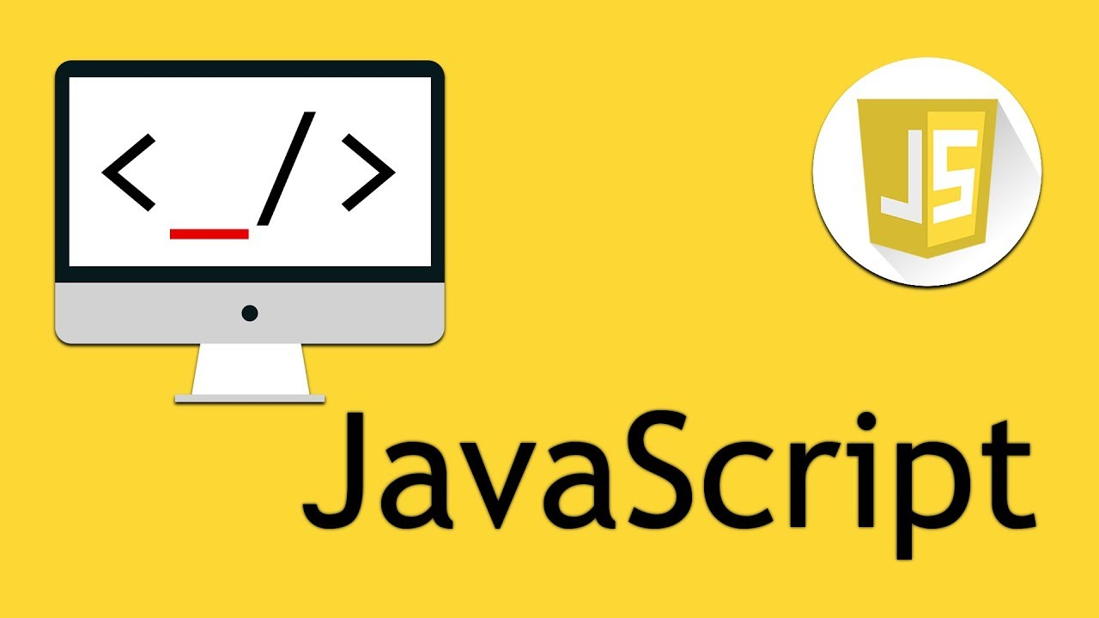

Slide 2
JavaScript Lecture-3
by
Naveed Rana

Slide 3

Recap-Lecture2
- Conditions
- Arrays
Notes:
<number>

Slide 4
Arrays
Arrays a kind of data structure that can store a fixed-size sequential collection of elements of the same type. An array is used to store a collection of data, but it is often more useful to think of an array as a collection of variables of the same type.
10/27/2018 Naveed
Notes:
<number>

Slide 5
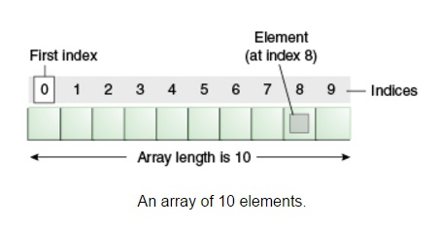
Array

Slide 6
Array why?
›Let's assign some string values to some variables.
var city0 = "Atlanta";
var city1 = "Baltimore";
var city2 = "Chicago";
var city3 = "Denver";
var city4 = "Los Angeles";
var city5 = "Seattle";
………………….
alert("Welcome to " + city3);

Slide 7
Array why?
›syntax
var cities = [];
var cities = ["Atlanta", "Baltimore", "Chicago", "Denver", "Los Angeles", "Seattle"];
//alert
alert("Welcome to " + cities[3]);

Slide 8
Adding elements into array
var cities = [ "Islamabad", "Karachi", "Lahore", "Peshawar", "Queta" ];
//Adding Elements
cities[5] = "Faisalabad";
//Adding Elements to the end of array
cities.push( "Chiniot", "Multan" );
//Adding Elements to the beginning of array
cities.unshift( "Chiniot", "Multan" );

Slide 9
Removing elements from array
var cities = [ "Islamabad", "Karachi", "Lahore", "Peshawar", "Queta" ];
//Removing last element of array
cities.pop();
//Removing first element of array
cities.shift();

Slide 10
Splice
Use the splice method to insert one or more elements anywhere in an array, while optionally removing one or more elements that come after it.
var cities = [ "Islamabad", "Karachi", "Lahore", "Peshawar", "Queta" ];
cities.splice( 2, 2, "Faisalabad", "Multan" );

Slide 11
Slice
Use the slice method to copy one or more consecutive elements in any position and put them into a new array.
var cities = [ "Islamabad", "Karachi", "Lahore", "Peshawar", "Queta" ];
var newCities = cities.slice( 2, 4 );

Slide 12
Loop
A loop statement allows us to execute a statement or group of statements multiple times and following is the general from of a loop statement in most of the programming languages.
Loops are handy, if you want to run the same code over and over again, each time with a different value.
10/27/2018 Naveed
Notes:
<number>

Slide 13
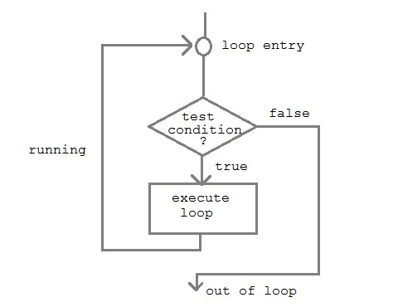
Loops

Slide 14
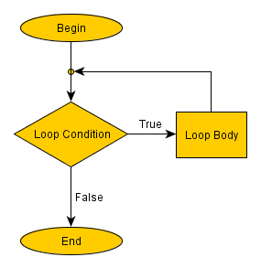
Loops

Slide 15
Loop
The for loop has the following syntax:
for (var i=0 ; i<10 ; i++) {
//code block to be executed
alert(i); }

Slide 16


