Slide 1


Slide 2

Recap Lecture
1- What’s NPM?
2- Why we use NPM?
3- How to setup REACT App
4- What’s Component in REACT JS
5- Convert any HTML + CSS page to REACT

Slide 3
INSTALLING NPM
›Node.js is an open-source, cross-platform JavaScript run-time environment that executes JavaScript code outside of a browser.
Step1- Go to https://nodejs.org/en/
Step2- Install Nodejs Server
Step3- Test it
> Node -–version
> Npm – version

Slide 4
INSTALLING REACT [SPA]
›Create React App is the best way to starting building a new React single page application. It sets up your development environment so that you can use the latest JavaScript features, provides a nice developer experience, and optimizes your app for production.
>npm install -g create-react-app
>create-react-app hello-world
>cd hello-world
>npm start

Slide 5
Components Reactjs

Slide 6
What's a component?
›A component is a small, reusable chunk of code that is responsible for one job. That job is often to render some HTML. The terms "component," "React component," and "component instance" all refer to the same thing.

Slide 7
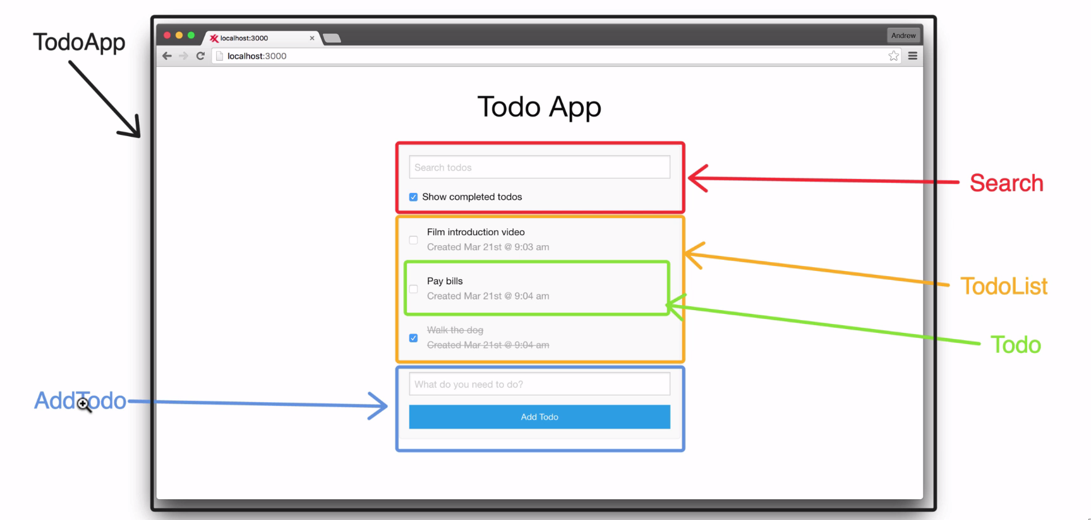
Is everything component?

Slide 8
INSTRUCTIONS FOR CONVERTING HTML + CSS TO REACT
Step1- Decide Reasonable Components
Step2- Add custom Css, Bootstrap css to app.js.
Step3- Change class= to className
Step4- Close every self tag, e.g <img src={} />

Slide 9
Props Reactjs

Slide 10
Props
›Props because you don’t want to have a component rendering static data, but pass dynamic data to your component instead. That’s where React’s props come into play. You can pass data in React by defining custom HTML attributes to which you assign your data with JSX syntax. So don’t forget the curly braces.

Slide 11
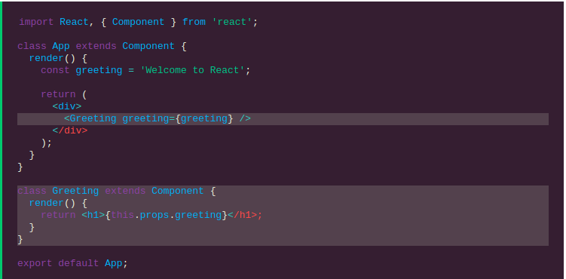
Props

Slide 12
New Concept
Context API Reactjs

Slide 13
Context Api
› Would recommend reaching for Context when you find yourself passing props down through three or more levels in your component tree. You might notice that you have renamed your props, making it challenging to determine the data’s origin. You might consider implementing context if a bunch of your components know about irrelevant data.

Slide 14


