Slide 1

Lecture2
By
Naveed Rana

Slide 2

Recap Lecture1
1- Why node.js?
2- Why express.js?
3- Nodejs working
4- How to request to nodejs from REACT app?

Slide 3
Middleware
How Node JS middleware Works?

Slide 4
What is Middleware?
As name suggests it comes in middle of something and that is request and response cycle.
Middleware functions are functions that have access to the request object (req), the response object (res), and the next middleware function in the application’s request-response cycle.
Middleware has access to request and response object

Slide 5
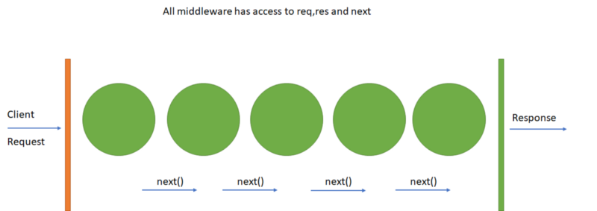
Middleware?

Slide 6
Middleware functions can perform
1- Execute any code.
2- Make changes to the request and the response objects.
3- End the request-response cycle.
4- Call the next middleware in the stack.

Slide 7
What is this next()?
A middleware is basically a function that will the receive the Request and Response objects, just like your route Handlers do. As a third argument you have another function which you should call once your middleware code completed.

Slide 8
Types of express middleware
1-. Application level middleware app.use
2-. Router level middleware router.use
3-. Built-in middleware express.static,express.json,express.urlencoded
4-. Error handling middleware app.use(err,req,res,next)
5-. Thirdparty middleware bodyparser,cookieparser

Slide 9
Third-party Middlewares ?
In some cases we will be adding some extra features to our backend
Install the Node.js module for the required functionality, then load it in your app at the application level or at the router level.
Example: body-parser, cors, cookieparser, express-session,etc

Slide 10
Export,import in nodejs ?
exports is an object. So it exposes whatever you assigned to it as a module. For example, if you assign a string literal then it will expose that string literal as a module..
Example: module.exports = 'Hello world';
Now, import this message module and use it as shown below.
var msg = require('./Messages.js');

Slide 11
Get post data from client?
Add body-parser
app.use(bodyParser.urlencoded({extended:true}))
app.use(bodyParser.json())
//client
Axios.post(‘/url’,{data:’das’})

Slide 12
Today Task ?
currency converter with nodejs.

Slide 13


