Slide 1

Lecture1
By
Naveed Rana

Slide 2

Background
For most of its life, the JavaScript programming language has lived inside web browsers.
It started as a simple scripting language for modifying small details of web pages but grew into a complex language, with loads of applications and libraries.
JavaScript is not aiming to be the most optimized server-side language for high scale and throughput. Nevertheless, since the introduction of V8

Slide 3
Background
Now you can do much more with JavaScript than just making websites interactive.
JavaScript now has the capability to do things that other scripting languages like Python can do.
Both your browser JavaScript and Node.js run on the V8 JavaScript runtime engine. This engine takes your JavaScript code and converts it into a faster machine code. Machine code is low-level code which the computer can run without needing to first interpret it.

Slide 4
Nodejs
(in 2009 , Nodejs came along)

Slide 5
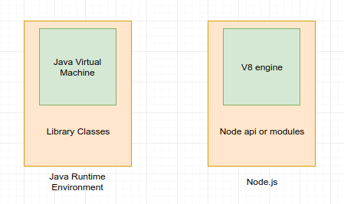
What is Nodejs?
Node.js® is a JavaScript runtime built on Chrome’s V8 JavaScript engine.
Node.js uses an event-driven, non-blocking I/O model that makes it lightweight and efficient.
Node.js’ package ecosystem, npm, is the largest ecosystem of open source libraries in the world.

Slide 6
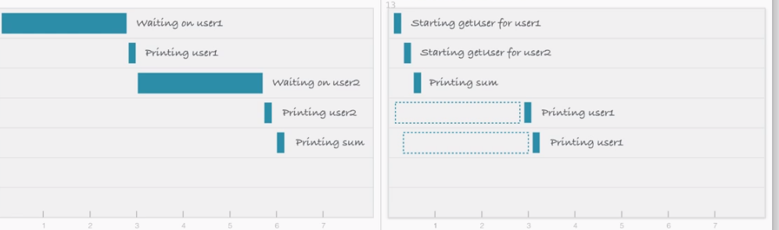
Why Nodejs?
Consider a scenario where we request a backend database for the details of user1 and user2 and then print them on the screen/console. The response to this request takes time, but both of the user data requests can be carried out independently and at the same time.

Slide 7
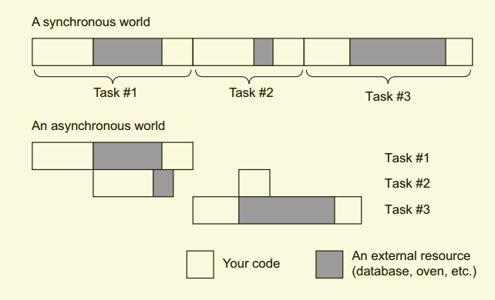
More...

Slide 8
Why Nodejs? 1.Non-blocking I/O
On the other hand, using a non-blocking request, you can initiate a data request for user2 without waiting for the response to the request for user1. You can initiate both requests in parallel.
This non-blocking I/O eliminates the need for multi-threading since the server can handle multiple requests at the same time.

Slide 9
Why Nodejs? 2.Speed
JavaScript like there’s no tomorrow, processing thousands of instructions a second.
The second reason for its speed lies in its ability to handle concurrency, and it’s a bit less straightforward. Its performance comes from its asynchronous workings.
Example:
The best real-world analogy I can come up with is baking. Let’s say I’m making muffins. I have to prepare the batter and while I’m doing that, I can’t do anythingelse.

Slide 10
Why Nodejs? 3.one programming language
Personally, I don’t believe that performance is the biggest reason to chooseNode.js. Although it’s often faster than other scripting languages like Ruby or Python,
I think the biggest reason is that it’s all one programming language.

Slide 11
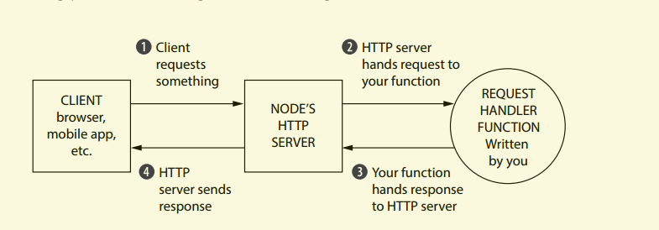
Nodejs Working

Slide 12
Hello world. Nodejs
var http = require("http");
http.createServer(function (request, response) {
response.writeHead(200, {'Content-Type': 'text/plain'});
response.end('Hello World\n');
}).listen(8081);
console.log('Server running at http://127.0.0.1:8081/');

Slide 13
Complex ?
the problem is that the Node.js APIs can get complex. Want to send a single JPEGfile?
That’ll be about 45 lines of code. Want to create reusable HTML templates? Figure out how to do it yourself. Node.js’s HTTP server is powerful, but it’s missing a lot of features that you might want if you were building a real application.
Express was born to make it easier to write web applications with Node.js.

Slide 14
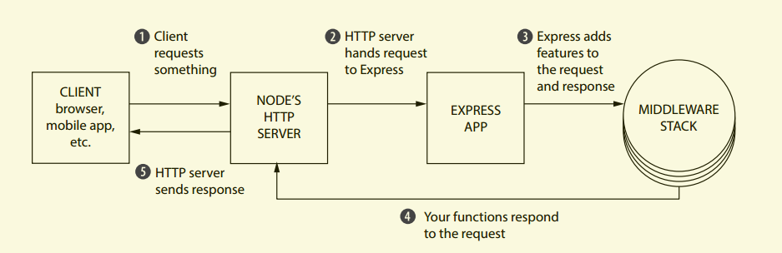
What Express adds to Node.js

Slide 15
Hello World In Express.js
var express = require("express");
var app = express();
app.get("/", function(request, response) {
response.send("Hello, world!");
});
app.listen(3000, function() {
console.log("Express app started on port 3000.");
});

Slide 16
Today Task ?
1- setup express server, listen at port 8080
2- ‘/’ for handle get request
3- ‘/test’ for handle post request
4- send request to server using axios, in redux action!
5- call action by clicking on button generate get && generate post, request
5- display response into react component.

Slide 17


