Slide 2

Recap Lecture
1- What is Redux?
2- Why we use Redux?
3- What’s Actions?
4- What’s Reducer?
5- Steps to get data from Redux Store?
6- Steps to add/update data to Redux store?

Slide 3
Client-Server-Architecture

Slide 4
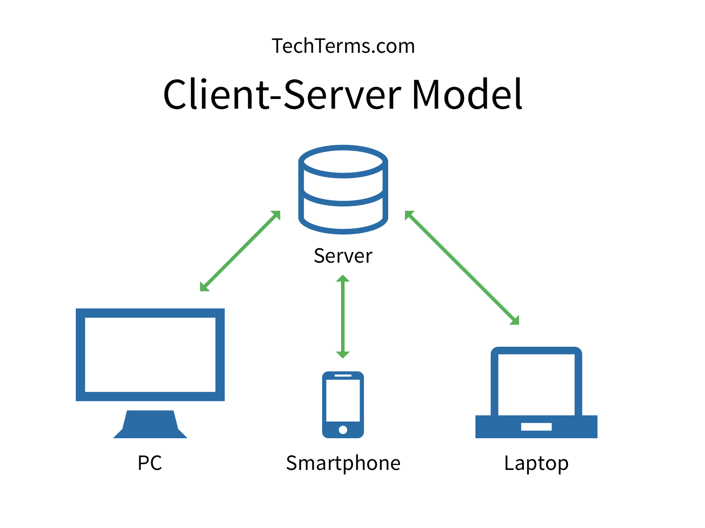
Client
Clients are PCs or workstations on which users run applications. Clients rely on servers for resources, such as files, devices, and even processing power.
In client server computing, the clients requests a resource and the server provides that resource. A server may serve multiple clients at the same time while a client is in contact with only one server. Both the client and server usually communicate via a computer network

Slide 5

Server
Servers are powerful computers or processes dedicated to managing disk drives (fileservers), network traffic (network servers ).
server is an instance of a computer program or device that accepts and responds to requests made by another program, known as a client. A good metaphor would be a customer (client) ordering a package then the mailman (server) delivering it to them or someone else

Slide 6
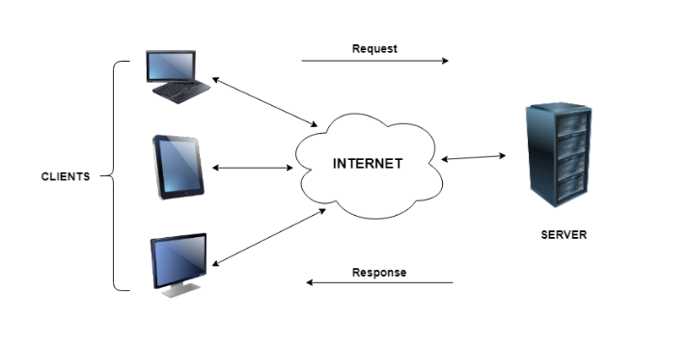
Client Server Architecture

Slide 7
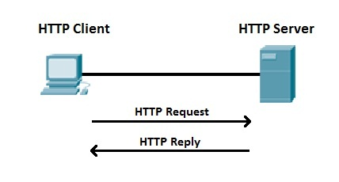
Hypertext Transfer Protocol

Slide 8
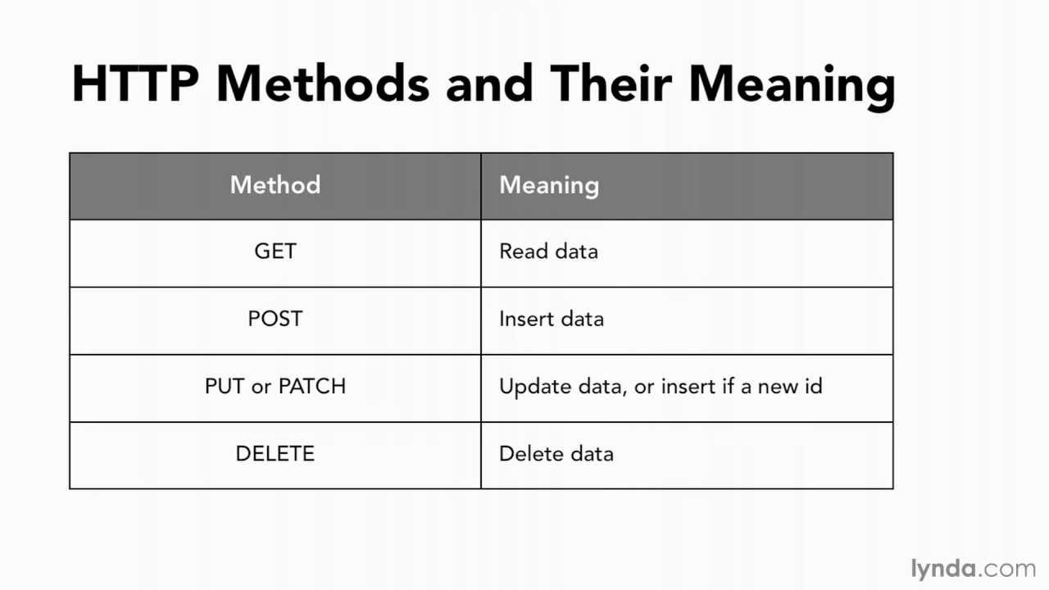
HTTP Methods

Slide 9
How to request?
Fetch / Axios.js for making http requests
Axios is a Javascript library used to make http requests from node.js or XMLHttpRequests from the browser and it supports the Promise API that is native to JS ES6.
JavaScript has it's own built-in, Along comes the Fetch API a new standard to make server request jam-packed with promises and all those things we learned to love over the years.

Slide 10
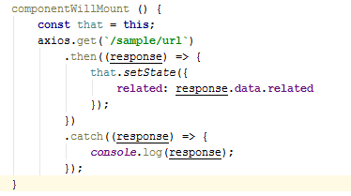
Example request

Slide 11
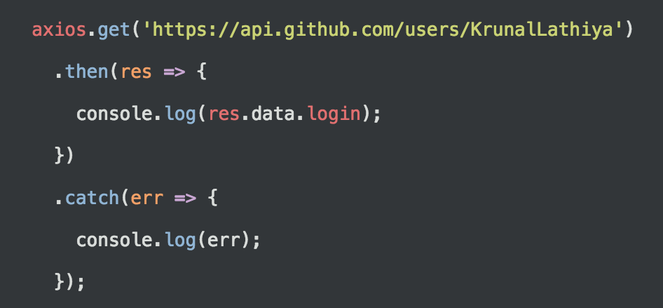
Today Task – Git Application
1- npm I axios
2- In CDM, make HTTP axios GET request.
3- Use github Server endpoint for getting user.
4- Now data in your hand, display it by using Map method, with little style.

Slide 12
URL’s
1- https://api.github.com/users/naveed-rana/followers
2-https://api.github.com/users/naveed-rana
3- https://api.github.com/users/{dyanmic_name}/followers

Slide 13
Today Task – Git Application
1- npm I axios
2- In CDM, make HTTP axios GET request.
3- Use github Server endpoint for getting user.
4- Now data in your hand, display it by using Map method, with little style.

Slide 14


