Slide 1
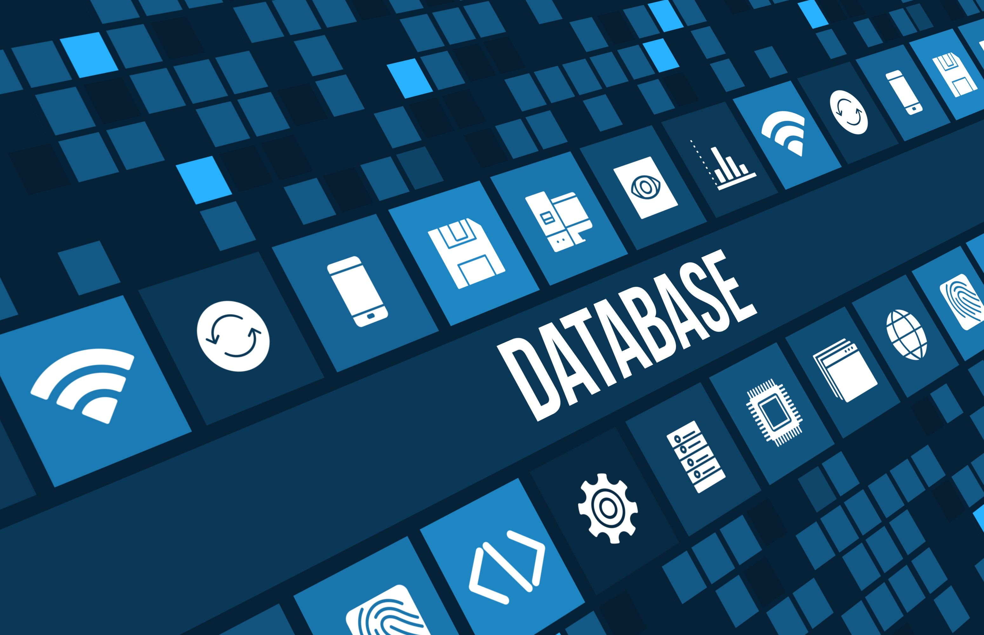
Lecture2
By
Naveed Rana

Slide 2

Data
Computer data is information processed or stored by a computer. This information may be in the form of text documents, images, audio clips, software programs, or other types of data.
Computer data may be processed by the computer's CPU and is stored in files and folders on the computer's hard disk.

Slide 3
DATABASE

Slide 4
What is Database?
A database is a collection of information that is organized so that it can be easily accessed, managed and updated.
Data is organized into rows, columns and tables, and it is indexed to make it easier to find relevant information..

Slide 5
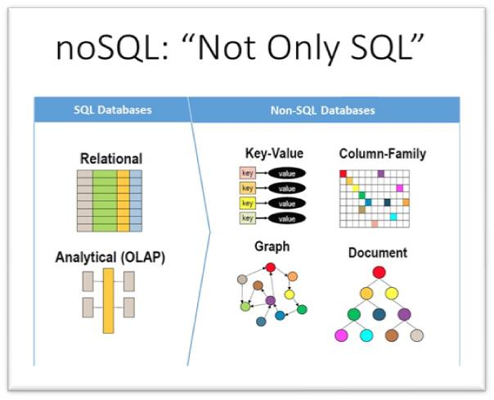
Sql vs Nosql?
When it comes to choosing a database, one of the biggest decisions is picking a relational (SQL) or non-relational (NoSQL) data structure. While both are viable options, there are certain key differences between the two that users must keep in mind when making a decision.

Slide 6
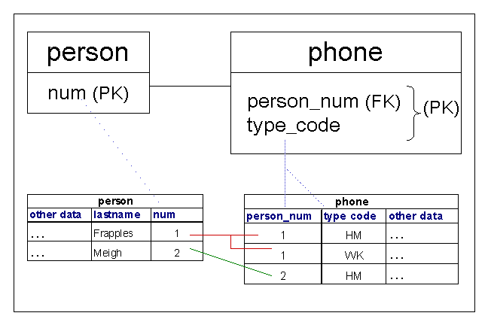
SQL
SQL stands for Structured Query Language. SQL is a programming language that lets you communicate with databases to store, manipulate, and retrieve data, and also modify the structure of the database.
A database can be considered as a container for tables and a table is a grid with rows and columns to hold data. Individual statements in SQL are called queries

Slide 7
SQL base - Databases?
#1) Oracle RDBMS
#2) Postgress sql
#3) Microsoft SQL Server
#4) ADABAS
#5) MySQL ….

Slide 8
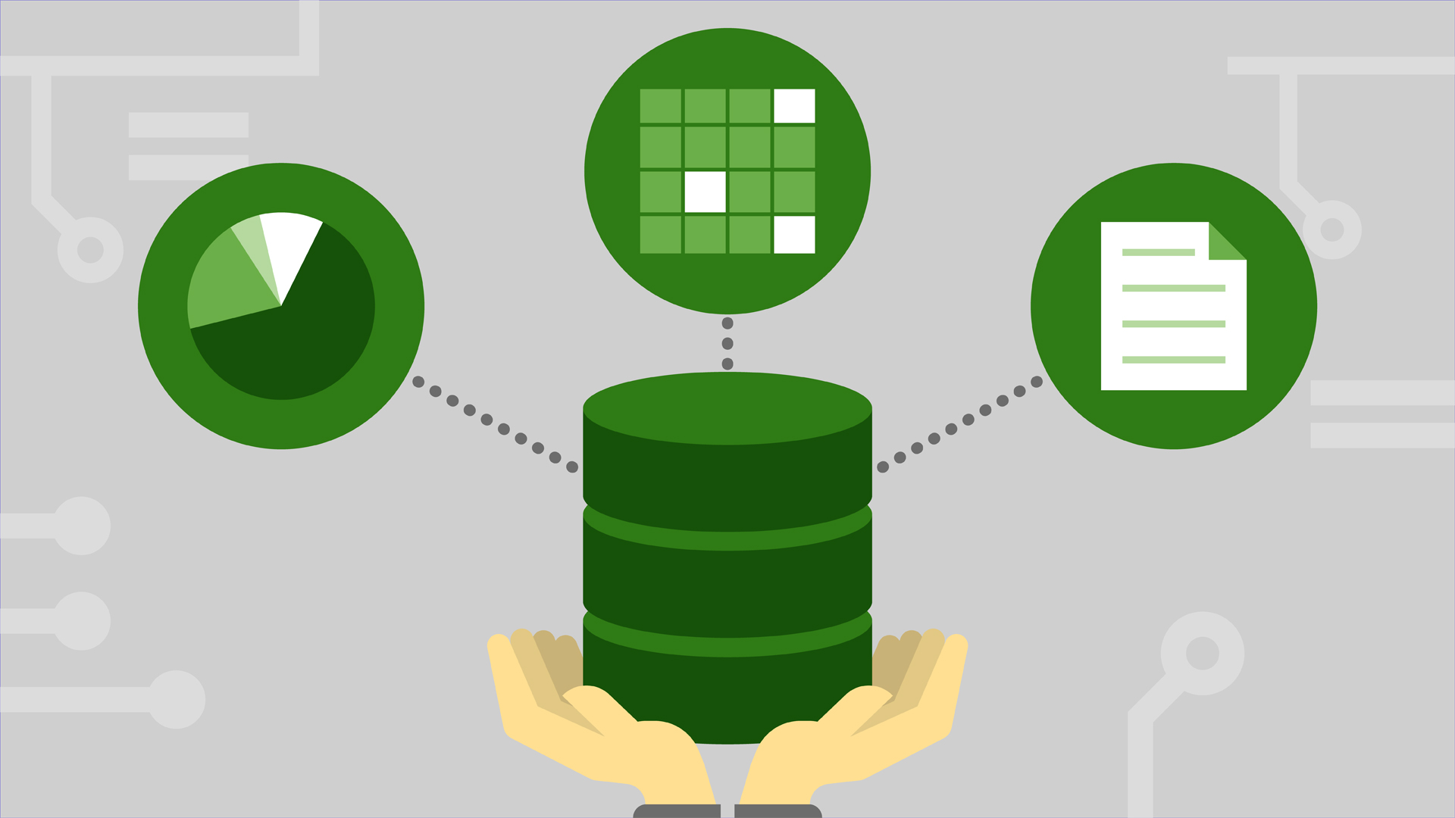
NOSQL
NoSQL systems are distributed, non-relational databases designed for large-scale data storage and for massively-parallel, high-performance data processing across a large number of commodity servers. They arose out of a need for agility, performance, and scale, and can support a wide set of use cases

Slide 9
NOSQL base - Databases?
#1) MongoDB
#2) Firestore (firebase db)
#3) Apache Cassandra
#4) Amazon DynamoDB
#5) Arora db ….

Slide 10
What is MongoDB?
MongoDB is a *document-based* database management system which leverages a JSON-style storage format known as binary JSON.
Ad hoc queries
Indexing
Load Balancing
Replicated file storage over multiple servers
Capped collections

Slide 11
How to connect Nodejs with MongoDB
Third Party, modules
1-Mongoose
2- Mongoclient ...

Slide 12
What is Mongoose?
MongooseJS is an Object Document Mapper (ODM) that makes using MongoDB easier by translating documents in a MongoDB database to objects in the program.
Besides MongooseJS there are several other ODM’s that have been developed for MongoDB including Doctrine, MongoLink , and Mandango.
let’s play with mongoose

Slide 13


